Slide 1
The past, present, and future of data.table
Tyson S. Barrett, PhD | useR! 2024 | Salzburg, Austria

Slide 2
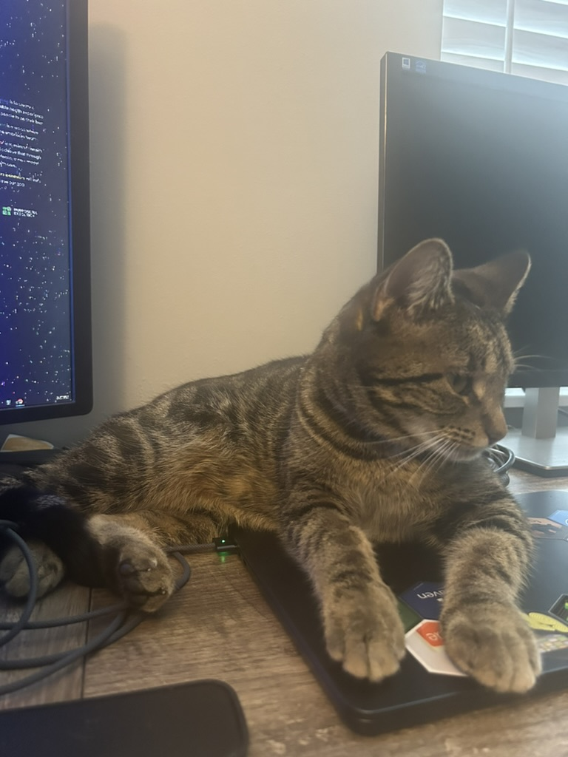
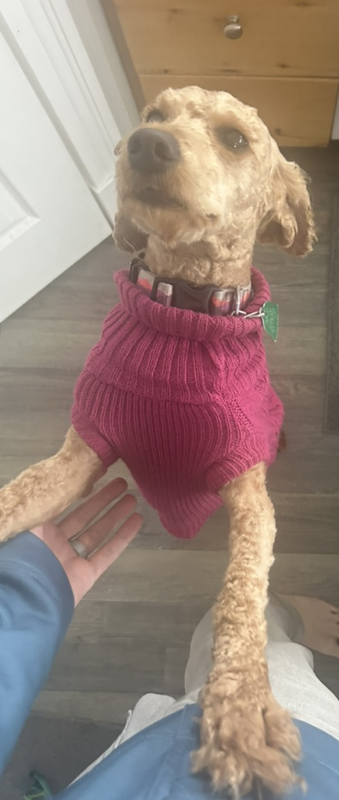
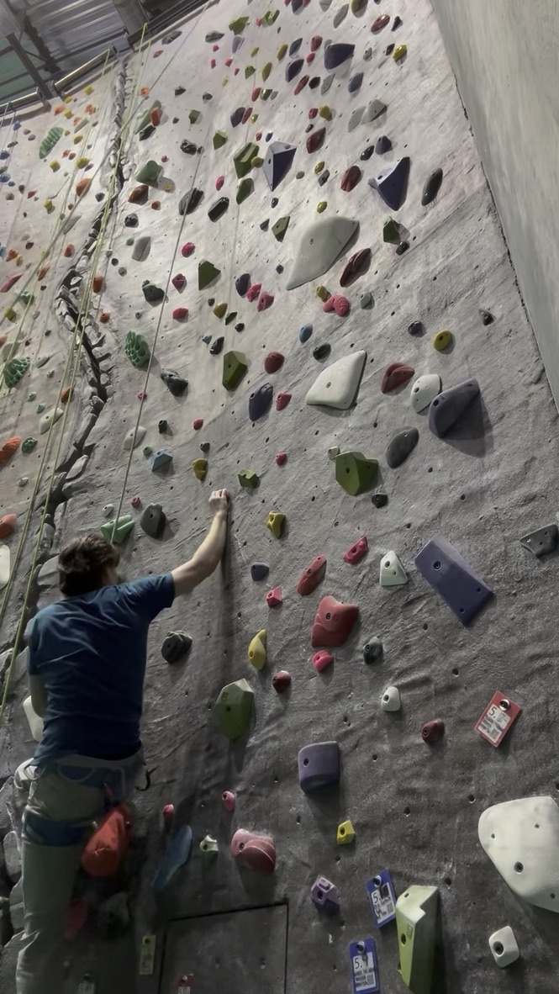
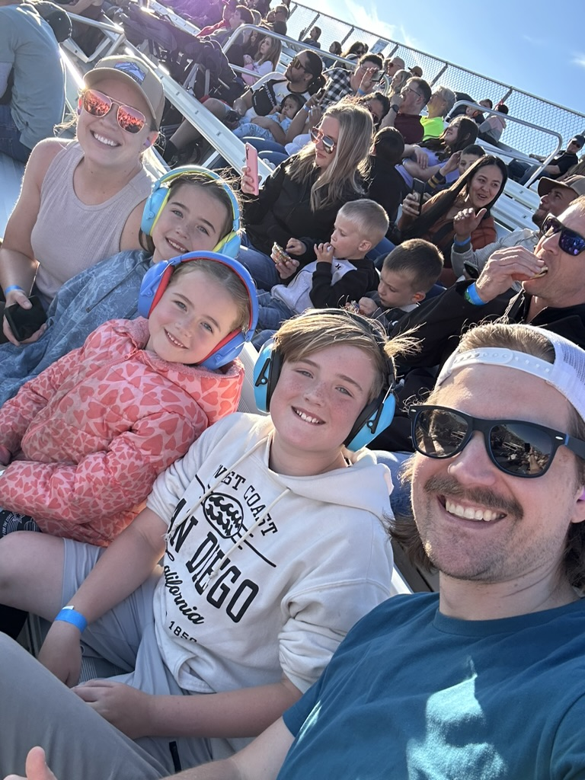

Who am I?
Current maintainer of
data.table
Research Manager at a large US Health Insurer
Human nerd

Slide 3
Why ?
data.table
dt[i, j, by]
Concise syntax
Fast speed
Memory efficient
Careful API lifecycle management
Community
Feature rich

Slide 4
Why ?
data.table
dt[i, j, by]
Concise syntax
Fast speed
dt[grp == “treatment”, new := mean(x), by = id]
Memory efficient
dt[dt2, on = “id”]
Careful API lifecycle management
dt[dt2, on = “id”, roll = TRUE]
Community
dt[, .N, by = id]
Feature rich

Slide 5
past
User 2014
pandemic
data.table continues development but updates begin to slow down
Matt gives talk on data.table, discussing history of its development and shows new features (eg fread, roll)
https://youtu.be/qLrdYhizEMg?si=a_LSGV2NhDJpBmol
Beginning
Matt Dowle releases initial version of data.table package on GitHub
2011
2017
2023
2008
2014
2020
:=
More Dev
Walrus operator given birth within data.table
Continue to build features, more packages import data.table, dtplyr released
Pose grant
Toby Hocking receives grant to establish governance and to re-invigorate development of data.table package (with permission from Matt)

Slide 6

User 2014
pandemic
data.table continues development but updates begin to slow down
Matt gives talk on data.table, discussing history of its development and shows new features (eg fread, roll)
https://youtu.be/qLrdYhizEMg?si=a_LSGV2NhDJpBmol
Beginning
Matt Dowle releases initial version of data.table package on GitHub
2011
2017
2023
2008
2014
2020
:=
More Dev
Walrus operator given birth within data.table
Continue to build features, more packages import data.table, dtplyr released
Pose grant
Toby Hocking receives grant to establish governance and to re-invigorate development of data.table package (with permission from Matt)

Slide 7
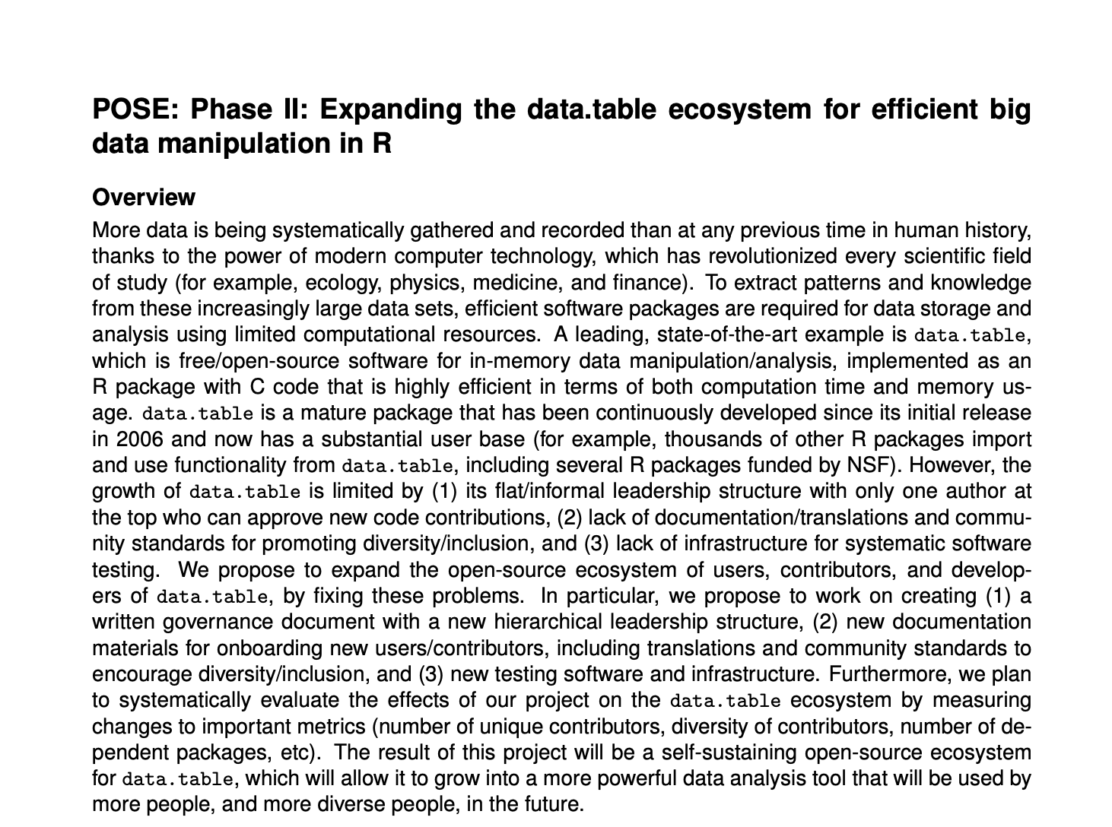
User 2014
pandemic
data.table continues development but updates begin to slow down
Matt gives talk on data.table, discussing history of its development and shows new features (eg fread, roll)
https://youtu.be/qLrdYhizEMg?si=a_LSGV2NhDJpBmol
Beginning
Matt Dowle releases initial version of data.table package on GitHub
2011
2017
2023
2008
2014
2020
:=
More Dev
Walrus operator given birth within data.table
Continue to build features, more packages import data.table, dtplyr released
Pose grant
Toby Hocking receives grant to establish governance and to re-invigorate development of data.table package (with permission from Matt)

Slide 8
Present
Today
3 goals of pose grant
data.table
is a community-based open-source project that is sustainable and modern
1
A written governance document with a new hierarchical leadership structure
New documentation materials for onboarding new users/contributors, including translations and community standards to encourage diversity/inclusion
2
3
New testing software and infrastructure

Slide 9
Present
1
A written governance document with a new hierarchical leadership structure
Today
https://github.com/Rdatatable/data.table/blob/master/GOVERNANCE.md
Reviewed Other Open-Source Governance
Proposed Initial Governance Doc
Reviewed by Project Team
Edits incorporated
...
Initial Governance Doc Merged
...

Slide 10
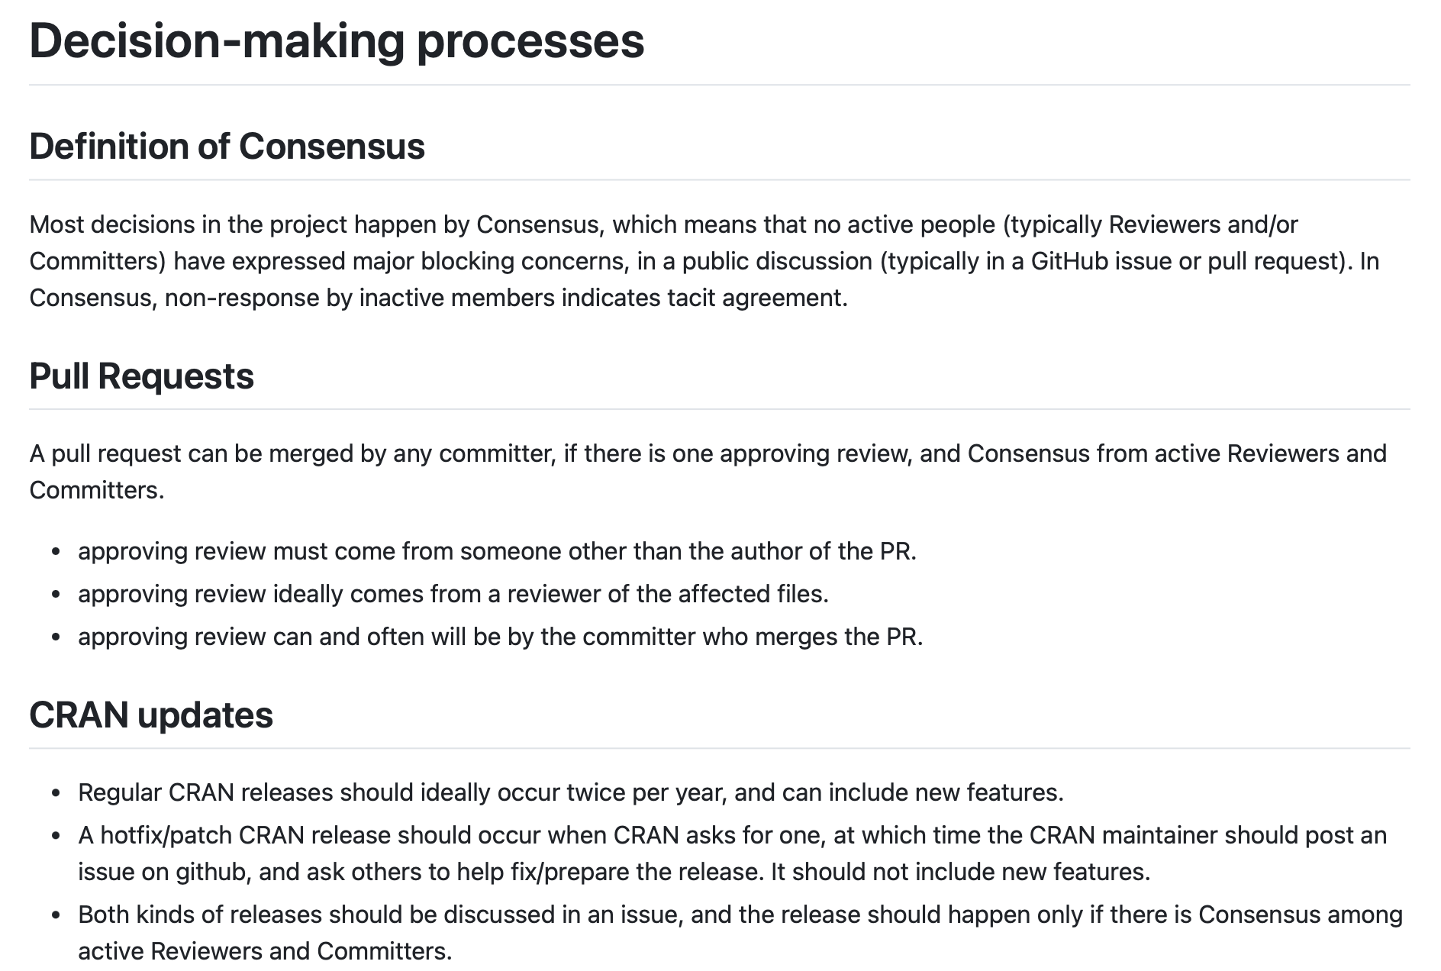
Present
1
A written governance document with a new hierarchical leadership structure
Today
https://github.com/Rdatatable/data.table/blob/master/GOVERNANCE.md
A semi-democratic approach to dev
Can become any role in data.table by submitting PR and enough votes from the community (and no strong pushback)
Can help shape the development of the package
One aspect of the governance is the “what is possible for development” which can be updated

Slide 11
Present
New documentation materials for onboarding new users/contributors, including translations and community standards to encourage diversity/inclusion
Translations of messages into Chinese, Portuguese, etc. via grants
Governance document provides onboarding info
Updated/new vignettes, The Raft blog, potential data.table book
Today
2

Slide 12

Present
3
New testing software and infrastructure
Today
Beyond the normal unit-testing for the package (data.table has a lot!)
Benchmark how pull requests impact speed of the package

Slide 13
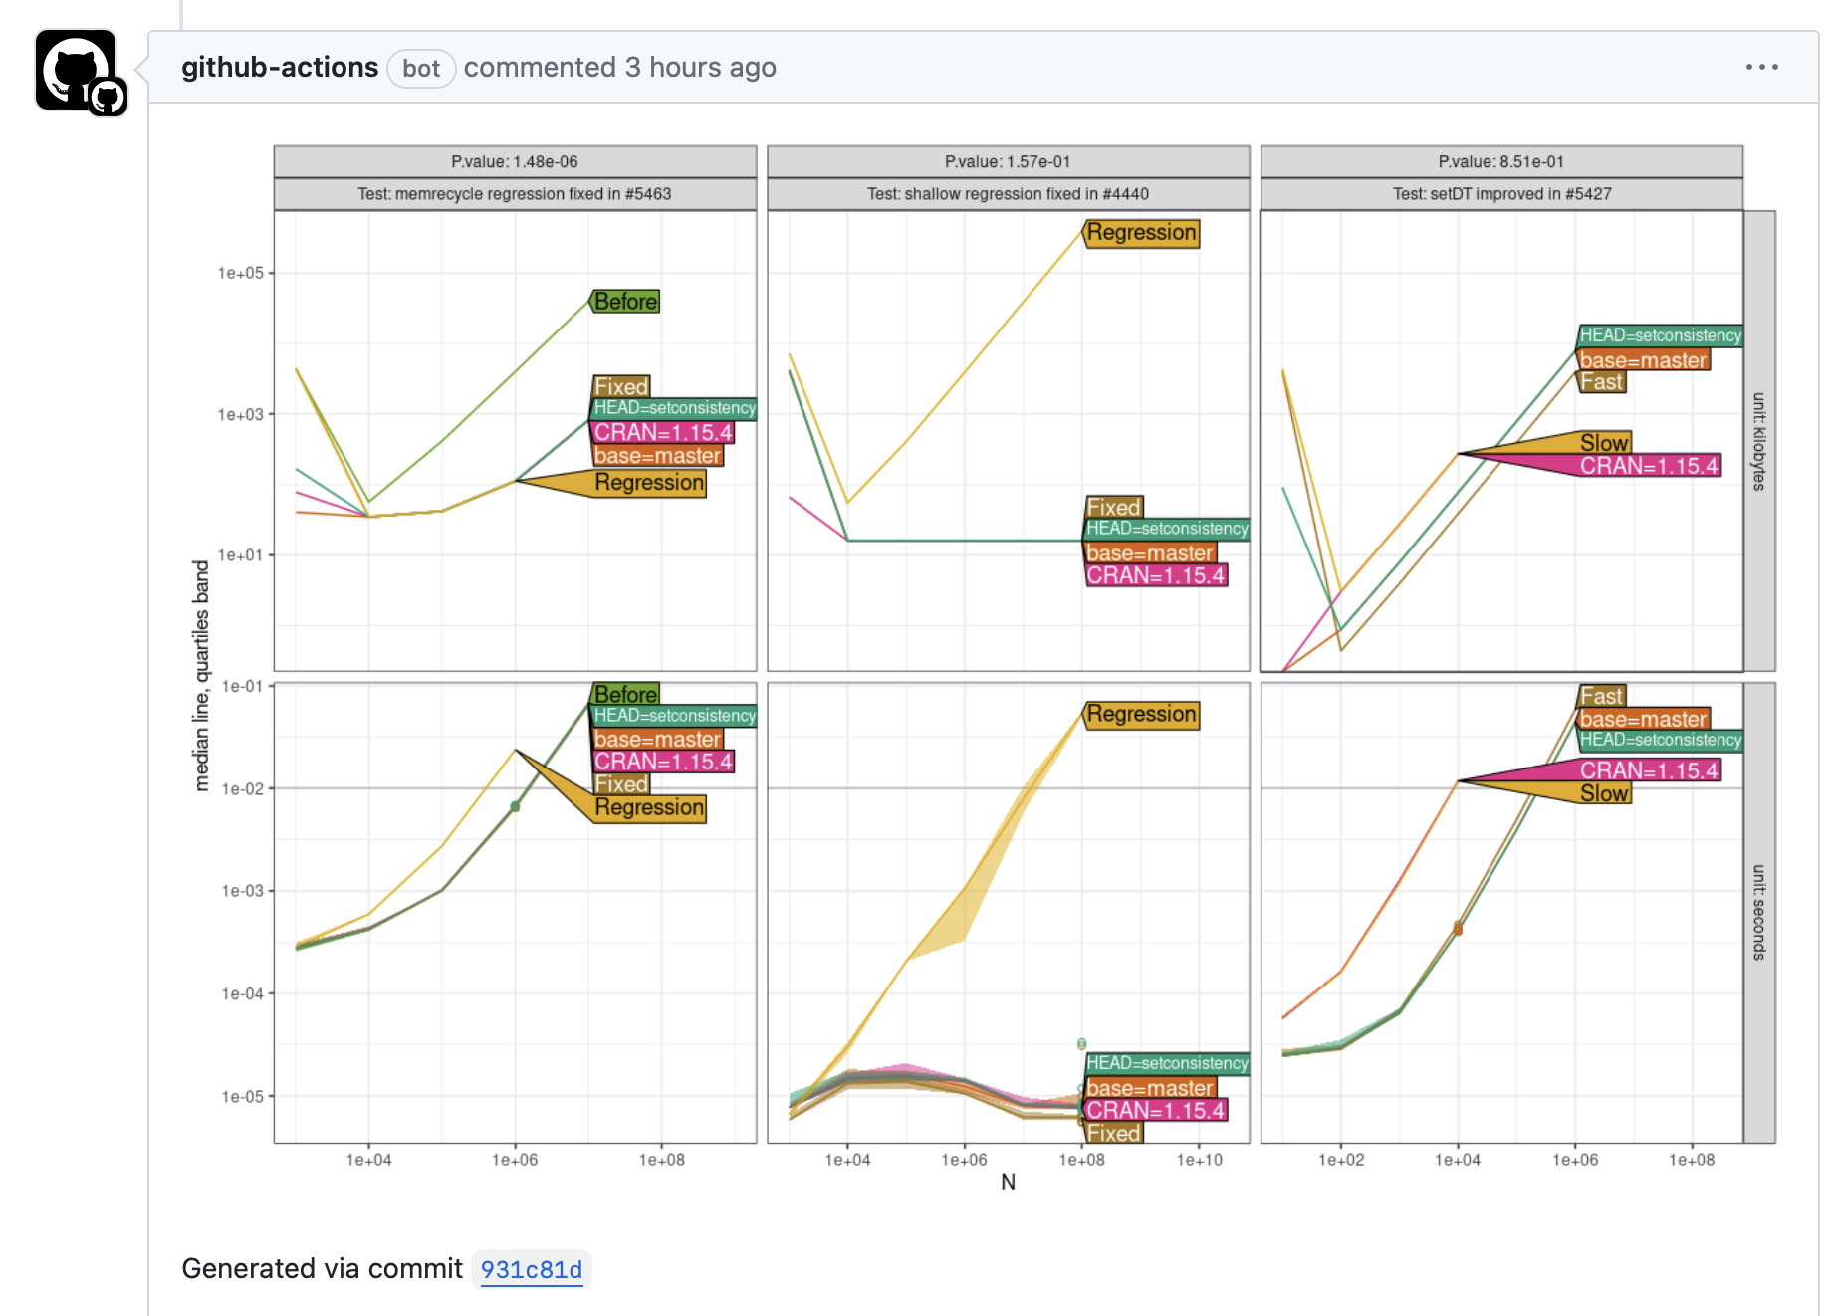

Slide 14
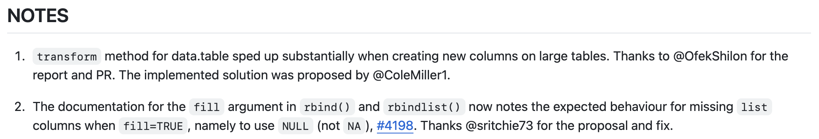
Present
New features
Today
https://github.com/Rdatatable/data.table/blob/master/NEWS.md
Long awaited updates are happening now using the classic data.table principles
Bug fixes and other notable improvements

Slide 15
future
The goal of this re-invigoration of data.table is to produce a sustainable open-source project
New Governance
Onboard New Users and Developers
Long-term Sustained Open-Source Package
Maintain and Build Community
Beyond adding features, a few notable plans:
Establish pathways for funding (individual features or ongoing, eg NumFocus)
Build more infrastructure to help devs to parse the vast complexity of data.table package
More education on R’s C APIs and how they can be used with compiled code

Slide 16







Tyson S. Barrett
Thanks to Matt Dowle, Arun Srinivasan, Michael Cherico, Jan Gorecki, Toby Hocking and the data.table team!
t.barrett88@gmail.com
tysonbarrett.com
@healthandstats
github.com/tysonstanley
Slides will be on useR! 2024 website

