Slide 1
The Bottom Line on Depression
Tyson S. Barrett, PhD | Workplace Mental Health Community Forum 2025
Why Employers Can’t Afford to Ignore Mental Health

Slide 2






But first, Who am I?
Lead a team of researchers at Highmark Health
Applied statistician and
researcher
Human nerd

Slide 3
depression: A short history
Melancholy 3.0
Spiritual causes, including sin, possession, etc.
Melancholy
Melancholy 4.0
Humor imbalance (too much black bile)
Might be a medical condition?
100 CE
1950
2025
500 BCE
600 CE
1800
Melancholy 2.0
Depression
Diet and lifestyle may be involved
Medical and psychological condition, DSM created
Today
Depression is a complex medical condition based on genetic, biological, environmental, and psychological factors
Notes:
Let’s start with a VERY brief history lesson about data frames

Slide 4

Notes:
Let’s start with a VERY brief history lesson about data frames

Slide 5
Depression Impacts
As employers, is it really all that important?
Reduced productivity
Increased Absenteeism
Elevated Healthcare Costs
Higher Turnover
Diminished Engagement/ Morale
Workplace Safety
Increased Presenteeism
Unresolved depression can lead to a 35% reduction in
productivity, contributing to substantial economic losses.
Notes:
In 2008 data.table was released to build on this, keep the good stuff, drop the bad, make it faster (both to type and to compute) – but importantly keeps a similar syntax and feel to data frames

Slide 6
Depression Impacts
As employers, is it really all that important?
Reduced productivity
Increased Absenteeism
Elevated Healthcare Costs
Higher Turnover
Diminished Engagement/ Morale
Workplace Safety
Increased Presenteeism
Depression contributes to higher rates of absenteeism, with
affected employees missing an average of 31.4 workdays
per year.
Notes:
In 2008 data.table was released to build on this, keep the good stuff, drop the bad, make it faster (both to type and to compute) – but importantly keeps a similar syntax and feel to data frames

Slide 7
Depression Impacts
As employers, is it really all that important?
Reduced productivity
Increased Absenteeism
Elevated Healthcare Costs
Higher Turnover
Diminished Engagement/ Morale
Workplace Safety
Increased Presenteeism
Employees with depression incur higher medical expenses,
including costs related to treatment and associated health
issues.
Notes:
In 2008 data.table was released to build on this, keep the good stuff, drop the bad, make it faster (both to type and to compute) – but importantly keeps a similar syntax and feel to data frames

Slide 8
Depression Impacts
As employers, is it really all that important?
Reduced productivity
Increased Absenteeism
Elevated Healthcare Costs
Higher Turnover
Diminished Engagement/ Morale
Workplace Safety
Increased Presenteeism
Depression can result in increased employee turnover,
leading to additional costs related to recruiting, hiring, and
training new staff. Approximately 40% of job turnover is
attributed to stress-related factors.
Notes:
In 2008 data.table was released to build on this, keep the good stuff, drop the bad, make it faster (both to type and to compute) – but importantly keeps a similar syntax and feel to data frames

Slide 9
Depression Impacts
As employers, is it really all that important?
Reduced productivity
Increased Absenteeism
Elevated Healthcare Costs
Higher Turnover
Diminished Engagement/ Morale
Workplace Safety
Increased Presenteeism
Depression may impair concentration and decision-making.
This not only endangers employees but can also lead to
higher workers’ compensation claims and liability for
employers.
Notes:
In 2008 data.table was released to build on this, keep the good stuff, drop the bad, make it faster (both to type and to compute) – but importantly keeps a similar syntax and feel to data frames

Slide 10
Depression Impacts
Depression can lead to decreased engagement, motivation, and morale among employees. This disengagement can further reduce productivity and increase the likelihood of conflicts.
As employers, is it really all that important?
Reduced productivity
Increased Absenteeism
Elevated Healthcare Costs
Higher Turnover
Diminished Engagement/ Morale
Workplace Safety
Increased Presenteeism
Notes:
In 2008 data.table was released to build on this, keep the good stuff, drop the bad, make it faster (both to type and to compute) – but importantly keeps a similar syntax and feel to data frames

Slide 11
Employees with depression may attend work but perform below their capacity, a phenomenon known as presenteeism. This can lead to errors, decreased efficiency, and compromised quality of work.
Depression Impacts
As employers, is it really all that important?
Reduced productivity
Increased Absenteeism
Elevated Healthcare Costs
Higher Turnover
Diminished Engagement/ Morale
Workplace Safety
Increased Presenteeism
Notes:
In 2008 data.table was released to build on this, keep the good stuff, drop the bad, make it faster (both to type and to compute) – but importantly keeps a similar syntax and feel to data frames

Slide 12
Depression Impacts
As employers, is it really all that important?
Reduced productivity
Increased Absenteeism
Elevated Healthcare Costs
Higher Turnover
Diminished Engagement/ Morale
Workplace Safety
Increased Presenteeism
IMPACTS
Notes:
In 2008 data.table was released to build on this, keep the good stuff, drop the bad, make it faster (both to type and to compute) – but importantly keeps a similar syntax and feel to data frames

Slide 13
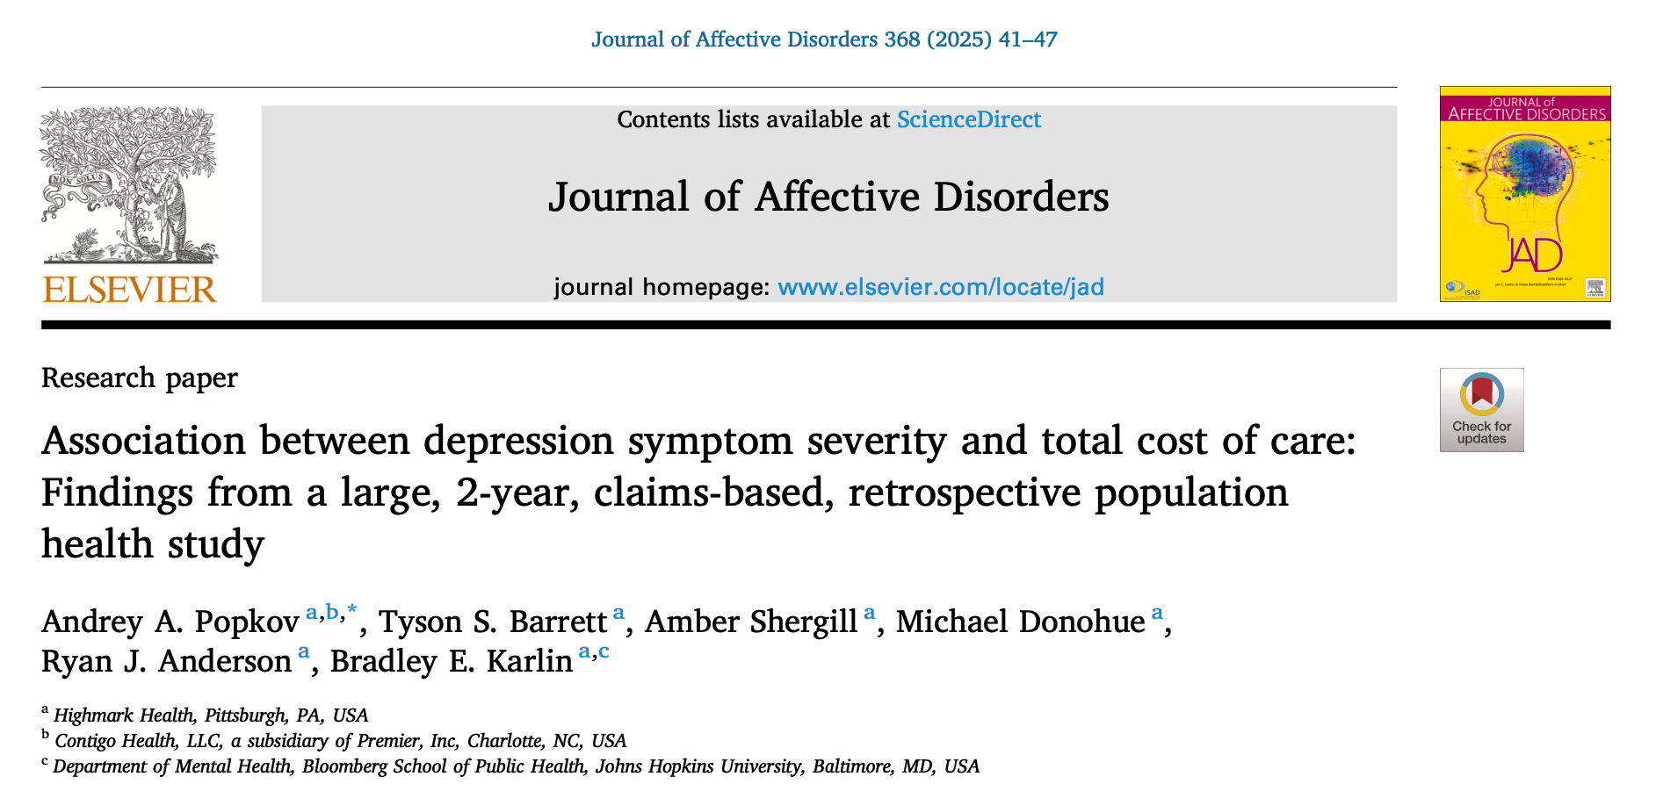
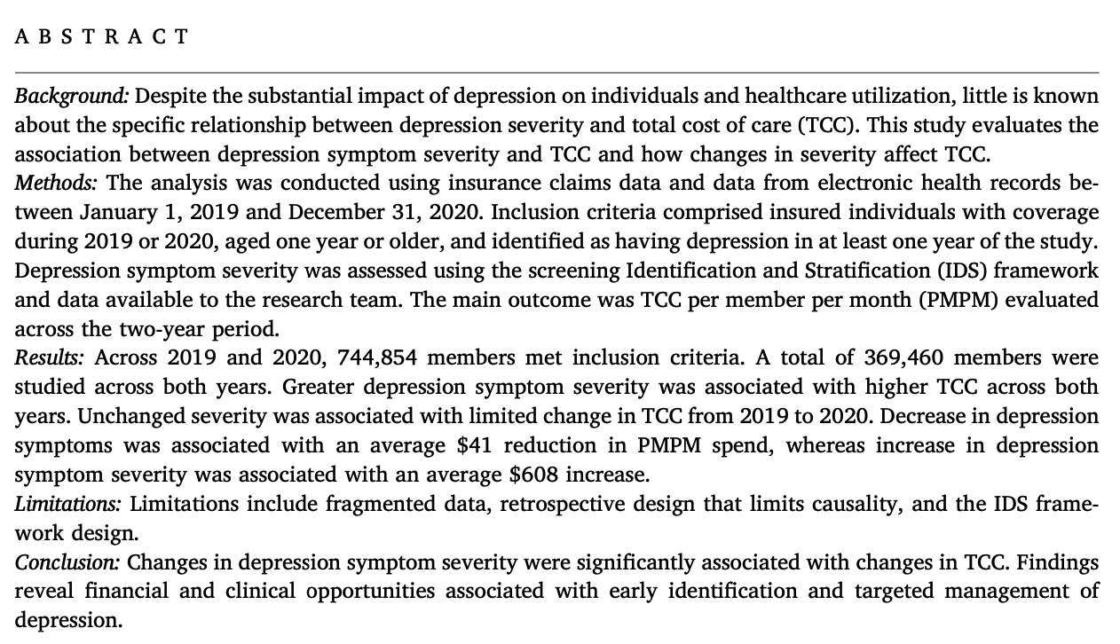
https://doi.org/10.1016/j.jad.2024.09.056
Notes:
At the time was groundbreaking and made so many data operations easier

Slide 14
In 2020
Over 3 in 20 individuals had some level of depression
Of those, 1 in 3 had moderate or severe depression
Notes:
At the time was groundbreaking and made so many data operations easier

Slide 15
Healthcare costs
Let’s dive into what depression means for costs (per member per month)
Notes:
In 2008 data.table was released to build on this, keep the good stuff, drop the bad, make it faster (both to type and to compute) – but importantly keeps a similar syntax and feel to data frames

Slide 16
But there is more
Costs also depend on whether the person is getting worse depression
Mild Depression
in 2019
$655 (46%) INCREASE PER MONTH
Severe Depression
in 2020
Getting Worse
Moderate Depression
in 2019
$58 (4%) INCREASE PER MONTH
Moderate Depression
in 2020
No Change
Severe Depression
in 2019
$267 (15%) DECREASE PER MONTH
Mild Depression
in 2020
Getting Better
Notes:
At the time was groundbreaking and made so many data operations easier
In 2008 data.table was released to build on this, keep the good stuff, drop the bad, make it faster (both to type and to compute) – but importantly keeps a similar syntax and feel to data frames

Slide 17
But there is more
Costs also depend on whether the person is getting worse depression
Mild Depression
in 2019
$655 (46%) INCREASE PER MONTH
Severe Depression
in 2020
Getting Worse
Moderate Depression
in 2019
$58 (4%) INCREASE PER MONTH
Moderate Depression
in 2020
No Change
Severe Depression
in 2019
$267 (15%) DECREASE PER MONTH
Mild Depression
in 2020
Getting Better
Notes:
At the time was groundbreaking and made so many data operations easier
In 2008 data.table was released to build on this, keep the good stuff, drop the bad, make it faster (both to type and to compute) – but importantly keeps a similar syntax and feel to data frames

Slide 18
But there is more
Costs also depend on whether the person is getting worse depression
Mild Depression
in 2019
$655 (46%) INCREASE PER MONTH
Severe Depression
in 2020
Getting Worse
Moderate Depression
in 2019
$58 (4%) INCREASE PER MONTH
Moderate Depression
in 2020
No Change
Severe Depression
in 2019
$267 (15%) DECREASE PER MONTH
Mild Depression
in 2020
Getting Better
Notes:
At the time was groundbreaking and made so many data operations easier
In 2008 data.table was released to build on this, keep the good stuff, drop the bad, make it faster (both to type and to compute) – but importantly keeps a similar syntax and feel to data frames

Slide 19

Let’s process all of this
1
Life Event
CAUSE and EFFECT
2
LEADING INDICATOR
Outcome
Notes:
At the time was groundbreaking and made so many data operations easier
In 2008 data.table was released to build on this, keep the good stuff, drop the bad, make it faster (both to type and to compute) – but importantly keeps a similar syntax and feel to data frames

Slide 20
Let’s process all of this
1
CAUSE and EFFECT
$655 (46%) INCREASE PER MONTH
2
vs
LEADING INDICATOR
$267 (15%) DECREASE PER MONTH
3
PREVENTION
Notes:
At the time was groundbreaking and made so many data operations easier
In 2008 data.table was released to build on this, keep the good stuff, drop the bad, make it faster (both to type and to compute) – but importantly keeps a similar syntax and feel to data frames

Slide 21

Tyson S. Barrett
Thanks to all of the coauthors and Highmark Health in supporting this important research!
Questions or comments?
tyson.barrett@highmarkhealth.org

Slide 22
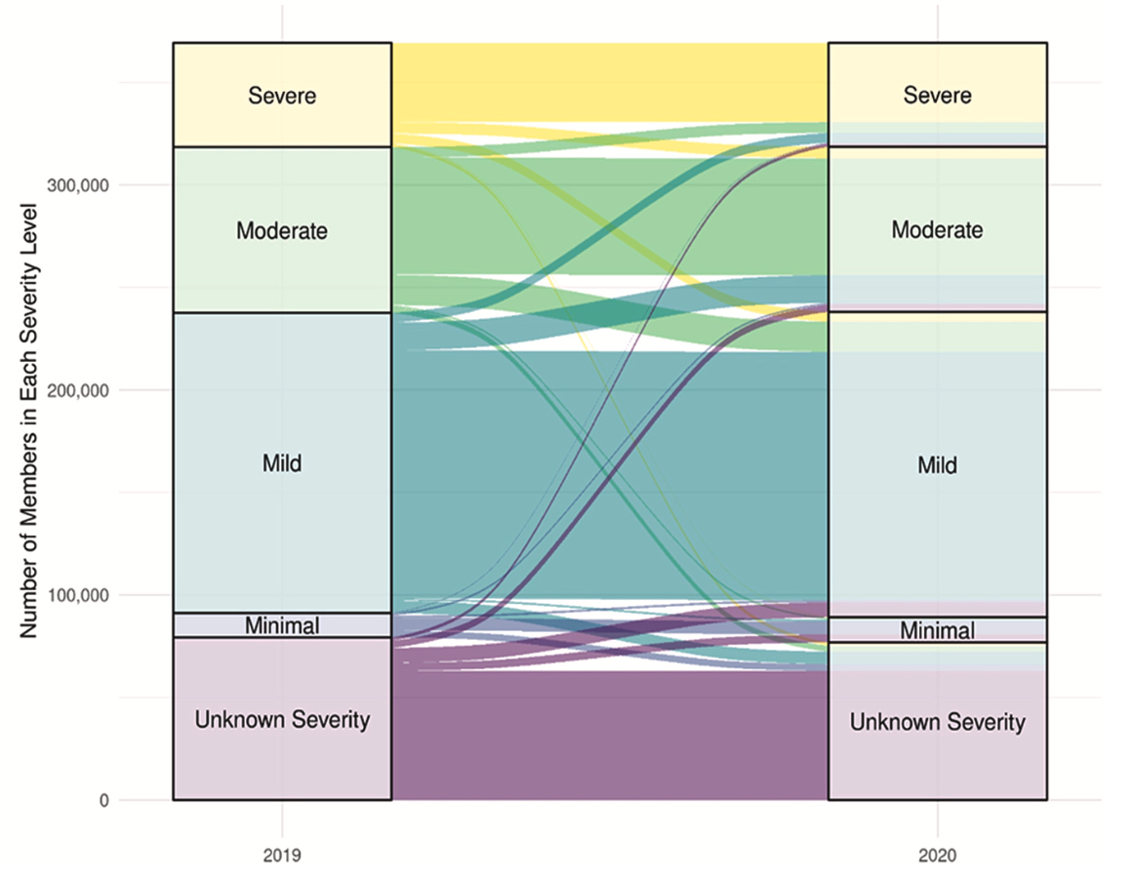
Notes:
At the time was groundbreaking and made so many data operations easier

Slide 23
Notes:
At the time was groundbreaking and made so many data operations easier

