Slide 1
Verification and Validation of a LabVIEW simulated Autonomous Vehicle
By Cory Ness and Kokila Subramanian

Slide 2
Abstract (Kokila adds stuff here)

Slide 3
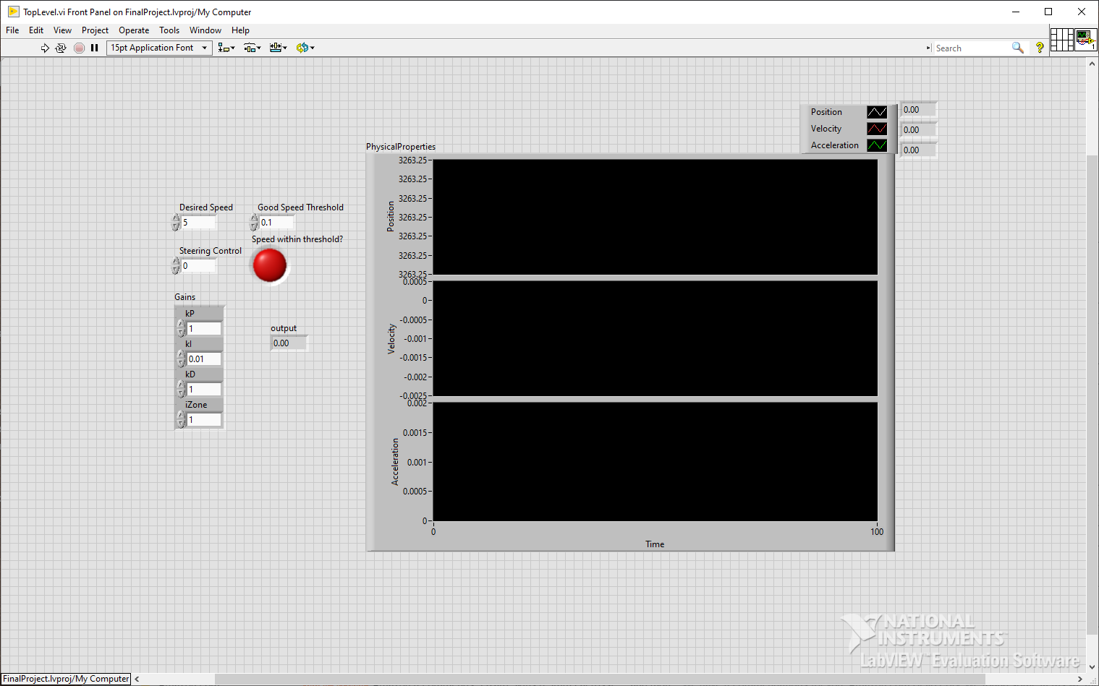
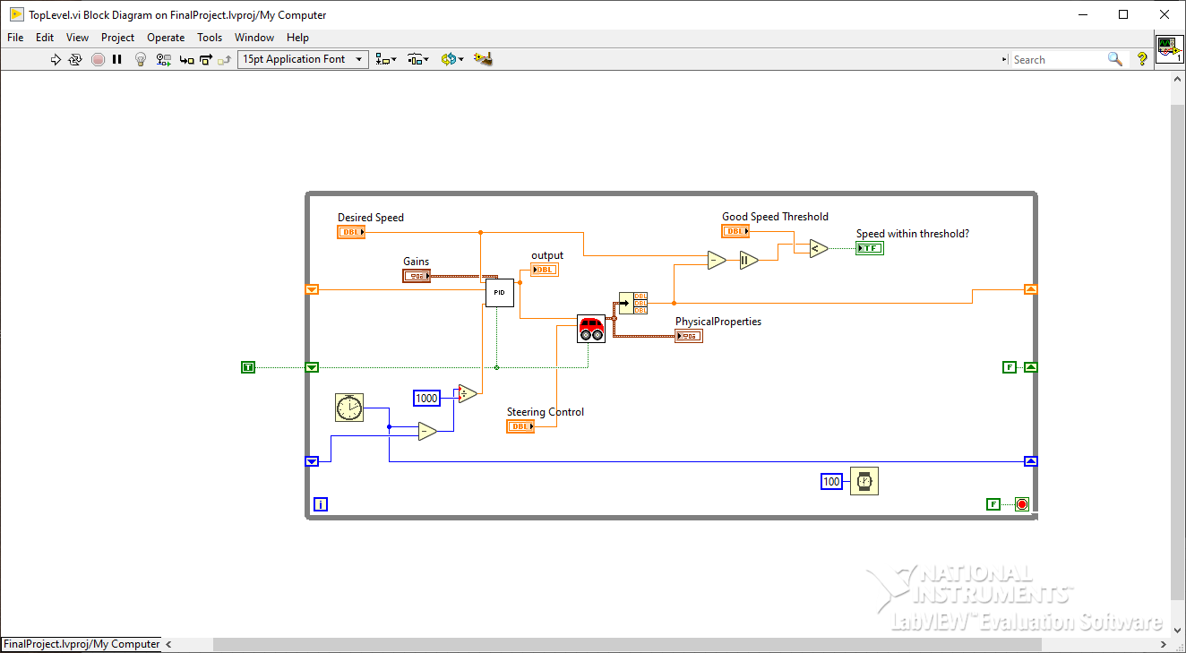
LabVIEW
Visual-based programming language where you wire inputs into outputs to construct the program.
Easy to create inputs and outputs to verify the program does what it’s supposed to.
Easy to create models using built-in tools language features and easy debugging.
Very easy to create a front dashboard that reports the status of the verification and validation tests.

Slide 4
Model
Uses a kinematic approach
Simplified model based on existing complex models from papers such as “Kinematic and Dynamic Vehicle Models for Autonomous Driving Control Design”, “On controllability and trajectory tracking of a kinematic vehicle model”, and “Multirate Lane-Keeping System With Kinematic Vehicle Model”.
Calculates Acceleration, Velocity, and Position continuously which is then compared against in the verification and validation program to ensure it’s within constraints

