Slide 1
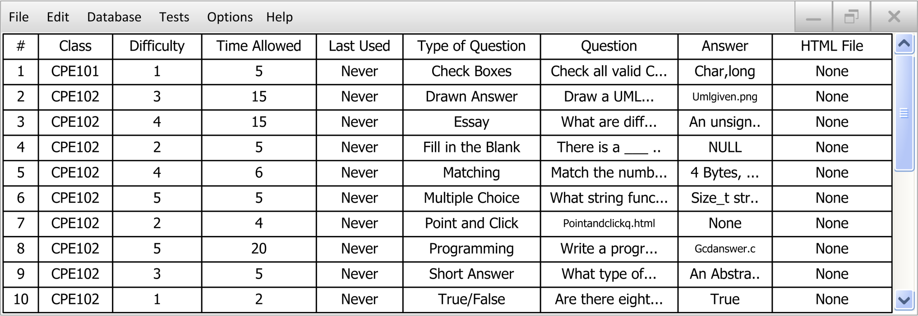
Questions Database
Notes:
Go over:
Menu bar
Class tabs, the database can hold multiple classes without having to close and reopen the program
Each of the columns can be clicked on in order to sort the questions based on that attribute (ascending, descending, no sort)
By default the questions are shown with the most recently added question on the top
I chose this view to make it easy to see multiple questions at once and also to change individual values of a question easily without having to open a separate window

Slide 2
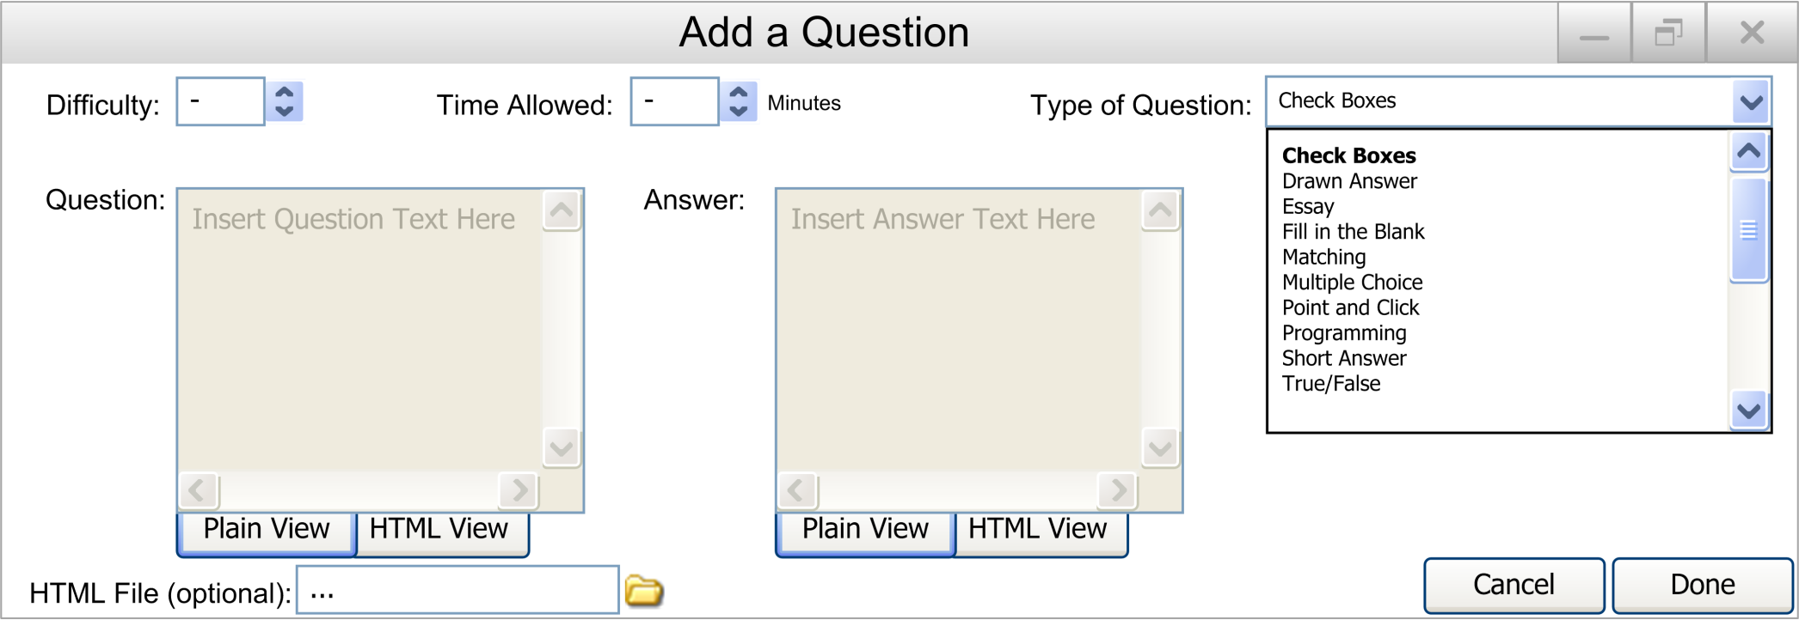
Adding a Question
Notes:
Go over:
When the teacher wants to add a question to the database, this window pops up
Each of the values are changeable here
The question and answer windows will change based on what type of question is selected. In this case short answer style is being shown, just as a default
If the teacher wants, they can add an HTML file in place of the question if they want to embed a picture or do something more advanced with the question

