Slide 1
Multiprocessor Benchmarks
Popular Benchmarks:
Linpack
SPECrate
SPLASH
NAS Parallel Benchmarks
PARSEC Benchmark Suite

Slide 2
Linpack
Scaling: Weak
Reprogram: Yes
It is a collection of linear algebra routines and routines for performing Gaussian elimination.
It lets the user pick any size problem.
The top 500 computers in terms of Linpack score are updated once a year at www.top500.org

Slide 3
SPECrate
Scaling: Weak
Reprogram: No
Runs many copies of the program simultaneously to measure job-level parallelism (no communication between jobs)
Run more copies to measure scaling

Slide 4
SPLASH
Scaling: Strong (offers 2 problem sizes)
Reprogram: No
Parallel benchmark suite by Stanford
Has both kernels and applications
Many programs are from the high-performance computing community

Slide 5
NAS Parallel Benchmarks
Scaling: Weak
Reprogram: Yes (C & Fortran only)
Developed by NASA
Consists of 5 kernels, uses computational fluid dynamics
Weak scaling via defining a few data sets
Can be re-written in C or Fortran

Slide 6
PARSEC Benchmark Suite
Scaling: Weak
Reprogram: No
Developed by Princeton
Consists of multithreaded programs
Uses Pthreads (POSIX threads) and OpenMP (Open Multiprocessing)
Applications focusing on: data parallelism, pipelined parallelism, or unstructured parallelism

Slide 7
Berkeley Design Patterns
Scaling: Strong or Weak
Reprogram: Yes
Design patterns based on:
Finite State Machine | Combinational Logic | Graph Traversal | Structured Grid
Dense Matrix | Spare Matrix | Spectral Methods (FFT) | Dynamic Programming
N-Body | MapReduce | Backtrack/Branch and Bound | Graphical Model Inference

Slide 8
Roofline: A Simple Performance Model
Arithmetic Intensity:
The Ratio of floating-point operations per byte of memory accessed
Calculated by:
(Floating-Point Operations / Sec) / (Floating-Point Operations / Byte) = Bytes/Sec

Slide 9
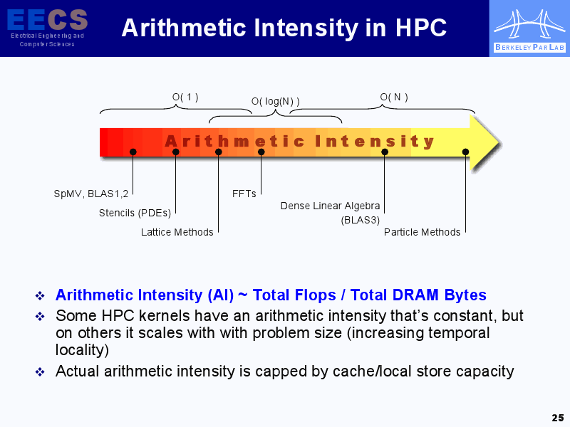
Roofline: A Simple Performance Model
Slide from:
www.eecs.berkeley.edu/~waterman/papers/roofline.pdf
ParLab Summer Retreat
Samuel Williams, David Patterson: samw@cs.berkeley.edu

Slide 10
Roofline: A Simple Performance Model
The Roofline Model:
Ties floating-point performance, arithmetic intensity, and memory performance into a graph
FLOPs/second on Y-axis, arithmetic intensity on X-axis

Slide 11
Roofline: A Simple Performance Model
Comparing Dual-core vs Quad-core:
AMD Opteron X4 (4 cores) vs Opteron X2 (2 cores)
X4 can perform double the peak FLOPs per core from the X2
2.2ghz X2 vs 2.3ghz X4
Roofline model ridge point moves from 1 with the X2 to 6 with the X4
To get more performance with the X4, kernels need an arithmetic intensity higher than 1 to see a benefit from the X2

Slide 12
Roofline: A Simple Performance Model
Computational Roofline can be found from processor manuals (horizontal line)
Memory roofline can be found by running benchmarks (slanted line)

Slide 13
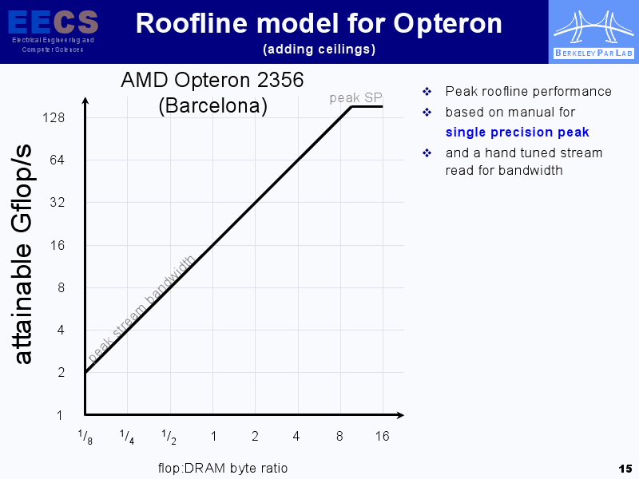
Roofline: A Simple Performance Model
Slide from:
www.eecs.berkeley.edu/~waterman/papers/roofline.pdf
ParLab Summer Retreat
Samuel Williams, David Patterson: samw@cs.berkeley.edu

Slide 14
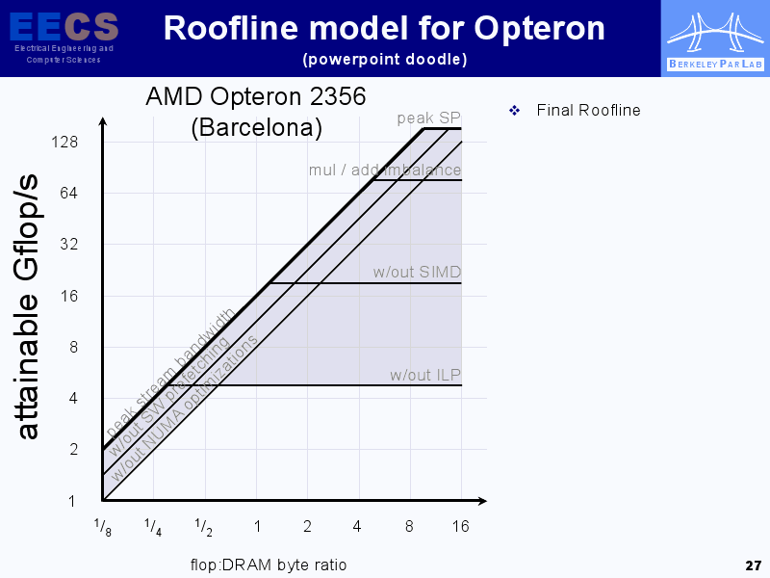
Roofline: A Simple Performance Model
Slide from:
www.eecs.berkeley.edu/~waterman/papers/roofline.pdf
ParLab Summer Retreat
Samuel Williams, David Patterson: samw@cs.berkeley.edu

Slide 15
Roofline: A Simple Performance Model
Reducing Computational Bottlenecks:
Floating-point operation mix
Peak performance is obtained with an equal number of nearly simultaneous adds and multiplies
Different hardware for each command
Improve instruction-level parallelism & apply SIMD
Superscalar architectures have the highest performance when having a 3-4 instruction/clock cycle pipeline
Improve the compiler to increase ILP by doing something such as unrolling loops

Slide 16
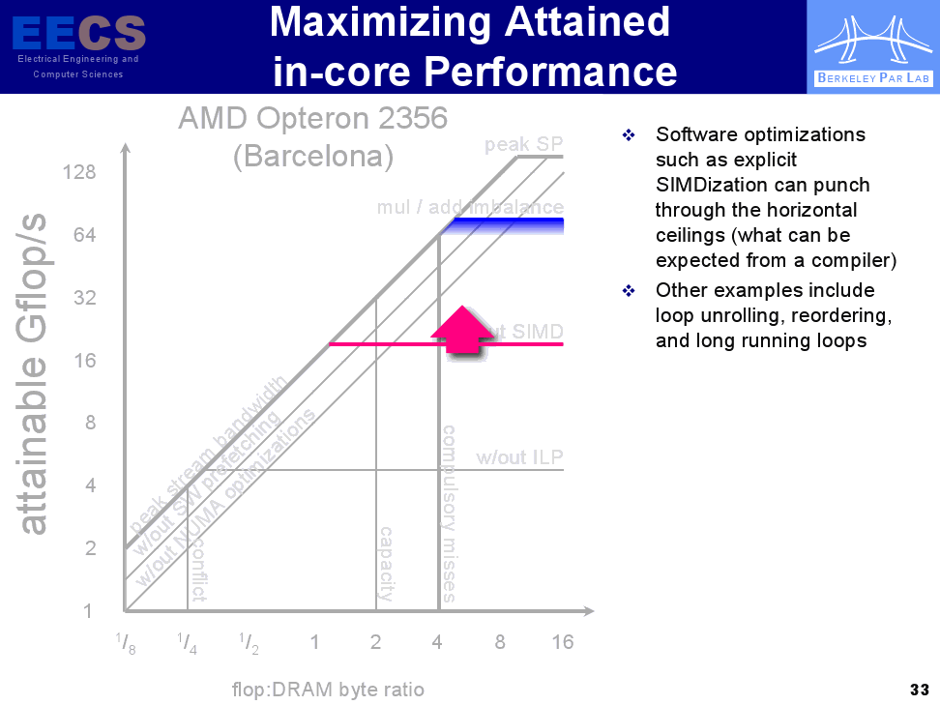
Roofline: A Simple Performance Model
Slide from:
www.eecs.berkeley.edu/~waterman/papers/roofline.pdf
ParLab Summer Retreat
Samuel Williams, David Patterson: samw@cs.berkeley.edu

Slide 17
Roofline: A Simple Performance Model
Reducing Memory Bottlenecks:
Software Prefetching
Have the software pre-fetch instructions rather than waiting until the data is required
Memory Affinity
Multiple memory controller chips means some memory addresses are only local to one of the chips
Optimize in order to allocate data and threads so that they are tasked to operate on the same memory-processor pair to avoid having to access the memory of the other chips (which is slow)

Slide 18
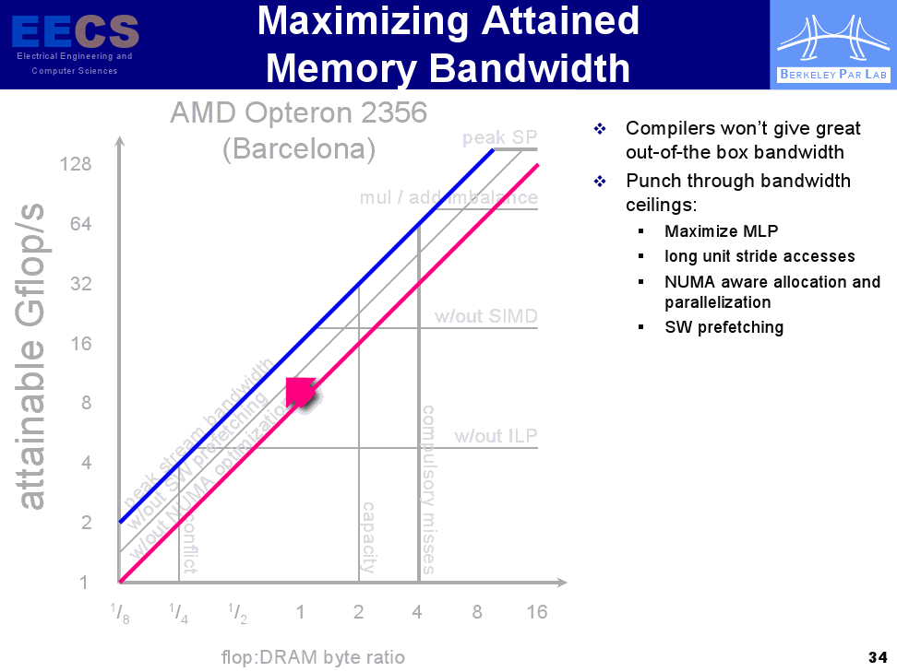
Roofline: A Simple Performance Model
Slide from:
www.eecs.berkeley.edu/~waterman/papers/roofline.pdf
ParLab Summer Retreat
Samuel Williams, David Patterson: samw@cs.berkeley.edu

Slide 19
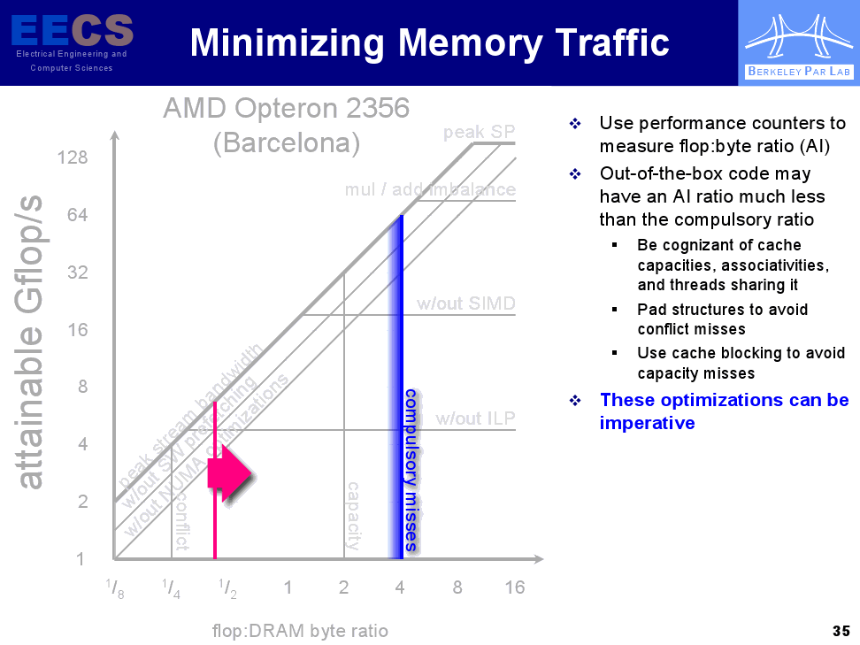
Roofline: A Simple Performance Model
Slide from:
www.eecs.berkeley.edu/~waterman/papers/roofline.pdf
ParLab Summer Retreat
Samuel Williams, David Patterson: samw@cs.berkeley.edu

Slide 20
Roofline: A Simple Performance Model
The following slides represent the change in the roofline model after optimization

Slide 21
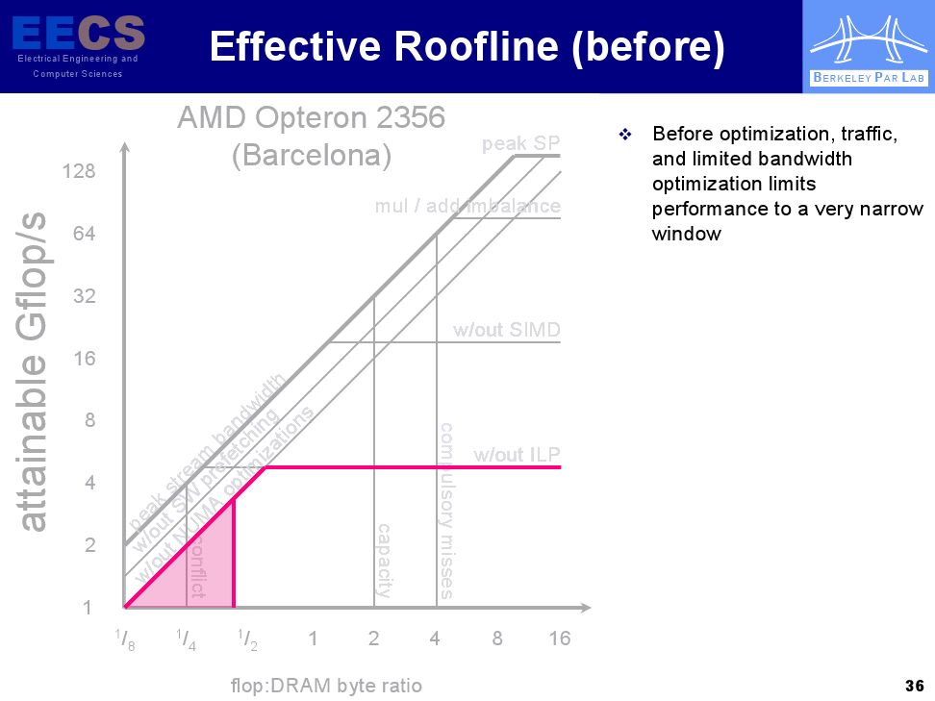
Roofline: A Simple Performance Model
Slide from:
www.eecs.berkeley.edu/~waterman/papers/roofline.pdf
ParLab Summer Retreat
Samuel Williams, David Patterson: samw@cs.berkeley.edu

Slide 22
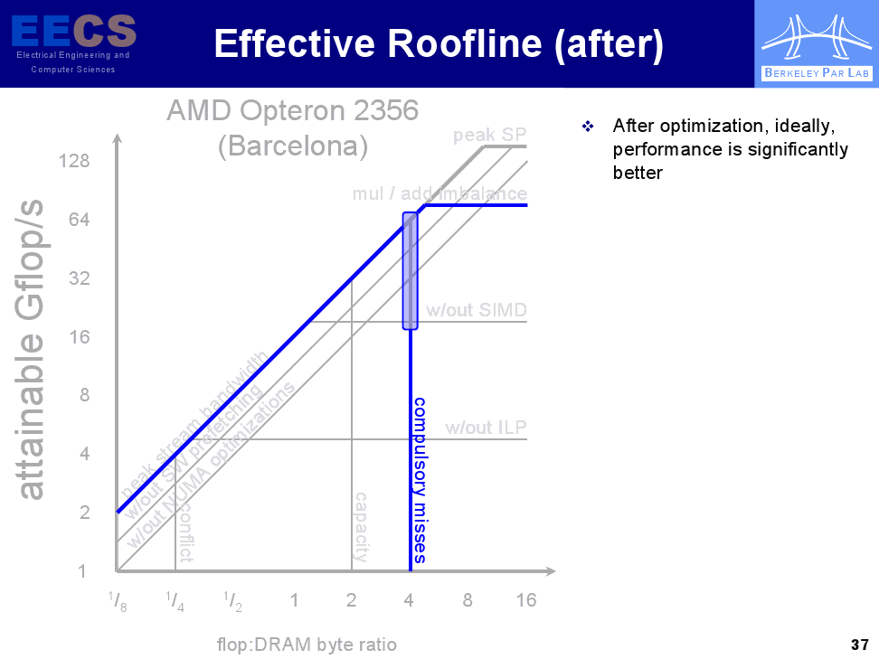
Roofline: A Simple Performance Model
Slide from:
www.eecs.berkeley.edu/~waterman/papers/roofline.pdf
ParLab Summer Retreat
Samuel Williams, David Patterson: samw@cs.berkeley.edu

