Slide 1
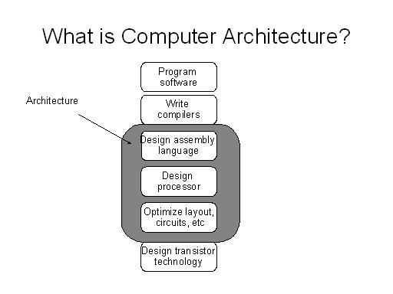
Where do you think we will start?

Slide 2
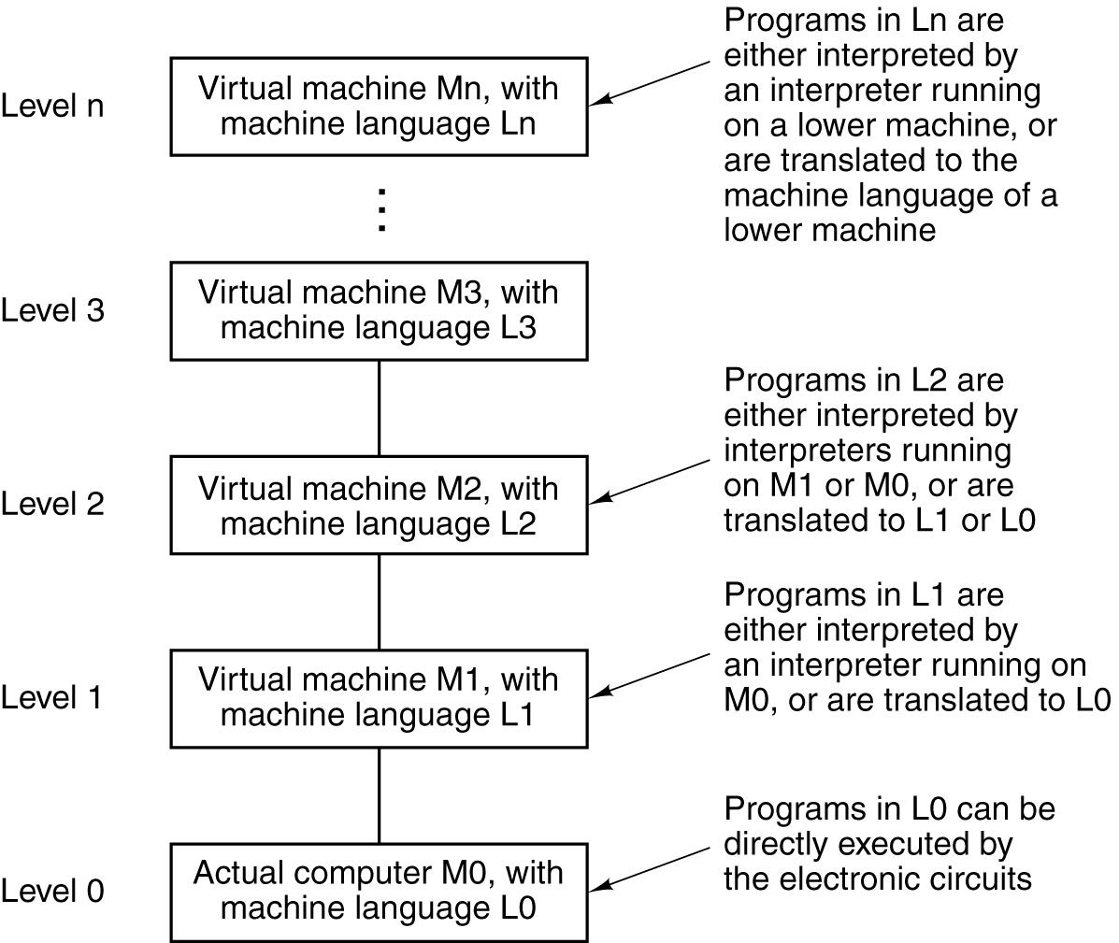
Languages, Levels, Virtual Machines
What are some computers that have all levels?
Why don’t some computers have all levels?
A multilevel machine
Tannenbaum, Structured Computer Organization, Fifth Edition, © 2006 Pearson Education, Inc. All rights reserved. 0-13-148521-0

Slide 3
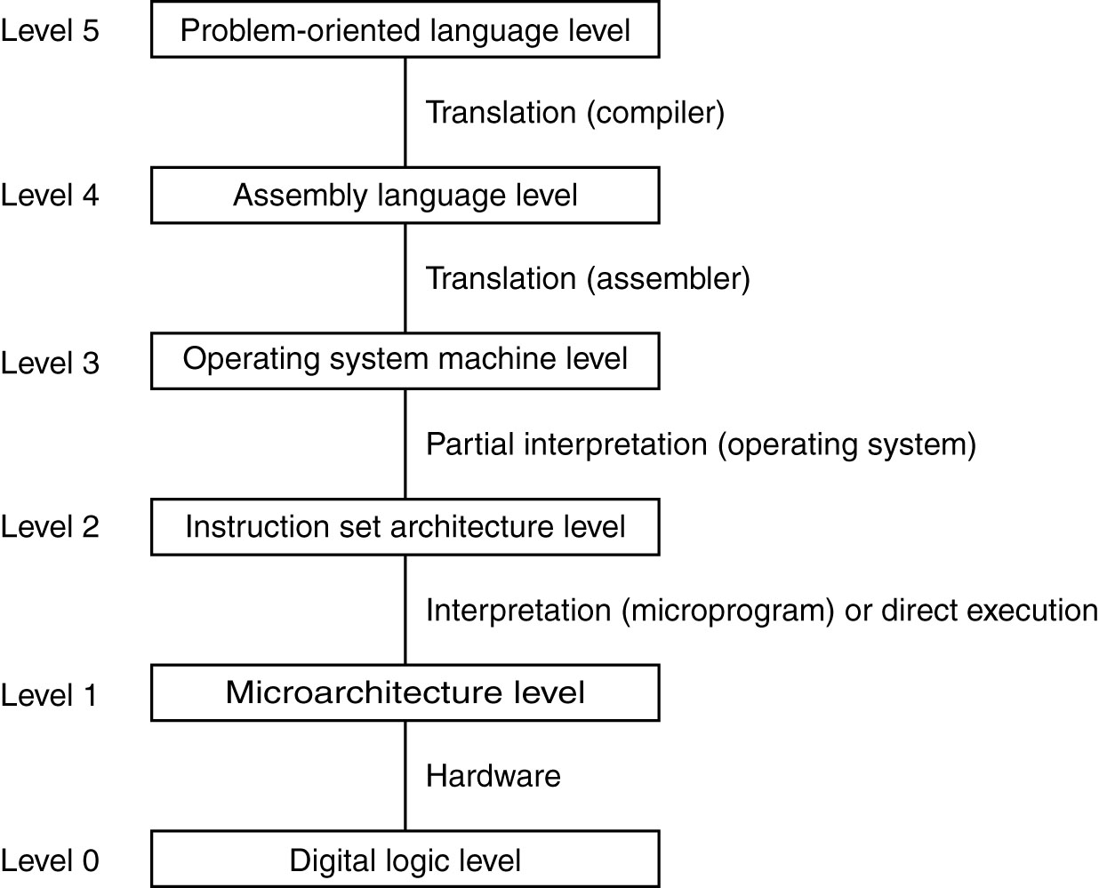
Multilevel Machines
Be able to discuss this example. How does this relate to MIPS?
A six-level computer.
The support method for each level is indicated below it .
Tannenbaum, Structured Computer Organization, Fifth Edition, © 2006 Pearson Education, Inc. All rights reserved. 0-13-148521-0

Slide 4
MIPS Register File
Register File
Holds thirty-two 32-bit registers
Two read ports and
One write port
32 bits
5
32
src1 addr
src1
data
5
src2 addr
32
locations
5
Registers are
Faster than main memory
But register files with more locations are slower (e.g., a 64 word file could be as much as 50% slower than a 32 word file)
Read/write port increase impacts speed quadratically
Easier for a compiler to use
e.g., (A*B) – (C*D) – (E*F) can do multiplies in any order vs. stack
Can hold variables so that
code density improves (since register are named with fewer bits than a memory location)
Can you explain all of the elements of this slide?
dst addr
32
src2
data
32
write data
write control
CSE431 Chapter 2.
Irwin, PSU, 2008

Slide 5
Aside: MIPS Register Convention
Name | Register Number | Usage | Preserve on call?
$zero | 0 | constant 0 (hardware) | n.a.
$at | 1 | reserved for assembler | n.a.
$v0 - $v1 | 2-3 | returned values | no
$a0 - $a3 | 4-7 | arguments | yes
$t0 - $t7 | 8-15 | temporaries | no
$s0 - $s7 | 16-23 | saved values | yes
$t8 - $t9 | 24-25 | temporaries | no
$gp | 28 | global pointer | yes
$sp | 29 | stack pointer | yes
$fp | 30 | frame pointer | yes
$ra | 31 | return addr (hardware) | yes
What does this mean?
CSE431 Chapter 2.
Irwin, PSU, 2008

Slide 6
Aside: MIPS Register Convention
$zero (0) constant 0 (hardware)
$at (1) $k0 (26), & $k1 (27) reserved for Assembler and O/S
$a0-$a3 (4-7) are used to pass the first four arguments to routines (remaining are passed on the stack)
$v0 - $v1 (2-3) returned values
$t0 - $t7 (8-15) are caller-saved registers
$s0 - $s7 (16-23) are callee-saved registers
$gp (28) global pointer that points to the middle of a 64K block memory in the static data segment. Static memory vs. automatic memory
$sp (29) stack pointer
$fp (30) frame pointer
$ra (31) return addr (hardware)

Slide 7
MIPS Shift Operations
Need operations to pack and unpack 8-bit characters into 32-bit words
Shifts move all the bits in a word left or right
sll $t2, $s0, 8 #$t2 = $s0 << 8 bits
srl $t2, $s0, 8 #$t2 = $s0 >> 8 bits
Instruction Format (R format)
0 16 10 8 0x00
Such shifts are called logical because they fill with zeros
Notice that a 5-bit shamt field is enough to shift a 32-bit value 2⁵ – 1 or 31 bit positions
CSE431 Chapter 2.
Irwin, PSU, 2008

Slide 8
MIPS Logical Operations
There are a number of bit-wise logical operations in the MIPS ISA
and $t0, $t1, $t2 #$t0 = $t1 & $t2
or $t0, $t1, $t2 #$t0 = $t1 | $t2
nor $t0, $t1, $t2 #$t0 = not($t1 | $t2)
Instruction Format (R format)
andi $t0, $t1, 0xFF00 #$t0 = $t1 & ff00
ori $t0, $t1, 0xFF00 #$t0 = $t1 | ff00
Instruction Format (I format)
0 9 10 8 0 0x24
0x0D 9 8 0xFF00
CSE431 Chapter 2.
Irwin, PSU, 2008

Slide 9
Possible Memory Addressing Modes (MIPS supports few)
Mode
Example
Meaning
Use
Displacement
Lw R4, 100(R1)
$4 <- M[$1 + 100]
Arrays w/constant offset
Register Indirect
Lw R4, (R1)
$4 <- M[$1]
You have pointer
Indexed
Lw R4, (R1+R2)
$4 <- M[$1 + $2]
$1 has base,$2 has offset
Direct or absolute
Lw R4, (1001)
$4 <- M[1001]
Globals, static data?
Memory indirect
Lw R4, @(R1)
$4 <- M[M[$1]]
Double-pointer
Autoincrement
Lw R1, (R2) +
$4 <- M[$2], $2 = $2 + d
Stepping through array in loop
Autodecrement
Lw R1, (R2) -
$4 <- M[$2], $2 = $2 - d
Stepping through array in loop
Scaled
Lw R4, 100(R2)[R3]
$4 <- M[100+$2+ ($3*d)]
Indexing arrays of large elements

Slide 10
RISC Philosophy
Instructions all same size
Small number of opcodes (small opcode space)
Opcode in same place for every instruction
Simple memory addressing
Instructions that manipulate data don’t manipulate memory, and vice versa
Minimize memory references by providing ample registers
How does MIPS satisfy these points?

Slide 11
Six Steps in Execution of a Procedure
Main routine (caller) places parameters in a place where the procedure (callee) can access them
$a0 - $a3: four argument registers
Caller transfers control to the callee
Callee acquires the storage resources needed
Callee performs the desired task
Callee places the result value in a place where the caller can access it
$v0 - $v1: two value registers for result values
Callee returns control to the caller
$ra: one return address register to return to the point of origin
CSE431 Chapter 2.
Irwin, PSU, 2008

Slide 12
Aside: Allocating Space on the Stack
The segment of the stack containing a procedure’s saved registers and local variables is its procedure frame (aka activation record)
The frame pointer ($fp) points to the first word of the frame of a procedure – providing a stable “base” register for the procedure
$fp is initialized using $sp on a call and $sp is restored using $fp on a return
high addr
Saved argument regs (if any)
$fp
Saved return addr
Saved local regs (if any)
Local arrays & structures (if any)
$sp
low addr
CSE431 Chapter 2.
Irwin, PSU, 2008
Notes:
On the other hand, the stack pointer (sp) might change during the procedure (not the case for all of our examples) so references to a local variable in memory might have different offsets wrt the sp depending on where they are in the procedure.

Slide 13
Aside: Allocating Space on the Heap
Static data segment for constants and other static variables (e.g., arrays)
Dynamic data segment (aka heap) for structures that grow and shrink (e.g., linked lists)
Allocate space on the heap with malloc() and free it with free() in C
Memory
$sp
0x 7f f f f f f c
Stack
Dynamic data
(heap)
$gp
0x 1000 8000
Static data
0x 1000 0000
Text
(Your code)
PC
0x 0040 0000
Reserved
0x 0000 0000
How much space is reserved? Are these sizes fixed?
CSE431 Chapter 2.
Irwin, PSU, 2008
Notes:
Stack and heap grow towards each other.
Malloc() allocates space on the heap and returns a pointer to it. Memory allocation is controlled by programs (in C) and is the source of many common and difficult bugs. Forgetting to free space leads to “memory leak” and the need for “garbage collection” and freeing space to early to “dangling pointers”.

Slide 14
The C Code Translation Hierarchy
C program
compiler
assembly code
assembler
object code
library routines
linker
machine code
executable
loader
memory
CSE431 Chapter 2.
Irwin, PSU, 2008
Notes:
Four logical phases all programs go through
C code – x.c or .TXT
assembly code – x.s or .ASM
object code – x.o or .OBJ
executable – a.out or .EXE

Slide 15
MIPS Organization So Far
Processor
Memory
Register File
1…1100
src1 addr
5
src1
data
32
src2 addr
5
32
registers
($zero - $ra)
dst addr
read/write
addr
5
src2
data
write data
32
32
2³⁰
words
32
32 bits
branch offset
read data
32
Add
32
PC
32
Add
32
32
4
32
Fetch
PC = PC+4
32
write data
0…1100
32
0…1000
4
5
6
7
0…0100
32
ALU
0
1
2
3
0…0000
Exec
Decode
32
32 bits
word address
(binary)
32
byte address
(big Endian)
CSE431 Chapter 2.
Irwin, PSU, 2008

Slide 17
Declaring, Allocating & Initializing Heap Arrays in MIPS
…..Real MIPS……
add $sp, $sp, -(24 + x + 8)
addi $a0, $0, 4
jal malloc
sw $v0, 4($sp)
addi $t0, $0, 5
sw $t0, 0($v0)
addi $a0, $0, 12
jal malloc
sw $v0, 0($sp)
addi $t0, $0, 1
sw $t0, 0($v0)
addi $t0, $0, 2
sw $t1, 4($v0)
addi $t0, $0, 3
sw $t1, 8($v0)
…..Simulator MIPS……
add $sp, $sp, -(24 + x + 8)
addi $a0, $0, 4 # how much space
addi $v0, $0, 9
syscall
sw $v0, 4($sp) # address in $v0
addi $t0, $0, 5
sw $t0, 0($v0)
addi $a0, $0, 12 # how much space
addi $v0, $0, 9
syscall
sw $v0, 0($sp) # address in $v0
addi $t0, $0, 1
sw $t0, 0($v0)
addi $t0, $0, 2
sw $t1, 4($v0)
addi $t0, $0, 3
sw $t1, 8($v0)

Slide 18
Performance Initial Points
The concept of performance is simple, but the determination is difficult.
The complexity occurs because of:
Complexity of current software systems
Hardware issues and improvements
User needs
A complexity is that the words used may vary. Example: clock cycles, ticks, clock ticks, clock periods, clocks, cycles.
The network interface is a big factor
Performance will vary from:
From business to business
From university to university
From business to university and vice versa
Why? For all above.
Notes:
18

Slide 19
Performance
Measure, Report, and Summarize
Make intelligent choices
See through the marketing hype
Key to understanding underlying organizational motivation Why is some hardware better than others for different programs? What factors of system performance are hardware related? (e.g., Do we need a new machine, or a new operating system?) How does the machine's instruction set affect performance?
Notes:
19

Slide 20
Metrics of performance
Answers per month
Useful Operations per second
Application
Programming
Language
Compiler
(millions) of Instructions per second – MIPS
(millions) of (F.P.) operations per second – MFLOP/s
ISA
Datapath
Control
Megabytes per second
Functioaln Units
Transistors
Wires
Pins
Cycles per second (clock rate)
Each metric has a place and a purpose, and each can be misused
What are some of the possible misuses?
Notes:
20

Slide 21
Performance Metrics
Purchasing perspective
given a collection of machines, which has the
best performance ? - best total cost of ownership?
least cost ? - best green?
best cost/performance?
Design perspective
faced with design options, which has the
best performance improvement ?
least cost ?
best cost/performance?
Both require
basis for comparison
metric for evaluation
Our goal is to understand what factors in the architecture contribute to overall system performance and the relative importance (and cost) of these factors
CSE431 Chapter 1.
Irwin, PSU, 2008
Notes:
Or smallest/lightest
Longest battery life
Most reliable/durable (in space)

Slide 22
Latency vs. Throughput
Latency (Response Time)
How long does it take for my job to run?
How long does it take to execute a job?
How long must I wait for the database query?
Example: Time taken for a sent packet of data to go from point A to point B.
Throughput
How many jobs can the machine run at once?
What is the average execution rate?
How much work is getting done?
Example: Number of sent packet of data to go from point A to point B in a certain amount of time.
If we upgrade a machine with a new processor what do we increase? Tricky
If we add a new machine to the lab what do we increase?
Notes:
22
New processor: Throughput and latency; new machine: throughput

Slide 23
Throughput versus Response Time
Response time (execution time) – the time between the start and the completion of a task
Who is most concerned with latency? – Response time
Throughput (bandwidth) – the total amount of work done in a given time
Who is most concerned with throughput?
Will need different performance metrics as well as a different set of applications to benchmark embedded and desktop computers, which are more focused on response time, versus servers, which are more focused on throughput
What is a benchmark?
CSE431 Chapter 1.
Irwin, PSU, 2008
Notes:
Important to individual users
Important to data center managers

Slide 24
Workloads and Benchmarks
Benchmarks – a set of programs that form a “workload” specifically chosen to measure performance
SPEC (System Performance Evaluation Cooperative) creates standard sets of benchmarks starting with SPEC89. The latest is SPEC CPU2006 which consists of 12 integer benchmarks (CINT2006) and 17 floating-point benchmarks (CFP2006).
www.spec.org
There are also benchmark collections for power workloads (SPECpower_ssj2008), for mail workloads (SPECmail2008), for multimedia workloads (mediabench), …
CSE431 Chapter 1.
Irwin, PSU, 2008

Slide 25
Two notions of “performance”
Plane
DC to Paris
Speed
Passengers
Throughput (pmph)
Boeing 747
6.5 hours
610 mph
470
286,700
BAD/Sud Concorde
3 hours
1350 mph
132
178,200
Which has higher performance?
Time to do the task (Execution Time)
execution time, response time, latency
Tasks per day, hour, week, sec, ns … (Performance)
throughput, bandwidth
Response time and throughput often are in opposition
What influences cost?
Notes:
25

Slide 26
Clock Cycles
Instead of reporting execution time in seconds, we often use cycles:
Clock “ticks” indicate when to start activities
Cycle time = time between ticks = seconds per cycle
Clock rate (frequency) = cycles per second (1 Hz = 1 cycle/sec)
A 200 MHz clock has a cycle time of …
time
1 X 10⁹ = 5 nanoseconds
200 X 10⁶
Notes:
26

Slide 27
How to Improve Performance
So, to improve performance (everything else being equal) you can either (increase/ decrease):
________ the # of required cycles for a program, or ________ the clock cycle time or, said another way, ________ the clock rate.
Why?
Notes:
27

Slide 28
CPI
How many clock cycles, on average, does it take for every instruction executed?
We call this CPI (“Cycles Per Instruction”).
Its inverse (1/CPI) is IPC (“Instructions Per Cycle”).
CISC machines: this number (CPI) is
high(er)
RISC machines: this number (CPI) is
low(er)

Slide 29
CPI: Average Cycles per Instruction
CPI = (CPU Time * Clock Rate) / Instruction Count
= Clock Cycles / Instruction Count
n
CPI = Σ CPI × F where F = I
i
i
i
i
i = 1
Instruction Count for Application Execution
Where: CPI = clock cycles for Inst. Ii I = Number of times instruction I is executed
i
i
On Imagine, integer adds are 2 cycles, FP adds are 4.
Consider an application that has 1/3 integer adds and 2/3 FP adds.
What is its CPI?
Given a 3 GHz machine, how many instrs/sec?
Notes:
29
CPI = 1/3 * 2 + 2/3 * 4 = 2/3 + 8/3 = 10/3 = 3 1/3
3/10 instrs/cycle * 3B cycles/s = 900M instrs/second

Slide 30
The Performance Equation
Time = Cycle Time * CPI * Instruction Count
= seconds/cycle * cycles/instr * instrs/program
=> seconds/program
Performance = Clock Rate * IPC * 1/I
= cycles/second * instr/cycle * program/instr
=> programs/second
Clock rate * IPC = instr/second = IPS (MIPS)
“The only reliable measure of computer performance is time.”

Slide 31
Defining (Speed) Performance
To maximize performance, need to minimize execution time
performance_{X} = 1 / execution_time_{X}
If X is n times faster than Y, then
performance_{X} execution_time_{Y}
-------------------- = --------------------- = n
performance_{Y} execution_time_{X}
Decreasing response time almost always improves throughput
CSE431 Chapter 1.
Irwin, PSU, 2008
Notes:
Increasing performance requires decreasing execution time

Slide 32
Performance Factors
CPU execution time (CPU time) – time the CPU spends working on a task
Does not include time waiting for I/O or running other programs
CPU execution time # CPU clock cycles
= x clock cycle time
for a program for a program
or
CPU execution time # CPU clock cycles for a program
= -------------------------------------------
for a program clock rate
Can improve performance by reducing either the length of the clock cycle or the number of clock cycles required for a program
CSE431 Chapter 1.
Irwin, PSU, 2008
Notes:
Many techniques that decrease the number of clock cycles also increase the clock cycle time

Slide 33
Review: Machine Clock Rate
Clock rate (clock cycles per second in MHz or GHz) is inverse of clock cycle time (clock period)
CC = 1 / CR
one clock period
10 nsec clock cycle => 100 MHz clock rate
5 nsec clock cycle => 200 MHz clock rate
2 nsec clock cycle => 500 MHz clock rate
1 nsec (10⁻⁹) clock cycle => 1 GHz (10⁹) clock rate
500 psec clock cycle => 2 GHz clock rate
250 psec clock cycle => 4 GHz clock rate
200 psec clock cycle => 5 GHz clock rate
CSE431 Chapter 1.
Irwin, PSU, 2008
Notes:
A clock cycle is the basic unit of time to execute one operation/pipeline stage/etc.

Slide 34
Clock Cycles per Instruction
Not all instructions take the same amount of time to execute
One way to think about execution time is that it equals the number of instructions executed multiplied by the average time per instruction
# CPU clock cycles # Instructions Average clock cycles
= x
for a program for a program per instruction
Clock cycles per instruction (CPI) – the average number of clock cycles each instruction takes to execute
A way to compare two different implementations of the same ISA
Is this a MIPS computer?
 | CPI for this instruction class
 | A | B | C
CPI | 1 | 2 | 3
CSE431 Chapter 1.
Irwin, PSU, 2008

Slide 35
Effective (Average) CPI
Computing the overall effective CPI is done by looking at the different types of instructions and their individual cycle counts and averaging
n
Overall effective CPI = Σ (CPI_{i} x IC_{i})
i = 1
Where IC_{i} is the count (percentage) of the number of instructions of class i executed
CPI_{i} is the (average) number of clock cycles per instruction for that instruction class
n is the number of instruction classes
The overall effective CPI varies by instruction mix – a measure of the dynamic frequency of instructions across one or many programs
CSE431 Chapter 1.
Irwin, PSU, 2008

Slide 36
THE Performance Equation
Our basic performance equation is then
CPU time = Instruction_count x CPI x clock_cycle
or
Instruction_count x CPI
CPU time = -----------------------------------------------
clock_rate
These equations separate the three key factors that affect performance
Can measure the CPU execution time by running the program
The clock rate is usually given
Can measure overall instruction count by using profilers/ simulators without knowing all of the implementation details
CPI varies by instruction type and ISA implementation for which we must know the implementation details
CSE431 Chapter 1.
Irwin, PSU, 2008
Notes:
Note that instruction count is dynamic – i.e., its not the number of lines in the code, but THE NUMBER OF INSTRUCTIONS EXECUTED

Slide 37
A Simple Example
Op | Freq | CPI_{i} | Freq x CPI_{i}
ALU | 50% | 1
Load | 20% | 5
Store | 10% | 3
Branch | 20% | 2
 |  |  | Σ =
How much faster would the machine be if a better data cache reduced the average load time to 2 cycles?
How does this compare with using branch prediction to shave a cycle off the branch time?
What if two ALU instructions could be executed at once?
What is the CPI for the original configuration?
CSE431 Chapter 1.
Irwin, PSU, 2008
Notes:
Fill out the last column for each case.
CPU time new = 1.6 x IC x CC so 2.2/1.6 means 37.5% faster
CPU time new = 2.0 x IC x CC so 2.2/2.0 means 10% faster
CPU time new = 1.95 x IC x CC so 2.2/1.95 means 12.8% faster
CPI = 0.5*1 + 0.2*5 + 0.1*3 + 0.2*2 = 2.2

Slide 38
Determinates of CPU Performance
CPU time = Instruction_count x CPI x clock_cycle
 | Instruction_count | CPI | clock_cycle
Algorithm
Programming language
Compiler
ISA
Core organization
Technology
X
X
X
X
X
X
X
X
X
X
X
X
How do each of these influence performance?
CSE431 Chapter 1.
Irwin, PSU, 2008
Notes:
For lecture

Slide 39
Graphically Representing Pipelines
Can help with answering questions like:
how many cycles does it take to execute this code?
what is the ALU doing during cycle 4?
use this representation to help understand datapaths
Notes:
How many cycles does this take without pipelining?

Slide 40
Conventional Pipelined Execution Representation
Time
IFetch
Dcd
Exec
Mem
WB
IFetch
Dcd
Exec
Mem
WB
IFetch
Dcd
Exec
Mem
WB
IFetch
Dcd
Exec
Mem
WB
IFetch
Dcd
Exec
Mem
WB
Program Flow
IFetch
Dcd
Exec
Mem
WB
Notes:
How many cycles does this take? How many does it take without pipeline?

Slide 41
Why Pipeline?
Suppose we execute 100 instructions. How long on each architecture?
Single Cycle Machine
4.5 ns/cycle, CPI=1
Ideal pipelined machine
1.0 ns/cycle, CPI=1 (but remember fill cost!)
Notes:
ASSUME 5 STAGE PIPELINE
Single Cycle Machine
4.5 ns/cycle x 1 CPI x 100 inst = 450 ns
Ideal pipelined machine
1.0 ns/cycle x (1 CPI x 100 inst + 4 cycle fill) = 104 ns

Slide 42
Can pipelining get us into trouble?
Yes: Pipeline Hazards
structural hazards: attempt to use the same resource two different ways at the same time
control hazards: attempt to make a decision before condition is evaluated
data hazards: attempt to use item before it is ready
Can always resolve hazards by waiting
pipeline control must detect the hazard
take action (or delay action) to resolve hazards
Why are hazards problematic?
Notes:
Did we have anything in the datapath and control to deal with hazard?

Slide 43
Single Memory is a Structural Hazard
Time (clock cycles)
I
n
s
t
r.
O
r
d
e
r
Load
Mem
Reg
ALU
Mem
Reg
Instr 1
Mem
Reg
ALU
Mem
Reg
Instr 2
Mem
Reg
ALU
Mem
Reg
Instr 3
Mem
Reg
ALU
Mem
Reg
Instr 4
Mem
Reg
ALU
Mem
Reg
Detection is easy in this case! (right half highlight means read, left half write)

Slide 44
Structural Hazards limit performance
Example: if 1.3 memory accesses per instruction and only one memory access per cycle then
average CPI ≥ 1.3
otherwise resource is more than 100% utilized
One Structural Hazard solution: more resources
Instruction cache and Data cache
What is cache? Look up memory hierarchy. What is memory hierarchy?

Slide 45
Control Hazards
Control hazards: attempt to make a decision before condition is evaluated
E.g., washing football uniforms and need to get proper detergent level; need to see after dryer before next load in
branch instructions

Slide 46
Control Hazards
I
n
s
t
r.
O
r
d
e
r
Time (clock cycles)
Mem
Reg
ALU
Mem
Reg
Load
Beq
Mem
Reg
ALU
Mem
Reg
Add
Mem
Reg
ALU
Mem
Reg
BEQ instruction: Decides which instruction to run next
We don’t know the outcome of the BEQ until ALU is done
What do we fetch?
Notes:
Above depicts two different potential instruction in red.

Slide 47
Control Hazard Solution #1: Stall
I
n
s
t
r.
O
r
d
e
r
Time (clock cycles)
Mem
Reg
ALU
Mem
Reg
Load
Beq
Mem
Reg
ALU
Mem
Reg
Add
Lost
potential
Reg
ALU
Mem
Reg
Mem
Stall: wait until decision is clear
Impact: 2 lost cycles (i.e. 3 clock cycles for Beq instruction above) => slow
Move decision to end of decode
save 1 cycle per branch, may stretch clock cycle
What are tradeoffs for this?

Slide 48
Control Hazard Solution #2: Predict
I
n
s
t
r.
O
r
d
e
r
Time (clock cycles)
Mem
Reg
ALU
Mem
Reg
Add
Beq
Mem
Reg
ALU
Mem
Reg
Load
Mem
Reg
ALU
Mem
Reg
Predict: guess one direction then back up if wrong
Impact: 0 lost cycles per branch instruction if guess right, 1 if wrong (right ~ 50% of time)
Need to “Squash” and restart following instruction if wrong
Produce CPI on branch of (1 *.5 + 2 * .5) = 1.5
Total CPI might then be: 1.5 * .2 + 1 * .8 = 1.1 (20% branch)
More dynamic schemes: history of branch behaviour (~90-99%)
What are tradeoffs for this? How does this compare to stall?

Slide 49
Control Hazard Solution #3: Delayed Branch
I
n
s
t
r.
O
r
d
e
r
Time (clock cycles)
Mem
Reg
ALU
Mem
Reg
Add
Beq
Mem
Reg
ALU
Mem
Reg
Misc
Mem
Reg
ALU
Mem
Reg
Load
Mem
Reg
ALU
Mem
Reg
Delayed Branch: Redefine branch behavior (takes place after next instruction)
Impact: 0 clock cycles per branch instruction if can find instruction to put in “slot” (~50% of time)
As launch more instruction per clock cycle, less useful
What are tradeoffs for this? How does this compare to stall and ?

Slide 50
Consider following code:
for (i=0, s=0 ; i < 100 ; i++) { s += i*i; }
top: mul temp, i, i # pretend OK
add s, s, temp
addiu i, i, 1
sltiu b, i, 100
beq b, 0, top
nop # doesn’t count as an instr
How many cycles to run this? CPI? How to make it faster?
Notes:
100 * 6 = 600 cycles

Slide 51
Unmodified Code
Time
mul
add
addiu
slt
beq
nop
mul
6 cycles/iter * 100 iter = 600 cycles (+drain) CPI = 600 cycles / 500 instrs = 1.2
IFetch
Dcd
Exec
Mem
WB
IFetch
Dcd
Exec
Mem
WB
IFetch
Dcd
Exec
Mem
WB
IFetch
Dcd
Exec
Mem
WB
IFetch
Dcd
Exec
Mem
WB
IFetch
Dcd
Exec
Mem
WB
IFetch
Dcd
Exec
Mem

Slide 52
Rewrite:
for (i = 0, s = 0 ; i < 100 ; i++) { s += i*i; }
top: mul temp, i, i # pretend OK
addiu i, i, 1
sltiu b, i, 100
beq b, 0, top
add s, s, temp
How many cycles to run this? How to make it faster?

Slide 53
After Rewrite
Time
mul
addiu
slt
beq
add
mul
5 cycles/iter * 100 iter = 500 cycles CPI = 500 cycles / 500 instrs = 1.0
IFetch
Dcd
Exec
Mem
WB
IFetch
Dcd
Exec
Mem
WB
IFetch
Dcd
Exec
Mem
WB
IFetch
Dcd
Exec
Mem
WB
IFetch
Dcd
Exec
Mem
WB
IFetch
Dcd
Exec
Mem
WB

Slide 54
Loop Unrolling
for (i=0, s=0 ; i < 100 ; i++) { s += i*i; i++; s += i*i; }
top: mul temp, i, i # pretend OK add s, s, temp addiu i, i, 1 mul temp, i, i addiu i, i, 1 sltiu b, i, 100 beq b, 0, top add s, s, temp
How many cycles to run this? Where did we save?
8 cycles/iteration * 50 iterations = 400 cycles; CPI = 1
Notes:
Saved by only having one beq per two elements, also one sltiu per two elements

Slide 55
Data Hazards
Data hazards: attempt to use item before it is ready
E.g., one sock of pair in dryer and one in washer; can’t fold until get sock from washer through dryer
instruction depends on result of prior instruction still in the pipeline

Slide 56
Data Hazard Example
Time (clock cycles)
IF
ID/RF
EX
MEM
WB
add r1,r2,r3
Im
Reg
ALU
Dm
Reg
I
n
s
t
r.
O
r
d
e
r
sub r4,r1,r3
Im
Reg
ALU
Dm
Reg
Dependencies backwards in time are hazards
If we read r1 in the sub instr, will it get the right value of r1?

Slide 57
Data Hazard Terminology
Could the wrong thing happen?
RAW: Read After Write
“True Dependence” or “Data Dependence”
add $t0, $s0, $s1 sub $t2, $t0, $s3
WAW: Write After Write
“Output Dependence”
sub $t2, $t0, $s3 or $t2, $t7, $s2
WAR: Write After Read
“Name dependence” or “Antidependence”
sub $t2, $t0, $s3 or $s3, $t7, $s4
RAR: Read After Read?
Know this terminology!

Slide 58
Data Hazard on r1
add r1,r2,r3
sub r4,r1,r3
and r6,r1,r7
or r8,r1,r9
xor r10,r1,r11

Slide 59
Data Hazard on r1:
Dependencies backwards in time are hazards
Time (clock cycles)
IF
ID/RF
EX
MEM
WB
add r1,r2,r3
Im
Reg
ALU
Dm
Reg
I
n
s
t
r.
O
r
d
e
r
sub r4,r1,r3
Im
Reg
ALU
Dm
Reg
and r6,r1,r7
Im
Reg
ALU
Dm
Reg
or r8,r1,r9
Im
Reg
ALU
Dm
Reg
xor r10,r1,r11
Im
Reg
ALU
Dm
Reg

Slide 60
Data Hazard Solution:
“Forward” result from one stage to another
“or” OK if define read/write properly
What does this solution require?
Time (clock cycles)
IF
ID/RF
EX
MEM
WB
add r1,r2,r3
Im
Reg
ALU
Dm
Reg
I
n
s
t
r.
O
r
d
e
r
sub r4,r1,r3
Im
Reg
ALU
Dm
Reg
and r6,r1,r7
Im
Reg
ALU
Dm
Reg
or r8,r1,r9
Im
Reg
ALU
Dm
Reg
xor r10,r1,r11
Im
Reg
ALU
Dm
Reg

Slide 61
Pipelining the Load Instruction
Cycle 1
Cycle 2
Cycle 3
Cycle 4
Cycle 5
Cycle 6
Cycle 7
Clock
1st lw
Ifetch
Reg/Dec
Exec
Mem
Wr
2nd lw
Ifetch
Reg/Dec
Exec
Mem
Wr
3rd lw
Ifetch
Reg/Dec
Exec
Mem
Wr
The five independent functional units in the pipeline datapath are:
Instruction Memory for the Ifetch stage
Register File’s Read ports (bus A and busB) for the Reg/Dec stage
ALU for the Exec stage
Data Memory for the Mem stage
Register File’s Write port (bus W) for the Wr stage
Notes:
For the load instructions, the five independent functional units in the pipeline datapath are:
(a) Instruction Memory for the Ifetch stage.
(b) Register File’s Read ports for the Reg/Decode stage.
(c) ALU for the Exec stage. (d) Data memory for the Mem stage.
(e) And finally Register File’s write port for the Write Back stage.
Notice that I have treat Register File’s read and write ports as separate functional units because the register file we have allows us to read and write at the same time.
Notice that as soon as the 1st load finishes its Ifetch stage, it no longer needs the Instruction Memory. Consequently, the 2nd load can start using the Instruction Memory (2nd Ifetch).
Furthermore, since each functional unit is only used ONCE per instruction, we will not have any conflict down the pipeline (Exec-Ifet, Mem-Exec, Wr-Mem) either.
I will show you the interaction between instructions in the pipelined datapath later. But for now, I want to point out the performance advantages of pipelining.
If these 3 load instructions are to be executed by the multiple cycle processor, it will take 15 cycles. But with pipelining, it only takes 7 cycles. This (7 cycles), however, is not the best way to look at the performance advantages of pipelining.
A better way to look at this is that we have one instruction enters the pipeline every cycle so we will have one instruction coming out of the pipeline (Wr stages) every cycle.
Consequently, the “effective” (or average) number of cycles per instruction is now ONE even though it takes a total of 5 cycles to complete each instruction.
+3 = 14 min. (X:54)

Slide 62
The Four Stages of R-type
Cycle 1
Cycle 2
Cycle 3
Cycle 4
R-type
Ifetch
Reg/Dec
Exec
Wr
Ifetch: Instruction Fetch
Fetch the instruction from the Instruction Memory
Reg/Dec: Registers Fetch and Instruction Decode
Exec:
ALU operates on the two register operands
Update PC
Wr: Write the ALU output back to the register file
Notes:
Well, so far so good. Let’s take a look at the R-type instructions.
The R-type instruction does NOT access data memory so it only takes four clock cycles, or in our new pipeline terminology, four stages to complete.
The Ifetch and Reg/Dec stages are identical to the Load instructions. Well they have to be because at this point, we do not know we have a R-type instruction yet.
Instead of calculating the effective address during the Exec stage, the R-type instruction will use the ALU to operate on the register operands.
The result of this ALU operation is written back to the register file during the Wr back stage.
+1 = 15 min. (55)

Slide 63
Pipelining the R-type and Load Instruction
Cycle 1
Cycle 2
Cycle 3
Cycle 4
Cycle 5
Cycle 6
Cycle 7
Cycle 8
Cycle 9
Clock
R-type
Ifetch
Reg/Dec
Exec
Wr
Oops! We have a problem!
R-type
Ifetch
Reg/Dec
Exec
Wr
Load
Ifetch
Reg/Dec
Exec
Mem
Wr
R-type
Ifetch
Reg/Dec
Exec
Wr
R-type
Ifetch
Reg/Dec
Exec
Wr
We have pipeline conflict or structural hazard:
Two instructions try to write to the register file at the same time!
Only one write port
Notes:
What happened if we try to pipeline the R-type instructions with the Load instructions?
Well, we have a problem here!!!
We end up having two instructions trying to write to the register file at the same time!
Why do we have this problem (the write “bubble”)?
Well, the reason for this problem is that there is something I have not yet told you.
+1 = 16 min. (X:56)

Slide 64
Important Observation
Each functional unit can only be used once per instruction (Except Registers)
Each functional unit must be used at the same stage for all instructions:
Load uses Register File’s Write Port during its 5th stage
R-type uses Register File’s Write Port during its 4th stage
2 ways to solve this pipeline hazard.
How do we solve it?
1
2
3
4
5
Load
Ifetch
Reg/Dec
Exec
Mem
Wr
1
2
3
4
R-type
Ifetch
Reg/Dec
Exec
Wr
Notes:
I already told you that in order for pipeline to work perfectly, each functional unit can ONLY be used once per instruction.
What I have not told you is that this (1st bullet) is a necessary but NOT sufficient condition for pipeline to work.
The other condition to prevent pipeline hiccup is that each functional unit must be used at the same stage for all instructions.
For example here, the load instruction uses the Register File’s Wr port during its 5th stage but the R-type instruction right now will use the Register File’s port during its 4th stage.
This (5 versus 4) is what caused our problem. How do we solve it? We have 2 solutions.
+1 = 17 min. (X:57)

Slide 65
Solution 1: Insert “Bubble” into the Pipeline
Cycle 1
Cycle 2
Cycle 3
Cycle 4
Cycle 5
Cycle 6
Cycle 7
Cycle 8
Cycle 9
Clock
Ifetch
Reg/Dec
Exec
Wr
Load
Ifetch
Reg/Dec
Exec
Mem
Wr
R-type
Ifetch
Reg/Dec
Exec
Wr
R-type
Ifetch
Reg/Dec
Pipeline
Exec
Wr
R-type
Ifetch
Bubble
Reg/Dec
Exec
Wr
Ifetch
Reg/Dec
Exec
Insert a “bubble” into the pipeline to prevent 2 writes at the same cycle
The control logic can be complex.
Lose instruction fetch and issue opportunity.
No instruction is started in Cycle 6!
Notes:
The first solution is to insert a “bubble” into the pipeline AFTER the load instruction to push back every instruction after the load that are already in the pipeline by one cycle.
At the same time, the bubble will delay the Instruction Fetch of the instruction that is about to enter the pipeline by one cycle.
Needless to say, the control logic to accomplish this can be complex.
Furthermore, this solution also has a negative impact on performance.
Notice that due to the “extra” stage (Mem) Load instruction has, we will not have one instruction finishes every cycle (points to Cycle 5).
Consequently, a mix of load and R-type instruction will NOT have an average CPI of 1 because in effect, the Load instruction has an effective CPI of 2.
So this is not that hot an idea Let’s try something else.
+2 = 19 min. (X:59)

Slide 66
Solution 2: Delay R-type’s Write by One Cycle
Delay R-type’s register write by one cycle:
Now R-type instructions also use Reg File’s write port at Stage 5
Mem stage is a NOP stage: nothing is being done.
1
2
3
4
5
R-type
Ifetch
Reg/Dec
Exec
Mem
Wr
Cycle 1
Cycle 2
Cycle 3
Cycle 4
Cycle 5
Cycle 6
Cycle 7
Cycle 8
Cycle 9
Clock
R-type
Ifetch
Reg/Dec
Exec
Mem
Wr
R-type
Ifetch
Reg/Dec
Exec
Mem
Wr
Load
Ifetch
Reg/Dec
Exec
Mem
Wr
R-type
Ifetch
Reg/Dec
Exec
Mem
Wr
R-type
Ifetch
Reg/Dec
Exec
Mem
Wr
Notes:
Well one thing we can do is to add a “Nop” stage to the R-type instruction pipeline to delay its register file write by one cycle.
Now the R-type instruction ALSO uses the register file’s witer port at its 5th stage so we eliminate the write conflict with the load instruction.
This is a much simpler solution as far as the control logic is concerned. As far as performance is concerned, we also gets back to having one instruction completes per cycle.
This is kind of like promoting socialism: by making each individual R-type instruction takes 5 cycles instead of 4 cycles to finish, our overall performance is actually better off.
The reason for this higher performance is that we end up having a more efficient pipeline.
+1 = 20 min. (Y:00)

Slide 67
Summary: Pipelining
Reduce CPI by overlapping many instructions
Average throughput of approximately 1 CPI with fast clock
Utilize capabilities of the Datapath
start next instruction while working on the current one
limited by length of longest stage (plus fill/flush)
detect and resolve hazards
What makes it easy
all instructions are the same length
just a few instruction formats
memory operands appear only in loads and stores
What makes it hard?
structural hazards: suppose we had only one memory
control hazards: need to worry about branch instructions
data hazards: an instruction depends on a previous instruction

Slide 68
Level 1 Caches
L1 caches must be fast (small) to keep up with pipeline
0.5ns access time for 2 Ghz processor
Most current processors use two or more pipeline stages for Mem.
0.5ns access time for 4 Ghz processor using two stages
IF1
Decode
Reg Rd
Reg.
Write
IF2
ALU
Mem1
Mem2
Address
Instruction
Store Data
Load Data
Address
L1 ICache
L1 DCache
What does this do to the pipeline?

Slide 69
L2 Cache
IF 1
Decode
Reg Rd
Reg.
Write
IF 2
ALU
Mem1
Mem2
Address
Instruction
Store Data
Load Data
L1 ICache
L1 DCache
Address
Unified L2 Cache
What change had to be made to add L2 cache? What limitation doe unification create?

Slide 70
Main Memory
Memory access requires a slow off-chip access
L1 I
L1 D
L2
Main Memory

Slide 71
Caching: A Simple First Example
Main Memory
0000xx
0001xx
0010xx
0011xx
0100xx
0101xx
0110xx
0111xx
1000xx
1001xx
1010xx
1011xx
1100xx
1101xx
1110xx
1111xx
Cache
One word blocks
Two low order bits define the byte in the word (32b words)
Index
Valid
Tag
Data
00
01
10
11
Q2: How do we find it?
Use next 2 low order memory address bits – the index – to determine which cache block (i.e., modulo the number of blocks in the cache)
Q1: Is it there?
Compare the cache tag to the high order 2 memory address bits to tell if the memory block is in the cache
(block address) modulo (# of blocks in the cache)
What are addresses? How big is each rectangle of main memory? What is “Valid”?
CSE431 Chapter 5A.
Irwin, PSU, 2008
Notes:
For lecture
Valid bit indicates whether an entry contains valid information – if the bit is not set, there cannot be a match for this block

Slide 72
Temporal Locality
Data (instructions) that are recently used are likely to be used in the near future
Program in a small loop soon executes same set of instructions
Subroutine return address stored to stack often loaded a short time later

Slide 73
Cache Protocol: Direct Mapped
Where in cache should data be placed so it can be quickly located?
Direct Mapped (Simplest):
Cache size is selected to be 2^{i}, e.g., 2¹⁶
The entire 32-bit address is used to locate an instruction/data in main memory
The lower i bits (e.g., 16) are used to (quickly) find an item in the cache
Implies that each instruction/data from main memory is copied to (mapped to) a specific cache location
What is mapping? What does direct mapping mean?

Slide 74
Example: 1 KB Direct Mapped Cache with 32 B Blocks
For a 2^N byte cache:
The uppermost (32 - N) bits are always the Cache Tag
The lowest M bits are the Byte Select (Block Size = 2 ** M)
On cache miss, pull in complete “Cache Block” (or “Cache Line”)
Block address
31
10
9
5
4
0
Cache Tag
Example: 0x50
Cache Index
Byte Select
Ex: 0x01
Ex: 0x00
Stored as part
of the cache “state”
Valid Bit
Cache Tag
Cache Data
Byte 31
:
Byte 1
Byte 0
0
0x50
Byte 63
:
Byte 33
Byte 32
1
2
3
:
:
:
Byte 1023
:
Byte 992
31
Notes:
Let’s use a specific example with realistic numbers: assume we have a 1 KB direct mapped cache with block size equals to 32 bytes.
In other words, each block associated with the cache tag will have 32 bytes in it (Row 1).
With Block Size equals to 32 bytes, the 5 least significant bits of the address will be used as byte select within the cache block.
Since the cache size is 1K byte, the upper 32 minus 10 bits, or 22 bits of the address will be stored as cache tag.
The rest of the address bits in the middle, that is bit 5 through 9, will be used as Cache Index to select the proper cache entry.
+2 = 30 min. (Y:10)

Slide 75
Direct Mapped Cache
Consider the main memory word reference string
0(0) 4(1) 8(2) 12(3) 16(4) 12(3) 16(4) 60(15)
Start with an empty cache - all blocks initially marked as not valid
0
miss
1
miss
2
miss
3
miss
00 Mem(0)
00 Mem(0)
00 Mem(0)
00 Mem(1)
00 Mem(0)
00 Mem(1)
00 Mem(2)
00 Mem(1)
00 Mem(2)
00 Mem(3)
4
miss
3
hit
4
hit
15
miss
01
4
00 Mem(0)
00 Mem(1)
00 Mem(2)
00 Mem(3)
01 Mem(4)
00 Mem(1)
00 Mem(2)
00 Mem(3)
01 Mem(4)
00 Mem(1)
00 Mem(2)
00 Mem(3)
01 Mem(4)
00 Mem(1)
00 Mem(2)
00 Mem(3)
11
15
8 requests, 6 misses
What is the mathematical formula (algorithm) for determining the cache location?
CSE431 Chapter 5A.
Irwin, PSU, 2008
Notes:
For lecture
Reference string is word addresses (or block number since we are using one word blocks) – i.e., the low order two bits used to selected the byte in the 32-bit word are ignored

Slide 76
MIPS Direct Mapped Cache Example
One word blocks, cache size = 1K words (or 4KB)
Byte offset
31 30 . . . 13 12 11 . . . 2 1 0
Hit
Tag
20
10
Data
Index
Index
Valid
Tag
Data
0
1
2
.
.
.
1021
1022
1023
20
32
What are the kinds of locality? What kind of locality are we taking advantage of?
CSE431 Chapter 5A.
Irwin, PSU, 2008
Notes:
Let’s use a specific example with realistic numbers: assume we have a 1 K word (4Kbyte) direct mapped cache with block size equals to 4 bytes (1 word).
In other words, each block associated with the cache tag will have 4 bytes in it (Row 1).
With Block Size equals to 4 bytes, the 2 least significant bits of the address will be used as byte select within the cache block.
Since the cache size is 1K word, the upper 32 minus 10+2 bits, or 20 bits of the address will be stored as cache tag.
The rest of the (10) address bits in the middle, that is bit 2 through 11, will be used as Cache Index to select the proper cache entry
Temporal!

Slide 77
Multiword Block Direct Mapped Cache
Four words/block, cache size = 1K words
Byte offset
Hit
31 30 . . . 13 12 11 . . . 4 3 2 1 0
Data
Tag
20
8
Block offset
Index
Index
Valid
Tag
Data
0
1
2
.
.
.
253
254
255
20
32
What kind of locality are we taking advantage of? When a memory word is read or written to cache, what is the space that we are using?
CSE431 Chapter 5A.
Irwin, PSU, 2008
Notes:
to take advantage for spatial locality want a cache block that is larger than word word in size.

Slide 78
Taking Advantage of Spatial Locality
Let cache block hold more than one word
0(0) 4(1) 8(2) 12(3) 16(4) 12(3) 16(4) 60(15)
Start with an empty cache - all blocks initially marked as not valid
0
miss
1
hit
2
miss
00 Mem(1) Mem(0)
00 Mem(1) Mem(0)
00 Mem(1) Mem(0)
00 Mem(3) Mem(2)
3
hit
4
miss
3
hit
01
5
4
00 Mem(1) Mem(0)
00 Mem(1) Mem(0)
01 Mem(5) Mem(4)
00 Mem(3) Mem(2)
00 Mem(3) Mem(2)
00 Mem(3) Mem(2)
4
hit
15
miss
01 Mem(5) Mem(4)
11
01 Mem(5) Mem(4)
15
14
00 Mem(3) Mem(2)
00 Mem(3) Mem(2)
What has changed over the prior example? What are tradeoffs? What is replacement strategy?
8 requests, 4 misses
Notes:
For lecture
Show the 4-bit address mapping – 2-bits of tag, 1-bit of set address (index), 1-bit of word-in-block select

Slide 79
Cache Field Sizes
The number of bits in a cache includes both the storage for data and for the tags along with the valid bit
32-bit byte address
For a direct mapped cache with 2^{n} blocks, n bits are used for the index
For a block size of 2^{m} words (2^{m+2} bytes), m bits are used to address the word within the block and 2 bits are used to address the byte within the word
What is the size of the tag field?
The total number of bits in a direct-mapped cache is then
2^{n} x (block size + tag field size + valid field size)
How many total bits are required for a direct mapped cache with 16KB of data and 4-word blocks assuming a 32-bit address?
CSE431 Chapter 5A.
Irwin, PSU, 2008
Notes:
The tag field is 32 – (n+m+2)
16KB is 4K (2^12 words). With a block size of 4 words, there are 1024 (2^10) blocks. Each block has 4x32 or 128 bits of data plus a tag which is 32 – 10 -2 – 2 bits, plus a valid bit. So the total cache size is
2^10 x (4x32 +18 + 1) = 2^10 x 147 = 147Kbits (or about 1.15 times as many as needed just for storage of the data).

Slide 80
Handling Cache Hits
Read hits (I$ and D$)
this is what we want!
Write hits (D$ only)
require the cache and memory to be consistent
always write the data into both the cache block and the next level in the memory hierarchy (write-through)
writes run at the speed of the next level in the memory hierarchy – so slow! – or can use a write buffer and stall only if the write buffer is full
allow cache and memory to be inconsistent
write the data only into the cache block (write-back the cache block to the next level in the memory hierarchy when that cache block is “evicted”)
need a dirty bit for each data cache block to tell if it needs to be written back to memory when it is evicted – can use a write buffer to help “buffer” write-backs of dirty blocks
What are the differences between the read and write with cache? Is dirty bit the only solution?
CSE431 Chapter 5A.
Irwin, PSU, 2008
Notes:
In a write-back cache, because we cannot overwrite the block (since we may not have a backup copy anywhere), stores either require two cycles (one to check for a hit, followed by one to actually do the write) or require a write buffer to hold that data (essentially pipelining the write).
By comparison, a write-through cache can always be done in one cycle assuming there is room in the write buffer. Read the tag and write the data in parallel. If the tag doesn’t match, the generate a write miss to fetch the rest of that block from the next level in the hierarchy (and update the tag field).

Slide 81
Sources of Cache Misses
Compulsory (cold start or process migration, first reference):
First access to a block, “cold” fact of life, not a whole lot you can do about it. If you are going to run “millions” of instruction, compulsory misses are insignificant
Solution: increase block size (increases miss penalty; very large blocks could increase miss rate)
Capacity:
Cache cannot contain all blocks accessed by the program
Solution: increase cache size (may increase access time)
Conflict (collision):
Multiple memory locations mapped to the same cache location
Solution 1: increase cache size
Solution 2: increase associativity (stay tuned) (may increase access time)
CSE431 Chapter 5A.
Irwin, PSU, 2008
Notes:
(Capacity miss) That is the cache misses are due to the fact that the cache is simply not large enough to contain all the blocks that are accessed by the program.
The solution to reduce the Capacity miss rate is simple: increase the cache size.
Here is a summary of other types of cache miss we talked about.
First is the Compulsory misses. These are the misses that we cannot avoid. They are caused when we first start the program.
Then we talked about the conflict misses. They are the misses that caused by multiple memory locations being mapped to the same cache location.
There are two solutions to reduce conflict misses. The first one is, once again, increase the cache size. The second one is to increase the associativity.
For example, say using a 2-way set associative cache instead of directed mapped cache.
But keep in mind that cache miss rate is only one part of the equation. You also have to worry about cache access time and miss penalty. Do NOT optimize miss rate alone.
Finally, there is another source of cache miss we will not cover today. Those are referred to as invalidation misses caused by another process, such as IO , update the main memory so you have to flush the cache to avoid inconsistency between memory and cache.
+2 = 43 min. (Y:23)

Slide 82
Handling Cache Misses (Single Word Blocks)
Read misses (I$ and D$)
stall the pipeline, fetch the block from the next level in the memory hierarchy, install it in the cache and send the requested word to the processor, then let the pipeline resume
Write misses (D$ only)
stall the pipeline, fetch the block from next level in the memory hierarchy, install it in the cache (which may involve having to evict a dirty block if using a write-back cache), write the word from the processor to the cache, then let the pipeline resume
or
Write allocate – just write the word into the cache updating both the tag and data, no need to check for cache hit, no need to stall
or
No-write allocate – skip the cache write (but must invalidate that cache block since it will now hold stale data) and just write the word to the write buffer (and eventually to the next memory level), no need to stall if the write buffer isn’t full
CSE431 Chapter 5A.
Irwin, PSU, 2008
Notes:
Let’s look at our 1KB direct mapped cache again.
Assume we do a 16-bit write to memory location 0x000000 and causes a cache miss in our 1KB direct mapped cache that has 32-byte block select.
After we write the cache tag into the cache and write the 16-bit data into Byte 0 and Byte 1, do we have to read the rest of the block (Byte 2, 3, ... Byte 31) from memory?
If we do read the rest of the block in, it is called write allocate. But stop and think for a second. Is it really necessary to bring in the rest of the block on a write miss?
True, the principle of spatial locality implies that we are likely to access them soon.
But the type of access we are going to do is likely to be another write.
So if even if we do read in the data, we may end up overwriting them anyway so it is a common practice to NOT read in the rest of the block on a write miss.
If you don’t bring in the rest of the block, or use the more technical term, Write Not Allocate, you better have some way to tell the processor the rest of the block is no longer valid.
This bring us to the topic of sub-blocking.

Slide 83
Multiword Block Considerations
Read misses (I$ and D$)
Processed the same as for single word blocks – a miss returns the entire block from memory
Miss penalty grows as block size grows
Early restart – processor resumes execution as soon as the requested word of the block is returned
Requested word first – requested word is transferred from the memory to the cache (and processor) first
Nonblocking cache – allows the processor to continue to access the cache while the cache is handling an earlier miss
Write misses (D$)
If using write allocate must first fetch the block from memory and then write the word to the block (or could end up with a “garbled” block in the cache (e.g., for 4 word blocks, a new tag, one word of data from the new block, and three words of data from the old block)
CSE431 Chapter 5A.
Irwin, PSU, 2008
Notes:
Early restart works best for instruction caches (since it works best for sequential accesses) – if the memory system can deliver a word every clock cycle, it can return words just in time. But if the processor needs another word from a different block before the previous transfer is complete, then the processor will have to stall until the memory is no longer busy.
Unless you have a nonblocking cache that come in two flavors
Hit under miss – allow additional cache hits during a miss with the goal of hiding some of the miss latency
Miss under miss – allow multiple outstanding cache misses (need a high bandwidth memory system to support it)

Slide 84
Memory Systems that Support Caches
The off-chip interconnect and memory architecture can affect overall system performance in dramatic ways
on-chip
One word wide organization (one word wide bus and one word wide memory)
CPU
Assume
1 memory bus clock cycle to send the addr
15 memory bus clock cycles to get the 1st word in the block from DRAM (row cycle time), 5 memory bus clock cycles for 2nd, 3rd, 4th words (column access time)
1 memory bus clock cycle to return a word of data
Memory-Bus to Cache bandwidth
number of bytes accessed from memory and transferred to cache/CPU per memory bus clock cycle
Cache
32-bit data
&
32-bit addr
per cycle
bus
DRAM
Memory
CSE431 Chapter 5A.
What is a bus?
Irwin, PSU, 2008
Notes:
We can reduce the miss penalty if we can increase the bandwidth from the memory to the cache. Allows larger block sizes to be used while still maintaining a low miss penalty.
The clock rate of this bus is usually much slower than the processor which negatively affects the miss penalty

Slide 85
Review: (DDR) SDRAM Operation
Column
Address
+1
After a row is read into the SRAM register
Input CAS as the starting “burst” address along with a burst length
Transfers a burst of data (ideally a cache block) from a series of sequential addr’s within that row
The memory bus clock controls transfer of successive words in the burst
N cols
DRAM
Row
Address
N rows
N x M SRAM
M bit planes
M-bit Output
Cycle Time
1st M-bit Access
2nd M-bit
3rd M-bit
4th M-bit
RAS
CAS
Row Address
Col Address
Row Add
CSE431 Chapter 5A.
Are you able to define the terms used?
Irwin, PSU, 2008

Slide 86
Miss Rate vs Block Size vs Cache Size
What is the interpretation of this graph?
What happens to Miss rate if the block size becomes a significant fraction of the cache size?
CSE431 Chapter 5A.
Irwin, PSU, 2008

Slide 87
Cache Field Sizes
The number of bits in a cache includes both the storage for data and for the tags along with the valid bit
32-bit byte address
For a direct mapped cache with 2^{n} blocks, n bits are used for the index
For a block size of 2^{m} words (2^{m+2} bytes), m bits are used to address the word within the block and 2 bits are used to address the byte within the word
What is the size of the tag field?
The total number of bits in a direct-mapped cache is then
2^{n} x (block size + tag field size + valid field size)
How many total bits are required for a direct mapped cache with 16KB of data and 4-word blocks assuming a 32-bit address?
CSE431 Chapter 5A.
Irwin, PSU, 2008

Slide 88
One Word Wide Bus, One Word Blocks
If the block size is one word, then for a memory access due to a cache miss, the pipeline will have to stall for the number of cycles required to return one data word from memory
cycle to send address
cycles to read DRAM
cycle to return data
total clock cycles miss penalty
Number of bytes transferred per clock cycle (bandwidth) for a single miss is
bytes per memory bus clock cycle
on-chip
CPU
Cache
bus
DRAM
Memory
How do we determine the miss penalty? What influences the penalty?
CSE431 Chapter 5A.
Irwin, PSU, 2008

Slide 89
One Word Wide Bus, One Word Blocks
If the block size is one word, then for a memory access due to a cache miss, the pipeline will have to stall for the number of cycles required to return one data word from memory
memory bus clock cycle to send address
memory bus clock cycles to read DRAM
memory bus clock cycle to return data
total clock cycles miss penalty
Number of bytes transferred per clock cycle (bandwidth) for a single miss is
bytes per memory bus clock cycle
on-chip
CPU
1
15
1
17
Cache
bus
DRAM
Memory
4/17 = 0.235
CSE431 Chapter 5A.
Irwin, PSU, 2008

Slide 90
One Word Wide Bus, Four Word Blocks
What if the block size is four words and each word is in a different DRAM row?
cycle to send 1st address
cycles to read DRAM
cycles to return last data word
total clock cycles miss penalty
Number of bytes transferred per clock cycle (bandwidth) for a single miss is
bytes per clock
on-chip
CPU
Cache
bus
DRAM
Memory
CSE431 Chapter 5A.
Irwin, PSU, 2008

Slide 91
One Word Wide Bus, Four Word Blocks
What if the block size is four words and each word is in a different DRAM row?
cycle to send 1st address
cycles to read DRAM
cycles to return last data word
total clock cycles miss penalty
Number of bytes transferred per clock cycle (bandwidth) for a single miss is
bytes per clock
on-chip
CPU
1
4 x 15 = 60
1
62
Cache
bus
15 cycles
15 cycles
15 cycles
DRAM
Memory
15 cycles
(4 x 4)/62 = 0.258
CSE431 Chapter 5A.
Irwin, PSU, 2008

Slide 92
One Word Wide Bus, Four Word Blocks
What if the block size is four words and all words are in the same DRAM row?
cycle to send 1st address
cycles to read DRAM
cycles to return last data word
total clock cycles miss penalty
Number of bytes transferred per clock cycle (bandwidth) for a single miss is
bytes per clock
on-chip
CPU
Cache
bus
DRAM
Memory
CSE431 Chapter 5A.
Irwin, PSU, 2008

Slide 93
One Word Wide Bus, Four Word Blocks
What if the block size is four words and all words are in the same DRAM row?
cycle to send 1st address
cycles to read DRAM
cycles to return last data word
total clock cycles miss penalty
Number of bytes transferred per clock cycle (bandwidth) for a single miss is
bytes per clock
on-chip
CPU
1
15 + 3*5 = 30
1
32
Cache
bus
15 cycles
15 cycles
15 cycles
DRAM
Memory
15 cycles
(4 x 4)/32 = 0.5
CSE431 Chapter 5A.
Irwin, PSU, 2008

Slide 94
Interleaved Memory, One Word Wide Bus
For a block size of four words
cycle to send 1st address
cycles to read DRAM banks
cycles to return last data word
total clock cycles miss penalty
on-chip
CPU
Cache
bus
DRAM
Memory
bank 0
DRAM
Memory
bank 1
DRAM
Memory
bank 2
DRAM
Memory
bank 3
Number of bytes transferred per clock cycle (bandwidth) for a single miss is
bytes per clock
CSE431 Chapter 5A.
Irwin, PSU, 2008

Slide 95
Interleaved Memory, One Word Wide Bus
For a block size of four words
cycle to send 1st address
cycles to read DRAM banks
cycles to return last data word
total clock cycles miss penalty
on-chip
1
15
4*1 = 4
20
CPU
Cache
bus
15 cycles
DRAM
Memory
bank 0
DRAM
Memory
bank 1
DRAM
Memory
bank 2
DRAM
Memory
bank 3
15 cycles
15 cycles
15 cycles
Number of bytes transferred per clock cycle (bandwidth) for a single miss is
bytes per clock
(4 x 4)/20 = 0.8
CSE431 Chapter 5A.
Irwin, PSU, 2008

Slide 96
Measuring Cache Performance
Assuming cache hit costs are included as part of the normal CPU execution cycle, then
CPU time = IC × CPI × CC
= IC × (CPI_{ideal} + Memory-stall cycles) × CC
CPI_{stall}
Memory-stall cycles come from cache misses (a sum of read-stalls and write-stalls)
Read-stall cycles = reads/program × read miss rate × read miss penalty
Write-stall cycles = (writes/program × write miss rate × write miss penalty)
+ write buffer stalls
For write-through caches, we can simplify this to
Memory-stall cycles = accesses/program × miss rate × miss penalty
CSE431 Chapter 5A.
Irwin, PSU, 2008

Slide 97
Impacts of Cache Performance
Relative cache penalty increases as processor performance improves (faster clock rate and/or lower CPI)
The memory speed is unlikely to improve as fast as processor cycle time. When calculating CPI_{stall}, the cache miss penalty is measured in processor clock cycles needed to handle a miss
The lower the CPI_{ideal}, the more pronounced the impact of stalls
A processor with a CPI_{ideal} of 2, a 100 cycle miss penalty, 36% load/store instr’s, and 2% I$ and 4% D$ miss rates
Memory-stall cycles = 2% × 100 + 36% × 4% × 100 = 3.44
So CPI_{stalls} = 2 + 3.44 = 5.44
more than twice the CPI_{ideal} !
What if the CPI_{ideal} is reduced to 1? 0.5? 0.25?
What if the D$ miss rate went up 1%? 2%?
What if the processor clock rate is doubled (doubling the miss penalty)?
CSE431 Chapter 5A.
Irwin, PSU, 2008

Slide 98
Average Memory Access Time (AMAT)
A larger cache will have a longer access time. An increase in hit time will likely add another stage to the pipeline. At some point the increase in hit time for a larger cache will overcome the improvement in hit rate leading to a decrease in performance.
Average Memory Access Time (AMAT) is the average to access memory considering both hits and misses
AMAT = Time for a hit + Miss rate x Miss penalty
What is the AMAT for a processor with a 20 psec clock, a miss penalty of 50 clock cycles, a miss rate of 0.02 misses per instruction and a cache access time of 1 clock cycle?
CSE431 Chapter 5A.
Irwin, PSU, 2008

Slide 99
Reducing Cache Miss Rates #1
Allow more flexible block placement
In a direct mapped cache a memory block maps to exactly one cache block
At the other extreme, could allow a memory block to be mapped to any cache block – fully associative cache
A compromise is to divide the cache into sets each of which consists of n “ways” (n-way set associative). A memory block maps to a unique set (specified by the index field) and can be placed in any way of that set (so there are n choices)
(block address) modulo (# sets in the cache)
CSE431 Chapter 5A.
Irwin, PSU, 2008

Slide 100
Set Associative Cache Example
Main Memory
0000xx
0001xx
0010xx
0011xx
0100xx
0101xx
0110xx
0111xx
1000xx
1001xx
1010xx
1011xx
1100xx
1101xx
1110xx
1111xx
One word blocks
Two low order bits define the byte in the word (32b words)
Cache
Way
Set
V
Tag
Data
0
0
1
0
1
1
Q2: How do we find it?
Use next 1 low order memory address bit to determine which cache set (i.e., modulo the number of sets in the cache)
Q1: Is it there?
Compare all the cache tags in the set to the high order 3 memory address bits to tell if the memory block is in the cache
Can you explain this? What is genera laddress format for set associative cache?
CSE431 Chapter 5A.
Irwin, PSU, 2008

Slide 101
Example: Set Associative Cache
N-way set associative: N entries for each Cache Index
N direct mapped caches operates in parallel
Example: Two-way set associative cache
Cache Index selects a “set” from the cache
The two tags in the set are compared to the input in parallel
Data is selected based on the tag result
Cache Index
Valid
Cache Tag
Cache Data
Cache Data
Cache Tag
Valid
Cache Block 0
Cache Block 0
:
:
:
:
:
:
Adr Tag
Compare
1
Mux
0
Compare
Sel1
Sel0
OR
Cache Block
Hit
What is the mapping for this reference string?

Slide 102
Disadvantage of Set Associative Cache
N-way Set Associative Cache versus Direct Mapped Cache:
N comparators vs. 1
Extra MUX delay for the data
Data comes AFTER Hit/Miss decision and set selection
In a direct mapped cache, Cache Block is available BEFORE Hit/Miss:
Possible to assume a hit and continue. Recover later if miss.
Cache Index
Valid
Cache Tag
Cache Data
Cache Data
Cache Tag
Valid
Cache Block 0
Cache Block 0
:
:
:
:
:
:
Adr Tag
Compare
1
Mux
0
Compare
Sel1
Sel0
OR
Cache Block
Hit
What will happen step-by-step on a reference?

Slide 103
Four-Way Set Associative Cache
2⁸ = 256 sets each with four ways (each with one block)
31 30 . . . 13 12 11 . . . 2 1 0
Byte offset
Tag
22
8
Index
Index
V
Tag
Data
V
Tag
Data
V
Tag
Data
V
Tag
Data
0
1
2
.
.
.
253
254
255
0
1
2
.
.
.
253
254
255
0
1
2
.
.
.
253
254
255
0
1
2
.
.
.
253
254
255
Way 0
Way 1
Way 2
Way 3
32
What will happen step by step here?
4x1 select
Hit
Data
CSE431 Chapter 5A.
Irwin, PSU, 2008

Slide 104
Range of Set Associative Caches
For a fixed size cache, each increase by a factor of two in associativity doubles the number of blocks per set (i.e., the number or ways) and halves the number of sets – decreases the size of the index by 1 bit and increases the size of the tag by 1 bit
Tag
Index
Block offset
Byte offset
What is the meaning of each field? How is this different from direct mapped cache?
CSE431 Chapter 5A.
Irwin, PSU, 2008

Slide 105
Range of Set Associative Caches
For a fixed size cache, each increase by a factor of two in associativity doubles the number of blocks per set (i.e., the number or ways) and halves the number of sets – decreases the size of the index by 1 bit and increases the size of the tag by 1 bit
Used for tag compare
Selects the set
Selects the word in the block
Tag
Index
Block offset
Byte offset
Increasing associativity
Decreasing associativity
Fully associative
(only one set)
Tag is all the bits except
block and byte offset
Direct mapped
(only one way)
Smaller tags, only a single comparator
What is the meaning of each field? How is this different from direct mapped cache?
CSE431 Chapter 5A.
Irwin, PSU, 2008

Slide 106
Costs of Set Associative Caches
When a miss occurs, which way’s block do we pick for replacement?
Least Recently Used (LRU): the block replaced is the one that has been unused for the longest time
Must have hardware to keep track of when each way’s block was used relative to the other blocks in the set
For 2-way set associative, takes one bit per set → set the bit when a block is referenced (and reset the other way’s bit)
N-way set associative cache costs
N comparators (delay and area)
MUX delay (set selection) before data is available
Data available after set selection (and Hit/Miss decision). In a direct mapped cache, the cache block is available before the Hit/Miss decision
So its not possible to just assume a hit and continue and recover later if it was a miss
CSE431 Chapter 5A.
Irwin, PSU, 2008

Slide 107
Reducing Cache Miss Rates #2
Use multiple levels of caches
With advancing technology have more than enough room on the die for bigger L1 caches or for a second level of caches – normally a unified L2 cache (i.e., it holds both instructions and data) and in some cases even a unified L3 cache
For our example, CPI_{ideal} of 2, 100 cycle miss penalty (to main memory) and a 25 cycle miss penalty (to UL2$), 36% load/stores, a 2% (4%) L1 I$ (D$) miss rate, add a 0.5% UL2$ miss rate
CPI_{stalls} = 2 + .02×25 + .36×.04×25 + .005×100 + .36×.005×100 = 3.54 (as compared to 5.44 with no L2$)
CSE431 Chapter 5A.
Irwin, PSU, 2008

Slide 108
Multilevel Cache Design Considerations
Design considerations for L1 and L2 caches are very different
Primary cache should focus on minimizing hit time in support of a shorter clock cycle
Smaller with smaller block sizes
Secondary cache(s) should focus on reducing miss rate to reduce the penalty of long main memory access times
Larger with larger block sizes
Higher levels of associativity
The miss penalty of the L1 cache is significantly reduced by the presence of an L2 cache – so it can be smaller (i.e., faster) but have a higher miss rate
For the L2 cache, hit time is less important than miss rate
The L2$ hit time determines L1$’s miss penalty
L2$ local miss rate >> than the global miss rate
CSE431 Chapter 5A.
Irwin, PSU, 2008

Slide 109
FSM Cache Controller
Key characteristics for a simple L1 cache
Direct mapped
Write-back using write-allocate
Block size of 4 32-bit words (so 16B); Cache size of 16KB (so 1024 blocks)
18-bit tags, 10-bit index, 2-bit block offset, 2-bit byte offset, dirty bit, valid bit, LRU bits (if set associative)
1-bit Read/Write
Cache
&
Cache
Controller
1-bit Read/Write
1-bit Valid
1-bit Valid
Processor
32-bit address
32-bit address
DDR SDRAM
32-bit data
128-bit data
32-bit data
128-bit data
1-bit Ready
1-bit Ready
CSE431 Chapter 5A.
Irwin, PSU, 2008

Slide 110
Four State Cache Controller
Cache Hit
Mark Cache Ready
Compare Tag
If Valid && Hit
Set Valid, Set Tag,
If Write set Dirty
Idle
Valid CPU request
Cache Miss
Old block is
Dirty
Memory Ready
Cache Miss
Old block is
clean
Allocate
Read new block
from memory
Write Back
Write old block
to memory
Memory Ready
Memory
Not Ready
Memory
Not Ready
Can you define the different possible situations that can occur?
CSE431 Chapter 5A.
Irwin, PSU, 2008

Slide 111
Cache Coherence in Multicores
In future multicore processors its likely that the cores will share a common physical address space, causing a cache coherence problem
Core 1
Core 2
L1 I$
L1 D$
L1 I$
L1 D$
Unified (shared) L2
CSE431 Chapter 5A.
Irwin, PSU, 2008

Slide 112
Cache Coherence in Multicores
In future multicore processors its likely that the cores will share a common physical address space, causing a cache coherence problem
Read X
Read X
Core 1
Core 2
Write 1 to X
L1 I$
L1 D$
L1 I$
L1 D$
X = 0
X = 0
X = 1
X = 1
X = 0
Unified (shared) L2
What does this mean?
CSE431 Chapter 5A.
Irwin, PSU, 2008

Slide 113
A Coherent Memory System
Any read of a data item should return the most recently written value of the data item
Coherence – defines what values can be returned by a read
Writes to the same location are serialized (two writes to the same location must be seen in the same order by all cores)
Consistency – determines when a written value will be returned by a read
To enforce coherence, caches must provide
Replication of shared data items in multiple cores’ caches
Replication reduces both latency and contention for a read shared data item
Migration of shared data items to a core’s local cache
Migration reduced the latency of the access the data and the bandwidth demand on the shared memory (L2 in our example)
It this important to look at further in your capstone project? Why?
CSE431 Chapter 5A.
Irwin, PSU, 2008

Slide 114
Cache Coherence Protocols
Need a hardware protocol to ensure cache coherence the most popular of which is snooping
The cache controllers monitor (snoop) on the broadcast medium (e.g., bus) with duplicate address tag hardware (so they don’t interfere with core’s access to the cache) to determine if their cache has a copy of a block that is requested
Write invalidate protocol – writes require exclusive access and invalidate all other copies
Exclusive access ensure that no other readable or writable copies of an item exists
If two processors attempt to write the same data at the same time, one of them wins the race causing the other core’s copy to be invalidated. For the other core to complete, it must obtain a new copy of the data which must now contain the updated value – thus enforcing write serialization
Can you craw a picture of this?
CSE431 Chapter 5A.
Irwin, PSU, 2008

Slide 115
Handling Writes
Ensuring that all other processors sharing data are informed of writes can be handled two ways:
Write-update (write-broadcast) – writing processor broadcasts new data over the bus, all copies are updated
All writes go to the bus → higher bus traffic
Since new values appear in caches sooner, can reduce latency
Write-invalidate – writing processor issues invalidation signal on bus, cache snoops check to see if they have a copy of the data, if so they invalidate their cache block containing the word (this allows multiple readers but only one writer)
Uses the bus only on the first write → lower bus traffic, so better use of bus bandwidth
Can you craw a picture of this?
CSE431 Chapter 5A.
Irwin, PSU, 2008

Slide 116
Example of Snooping Invalidation
Read X
Read X
Core 1
Core 2
Write 1 to X
Read X
L1 I$
L1 D$
L1 I$
L1 D$
X = 0
X = 0
X = 1
X = I
X = 1
X = I
X = 1
X = 0
Unified (shared) L2
When the second miss by Core 2 occurs, Core 1 responds with the value canceling the response from the L2 cache (and also updating the L2 copy)
Your slides don’t show step details. Do you draw the steps? What kind of write protocol is this?
CSE431 Chapter 5A.
Irwin, PSU, 2008

Slide 117
A Write-Invalidate CC Protocol
read (hit or miss)
read (miss)
Invalid
receives invalidate
(write by another core
to this block)
Shared
(clean)
write-back due to read (miss) by another core to this block
write (miss)
send invalidate
send invalidate
write (hit or miss)
write-back caching protocol in black
Modified
(dirty)
signals from the core in red
signals from the bus in blue
read (hit) or write (hit)
CSE431 Chapter 5A.
Irwin, PSU, 2008
Notes:
(dirty) state). All the other caches monitor the read miss to see if this block is in their cache. If one has a copy and it is in the Modified state, then the block is written back and its state is changed to Invalid. The read miss is then satisfied by reading from the block memory, and the state of the block is set to Shared.
Read hits do not change the cache state.
A write miss to an Invalid block causes the cache to acquire the bus, read the block, modify the portion of the block being written and changing the block’s state to Modified. A write miss to a Shared block causes the cache to acquire the bus, send an invalidate signal to invalidate any other existing copies in other caches, modify the portion of the block being written and chang the block’s state to Modified.
A write hit to a Modified block causes no action. A write hit to a Shared block causes the cache to acquire the bus, send an invalidate signal to invalidate any other existing copies in other caches, modify the part of the block being written, and change the state to Modified.

Slide 118
Write-Invalidate CC Examples
I = invalid (many), S = shared (many), M = modified (only one)
3. snoop sees read request for A & lets MM supply A
1. read miss for A
1. write miss for A
Core 1
Core 2
Core 1
Core 2
4. gets A from MM & changes its state to S
2. writes A & changes its state to M
4. change A state to I
A S
A I
A S
A I
2. read request for A
3. C2 sends invalidate for A
Main Mem
A
Main Mem
A
3. snoop sees read request for A, writes-back A to MM
1. read miss for A
1. write miss for A
Core 1
Core 2
Core 1
Core 2
4. gets A from MM & changes its state to M
2. writes A & changes its state to M
5. change A state to I
4. change A state to I
A M
A I
A M
A I
5. C2 sends invalidate for A
2. read request for A
3. C2 sends invalidate for A
Main Mem
A
Main Mem
A
CSE431 Chapter 5A.
Irwin, PSU, 2008

Slide 119
Data Miss Rates
Shared data has lower spatial and temporal locality
Share data misses often dominate cache behavior even though they may only be 10% to 40% of the data accesses
64KB 2-way set associative data cache with 32B blocks
Hennessy & Patterson, Computer Architecture: A Quantitative Approach
Why this conclusion?
CSE431 Chapter 5A.
Irwin, PSU, 2008

Slide 120
Block Size Effects
Writes to one word in a multi-word block mean that the full block is invalidated
Multi-word blocks can also result in false sharing: when two cores are writing to two different variables that happen to fall in the same cache block
With write-invalidate false sharing increases cache miss rates
Core1
Core2
A
B
4 word cache block
Compilers can help reduce false sharing by allocating highly correlated data to the same cache block
How does this relate to design?
CSE431 Chapter 5A.
Irwin, PSU, 2008

Slide 121
Other Coherence Protocols
There are many variations on cache coherence protocols
Another write-invalidate protocol used in the Pentium 4 (and many other processors) is MESI with four states:
Modified – same
Exclusive – only one copy of the shared data is allowed to be cached; memory has an up-to-date copy
Since there is only one copy of the block, write hits don’t need to send invalidate signal
Shared – multiple copies of the shared data may be cached (i.e., data permitted to be cached with more than one processor); memory has an up-to-date copy
Invalid – same
Can you craw a picture of this? See the next slide.
CSE431 Chapter 5A.
Irwin, PSU, 2008

Slide 122
MESI Cache Coherency Protocol
Processor
shared read
Invalidate for this block
Invalid
(not valid
block)
Another
processor
has read/write
miss for this
block
Shared
(clean)
Processor
shared read
miss
Processor
shared
read
Processor
write
miss
[Write back block]
[Send invalidate signal]
[Write back block]
Processor
exclusive
read
Processor
exclusive
read miss
Processor
write
Modified
(dirty)
Exclusive
(clean)
[Write back block]
Processor exclusive
read miss
Processor write
or read hit
Processor
exclusive
read
CSE431 Chapter 5A.
Irwin, PSU, 2008

Slide 123
Summary: Improving Cache Performance
0. Reduce the time to hit in the cache
smaller cache
direct mapped cache
smaller blocks
for writes
no write allocate – no “hit” on cache, just write to write buffer
write allocate – to avoid two cycles (first check for hit, then write) pipeline writes via a delayed write buffer to cache
1. Reduce the miss rate
bigger cache
more flexible placement (increase associativity)
larger blocks (16 to 64 bytes typical)
victim cache – small buffer holding most recently discarded blocks
0, 1, and 2 (See the next slide.) conflict. What do we do?
CSE431 Chapter 5A.
Irwin, PSU, 2008

Slide 124
Summary: Improving Cache Performance
2. Reduce the miss penalty
smaller blocks
use a write buffer to hold dirty blocks being replaced so don’t have to wait for the write to complete before reading
check write buffer (and/or victim cache) on read miss – may get lucky
for large blocks fetch critical word first
use multiple cache levels – L2 cache not tied to CPU clock rate
faster backing store/improved memory bandwidth
wider buses
memory interleaving, DDR SDRAMs
CSE431 Chapter 5A.
Irwin, PSU, 2008

Slide 125
Summary: The Cache Design Space
Several interacting dimensions
cache size
block size
associativity
replacement policy
write-through vs write-back
write allocation
The optimal choice is a compromise
depends on access characteristics
workload
use (I-cache, D-cache, TLB)
depends on technology / cost
Simplicity often wins
Cache Size
Associativity
Block Size
Bad
Good
Factor A
Factor B
Less
More
CSE431 Chapter 5A.
Irwin, PSU, 2008

Slide 126
Virtual Addresses
Each executing program (each process) is given its own virtual address space
A set of 2³² addresses that do not directly correspond to physical memory locations
Virtual Addresses
0
2³²-1
Is this the address space of your programs?

Slide 127
Virtual Pages
Each virtual address space is divided into blocks (don’t confuse this with cache blocks) called pages
Page size is typically 4-16 Kbytes
Virtual Addresses
page
How does the page relate to the address of the previous slide? How does block of cache relate to a page here?

Slide 128
Physical Pages
The main-memory physical address space is also divided into same-size physical pages
The size of the physical address space is the amount of RAM in the computer
Physical Addresses
page
What does this mean? Is there an analogy between this and cache blocks?

Slide 129
Virtual to Physical Mapping
The operating system assigns (maps) a virtual page to a physical page
Unused virtual pages are not mapped
Virtual Addresses
Physical Addresses
How is this mapping stored? What does your program use virtual addresses or physical addresses?

Slide 130
Address Translation
The processor uses virtual addresses to access instructions and data
Virtual addresses are translated by memory-system hardware into physical addresses using table look up
Virtual Address
Translation
Physical Address
What does this mean?

Slide 131
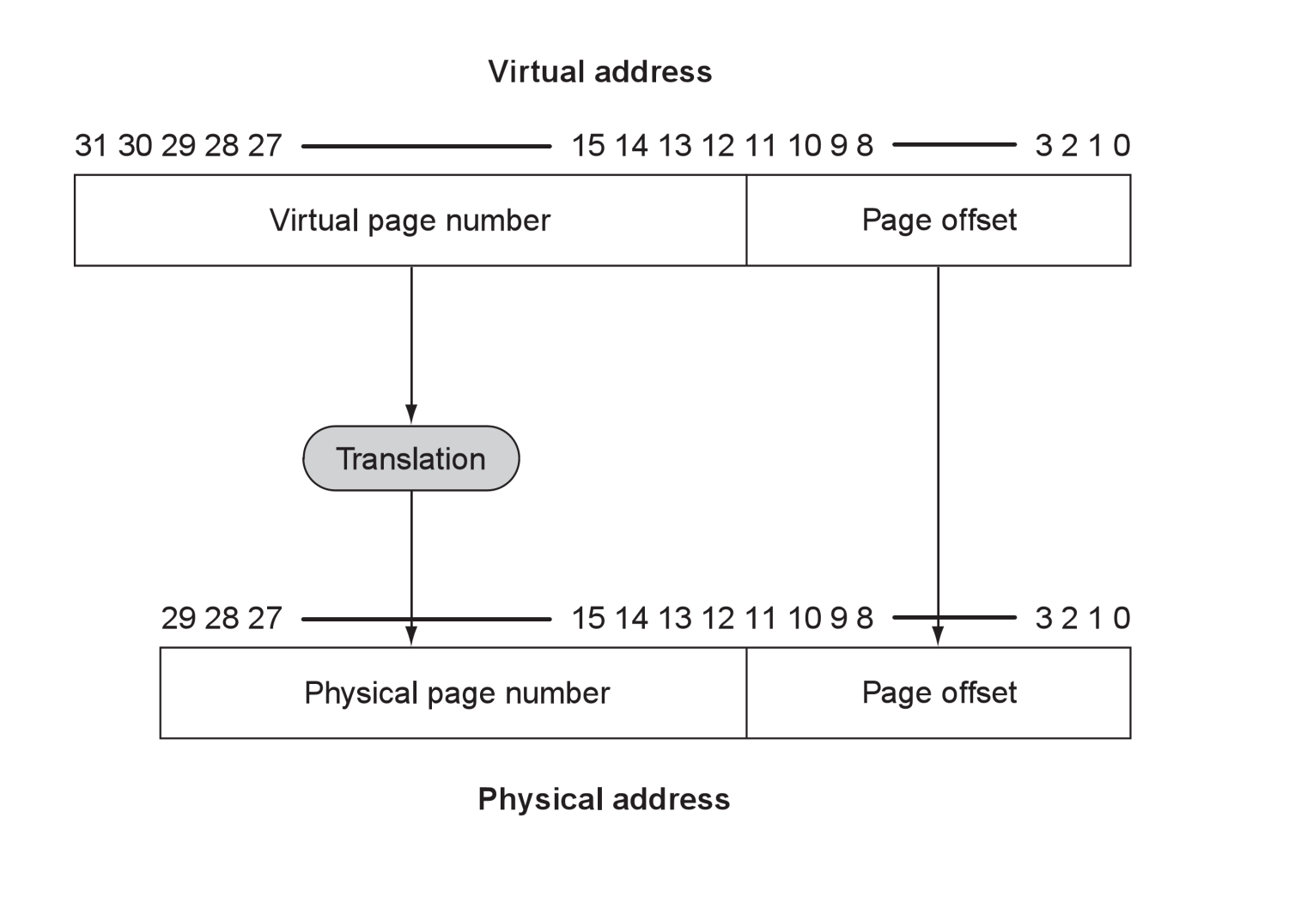
Address Translation
Addresses have into two parts:
Page number: mapping is assigned by OS
Page offset: not mapped What does this mean?
What is the size of this page? Was this page size arbitrarily chosen?

Slide 132
Process Isolation
Each process has its own virtual address space and own virtual-page to physical-page translation table
OS can isolate a process’s code/data from other processes
P1 Virtual Addresses
Physical Addresses
P2 Virtual Addrs.
Are all processes of the same size? Are all processes related to each other? What could be misleading about this diagram (There is more than the one of the next page?

Slide 133
Data/Code Sharing
Or the OS can allow processes to share certain data/code by mapping multiple virtual pages to the same physical page
P1 Virtual Addresses
Physical Addresses
P2 Virtual Addrs.

Slide 134
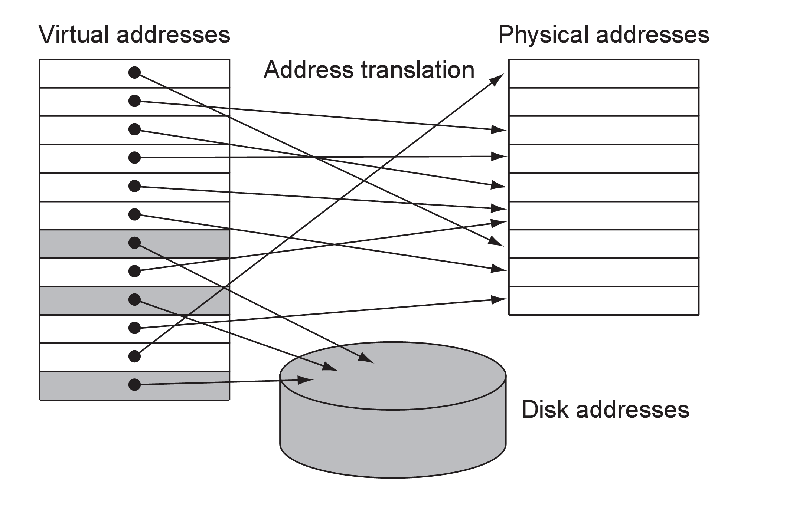
Disk Swap Space
Virtual pages that don’t fit in main memory are mapped to swap space on the disk
What could be misleading about this?

Slide 135
Page Table
A page table for each process stores the virtual page to physical page mappings assigned by the OS
Page tables are stored in a main memory area that’s only writeable by the OS
If a user process could write page tables, reliability and security would be lost
Page tables can be cached just like other data
Physical Memory
Page Tables
What if the page table is huge?

Slide 136
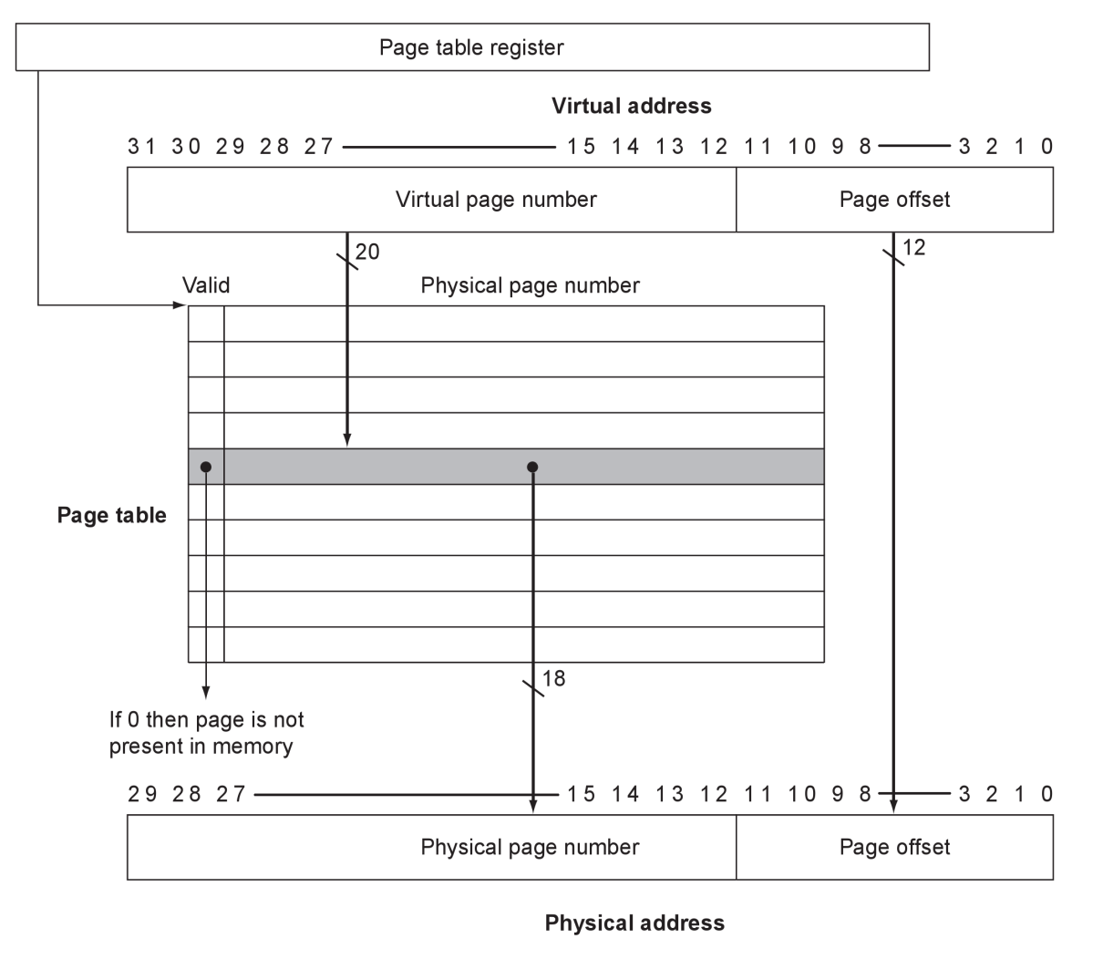
Page Table Register
A special register (page table register) holds the starting address of a process’s page table
Page table register is written by OS when OS activates the process
What does the valid bit mean (the answer is complex)? How many page tables will exist at a given time?

Slide 137

Page Table Address
Dedicated translation adder (not shown) computes: [page table register] + (VPN<<2) to produce memory address of 4-byte page table entry

Slide 138
Memory Accesses
With virtual memory, a logical memory access requires two physical memory accesses
Access physical page number
Physical
Page #
Latch
Physical
Memory
Page Table Register
VPN<<2
PT Address
+
M
U
X
Virtual Address
From Processor

Slide 139
Memory Access II
Access data (code)
Physical
Page #
Latch
Physical
Memory
Page Table Register
VPN<<2
PT Address
+
Page Offset
M
U
X
Virtual Address
From Processor
data
Physical
Page #

Slide 140
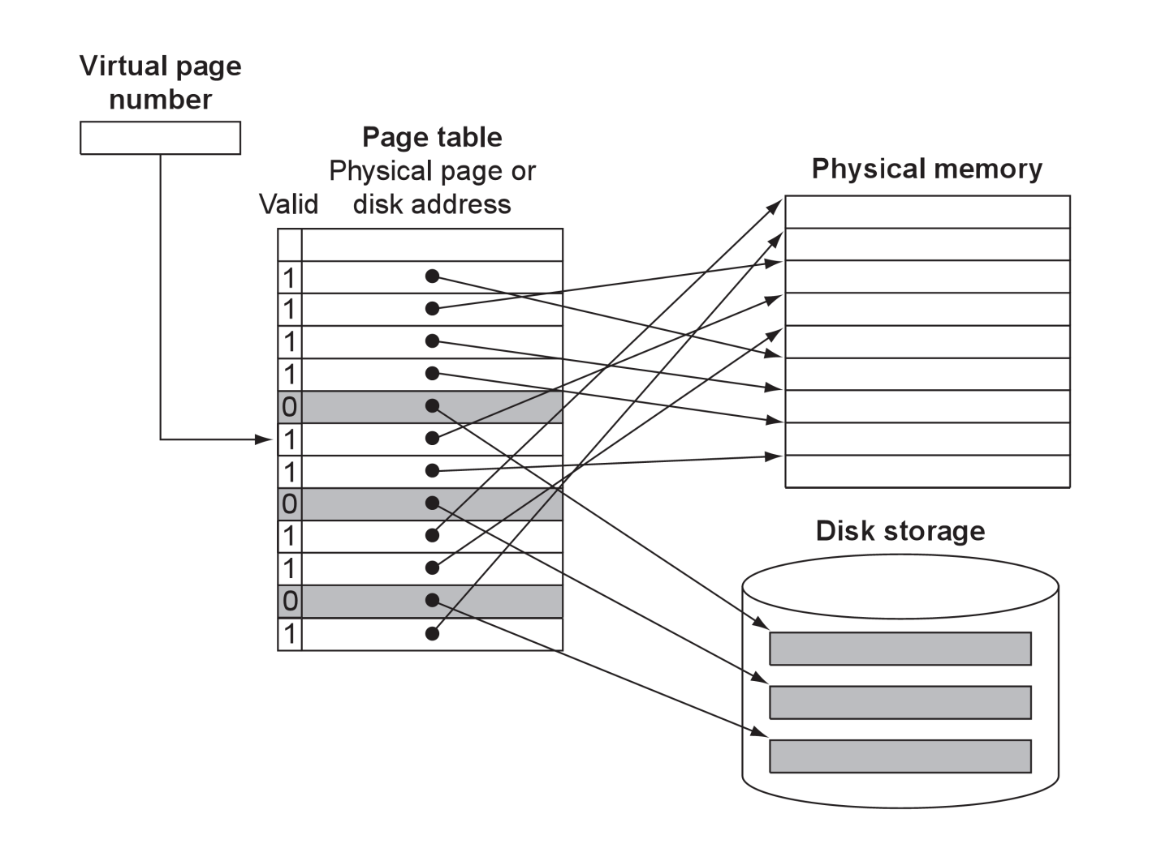
Mapping to Swap Space
Valid = 1: virtual page maps to main memory
Valid = 0: virtual page maps to disk, page table entry contains disk address

Slide 141
Page Fault
An access to a virtual page on disk is called a page fault
At a page fault the OS blocks the process from running until the disk access completes
OS can activate another process while waiting for disk
Disk is slow: ~10ms access = ~10⁷ CPU cycles
Page fault is a huge performance hit!
Want to avoid page faults if possible:
increase RAM so all processes fit in main memory
Must page faults occur?

Slide 142
Page Assignment
When a page fault occurs, OS must assign a physical page to the faulting virtual page
OS maintains a list of unassigned (free) physical pages and assigns the first page from the list
If free-page list is empty, OS must replace an already-assigned page
Which page to replace? How about least recently used like we did for cache?
What if the replaced page has new data?

Slide 143
Page Replacement
Replacement requires two more page-table fields:
Hardware sets the Dirty bit when the virtual page is written
a replaced dirty page must be written to disk
Hardware sets the Reference bit when the page is written or read. Ref is used to approximate LRU …
Physical page/
Disk address
Valid
Dirty
Ref
Page Table

Slide 144
TLB Structure
The TLB contains cached pairs of virtual page numbers and corresponding physical page numbers
TLB is very small (e.g., 32-256 entries) so that it’s very fast
VPN
PPN
VPN
PPN
VPN
PPN
TLB
VPN
PPN
VPN
PPN
VPN
PPN
VPN
PPN
VPN
PPN

Slide 145
TLB Organization
TLB is fully associative to increase hit rate
mux
VPN
PPN
=
Hit
VPN
PPN
=
Hit
VPN
PPN
VPN
PPN
=
Hit

Slide 146
Normal Memory Access
Address translation is now normally done by the TLB
Physical
Memory
Page Table Register
VPN<<2
PT Address
+
+
Page Offset
M
U
X
Virtual Address
From Processor
Physical
Page #
data
Virtual Page #
TLB

Slide 147
TLB Miss
If translation is not in the TLB (TLB miss):
Look up the translation in the page table
Physical
Memory
Page Table Register
VPN<<2
PT Address
page table
+
Page Offset
M
U
X
Virtual Address
From Processor
Physical
Page #
Virtual Page #
TLB
Physical Page #

Slide 148
TLB Replacement
Write virtual page # and physical page # to TLB
Random replacement is typical method
Empirical data show random is about as good as LRU for the large TLB associativity
Physical
Memory
Page Table Register
VPN<<2
PT Address
page table
+
Page Offset
M
U
X
Virtual Address
From Processor
Physical
Page #
Virtual Page #
TLB
Physical Page #

Slide 149
Retry Memory Access
Retry memory access using new TLB entry
Physical
Memory
Page Table Register
VPN<<2
PT Address
+
+
Page Offset
M
U
X
Virtual Address
From Processor
Physical
Page #
data
Virtual Page #
TLB

Slide 150
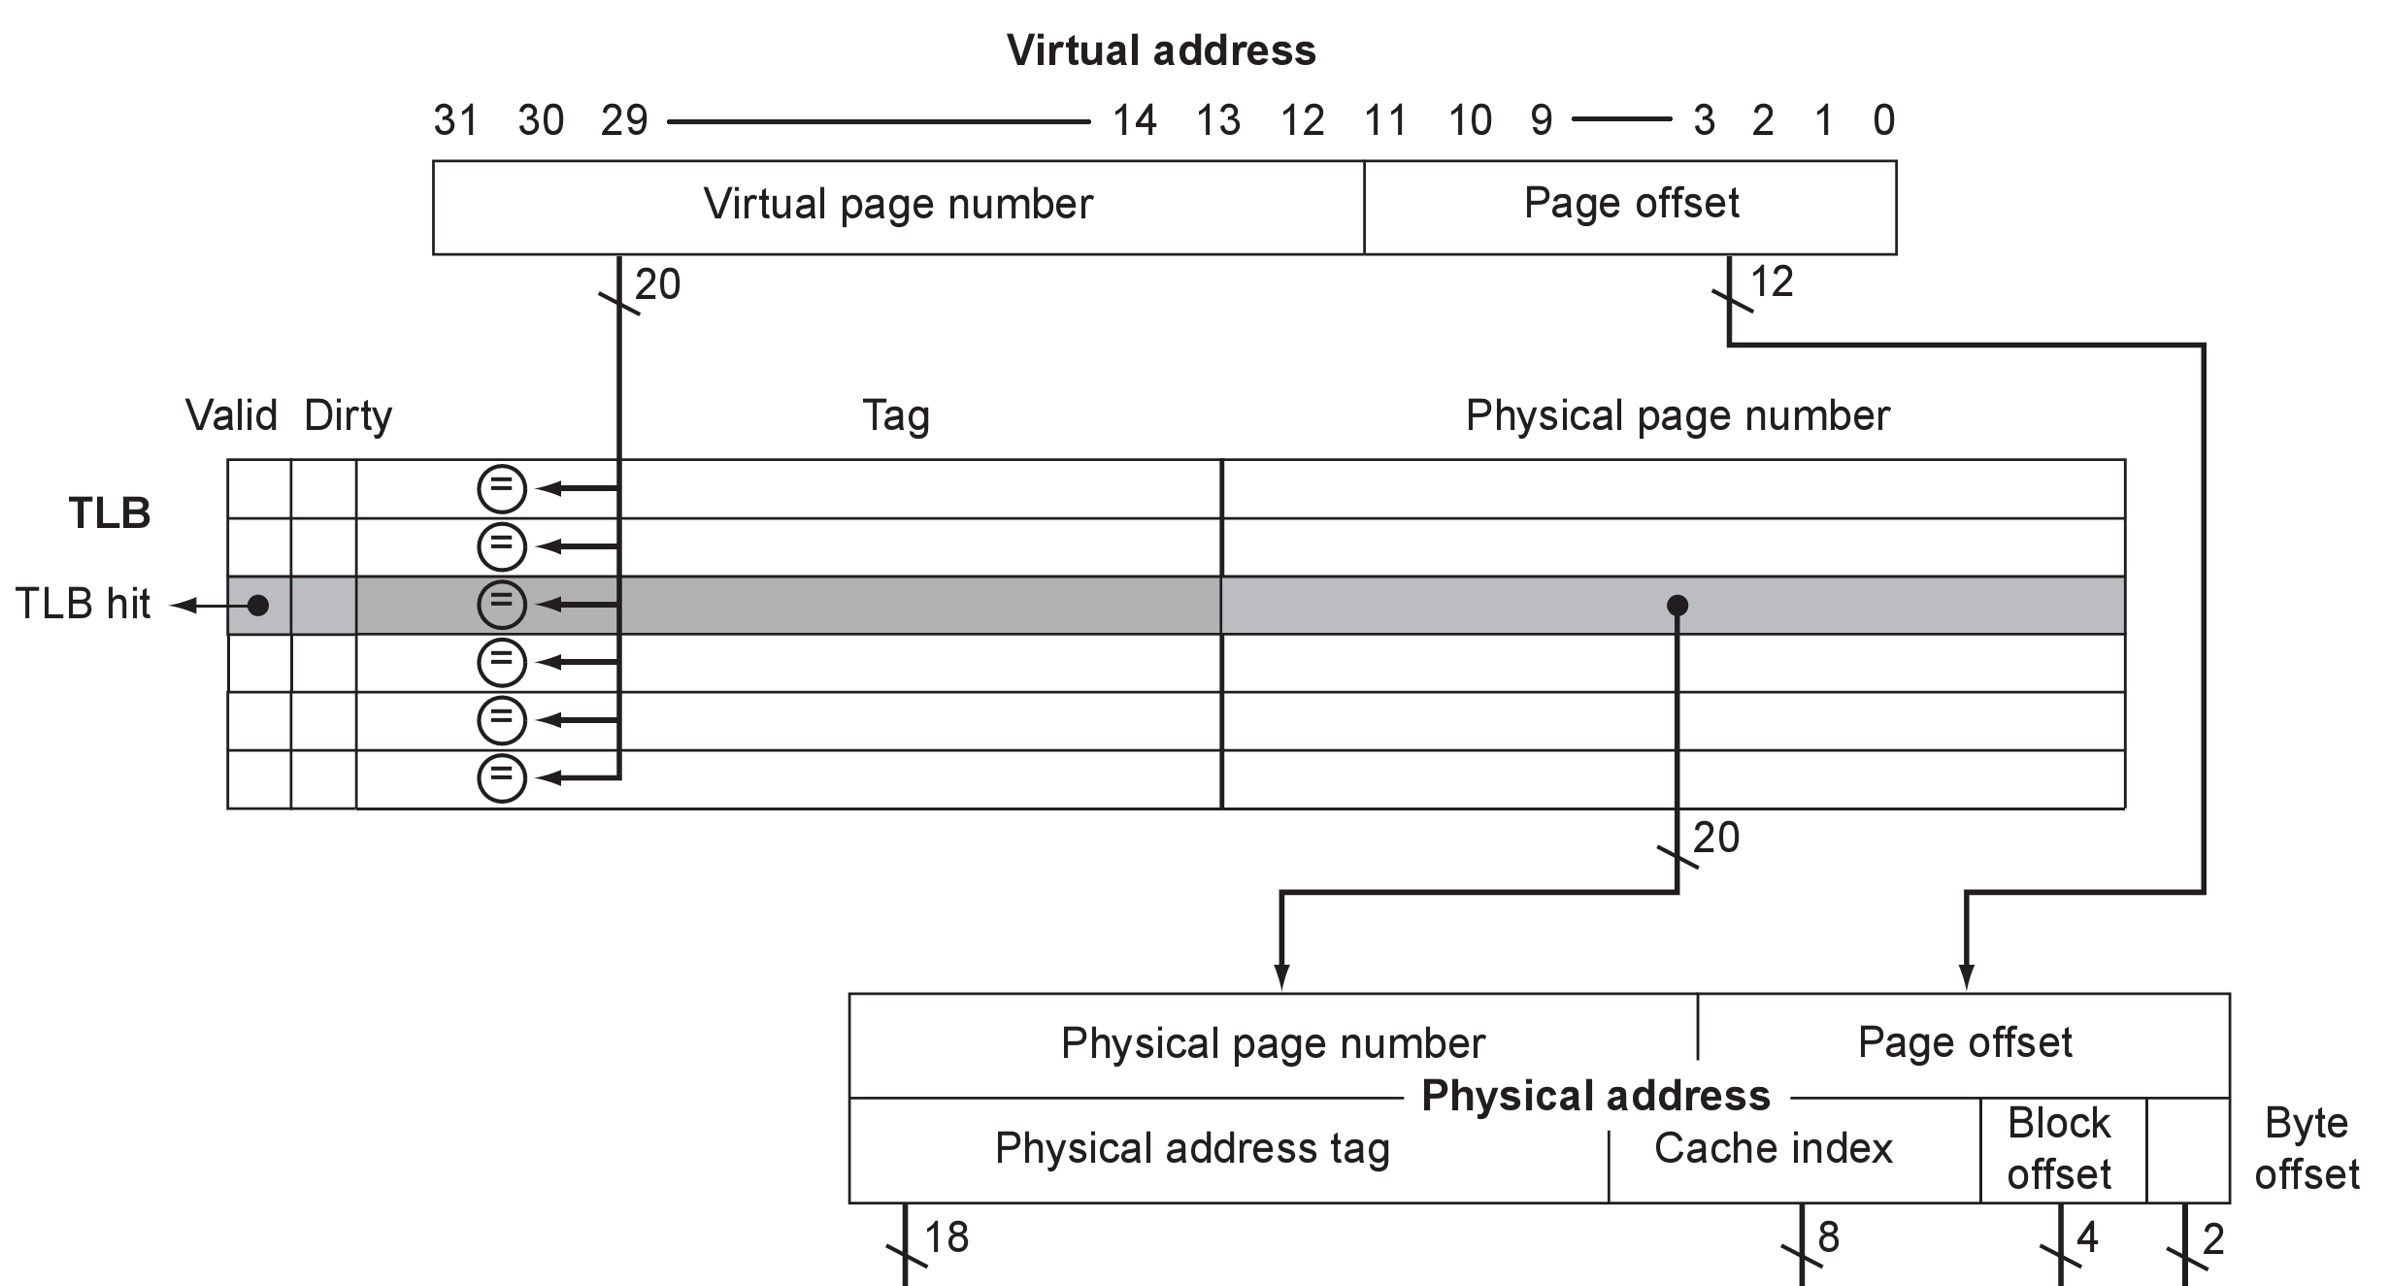
Integrating TLB and L1 Cache
First map Virtual address to Physical address using TLB
Virtual address from processor
Virtual page number
Page offset
Virtual page number
Physical page number
TLB
Physical page number
Page offset
Physical address
Cache tag
Cache index

Slide 151
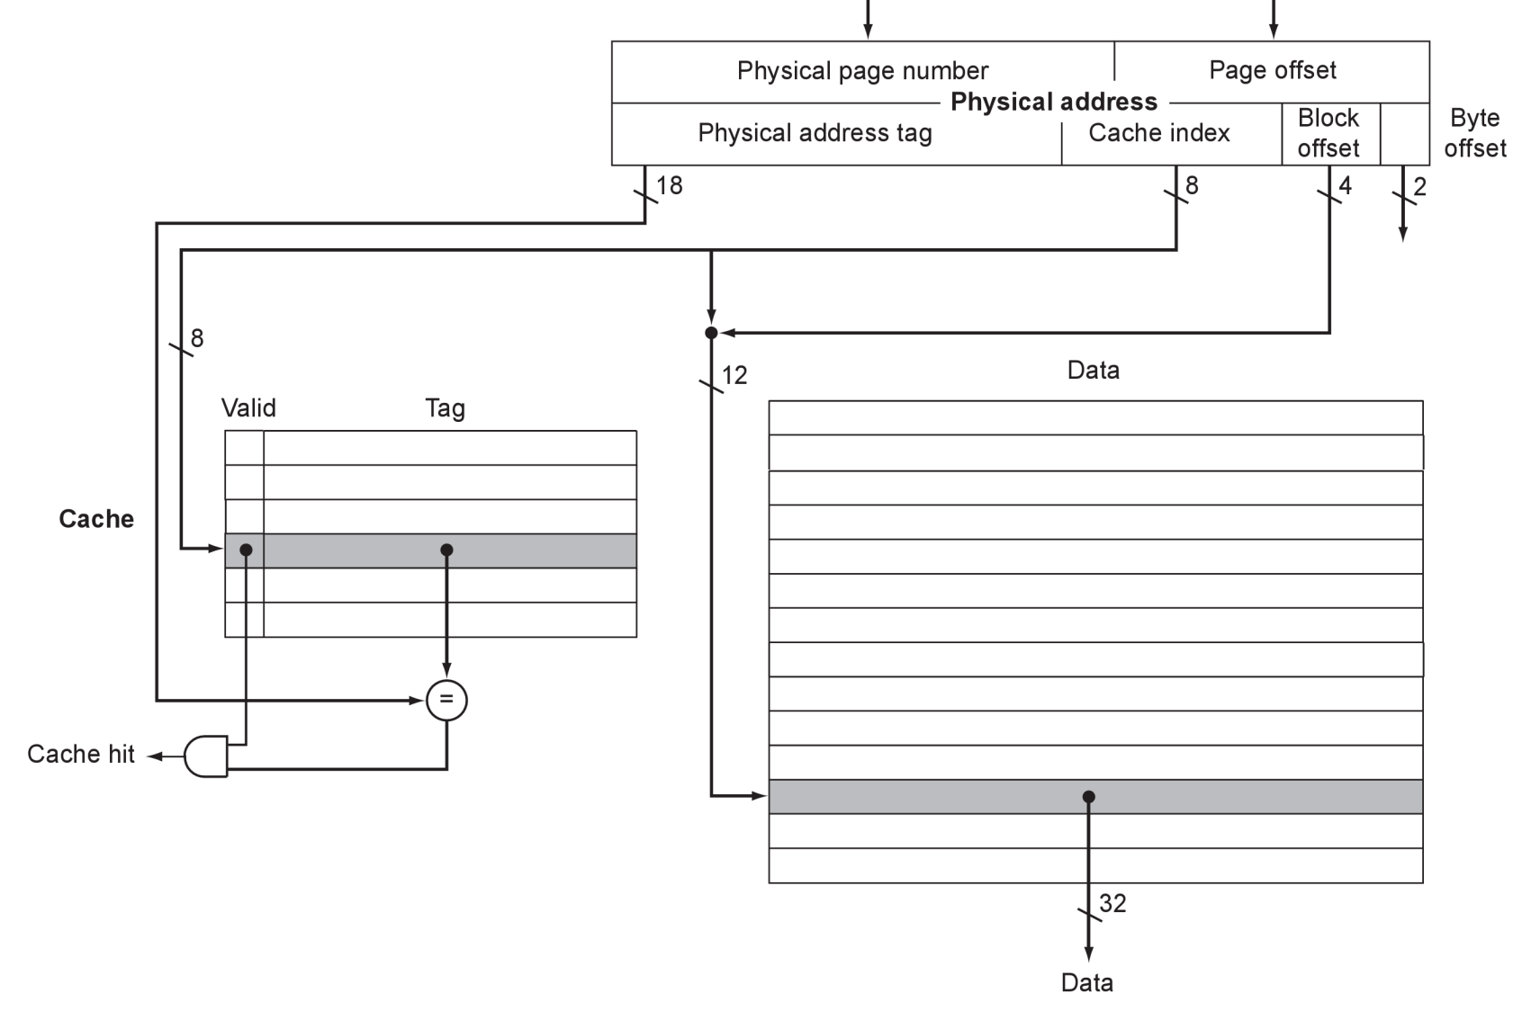
Integrating TLB and Cache
Next use Physical address to find data in the cache
Physical address
Physical page number
Cache tag
Cache index
data
Valid
Tag
cache
Cache
Cache
Cache hit
data

Slide 152
Fast L1 Cache Access
If L1 cache index fits inside page offset, can access TLB and cache in parallel
Access physical page #, Tag and Data
Virtual address
virtual page number
page offset
valid
physical page #
=
.
TLB
=
=
=
valid
tag
data
index
Cache
=
data
cache hit

Slide 153
Fast L1 Cache Access
Compare cache tag and physical page number for cache hit
Virtual address
virtual page number
page offset
valid
physical page number
=
.
TLB
=
=
=
valid
tag
data
index
=
data
cache hit

Slide 154
Fast L1 Cache Access
Maximum size for fast-access L1 cache is: (Page size) x (cache associativity)
Most modern processors use fast-access L1 caches. For example:
X86 architecture uses 4KByte pages
Intel Core processors have 32Kbyte, 8-way L1 caches

Slide 155
Comparing the 2 Levels of Hierarchy

Slide 156
How is the Hierarchy Managed?
registers ↔ memory
by compiler (programmer?)
cache ↔ main memory
by the cache controller hardware
main memory ↔ disks
by the operating system (virtual memory)
virtual to physical address mapping assisted by the hardware (TLB)
by the programmer (files)

Slide 157
Review: The Memory Hierarchy
Take advantage of the principle of locality to present the user with as much memory as is available in the cheapest technology at the speed offered by the fastest technology
Processor
4-8 bytes (word)
Inclusive– what is in L1$ is a subset of what is in L2$ is a subset of what is in MM that is a subset of is in SM
Increasing distance from the processor in access time
L1$
8-32 bytes (block)
L2$
1 to 4 blocks
Main Memory
1,024+ bytes (disk sector = page)
Secondary Memory
(Relative) size of the memory at each level

Slide 158
Virtual Addressing with a Cache
Thus it takes an extra memory access to translate a VA to a PA
VA
PA
miss
Trans-
lation
Cache
Main
Memory
CPU
hit
data
This makes memory (cache) accesses very expensive (if every access was really two accesses)
The hardware fix is to use a Translation Lookaside Buffer (TLB) – a small cache that keeps track of recently used address mappings to avoid having to do a page table lookup

Slide 159
Making Address Translation Fast
Virtual page #
Physical page
base addr
V
Tag
1
1
1
0
1
TLB
Physical page
base addr
V
1
1
1
1
1
1
0
1
0
1
0
Page table register
Main memory
Page Table
(in physical memory)
Disk storage

Slide 160
Translation Lookaside Buffers (TLBs)
Just like any other cache, the TLB can be organized as fully associative, set associative, or direct mapped
V Virtual Page # Physical Page # Dirty Ref Access
TLB access time is typically smaller than cache access time (because TLBs are much smaller than caches)
TLBs are typically not more than 512 entries even on high end machines

Slide 161
A TLB in the Memory Hierarchy
¼ t
hit
¾ t
VA
PA
miss
TLB
Lookup
Cache
Main
Memory
CPU
miss
hit
Trans-
lation
data
A TLB miss – is it a page fault or merely a TLB miss?
If the page is loaded into main memory, then the TLB miss can be handled (in hardware or software) by loading the translation information from the page table into the TLB
Takes 10’s of cycles to find and load the translation info into the TLB
If the page is not in main memory, then it’s a true page fault
Takes 1,000,000’s of cycles to service a page fault
TLB misses are much more frequent than true page faults

Slide 162
TLB Event Combinations
TLB | Page Table | Cache | Possible? Under what circumstances?
Hit | Hit | Hit | yes
Hit | Hit | Miss | yes
Miss | Hit | Hit | yes
Miss | Hit | Miss | yes
Miss | Miss | Miss | yes
Hit | Miss | Miss/ Hit | no
Miss | Miss | Hit | no

Slide 163
Handling a TLB Miss
Consider a TLB miss for a page that is present in memory (i.e., the Valid bit in the page table is set)
A TLB miss (or a page fault exception) must be asserted by the end of the same clock cycle that the memory access occurs so that the next clock cycle will begin exception processing
Register | CP0 Reg # | Description
EPC | 14 | Where to restart after exception
Cause | 13 | Cause of exception
BadVAddr | 8 | Address that caused exception
Index | 0 | Location in TLB to be read/written
Random | 1 | Pseudorandom location in TLB
EntryLo | 2 | Physical page address and flags
EntryHi | 10 | Virtual page address
Context | 4 | Page table address & page number

Slide 164
Reducing Translation Time
Can overlap the cache access with the TLB access
Works when the high order bits of the VA are used to access the TLB while the low order bits are used as index into cache
Virtual page #
Page offset
Block offset
2-way Associative Cache
Index
PA
Tag
VA Tag
Tag
Data
Tag
Data
PA Tag
TLB Hit
=
=
Cache Hit
Desired word

