Slide 1
How to buy the right computer for you
Save money & get a better computer

Slide 2
Preparation
Price Range
Usage
Portability
Operating System
Features

Slide 3
Life Span
“As new waves of computer models get introduced
the average new computer becomes obsolete within 18 months,
the trend is toward cheaper materials.”
newsreview.com
“planned obsolescence”

Slide 4
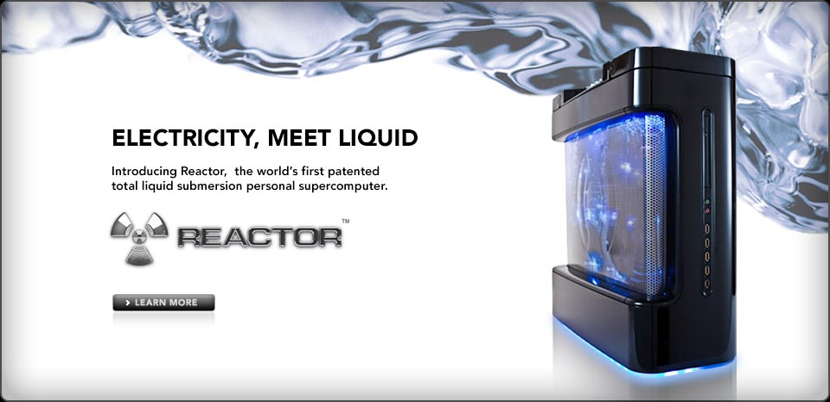
Price Ranges
$800+
Sub $500
Sub $800
Why don't you just buy a car $
$3500+

Slide 5
Usage
E-mail & Internet
Storing & Organizing Photos/Videos/Music
Professional Photo/Video Editing
Gaming
Sub $500
?
Sub $800
$800 +

Slide 6
Portability
Netbook
Laptop
Desktop

Slide 7
Operating System
Excellent
In-store help
Decent
Large user base
None!

Slide 8
Features
Blu-Ray
CD/DVD Burner
Video out
USB/Firewire ports
Slots for different
media cards:
SD, xD, etc.
Audio out/in
Mainly Laptops:
Battery life
Keyboard Quality
Screen size

Slide 9
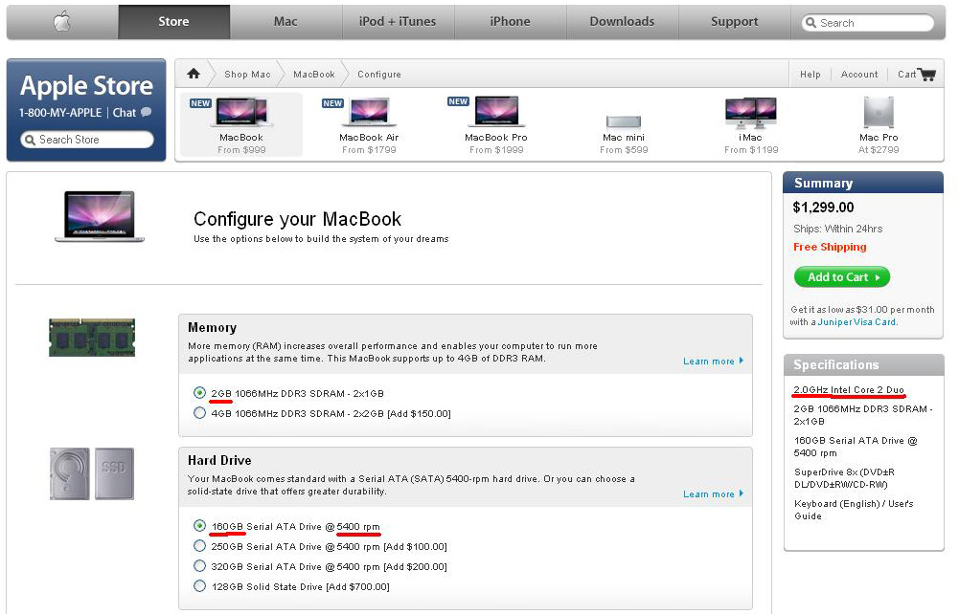
Now to customize... (Online)
-Memory
-Hard Drive
-Processor
-Video Card

Slide 10
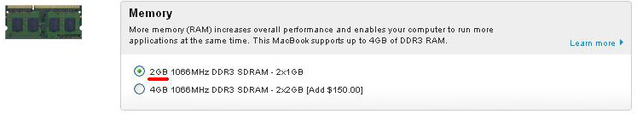
Memory (RAM)
Random Access Memory
More = faster program startup times
Generally easy to upgrade
“RAM is temporary storage, where the processor does its work, where programs run, and where information is stored while it's being worked on.”
-Yahoo! Tech

Slide 11
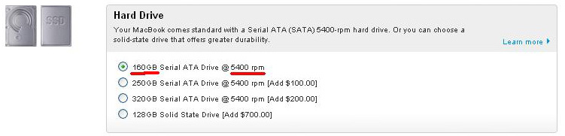
Hard Drive
Stores everything on your computer (music/pictures/etc)
Larger RPMs increase overall speed

Slide 12
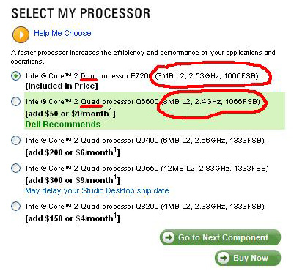
Processor
Larger GHz means faster programs
More cores mean more programs can run at the same time at the same speed
“The faster the speed of your processor,
the faster your PC will perform.”
-Yahoo! Tech

Slide 13
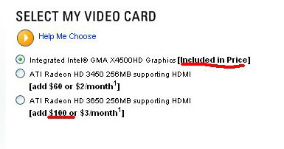
Video Card
Essentially RAM dedicated to video
More expensive / more MBs the faster
Needed for gaming or video editing
“The better the chipset, the faster and the more realistic 3-D graphics that your PC can produce.”
-Yahoo! Tech

Slide 14
So how do all these things work with each other?

Slide 15
It's Just Like Grocery Shopping!
Video Card
Bigger Hard Drive
=
More starting
groceries at once
More RAM
=
Faster access to
all of those groceries
Bigger/more CPUs
=
Access to more groceries
at once in less time

Slide 16
Remember:
Price Range
Usage
Portability
Operating System
Features
Customization Options

