Slide 1
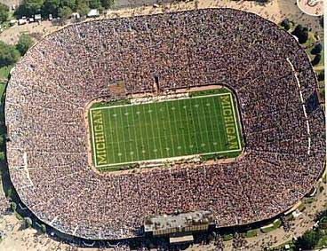
Illiteracy
X 7773

Slide 2

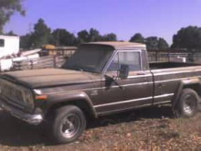
Car comparison- 2008 Kia Rio vs 1977 Jeep Truck
vs.

Slide 3





Urban Meyer- 7 years $14 million
Nick Saban- 8 years $32 million
Houston Nutt- 4 years $7.4 million
Les Miles- 5 years $16.5 million
Steve Spurrier- 6 years $10.5

Slide 4
Florida- 25%
Alabama- 25%
Mississippi – 30%
Louisiana- 28%
South Carolina- 25%

Slide 5

X 82

Slide 6
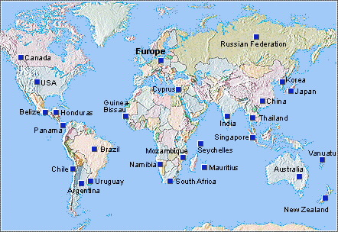
Location of Survivor South Pacific (Vanuatu)

Slide 7


Health Care

Slide 8
Why is illiteracy relevant?

Slide 9
Illiteracy in California
In 1960, California had 8.8 percent of the nation's total population and was home to 13.9 percent of its immigrants.
By 1995, California accounted for 12.1 percent of the country's population and 32.7 percent of the nation's immigrants.
Immigrate to California due to close proximity to Mexico

Slide 10
Illiteracy in California
Many of the immigrants are monolingual Spanish speakers who do not comprehend the English language. They also have limited or no formal education in their native language and, as a result, may be unable to read and write in Spanish.
Most of the 500,000 immigrants and refugees who enter the U.S. each year are illiterate in their own languages.

Slide 11
Illiteracy in California
In addition, as many as 25 million Americans cannot read or write.
There are an estimated 25,000 functionally illiterate adults in San Luis Obispo County
Illiteracy makes it very hard for a person to hold a well paying job, or to care for a family member, and is a contributing factor to poverty

Slide 12
Illiteracy in California
Many immigrants become migrant farm workers
Many older people did not receive the appropriate education and intervention, and are now struggling to read well enough to function in society as well
A literacy program can be a vital component of any community.

Slide 13
Programs That Fight Illiteracy

Slide 14
National Institute for Literacy
The National Institute for Literacy, a federal agency, provides leadership on literacy issues, including the improvement of reading instruction for children, youth, and adults.
In consultation with the U.S. Departments of Education, Labor, and Health and Human Services, the Institute serves as a national resource on current, comprehensive literacy research, practice, and policy.

Slide 15
The California State Collaborative Literacy Council
Designated by Governor Pete Wilson in California's application for State Literacy Resource Center (SLRC) funds available under the National Literacy Act of 1991, the State Collaborative Literacy Council (SCLC) is a multi-agency collaboration, which is responsible for planning and implementing the state literacy resource program in California.
The SCLC develops plans for the State Literacy Resource Center of California, directs the preparation and submittal of applications, plans and reports as required, and coordinates and collaborates with other public and private non-profit literacy service providers throughout the State.

Slide 16
Literacy Council
Literacy Council is a nonprofit organization that is programmed to help the less fortunate immigrants learn how to speak English. They have dedicated themselves to:
1. Recruiting and preparing volunteers as tutors in the delivery of quality instruction using a variety of approaches.
2. Providing individual and group instruction to learners in reading, writing, speaking and basic number skills, thereby furthering the ability of learners to function well in the community.
3. Promoting individual awareness and involvement in the literacy process.

Slide 17
The local Literacy Council of San Luis
ESL- English as Second Language
  For people that understand little to no English and who must be taught to speak, read, and write. Different techniques and materials are required to meet the learner’s needs.
They have learning centers county wide that provide learners and tutors with books, learning materials, and a friendly learning environment.
They are continually looking for community support such as:
1. Tutors
2. Donations
3. Student Materials
4. Friendly Learning Environment

Slide 18
My Experience
Where I worked
What I did
How often I worked
Training Skills
Who I worked with

Slide 19
Solution: Central Coast Literacy Council
Volunteer and become a tutor.
This is a very popular way to help out tutors
need only to be able to speak English fluently
this method directly benefits people in need

Slide 20
Solution: Central Coast Literacy Council
Become a member of the Board of Directors
a group of about 20 people
donate lots of time and effort
usually recommended for people who want to contribute to the CCLC on a regular basis
the board plays a major role in the fight against illiteracy

Slide 21
Solution: Central Coast Literacy Council
Become a member of the literacy Council
requires a donation
15 dollars for an individual membership
or 50 dollars for a business membership
Or donate your vehicle and allow the council to sell it as a used vehicle and generate money.

Slide 22
Donations From Home
But who has a book they don’t read any more?
Computers
School Supplies
Books

Slide 23
Local Donations
Our Donation:
We searched SLO Craigslist
Free used books
A Brand New 20-Volume Dictionary
Very simple and effective

Slide 24
Illiteracy is a definite problem
Negative effect on society
Especially relevant in California due to our proximity to Mexico
Already ways to help out (Literacy Council)‏
Other ways to help
  Dictionaries
  Computers

