Slide 1
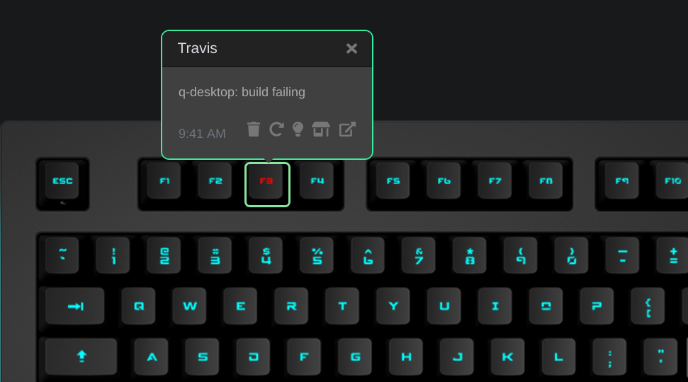
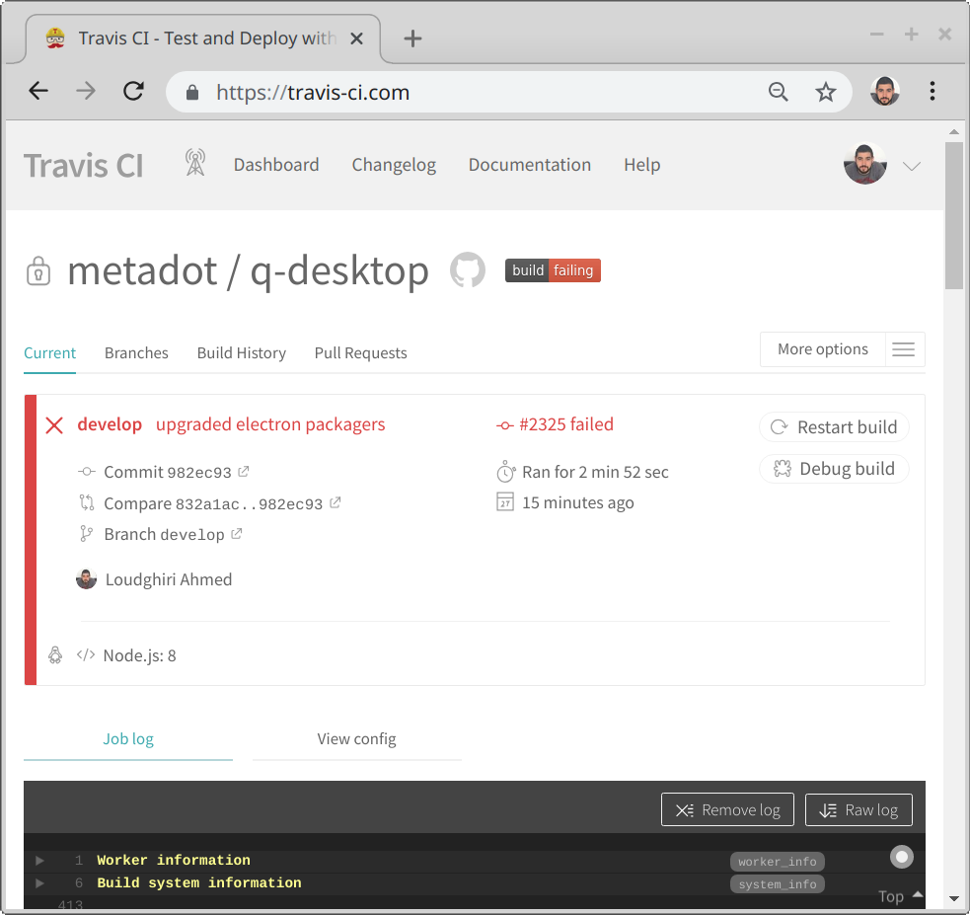
Red: build ERROR
Orange: build in progress
Green: build OK
Click to open travis-ci.com

