Slide 1

Wooster Admissions
Presented by Tyusha Sarawagi & Sarah Wright

Slide 2
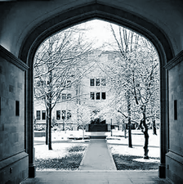
More people inquire about the college than apply
Of the 263,139 domestic prospects for the College’s classes of 2021 and 2022
Only 7970 of them inquire about the school
Only 2432 of them who inquire and send in an application
Notes:
Closing this gap benefits you

Slide 3

Who is Applying to Wooster?
Who is more likely to apply to Wooster?
How can we get more people to apply?

Slide 4

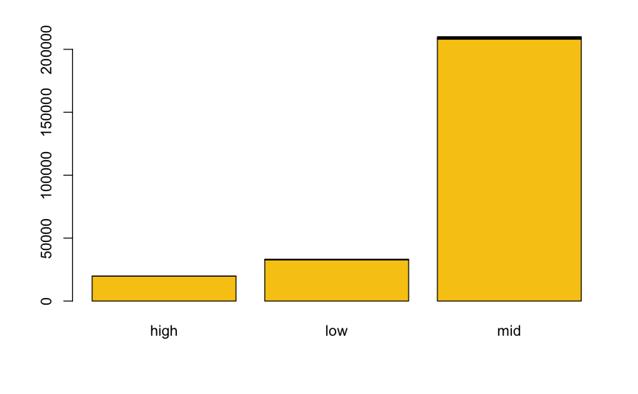
Who is applying to Wooster?
The main economic group to apply to the college are Middle income Families

Slide 5
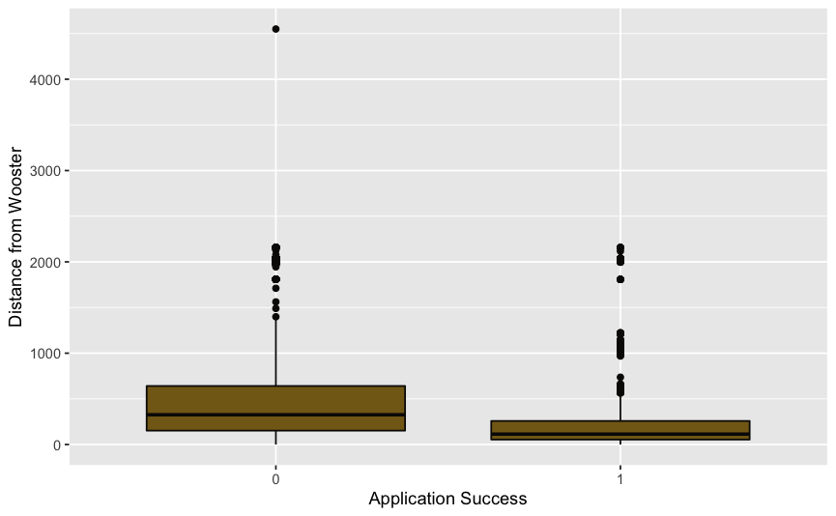
Who is applying to Wooster?
People who live closer are more likely to apply to the College
Did not Apply
Applied

Slide 6
Who is applying to Wooster?
Only 356 students are underrepresented minorities. This is approximately a 14.6% success rate using your current recruiting methods.
Non-Underrepresented Minority Status
Underrepresented Minority Status
2076 | 356
223981 | 36723
Students who Applied
Students who did not Apply
Notes:
Underrepresented minority status

Slide 7

Who is more likely to apply to Wooster?
Middle income Families seem to be the most likely to apply to the College of Wooster
A larger percentage of students who are applying to the college are local
Diversity is larger under-represented in recruitment efforts
Notes:
Many people who inquire do not apply. Of the 10402, only 2,432 people applied. This is approximately a 23.3% success rate using your current recruiting methods .

Slide 8
How can we get more people to apply?
Increase Efforts
Recruiting a Diverse Group
Recruiting in neighboring States
Expand & Maintain Efforts
Getting Local and Interaction with the Community
Appealing to Middle Income Families (and Providing Aid)
Notes:
Many people who inquire do not apply. Of the 10402, only 2,432 people applied. This is approximately a 23.3% success rate using your current recruiting methods .

Slide 9
Q & A

