Slide 1

Disaster Tweet Prediction
using NLP
By Tyusha Sarawagi & Sarah Wright
Notes:
Sarah
*welcome
*how to use NLP to predict Disasters & Emergencies using tweets

Slide 2

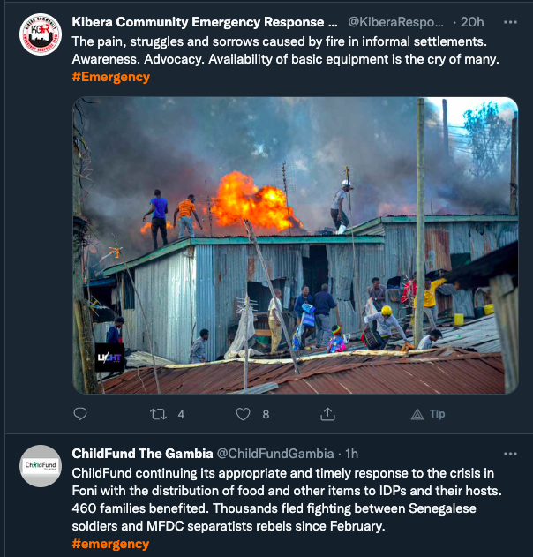
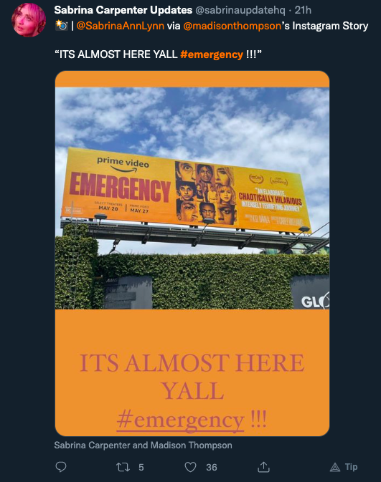

#emergency
We have seen in recent years how powerful Twitter can be as both a resource for finding urgent information and as a tool for communicating useless information about sales and petty gossip.
Hashtags can be useful tools for sifting through the nonsense, however, oftentimes they are misused
Notes:
Sarah
*twitter = tool for finding useful information like natural disasters & crisis situations
*twitter = spam & marketing ploys
*makes it hard to sift through information that may be important
*hastags help, but can be missued
such as putting #emergency on a sale add to increase views.

Slide 3

Disaster Tweet Prediction
Data
EDA
Methods
Modeling
Results
Conclusion & Purpose
Notes:
Tyusha

Slide 4
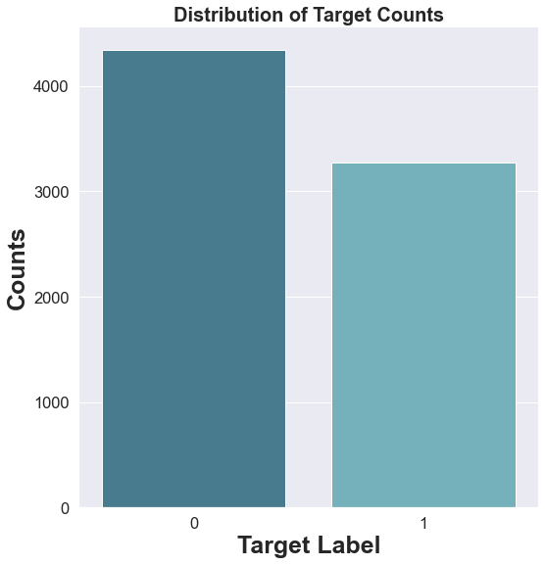
What do we know?
7613 tweets, each with its twitter-id, location, a keyword chosen from the tweet, and a target indicating whether the tweet is a disaster tweet or not in the training set.
Notes:
Tyusha

Slide 5
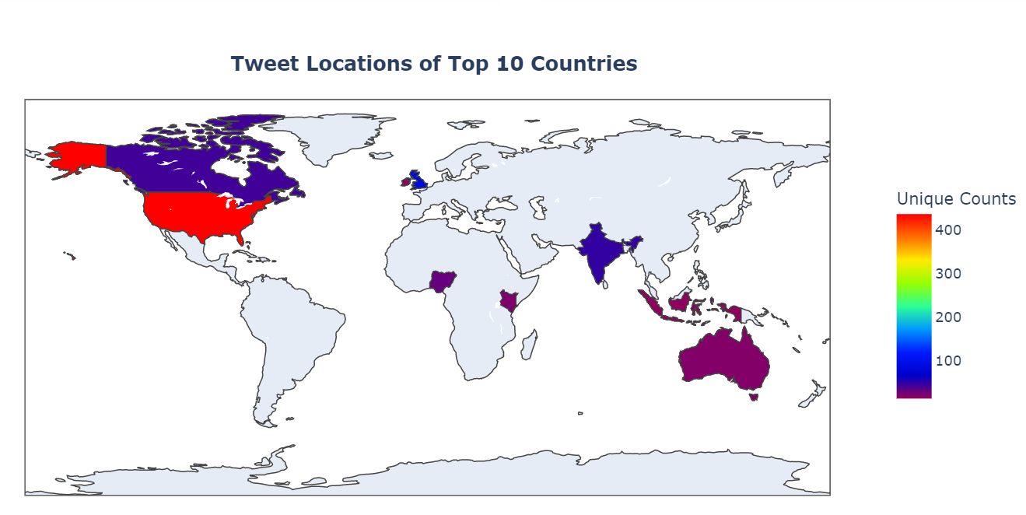
What do we know?
There are, 4521 unique locations in the dataset
Top ten countries from the dataset
Notes:
Sarah
*Our dataset comes from a brod distribution of places
*it is also difficult to sort through = locations: earth or “Yeezy Taught Me, ‘NV’” = hard to analyze
*sorted into top 10 countries and also re-sorted the cities , this is not exhaustive

Slide 6
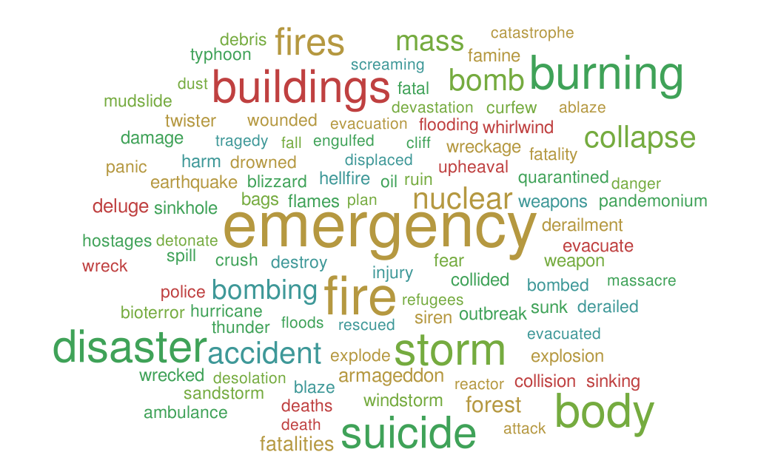
What do we know?
The words “emergency”, “disaster”, “fire”, “storm”, “suicide”, “burning” occurred more frequently in the text data as compared to others.
Notes:
Sarah
*top words across the entire dataset : bigger the more frequently used

Slide 7
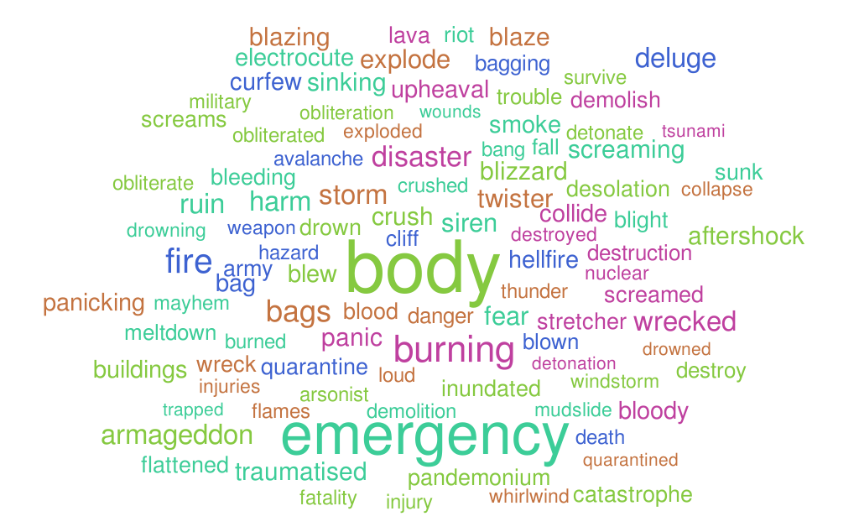
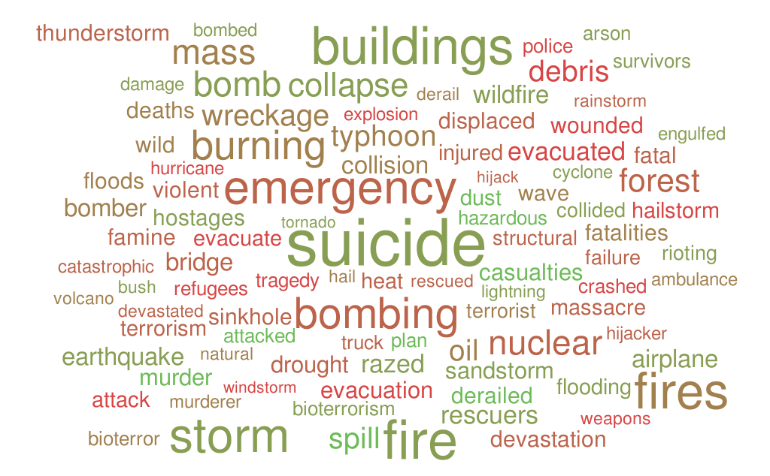
What do we know?
Non-disastrous tweets (only).
Most Frequent Words: “body” and “emergency”.
Disastrous tweets (only)
Most Frequent Words: “suicide”, “emergency”. “Bombing”, “storm”, “fire”
There is some overlap, such as with the word “emergency”.
Notes:
Tyusha

Slide 8

Which messages on Twitter can be classified as Natural Disasters, and how can we do that?
Notes:
Tyusha

Slide 9
Natural Language Processing (NLP)
Natural language processing (NLP) refers to the branch of computer science concerned with giving computers the ability to understand text and spoken words in much the same way human beings can.
Pre-Processing
Text Speech Processing
Tokenization
Stop Word Removal
Lemmatization
Notes:
Tyusha

Slide 10
Natural Language Processing (NLP)
Natural language processing (NLP) refers to the branch of computer science concerned with giving computers the ability to understand text and spoken words in much the same way human beings can.
Morphological Analysis
Bag-of-Words/ Count Vectorization
Term Frequency Inverse Document Frequency (TFIDF)
Part-of-Speech Tagging
Notes:
Tyusha

Slide 11
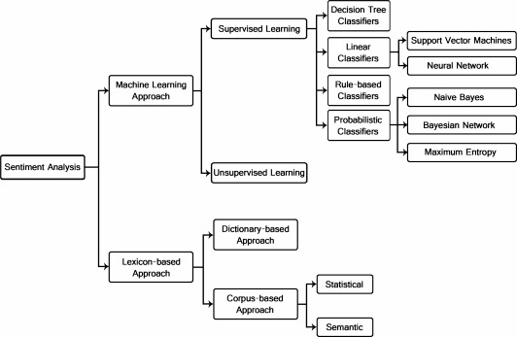
Model Selection
*Random Forest:
Which combines several Decision Trees
W. Medhat, A. Hassan, and H. Korashy, “Sentiment analysis algorithms and applications: A survey,”
Notes:
Sarah
*First step is sentimental analysis on preprocessed data
*There are a few methods that coud be used
*Lexicon Based Approached - Use rules based on language to sort and organize text
* Machine Learrning Approach - Use Supervised Learning method to make predictions about the data
Random Forest
Multinomial Naieve Bayes

Slide 12

Model Selection
Random Forest: 78% accuracy
Random forest is a supervised machine learning algorithm that is commonly used to solve classification and regression issues
Random Forest Algorithm is that it can handle data sets with both continuous and categorical variables
Multinomial Naive Bayes: 80% accuracy !!
Multinomial Naive Bayes is commonly used in multinomial event models such as bag-of-words, which is a way of representing a document as vector space by counting words.
80.6%
ACCURACY
Notes:
Sarah
*Out of the two approaches used
*Random Forres was the least effective! 78% accuracy
Method used to classify data into many decision tress in a way that a simple decision tree cannot do.
Most helpful when: continuous and categorical variables
* Multinomial Naive Bayes Regression was better with 80% accuracy
Good for multinomial event models where only two outcomes are possible
Bag of words method: way to represent text as a vector space that counts words

Slide 13
Which messages on Twitter can be classified as Natural Disasters, and
how can we use that?
how can we use that?
Notes:
Sarah
* we did all this research but how can we use this?

Slide 14

How can we use that?
Twitter is a crucial channel of communication.
Crisis information shared on social media has the potential to save thousands of lives by informing others and allowing them to take preventative action.
Many agencies are attempting to examine tweets programmatically to detect disasters and emergencies.
This type of effort can benefit millions of people who have access to the internet and can be notified in the event of an emergency or tragedy.
Notes:
Sarah
Twitter is a hub of communication
Crisis information can be shared and had the potential to save thousands of lives
Twitter is not the only one who wants this information
Notify others of emergencies and tragedies

Slide 15
How can we use that?
News organizations and disaster relief organizations are attempting to monitor tweets in real-time in order to detect calamities.
Millions of ordinary people would benefit from this, as it would help them avoid potential disasters.
People could take preventative action if they were notified in real-time about the occurrence of disasters in a specific place.
Before the situation becomes out of control, government agencies can carry out an evacuation too.
Notes:
Tyusha

Slide 16

Questions &
Comments
Notes:
Tyusha and Sarah
Questions
And comments

