Slide 1

DrivePass
Travis S Waggoner
Southern New Hampshire University
CS-255
12/06/2021

Slide 2
System Requirements
Web-based
Offline access
Testing
Driving appointments
Notes:
The most important requirement for this system to work the way it is intended is for it to be web-based. This will allow the users to be able to use the product on any of their respective platforms. This will also allow for the same look no matter what platform the using is accessing from. This will allow them to be able to make notes and access offline information on their mobile devices. This will assist with the facilitation of the testing and increase the overall passing. The users will even be able to access driving appoints from the program and be able to make the schedule for when they need it.

Slide 3
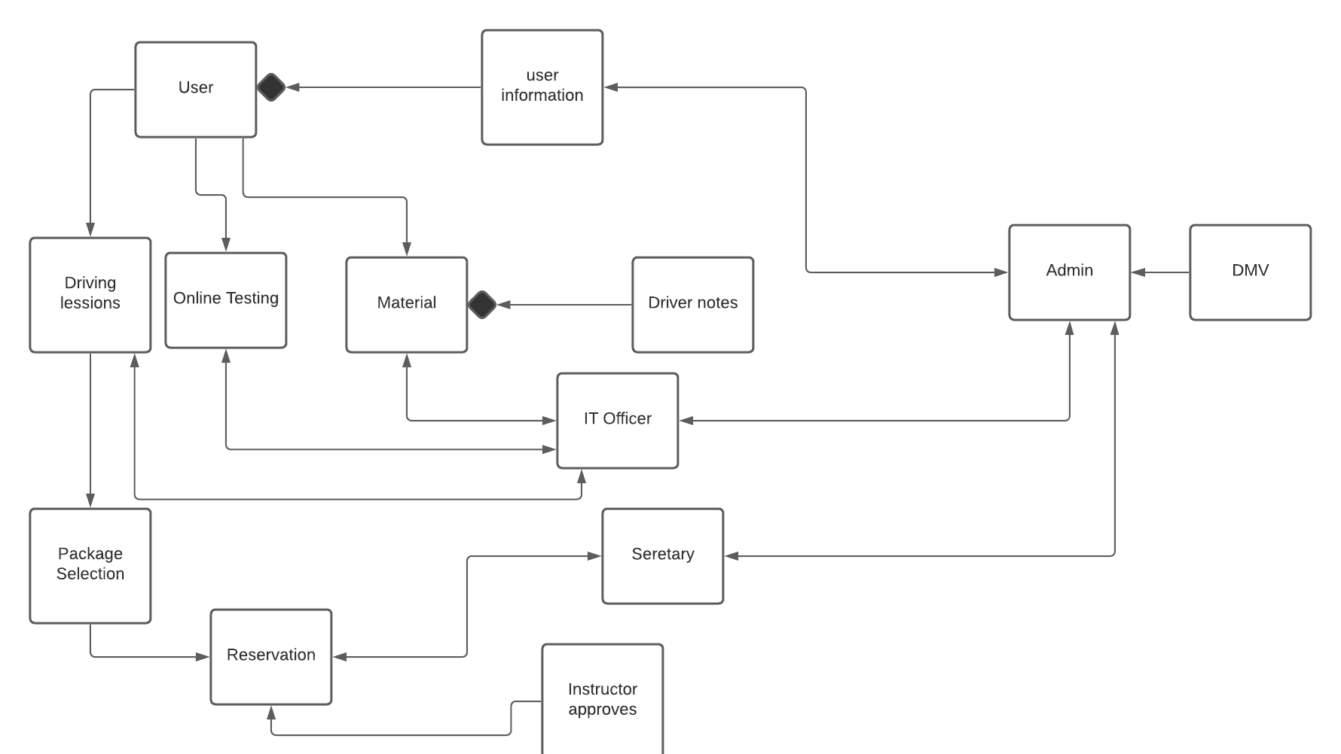
Case Diagram
Notes:
This diagram show how the overall program will talk to different sections of it’s self. While there is a lot of information the important sections start with how the user will interact with all of the information and capabilities the admins will have access to. This breaks down responsibilities of the team and the program.

Slide 4
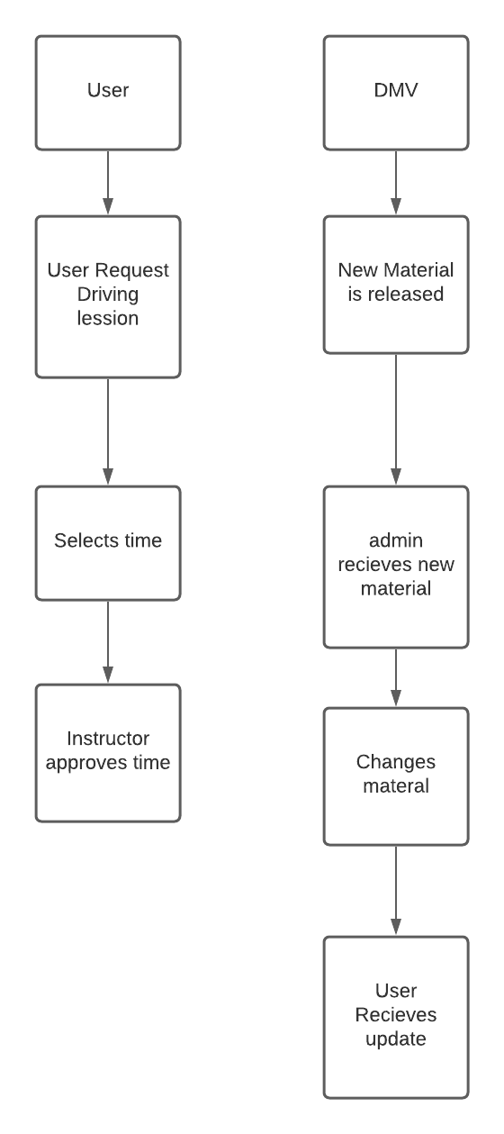
Activity Diagram
Notes:
These activities give great examples of how when a user goes to access a section of the program what happens. Instead of thinking of one particular section we can break it down step by step to find the best solution.

Slide 5
Security
User Information
Lesson Safety
Education
Notes:
The security of the user information is the number one most important part of an application like this because it is so valuable. The user will log in with a email and set a password with the requirements that you set. Also controlling who is interacting with what information is extremely important for safety because we might need a driver to be able to see what the student is going to look like for their safety but there isn’t a real reason for the IT Admin to be able to see that information. Also, the lead Admin will be able to see everything and how the educations sections are being utilized.

Slide 6
Limitations
Updates in state
Old information
Notes:
There will also be a delay from when the State passes a driving law, the DMV can implement it and will notify you of the change. The important part of this will be to update that information as quick as possible to keep the systems up to date. Old user information may cause a problem as much of the information gets add on to and accounts are not removed. For this limitation I would recommend some kind of timer so that if a user does not log in with in a particular amount of time the account be deactivated or removed. These limitations can be adapted to or correct as the program grows.

