Slide 1




PokeGear
Login
I don’t have an account

Slide 2
PokeGear
PokemonGo Username:
Tyzanol
User Level:
30
v
v
Signup

Slide 3

PokeGear
Personal Data
PokemonGo Username:
Tyzanol
User Level:
30

Slide 4
PokeGear
Event Time Adapter
Friend Present Reminder
Friend Level-Up Planner
Raid Locator
Personal Info
Logout

Slide 5
PokeGear
Event Time Adapter
Find out when a global PokemonGo event is
happening in your time zone
Time:
Convert

Slide 6
PokeGear
Event Time Adapter
Find out when a global PokemonGo event is
happening in your time zone
The event will occur at:
13:00
Time:
Ok
Convert

Slide 7
PokeGear
Present Reminder
Send a PokemonGo friend a reminder that you are
waiting for them to open your gift
Select friend:
V
Tyzanol
Friends_Username
Send Reminder

Slide 8
PokeGear
Present Reminder
Send a PokemonGo friend a reminder that you are
waiting for them to open your gift
Reminder sent to
‘Username’
Select friend:
V
V
Tyzanol
Ok
Tyzanol
Friends_Username
Send Reminder

Slide 9
PokeGear
Level-Up Planner
Set a level up time and date with a PokemonGo friend
in order to best utilize your ‘lucky egg’
Select friend:
V
Tyzanol
Friends_Username
Select Date:
Select Time:
04/01/16
v
12:00 PM
v
Send Request

Slide 10
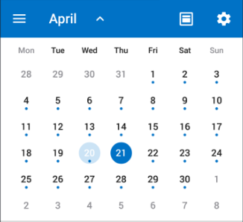
PokeGear
Level-Up Planner
Set a level up time and date with a PokemonGo friend
in order to best utilize your ‘lucky egg’
Select friend:
V
Tyzanol
Friends_Username
Select Date:
Select Time:
04/01/16
v
12:00 PM
v
Send Request

Slide 11
PokeGear
Level-Up Planner
Set a level up time and date with a PokemonGo friend
in order to best utilize your ‘lucky egg’
Level up request sent to:
‘Username’
At: 04/01/16 12:00 PM
Select friend:
V
V
Tyzanol
Tyzanol
Ok
Friends_Username
Select Date:
Select Time:
04/01/16
v
12:00 PM
v
Send Request

Slide 12
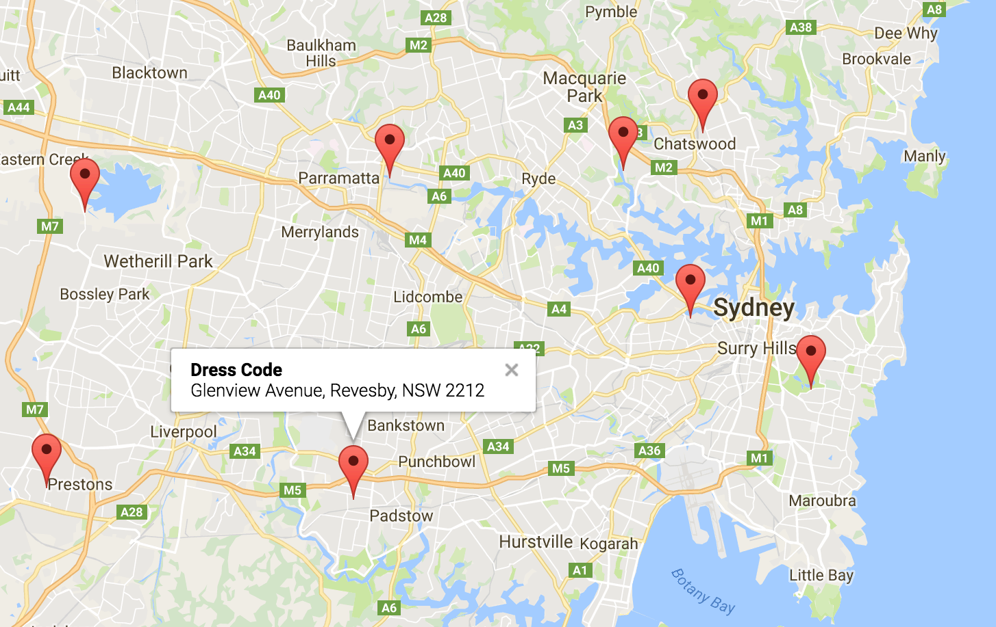
PokeGear
Raid Locator
Locate or create a raid call by selecting existing pins
or adding new pins to the map

Slide 13

PokeGear
Raid Locator
Locate or create a raid call by selecting existing pins
or adding new pins to the map
Join Raid

Slide 14
PokeGear
Raid Locator
Locate or create a raid call by selecting existing pins
or adding new pins to the map
Select Time:
v
12:00 PM
v
Create Raid

Slide 15

PokeGear
Raid Locator
Locate or create a raid call by selecting existing pins
or adding new pins to the map
You have created a raid meetup
At: 12:00 PM
Invite friends:
V
V
Jane123
Jill1010
Tyzanol
Ok
Select Time:
v
12:00 PM
v
Create Raid

Slide 16
PokeGear
Messages
See all messages sent to you by other
PokemonGo users
Friend
Message
Jane123
Level-up Request
V
Jane123
Present Reminder
Jill1010
Level-up request
Jill1010
Level-up request
Jill1010
Level-up request
Aria
Present Reminder
V
Accepted
Opened
Unopened

Slide 17
PokeGear
Messages
See all messages sent to you by other
PokemonGo users
Jill1010
has sent you a
Level-up request at:
04/01/16 12:00 PM
Friend
Message
Jane123
Level-up Request
V
Jane123
Present Reminder
Accept
Reject
Jill1010
Level-up request
Jill1010
Level-up request
Jill1010
Level-up request
Aria
Present Reminder
V
Accepted
Opened
Unopened

