Slide 1
1 · INTRODUCTION
Network Connection Recommendation Platform
Sprint 4 · Aug 27 – Sep 30, 2026 · Team 9 · Client: Blake Gibson, Cowles Ventures
Find who in your LinkedIn network to contact first
Tz-Ray Wang: export import, search ranking, storage, proxy security
Alan Qiu: ranking feedback, profile screen, chat widget
Sprint goal: from basic search to an AI-assisted platform (target: 80% of features)
Team 9 · Network Connection Recommendation Platform · Sprint 4
1
Notes:
Greet. Stack = React 19 + TypeScript, Firebase Auth/Firestore/Hosting, Gemini through a Node proxy that keeps the key off the browser. Live app: https://connectionrecommender.web.app

Slide 2
2 · SPRINT OBJECTIVES
Sprint objectives
Ranking feedback and tuning (both) — Done
AI profile pipeline (Alan) — Moved to Sprint 5
Saved searches and bookmarking (Tz-Ray) — Moved to Sprint 5
Added: full LinkedIn export import and a measured ranker rewrite
Added: Firestore storage and a secured AI proxy
Team 9 · Network Connection Recommendation Platform · Sprint 4
2
Notes:
Two of three planned deliverables slipped because the export import, relationship ranking and ranker rewrite took the sprint; those attack Sprint 3's sparse-data problem (blank titles) without scraping.

Slide 3
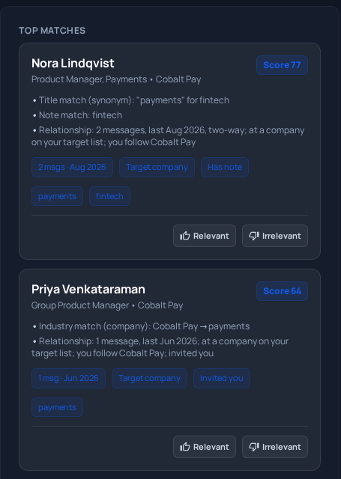
3 · FEATURE IMPLEMENTATION
Feature implementation
22 of 24 features working (92%); 2 moved to Sprint 5
Full LinkedIn export import; message text never kept (Tz-Ray)
Search that explains each match and favors people you know (Tz-Ray)
Relevant / Irrelevant votes reorder results (Alan)
Tested: 286 data tests, 31 rule tests, demo 10/10
Team 9 · Network Connection Recommendation Platform · Sprint 4
3
Notes:
Then switch to the live demo (sign in, upload, search, vote, connections, dashboard). Ranker NDCG@10 old -> new: tuning 0.610 -> 0.980, blind holdout 0.590 -> 0.687. Hosted app has AI off (no paid plan).

Slide 4
4 · KANBAN & CONTRIBUTIONS
Kanban board and contributions
Sprint 4: 22 issues, all closed
Tz-Ray: 7 solo + 8 shared
Alan: 7 solo + 8 shared
9 issues queued for Sprint 5
Team 9 · Network Connection Recommendation Platform · Sprint 4
4
Notes:
Show the live GitHub board here (github.com/users/Tz-Ray/projects/4, private).

Slide 5
5 · REPORT & DOCUMENTATION
Report and documentation
Sprint 4 report follows the course template
Deliverables, benchmark and issue tables included
README and setup docs refreshed
Team 9 · Network Connection Recommendation Platform · Sprint 4
5
Notes:
Report at reports/sprint-4/sprint-4-report.md.

Slide 6
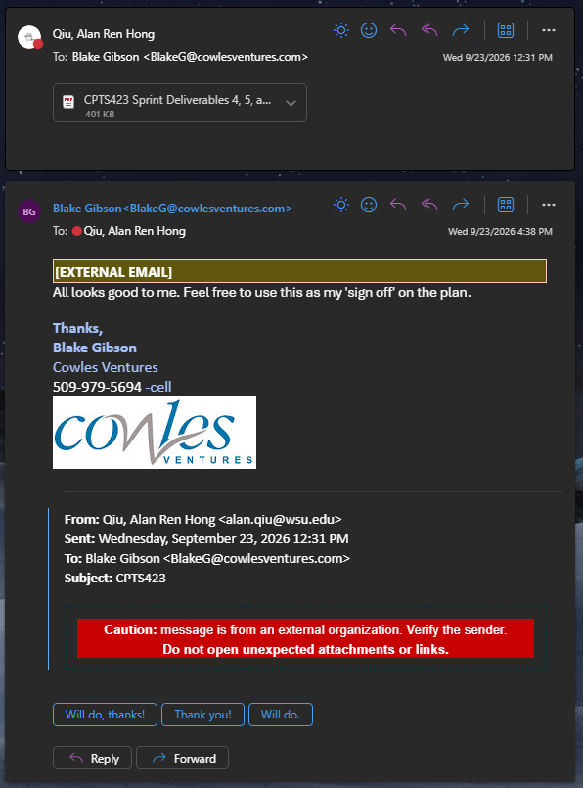
6 · CLIENT MEETINGS
Client meetings
Sep 9, 2026: Reviewed the Sprint 4–6 plan
Sep 16, 2026: Cancelled meeting by client
Sep 23, 2026: Progress check with Sprint 4
Sep 30, 2026: Progress check with Sprint 4
Feedback: Overall positive; Deliverables may change
Summary: Progress looks good and on track.
Team 9 · Network Connection Recommendation Platform · Sprint 4
6
Notes:
[Fill in: second meeting minutes]

Slide 7
7 · RESPONSIBLE USE OF GENAI
Responsible use of generative AI
Gemini only reorders people the app already found
It never sees message text or notes; AI is off on the hosted app
Claude code, Claude, Co-pilot, Gemini API
The team reviews and tests every change and owns the result
Limit we hit: 0.98 on tuning data, 0.69 on blind data
Team 9 · Network Connection Recommendation Platform · Sprint 4
7
Notes:
[Fill in: which AI tools each member used, and how]

Slide 8
8 · ACHIEVEMENTS & CHALLENGES
Achievements and challenges
Shipped export import, smarter search and ranking feedback
Blank titles → import the full LinkedIn export
Gemini replies cut off → turned off "thinking" tokens
Free tier, 20 AI calls a day → retries, fallback model, mock mode
No paid plan → hosted app ships with AI off and a notice
Team 9 · Network Connection Recommendation Platform · Sprint 4
8
Notes:
The live app was updated on Sep 30 with the new ranker and ranking feedback.

Slide 9
9 · NEXT STEPS & RETROSPECTIVE
Next steps and retrospective
Next: AI profile enrichment (#52), saved searches (#53)
Next: fix the 7 ranking-feedback defects (#54–#60)
Went well: solved sparse data without scraping; gains measured
Improve: 2 of 3 planned deliverables slipped
Improve: test features before merging
Team 9 · Network Connection Recommendation Platform · Sprint 4
9
Notes:
The planned client review (save criteria, star two profiles) needs #53.

Slide 10
10 · CONCLUSION
Thank you
Thanks to Blake Gibson and Cowles Ventures
Thanks to our instructor and TAs
connectionrecommender.web.app
Questions?
Team 9 · Network Connection Recommendation Platform · Sprint 4
10
Notes:
One-sentence recap: Sprint 4 turned the prototype into a privacy-first, relationship-aware recommender.

