Slide 1
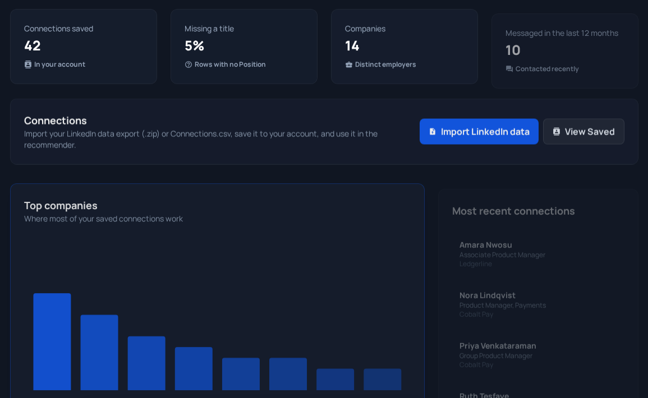
1 · INTRODUCTION
Network Connection Recommendation Platform
Sprint 5 · Oct 1 – Oct 31, 2026 · Team 9 · Client: Blake Gibson, Cowles Ventures
Find whom in your own LinkedIn network to contact first, with reasons
Alan Qiu: ranking feedback, AI chat on the live site, testing
Tz-Ray Wang: saved searches, connection graph, meaning-based search
Sprint 5 goal: finish the features, deploy for real, test at every level
Live: connectionrecommender.web.app
Team 9 · Network Connection Recommendation Platform · Sprint 5
1

Slide 2
2 · SPRINT OBJECTIVES
Sprint 5 objectives
Production cloud deployment, no localhost left — Done
Account registration and per-user data isolation — Done
Recommendation chat widget on the live site — Done
Scale and stability on 1,000+ connection datasets — Mostly done
Vision: a tool the client uses alone; Sprint 6 = polish and handoff
3 done · 1 mostly done of 4 planned
Team 9 · Network Connection Recommendation Platform · Sprint 5
2

Slide 3
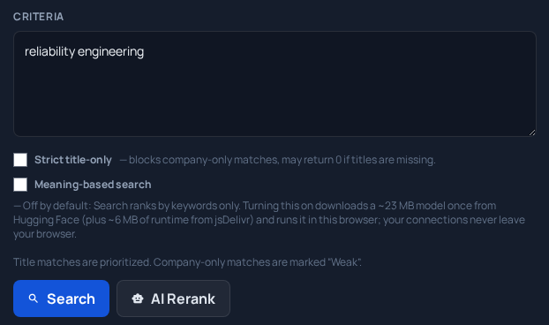
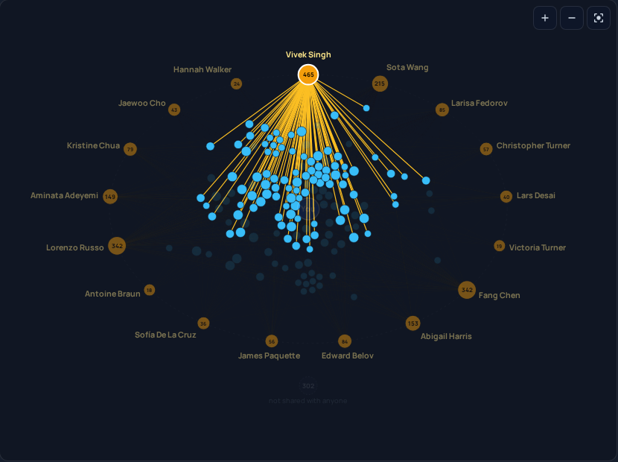
3 · FEATURE IMPLEMENTATION
Features built and tested this sprint
Feature (owner) | Before | Now | Validated by
Ranking feedback fixes (Alan) | 7 open defects | Loading state, race guard, "Marked irrelevant" | Regression flow
AI chat + AI Rerank on the live site (Alan, Tz-Ray) | AI switched off | Works via a free Cloudflare proxy | 24 integration tests
CI + AI-proxy tests (Alan, Tz-Ray) | Manual checks | 24 proxy tests; CI prepared | 24/24 pass
Saved searches + Saved Connections (Tz-Ray) | Re-type every search | Save, re-run, star people | Live end-to-end flow
Shared graph + Network page (Tz-Ray) | None | Opt-in "in common" graph | 62 security-rule tests
Meaning-based search (Tz-Ray) | Keywords only | Matches by meaning, on-device | 24/24 live checks
Meaning-based search
Network page
Team 9 · Network Connection Recommendation Platform · Sprint 5
3

Slide 4
4 · DEPLOYMENT AND USER TESTING
Deployed and tested
Free platforms: Firebase Hosting + Cloudflare Worker (Cloud Run needs a paid plan)
Deploy: build → firebase deploy → wrangler deploy, end-to-end run before and after
Integration: Worker 24/24 · proxy 24/24 · security rules 62/62
Live site: 8/8 end-to-end steps, 0 console errors, page load 0.5 s
Users: the client tried the live site; the new UI is not reviewed yet
Firebase Hosting
(React app)
Browser
Firestore
(security rules)
Cloudflare Worker
(AI proxy)
Gemini
Team 9 · Network Connection Recommendation Platform · Sprint 5
4

Slide 5
5 · KANBAN AND TEAM CONTRIBUTIONS
Kanban board and contributions
Board snapshot, Oct 31 (GitHub project, sprint 5 column)
14 issues in the Sprint 5 column: 11 closed, 3 open
Alan Qiu: #54–#60 feedback fixes, #64 AI proxy, #65 CI tests
Tz-Ray Wang: #53 saved searches, #61 graph, #66 meaning search, #64, #67
Backlog: #62 UI redesign (both), #63 new tests
Closed (11)
Open (3)
Backlog
#53 Saved searches
TR
#52 AI enrichment
AQ
#62 UI redesign
AQ+TR
#54 Loading state
AQ
#55 Rerank race
#65 CI + proxy tests
AQ+TR
#63 New tests
TR
AQ
#56 Marked irrelevant
AQ
#67 SQL insights
TR
#57 Move counts
AQ
#58 Vote note
AQ
#59 Stable ids
AQ
#60 Double-click guard
AQ
#61 Shared graph
TR
#64 Cloudflare AI proxy
AQ+TR
#66 Meaning search
TR
Team 9 · Network Connection Recommendation Platform · Sprint 5
5

Slide 6
6 · SPRINT REPORT
Sprint 5 report
reports/sprint-5/sprint-5-report.md, on the course template
New this sprint: deliverables vs plan table, testing table, GenAI section
What's New: 5 user-facing features
11 completed issues; 8 incomplete, each with a reason
README updated: install, features, known problems
Team 9 · Network Connection Recommendation Platform · Sprint 5
6

Slide 7
7 · CLIENT MEETINGS
Client meetings (minutes on GitHub)
Oct 6 (#4): Sprint 4 demo, Sprint 5 plan, repo stays public
Client liked the demo and the Chrome extension idea (kept out of scope)
Oct 27 (#5): progress update; poster event in December
Client: "a good update"; email updates "very helpful"
Files: reports/sprint-5/minutes/
Team 9 · Network Connection Recommendation Platform · Sprint 5
7

Slide 8
8 · RESPONSIBLE USE OF GENERATIVE AI
Responsible use of generative AI
Claude Code: code and test drafts, reviews, minutes and report drafts
Gemini in the app: only short derived summaries sent; off unless allowed
Checked by type check, tests, end-to-end runs, privacy scan before push
Limits seen: overfit ranker (0.994 tuning vs 0.687 blind); a bug caught by tests
The team reviews and decides; we own every deliverable
Team 9 · Network Connection Recommendation Platform · Sprint 5
8

Slide 9
9 · ACHIEVEMENTS AND CHALLENGES
Achievements and challenges
Achieved: AI on the live site, 3 new features live, all 4 plan items done or mostly
No paid plans → free Cloudflare Worker instead of Cloud Run
Gemini free tier (20 a day) → allowlist, daily caps, fallback model
23 MB model → off by default, Web Worker, browser cache
Since Sprint 4: AI off → on; 7 defects fixed; saved searches done
Team 9 · Network Connection Recommendation Platform · Sprint 5
9

Slide 10
10 · NEXT STEPS AND RETROSPECTIVE
Sprint 6 plan and retrospective
Sprint 6: UI polish (Alan), docs and handoff (Tz-Ray), final demo and poster (both)
Went well: free AI hosting, testing at every level, weekly client emails
Improve: AI enrichment slipped twice; issues closed in batches; no load test
Change: update issues as we work, demo weekly, client test session
From client feedback: live demo on Nov 3; send the poster date
Team 9 · Network Connection Recommendation Platform · Sprint 5
10

Slide 11
11 · CONCLUSION
Thank you
Sprint 5: deployed, AI live, tested from unit tests to the live site
Next: polish, handoff and the final presentation
Thanks to Blake Gibson (Cowles Ventures), our mentor Parteek Kumar, and the CptS 423 staff
Questions and feedback welcome
connectionrecommender.web.app · github.com/Tz-Ray/421-Network-Connection-Recommendation-Platform
Team 9 · Network Connection Recommendation Platform · Sprint 5
11

