Slide 1

Decentralot
Empowering Fairness and Innovation

Slide 2
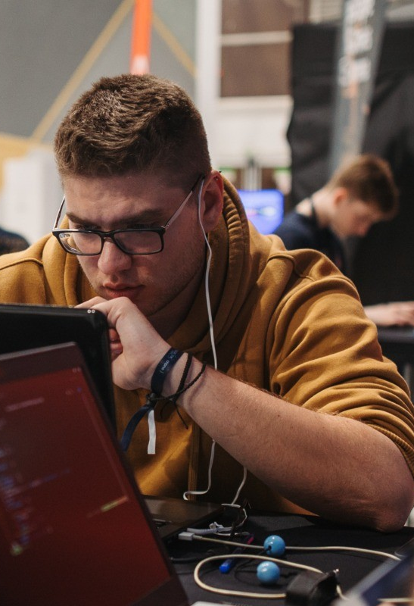



The team
https://github.com/TzannetosGiannis/Socituri_Decentralot
Mantzoutas Andreas: National Technical University of Athens (undegraduate)
Hadjichristofi Christos: National Technical Unicersity of Athens (PHD software engineering)
Nikolaou George: National and Capodistrian University of Athens (undergraduate)
Tzannetos Ioannis : National Technical University of Athens / Purdue USA (PHD Defi)

Slide 3
Why SUI ?
Fast finality and low fees.
Reliable and fast native on-chain randomness.
Enoki integration: will enable to seamlessly abstract blockchain processes
Move language and SUI objects model is inherently safe
Supportive community and adequate documentation

Slide 4
The problem
Traditional lotteries and crowdfunding campaigns lack transparency and fairness.
Participants often face issues with trust and verifiability.
Centralized systems are prone to manipulation and bias.

Slide 5
Mission
Facilitate a decentralized and fair lottery.
Provide trustless and verifiable randomness.
Support ecosystem projects through crowdfunding campaigns

Slide 6
Key offerings
Trustless and Verifiable Randomness: Ensures fair processes for all participants.
Protocol Earnings Participation: Users gain rewards and contribute to platform growth from day 1.
Crowdfunding Lottery Campaigns: Unique and engaging way to raise funds for projects.

Slide 7
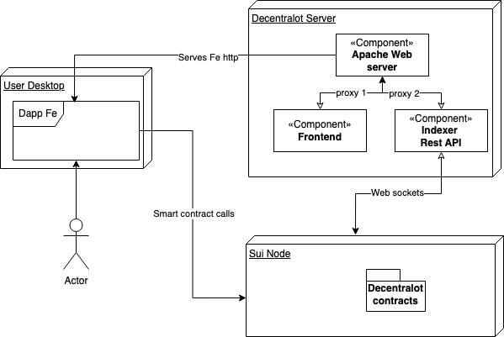
Tech stack
Smart contracts:
Move
Frontend:
ReactJS
docker
Indexer:
NodeJs
SUI websockets
MongoDB
docker

Slide 8
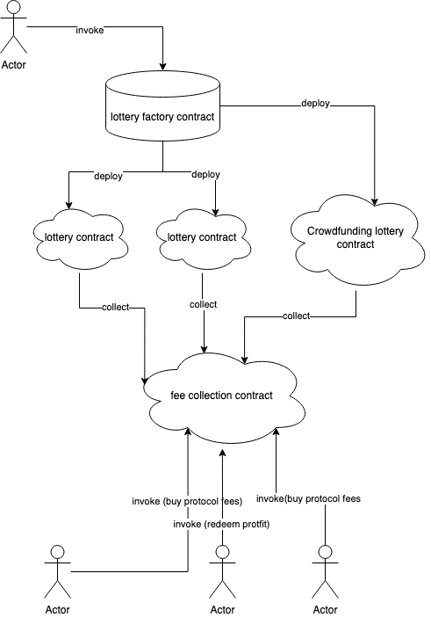
Contract flow overview
Everyone can interact with the lottery factory
Team owns nothing, everyone can buy protocol fees for subsequent epochs

Slide 9
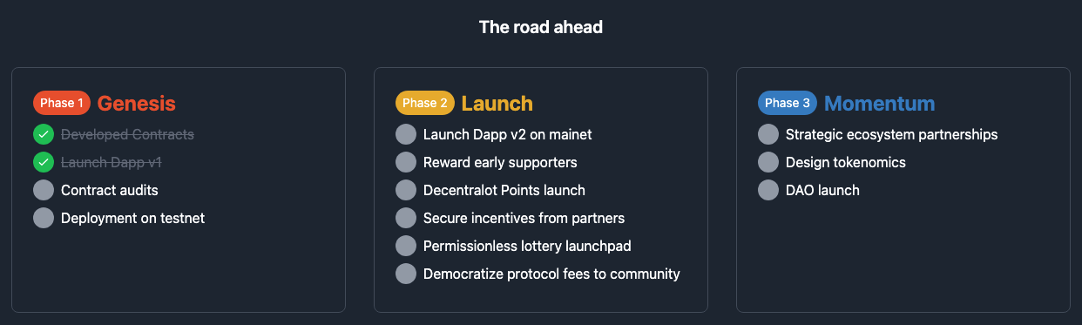
Roadmap

Slide 10

Don’t trust! Verify
~ Decentralot ~
:https://decentralot.xyz/
https://github.com/TzannetosGiannis/Socituri_Decentralot

