Slide 1

Smoking Status Identification from Clinical Notes
Group 2a: Tazeen Shaukat
Stephen Payne
Sneha Nagarale
Notes:
sneha

Slide 2
Agenda
01
02
03
04
Objectives
Preprocessing
Results
Discussion
Notes:
sneha

Slide 3
01
Objectives
of the project
Notes:
sneha

Slide 4
Objectives
Our aim
The goal
Classify smoking status from textual data using natural language processing (NLP) and machine learning techniques.
Automatic classification of smoking status for patients from clinical discharge notes.
Categories:
Past Smoker, Current Smoker, Smoker, Non Smoker, Unknown
Notes:
The primary aim of this project is to accurately classify smoking status from textual data using natural language processing (NLP) and machine learning techniques.
The goal of the project is to automatically classify the smoking status of patients from their clinical discharge notes. Specifically, the task is to categorize each discharge note into one of the following five categories: Past Smoker, Current Smoker, Smoker, Non Smoker, Unknown

Slide 5
02
Preprocessing

Slide 6
XML File Parsing
Parsing XML files that contain text data
XML elements extracted to retrieve relevant text sections
Ensures that the raw data is accurately transformed into a usable format for NLP tasks
Notes:
stephen
Parsing XML files that contains text data
XML elements are extracted to retrieve relevant text sections for further processing.
This step ensures that the raw data is accurately transformed into a usable format for NLP tasks.

Slide 7
2. Data Preparation - TF IDF
Smoking Sentence Selection
Token Generation
Negation Handling
Punctuation Removal
Stop Words Removal
Context Handling: Bigrams and Trigrams
TF IDF Vectors
Ngrams
(created separately and consolidated at the end to avoid sparsity)
Notes:
Tazeen (398, 4650) (104, 4650)

Slide 8
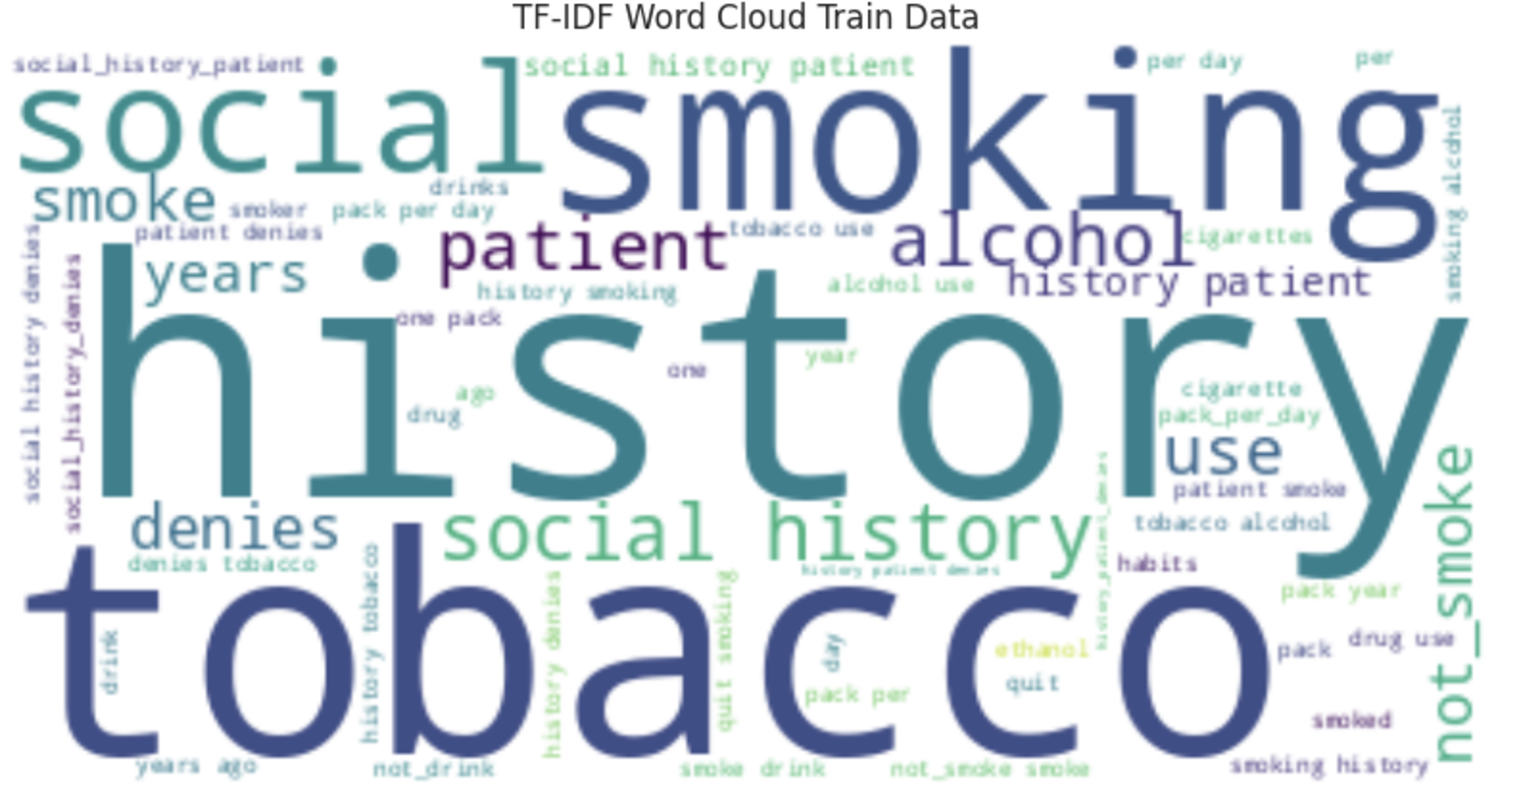

Slide 9
2. Data Preparation - Word Embeddings
API pre-trained model from Google News
Similarity Scoring
Checking for Words not in Model
Averages
Notes:
stephen

Slide 10
3. Machine Learning Models
Logistic Regression: A multi-class logistic regression model was initially applied but yielded suboptimal results.
Support Vector Machine: Tested multi-class SVM models with and without feature scaling to improve classification outcomes. Linear kernel was applied, with feature scaling for optimization.
Naïve Bayes: Applied with pipelines combining TF-IDF vectorisation
Notes:
Logistic Regression: A multi-class logistic regression model was initially applied but yielded suboptimal results. Then we used bigrams, and trigrams which improved the model.
sneha

Slide 11
4. Evaluation Metrics
Accuracy, precision, recall, F1 score and confusion matrices
Heatmaps of confusion matrices
Notes:
Models were evaluated using metrics such as accuracy, precision, recall, F1 score and confusion matrices.
Visualisations included heatmaps of confusion matrices for detailed performance breakdown.

Slide 12
03
Results

Slide 13
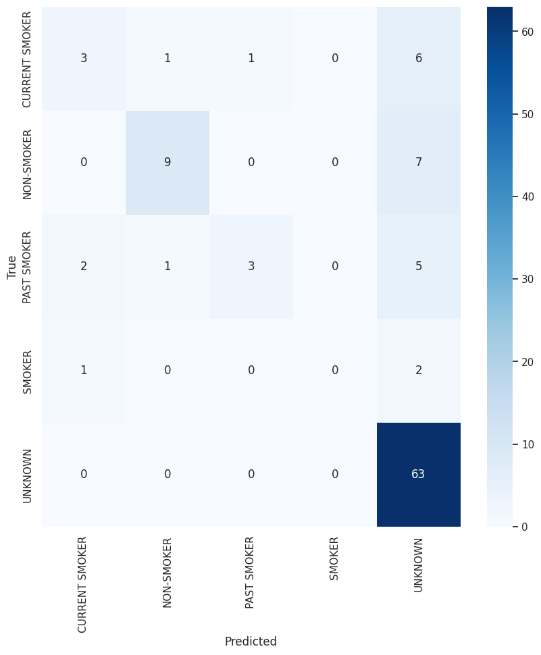
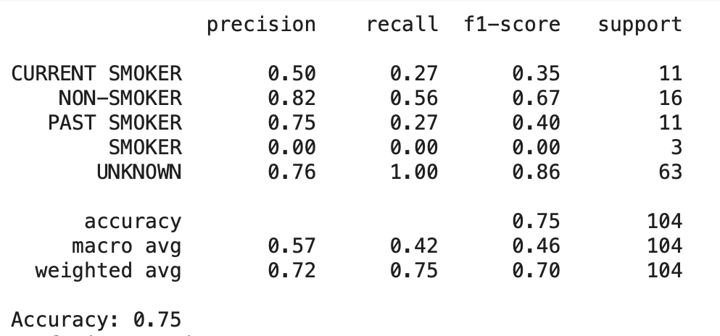
Logistic regression
Notes:
As we can see in this model current-smoker, non smoker, past smoker and unknown had a good score and we pretty much see 0’s for the smoker class. This could be due to limited data (3 samples) in the train set. And we also see that recall for unknown class is 1, so maybe the model is overfitting

Slide 14
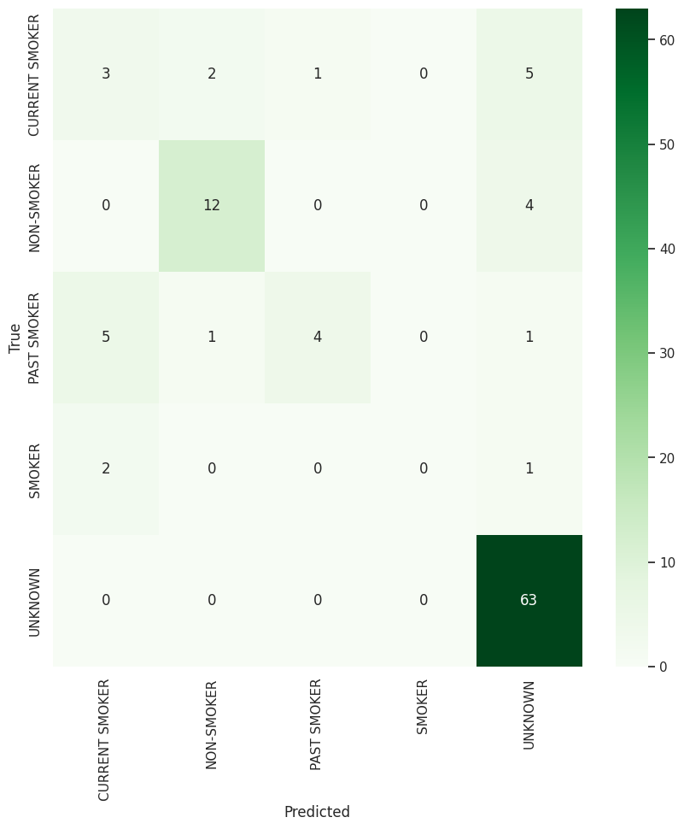
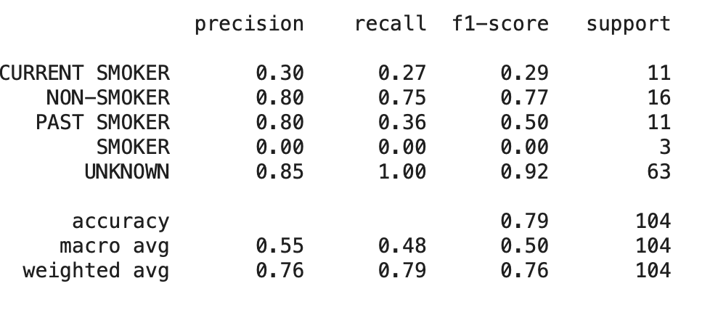
Multi-Class SVM
Notes:
As we can see in this model non smoker, past smoker and unknown had a good score and we pretty much see 0’s for the smoker class. This could be due to limited data (3 samples) in the train set. And we also see that recall for unknown class is 1, so maybe the model is overfitting

Slide 15
04
Discussion

Slide 16
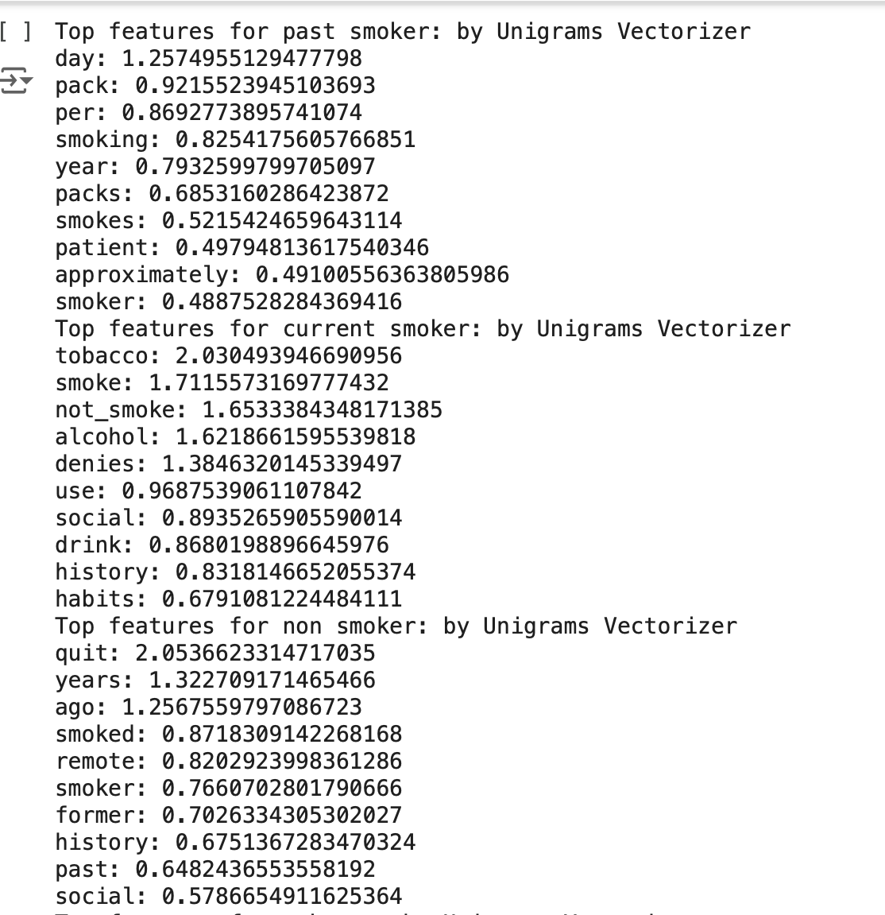
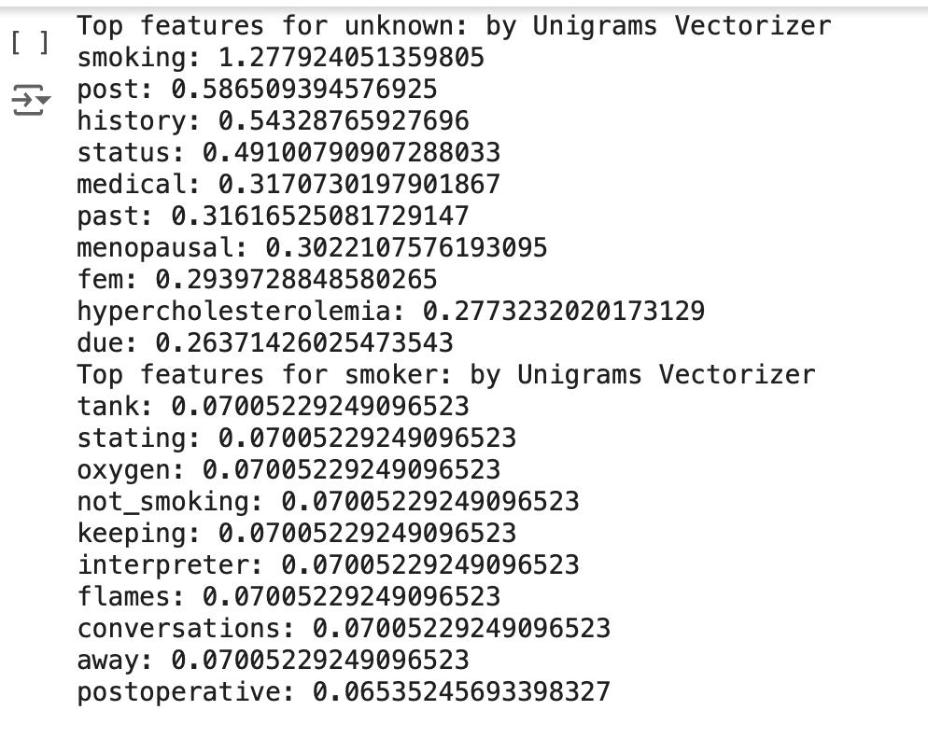
Top TF IDF Vector Features (Unigrams)
Top Features for Past Smoker Class
Top Features for Non Smoker Class
Top Features for Smoker Class
Top Features for Current Smoker Class
Top Features for Unknown Class

Slide 17
TFIDF Issues and Potential Improvements
Large Vocab: Very sparse feature matrix can lead to worse results
To tackle this, we made three different vectors using unigrams, bigrams, trigrams and consolidated them at the end. This improved model performance
Dimensionality reduction (pca) to deal with sparse matrix
Improve features for specific classes to incorporate better context.
Word embeddings are a better way
Use selective trigrams or bigrams which hold significance to the prediction classes
Model Fine Tuning using Grid Search
Notes:
Limited-memory Broyden-Fletcher-Goldfarb-Shanno (L-BFGS)

Slide 18
Word Embeddings Challenges
Similarity Score Differences
Having to skip words not in model
Issues with running models
Needing more time for research
Use domain specific embeddings (Clinical BERT)
Was tried but not completed - requires more time
Notes:
stephen

Slide 19
Thanks!
Do you have any questions?
Please keep this slide for attribution

Slide 20
Resources
https://www.kaggle.com/code/harshjain123/bert-for-everyone-tutorial-implementation/notebook
https://github.com/EmilyAlsentzer/clinicalBERT/blob/master/downstream_tasks/run_classifier.py

