Slide 1
參考API
https://stackoverflow.com/questions/18124896/requesting-definitions-using-the-wordnik-api
https://ithelp.ithome.com.tw/articles/10194237
https://rapidapi.com/blog/dictionary-apis/

Slide 2
實用API
https://rapidapi.com/dpventures/api/wordsapi
https://www.wordsapi.com/
http://www.gwicks.net/dictionaries.htm

Slide 3
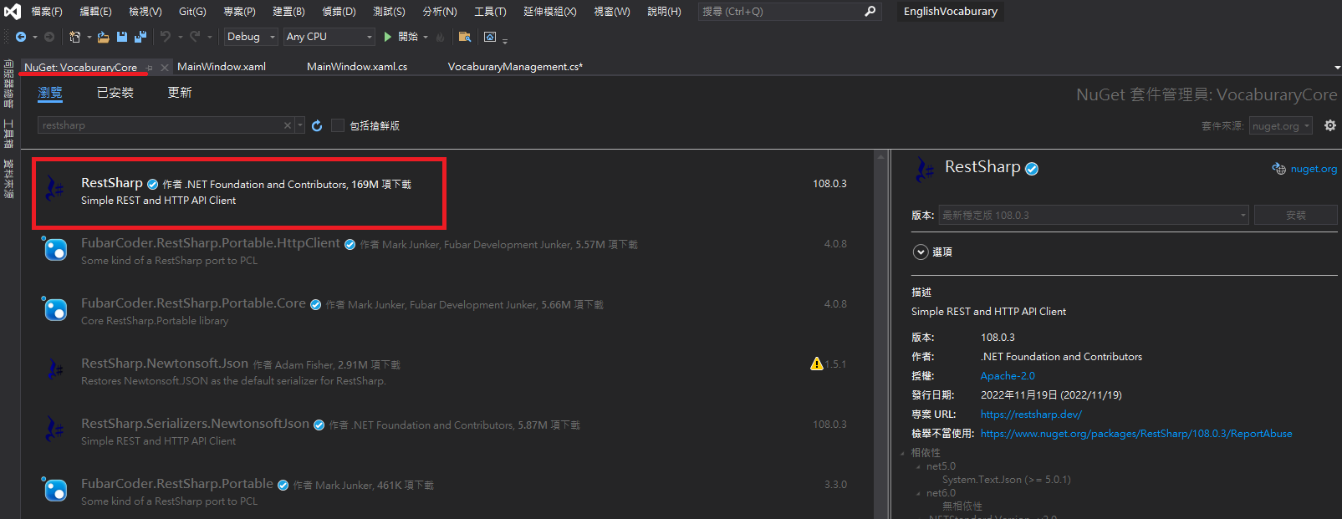
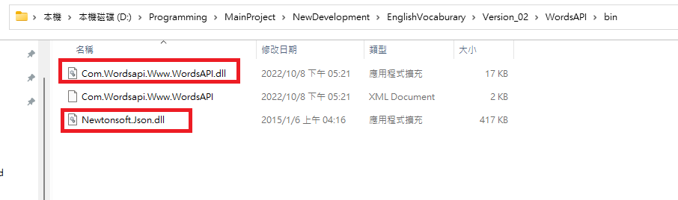
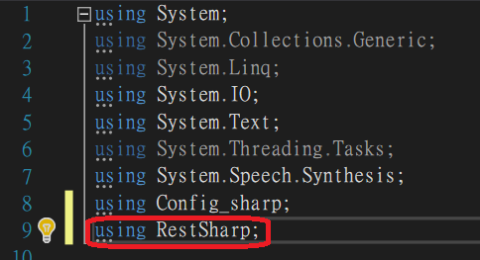

Slide 4
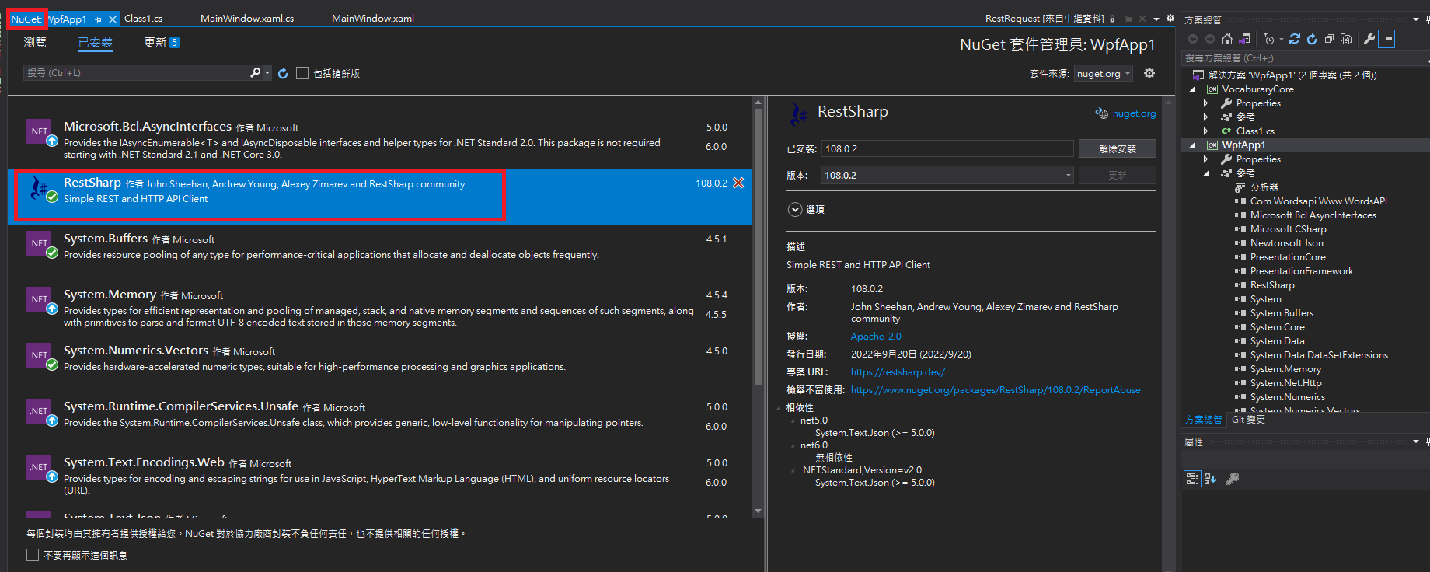
Visual Studio
熟悉開發環境
創建C#檔案
創建WPF檔案

Slide 5
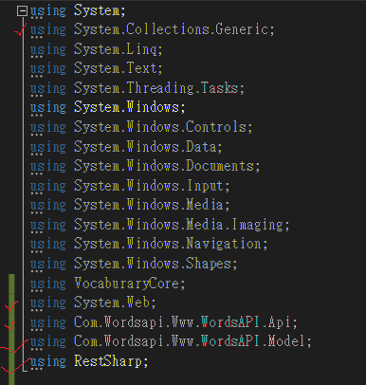
Visual Studio

Slide 6
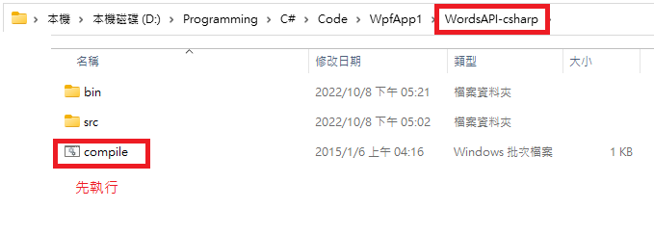
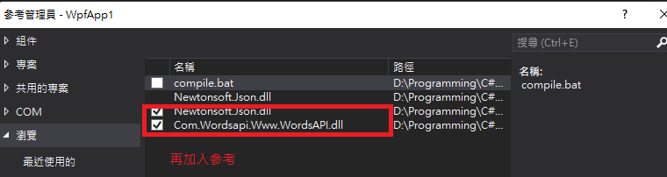
Visual Studio

Slide 7
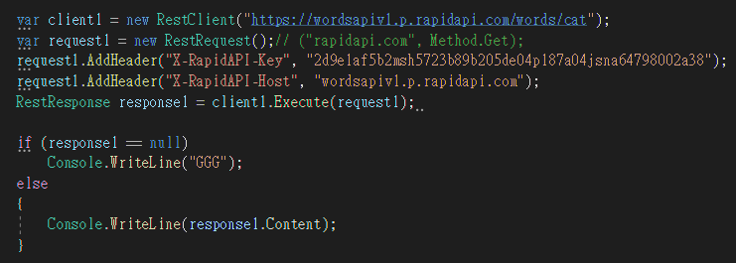
Visual Studio

Slide 8
後續整合
與EnglishChat整合

