Slide 1
DEVELOPMENT UPDATE
Telomere Analyzer
A graphical interface for the lab’s
Nanopore telomere workflow
Interface design • workflow integration • output review
Progress to date | September 2026
TELOMERE ANALYZER / LAB MEETING
01
Notes:
Opening: The main deliverable is a graphical tool that connects configuration, execution and output review for the laboratory workflow. This presentation is grounded in the current repository and saved results, not a new biological study. Suggested presentation length: 20–25 minutes plus discussion.

Slide 2
THE NEED
The workflow needs a single point of control
What must be coordinated
What the GUI brings together
Input format and barcode structure
Dorado, NanoTel and R analysis
Paths, parameters and output files
One place to configure the run
Selectable analysis steps
Run feedback and organized results
TELOMERE ANALYZER / LAB MEETING
02
Notes:
Source: README.md and current GUI/backend structure. Describe the practical challenge: separate tools need compatible inputs, options and output paths. These are design motivations; no time-saving or usability improvement was measured.

Slide 3
DEVELOPMENT SCOPE
The work spans more than the visible interface
01 Interface
02 Execution
Input selection, analysis options and contextual help
Connect GUI settings to the existing workflow engine
03 Reliability
04 Distribution
Validation, background execution and run feedback
Package resources and test clean installation
TELOMERE ANALYZER / LAB MEETING
03
Notes:
Source: dorado_gui, dorado_workflow and packaging documentation. Describe the current project scope without claiming authorship of the underlying Dorado or NanoTel algorithms. The contribution presented is interface and integration development.

Slide 4
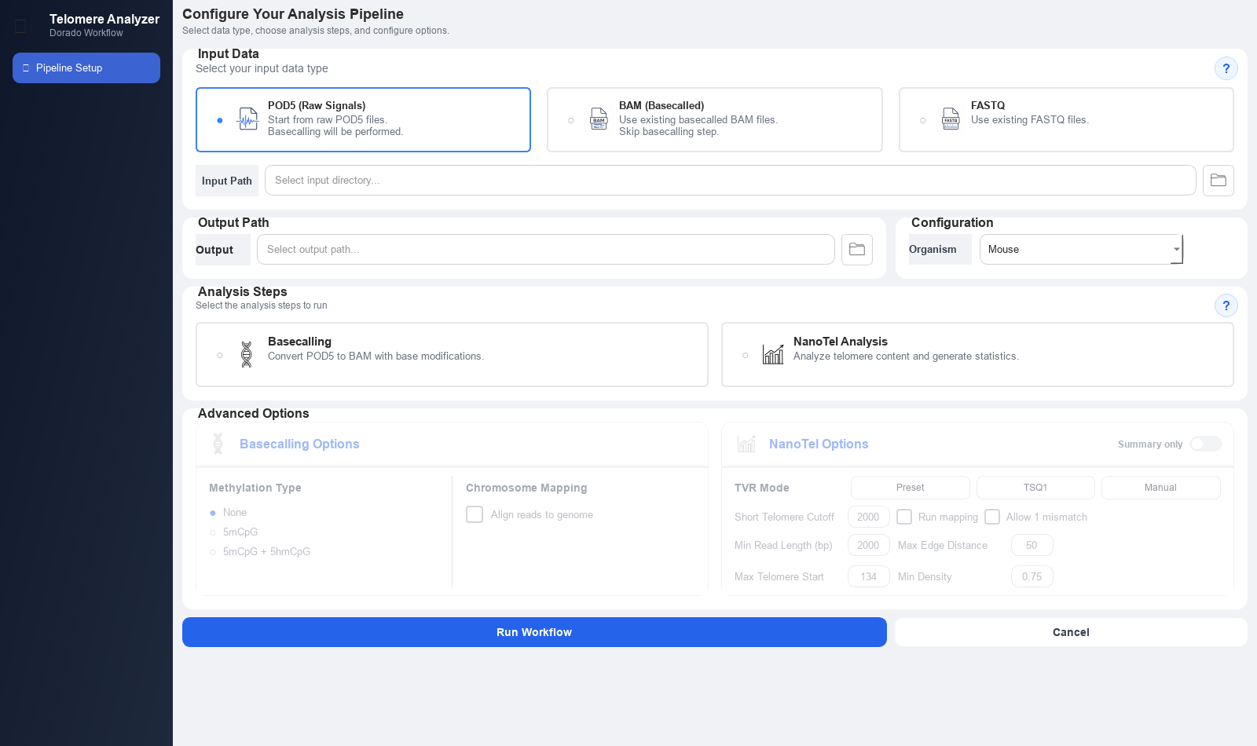
INTERFACE WALKTHROUGH
The main screen brings the setup together
TELOMERE ANALYZER / LAB MEETING
04
Notes:
Source: fresh offscreen capture of the current AppWindow. Arial was explicitly loaded for the screenshot because the offscreen environment initially lacked font discovery. No workflow was executed for this screenshot. Walk through the screen from input to run controls.

Slide 5
INPUT ROUTES
Users can start with the data they already have
POD5
BAM
FASTQ
Raw signal files
Basecalling produces reads for the downstream workflow.
Basecalled reads
Skip basecalling; convert reads for NanoTel analysis.
Sequence reads
Continue with NanoTel; barcode handling depends on input organization.
TELOMERE ANALYZER / LAB MEETING
05
Notes:
Source: input_section.py, workflow_section.py and pipeline_runner.py. POD5 uses Dorado basecalling. BAM skips basecalling and supplies reads via conversion. FASTQ can enter downstream analysis; unseparated reads may still require demultiplexing.

Slide 6
USER WORKFLOW
A run follows a clear sequence of choices
1 Select data
2 Set the context
Choose the input type and folder.
Choose output location and organism.
3 Configure analysis
4 Run and review
Select stages and review parameters.
Follow execution and inspect saved outputs.
TELOMERE ANALYZER / LAB MEETING
06
Notes:
Source: AppWindow and GUI section modules. Demo narrative: choose a data type and directory, choose an output folder and organism preset, select the analysis steps, review options, then run and inspect results. Organism options are Mouse, Human and Zebra Fish; availability of presets does not demonstrate validation on all organisms.

Slide 7
CONFIGURATION
Analysis options are exposed in the interface
Basecalling options
NanoTel options
No modified-base detection
5mCpG or 5mCpG + 5hmCpG
Optional chromosome mapping
TVR presets, TSQ1 or manual patterns
Read length, density and edge filters
Short-telomere cutoff and summary-only output
TELOMERE ANALYZER / LAB MEETING
07
Notes:
Source: advanced_section.py and workflow_section.py. Explain that these options configure existing tools; they are not new biological algorithms. Modified-base selection and chromosome mapping have dependencies. Preset TVR mode uses exact matching.

Slide 8
RELIABILITY
Input checks catch problems before execution
Checks implemented
Why this matters
Expected input files are present
Selected stages match the input
BAM alignment and modification metadata are inspected
Explain missing or incompatible inputs before an expensive run.
BAM inspection samples files and reads; it is not a complete data audit.
TELOMERE ANALYZER / LAB MEETING
08
Notes:
Source: core/validators.py and AppWindow. Concrete checks include file presence and workflow compatibility. BAM inspection is sampled: up to three BAM files and up to 1,000 reads for modification inspection by default, so it is not exhaustive validation.

Slide 9
IMPLEMENTATION
Long analyses run through a separate worker
Separation of responsibilities
Execution feedback
GUI collects user choices
Service prepares the workflow
Backend executes analysis stages
Background worker runs the job
Logs and progress reach the GUI
Cancel requests are checked by the workflow
TELOMERE ANALYZER / LAB MEETING
09
Notes:
Source: workers/worker_thread.py, services/pipeline_runner.py, AppWindow and workflow backend. The worker emits log/finished/error signals. Cancellation is requested through a stop flag and checked by the workflow; do not promise immediate cancellation of every external process.

Slide 10
OUTPUTS
Saved outputs support review at several levels
Detailed output
Compact output
Per-read density plots and sequences
Per-barcode and filtered summaries
Aggregate statistics and run reports
Summary-only mode keeps summaries in one Excel workbook.
Individual read plots and FASTA files are skipped in this mode.
TELOMERE ANALYZER / LAB MEETING
10
Notes:
Source: saved 2026-09-14 run and workflow_section.py. Distinguish full output from summary-only mode. The full run contains per-read plots, FASTA files, per-barcode tables and aggregate reports. A separate saved run contains nanotel_summary.xlsx.

Slide 11
EXAMPLE RUN • 14 SEPTEMBER 2026
A saved run demonstrates the NanoTel path
2
13
SUCCESS
barcodes processed
reads after filtering
reported NanoTel status
Mapping and methylation were disabled in this run.
This example shows saved processing outputs, not a biological comparison.
TELOMERE ANALYZER / LAB MEETING
11
Notes:
Sources: test/Telomere Analyzer_20260914_132210/results/reports/complete_pipeline_report.txt and nanotel/nanotel_analysis_report.txt. This is an existing saved result, not a run executed during preparation of the presentation. The report marks NanoTel SUCCESS, two barcodes, two files. Mapping and methylation were disabled.

Slide 12
EXAMPLE RESULTS
The summary makes output values easy to inspect
Barcode | Telomeres | Median length (bp) | Below 2 kb
barcode02 | 12 | 4,896.5 | 16.7%
barcode19 | 1 | 12,573 | 0%
Barcode19 has one retained observation.
Use these values to demonstrate the output; biological interpretation needs more data.
TELOMERE ANALYZER / LAB MEETING
12
Notes:
Source: test/Telomere Analyzer_20260914_132210/results/nanotel/nanotel_summary_statistics.csv. Exact values preserved. Counts refer to the saved filtered output. Barcode19 contains only one retained telomere, so its median is a single observation. These are illustrative outputs and should not be used to infer differences between biological conditions.

Slide 13
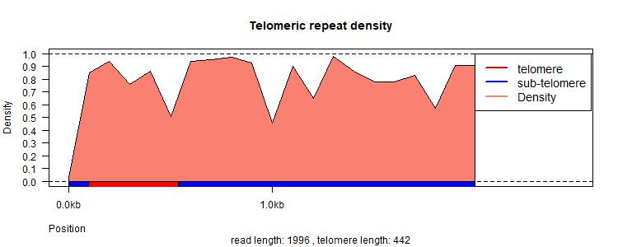
EXAMPLE OUTPUT
Per-read plots add detail behind the summary
Read-level view
Repeat density along the read
Telomere and subtelomere annotations
A generated read plot may represent a read excluded from the final filtered summary.
TELOMERE ANALYZER / LAB MEETING
13
Notes:
Source: test/Telomere Analyzer_20260914_132210/results/nanotel/barcode19/single_read_plots_adj/read1.jpeg. The plot label reports read length 1,996 and telomere length 442. This read is an individual generated plot, not the single retained barcode19 result in the filtered summary. Explain that plots may exist for reads excluded by downstream filtering.

Slide 14
PACKAGING PROGRESS
Installation was tested beyond the source folder
Documented local checks
Release work still open
Conda package built and installed
Installed GUI opened offscreen
Three real-data integration tests passed
Official Bioconda CI and metadata
External reference and model setup
Retest later changes in the next built package
TELOMERE ANALYZER / LAB MEETING
14
Notes:
Source: packaging/BIOCONDA_BUILD_REHEARSAL.md, recorded 6 August 2026. This is documented historical validation, not a fresh rerun. The build used a temporary package name and version. Three real-data tests passed, along with installed GUI construction and clean installation. Later NanoTel analysis assertions were added after this build and require another package-level rerun.

Slide 15
CURRENT LIMITATIONS
Validation coverage still has clear boundaries
Evidence available
Evidence still needed
Current GUI constructs successfully
Saved NanoTel outputs and reports
Recorded clean-installation tests
Tagged-BAM methylation integration test
Broader end-to-end input coverage
Measured usability and performance
TELOMERE ANALYZER / LAB MEETING
15
Notes:
Sources: saved run reports, packaging/README.md and BIOCONDA_BUILD_REHEARSAL.md. Distinguish implemented capability, historical test evidence and outstanding validation. Avoid presenting a working GUI as full scientific validation.

Slide 16
PROPOSED NEXT STEPS
The next step is a structured lab pilot
1 Choose a representative workflow
Agree on the first user task, dataset and expected outputs.
2 Check results and usability
Compare with an agreed baseline and observe a new user running the tool.
3 Prepare the next installable build
Repeat package tests after resolving configuration and release decisions.
TELOMERE ANALYZER / LAB MEETING
16
Notes:
Proposed plan, not a claim of committed or completed work. Ask the lab to prioritize the first use case and provide representative inputs with expected outputs. Validate both operation and scientific output correctness, then address package release blockers.

Slide 17
DISCUSSION
Which workflow should we validate first?
The tool now connects setup, execution
and output review in one interface.
Which input route matters most for the lab?
Which outputs must match the reference analysis?
What would make the tool ready for routine use?
TELOMERE ANALYZER / LAB MEETING
17
Notes:
Close by returning to the central contribution: one graphical entry point for the laboratory workflow, with configuration, execution and output organization. The requested discussion is prioritization, not a claim that deployment is finished.

Slide 18
BACKUP • SOURCES
Project evidence used in this presentation
Implementation
Results and installation
README.md
dorado_gui/gui/sections/
dorado_gui/core/validators.py
dorado_gui/workers/worker_thread.py
dorado_gui/services/pipeline_runner.py
Saved run: 20260914_132210
• complete_pipeline_report.txt
• nanotel_analysis_report.txt
• nanotel_summary_statistics.csv
packaging/BIOCONDA_BUILD_REHEARSAL.md
packaging/README.md
TELOMERE ANALYZER / LAB MEETING
18
Notes:
All content is grounded in local project files. No external scientific literature was added. GUI features were checked in source code. Numerical values come from the saved run. Packaging evidence is explicitly historical.

