Slide 1
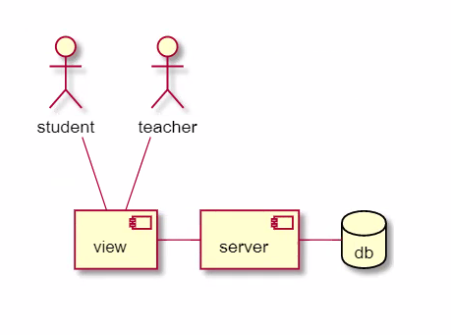



Main Tables:
Subjects
Teachers
1
1
N
N
SubjectsForTeachers
client
Subjects_model
teacher_model
Server
Add teacher
Find teachers
Display teacher details
Send message
Add like
Display students comments

