Slide 1
EMBEDDED SYSTEMS LAB3 FPGAS AS ACCELERATORS
Ioannis Papadopoulos, Maria Ilektra Tzormpatzaki
Student IDs: 03899, 03993

Slide 2
Software (x86 CPU)

Slide 3
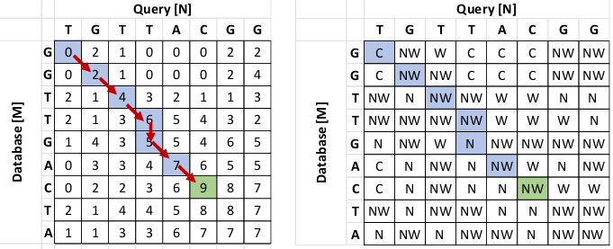
LSAL Implementation on the x86 CPU
Nested loop structure
Outer loop length of the database M
Inner loop length of the query N
Find the highest score from: North-West, North, and West.
Store the result in Similarity and Direction Matrix.

Slide 4
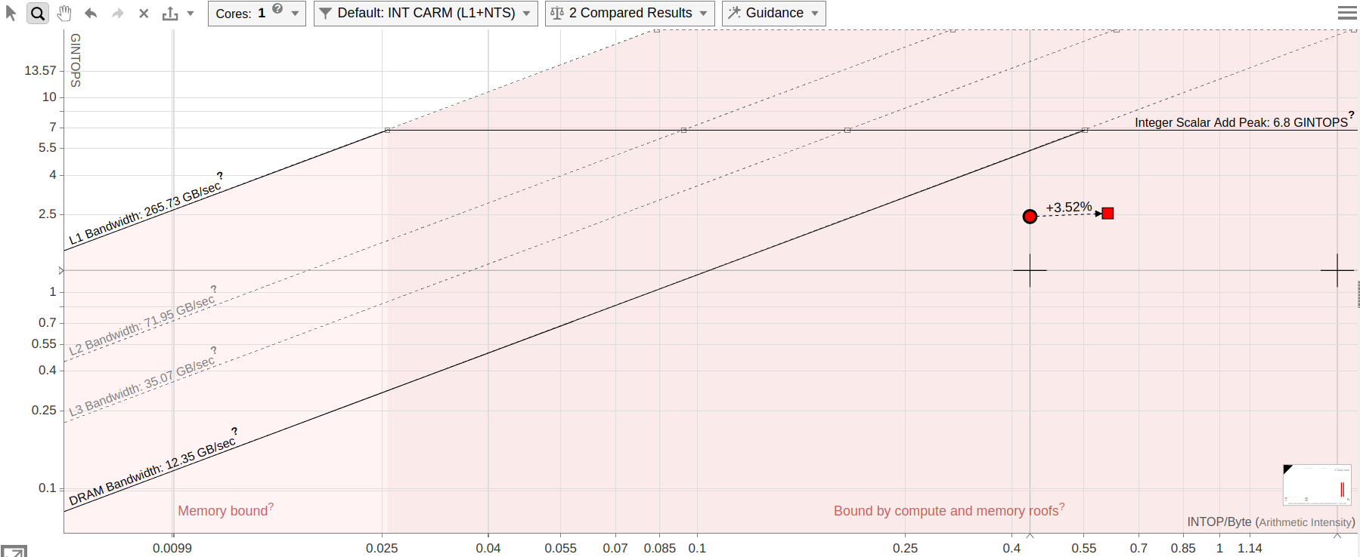
Picking the best implementation (1)
non-Padding
Padding
north = (j > 0) ? similarity_matrix[index- N] : 0;
west = (i > 0) ? similarity_matrix[index- 1] : 0;
northwest = (i > 0 && j > 0) ? similarity_matrix[index- N- 1] : 0;
north = similarity_matrix[index - N - 1];
west = similarity_matrix[index - 1];
northwest = similarity_matrix[index - N - 2];
Inputs | lsal | lsal_plus1
N=32 M=65536 | 0.016693 | 0.015844
N=256 M=65536 | 0.130641 | 0.120686
N=256 M=300000 | 0.570392 | 0.557866

Slide 5
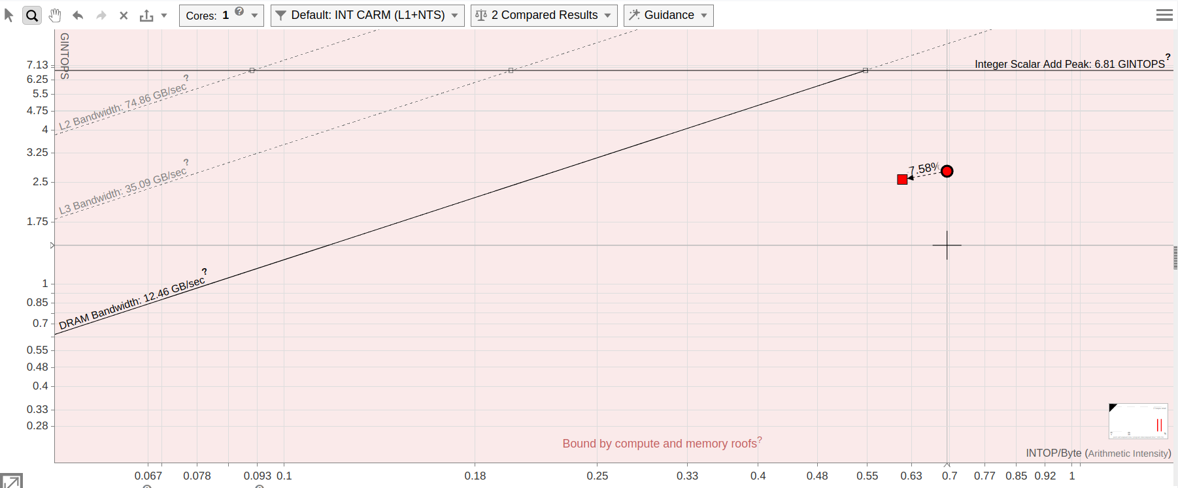
Picking the best implementation (2)
for (j = 0; j < M; j++) {
string2_temp = string2[j];
row_offset = j * N;
for (i = 0; i < N; i++) {
index = row_offset + i;
...
match_score = (string1[i] == string2_temp) ? MATCH : MISS_MATCH;
}
}
Outside
Inputs | lsal_plus1 | lsal_outside
N=32 M=65536 | 0.015844 | 0.014536
N=256 M=65536 | 0.120686 | 0.117629
N=256 M=300000 | 0.557866 | 0.538566

Slide 6
Software (Arm CPU)

Slide 7
The Arm Cortex-A9 is slower
lower clock frequency
smaller cache hierarchy
lack of out-of-order execution
Hitting the Memory Wall
Both CPUs are memory-bound, narrowing the gap

Slide 8
Hardware (FPGA)

Slide 9
Step 1: Serial logic
AXI Interface Mapping
Local Buffering
local_string1
local_west
local_northwest
prev_row
local_dir_row
Burst Writes: Writing the results back to external memory row-by-row .
Pipelining query and internal loop.
Metric | Result
Total Time (ms) | 254.111
CU Total Time (ms) | 178.206
LUT | 4,089 (7.69%)
Registers | 6,182 (N/A)
BRAM | 6 (4.29%)

Slide 10
Step 2
Anti-Diagonal Execution (Computing up to 32 cells concurrently.)
Local Database Fetching (local_string2):
Pre-loading 32 database characters before the internal loop begins.
Complete Array Partitioning:
3 diagonal buffers.
local strings and local direction buffer.
If-else structure for Priority Encoder:
Moved the global maximum tracking on the outside loop.
Metric | Result
Total Time (ms) | 99.573
CU Total Time (ms) | 69.359
LUT | 14,572 (27.39%)
Registers | 15,537 (N/A)
BRAM | 21 (15.0%)

Slide 11
Step 3
Arbitrary Types
3bit Query and Database
512bit wide word of 32 packed outputs
Shift-Register Window (local_string2_window)
5-Level Parallel Reduction Tree:
Finds the maximum in just 5 combinational steps (log2(32) = 5) instead of 32.
Metric | Result
Total Time (ms) | 13.304
CU Total Time (ms) | 8.614
LUT | 11,285 (21.21%)
Registers | 9,556 (N/A)
BRAM | 17 (12.14%)

Slide 12
Step 4
Elimination of the Similarity Matrix.
Direction Matrix Compression:
2bit directions instead of 16bits.
Metric | Result
Total Time (ms) | 7.722
CU Total Time (ms) | 4.816
LUT | 9,076 (17.06%)
Registers | 5,329 (N/A)
BRAM | 2 (1.43%)

Slide 13
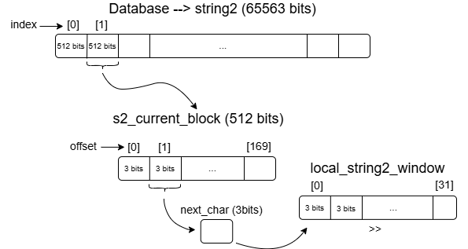
Step 5
Ultra-Wide Input Fetches (ap_uint<512>):
Fetching the complete Query at startup.
Fetching a 512bit block from Database only when needed
Metric | Result
Total Time (ms) | 1.991
CU Total Time (ms) | 0.729
LUT | 10.293 (19.35%)
Registers | 9.313 (N/A)
BRAM | 11 (7.86%)

