Slide 1
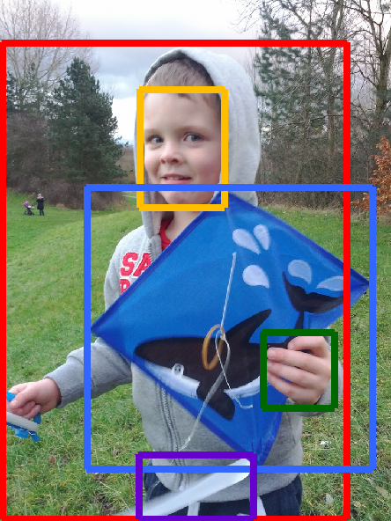
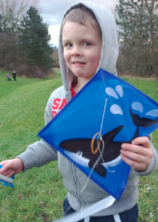


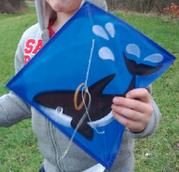

(a) ROI Proposals
(b) Agent Communication
(c) Object Labels
(d) Relation Labels
boy
pants
face
on
of
Relation Model
(e) Output Scene Graph
Graph Metric
Reward
holding
of
holding
kite
hand
Counterfactual Baseline Model
Baselines
Training Path
Test Path
Counterfactual Critic

