Slide 1
Good Coding Practice
Fanyi Wu

Slide 2
5 Good Coding Practice
Write Docstrings for Every Function, Class, and Module
Use None and Docstrings to Specific Dynamic Default Argument
Never Unpack More than three variables when functions return multiple values
Profile Before Optimizing
Use Virtual Environments for Isolated and Reproducible Dependencies

Slide 3
Software with good practice
https://github.com/Fanyi-Kaitlyn-Wu/Good_Practice.git
Sudoku Solver project
Solve any input Sudoku
Identify any false puzzles

Slide 4
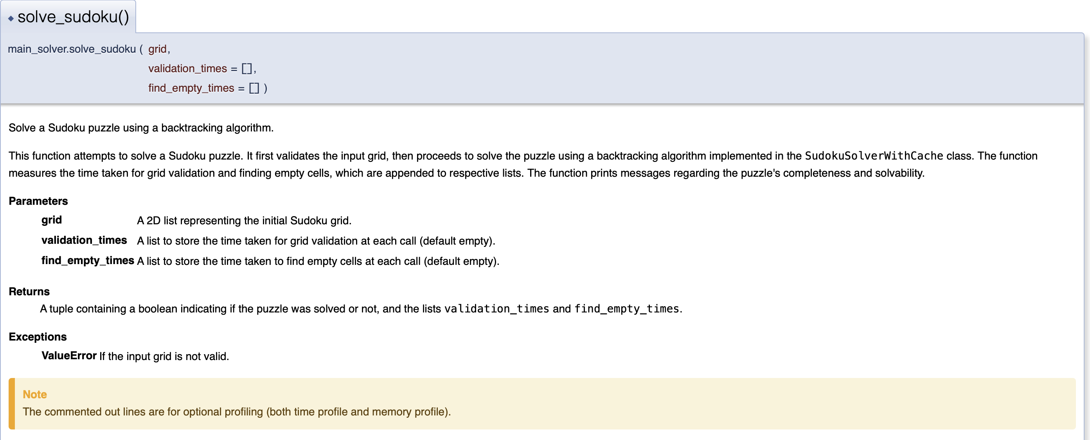
Write Docstrings for Every Function, Class, and Module
../docs/Doxyfile
../docs/html/ index.html

Slide 5
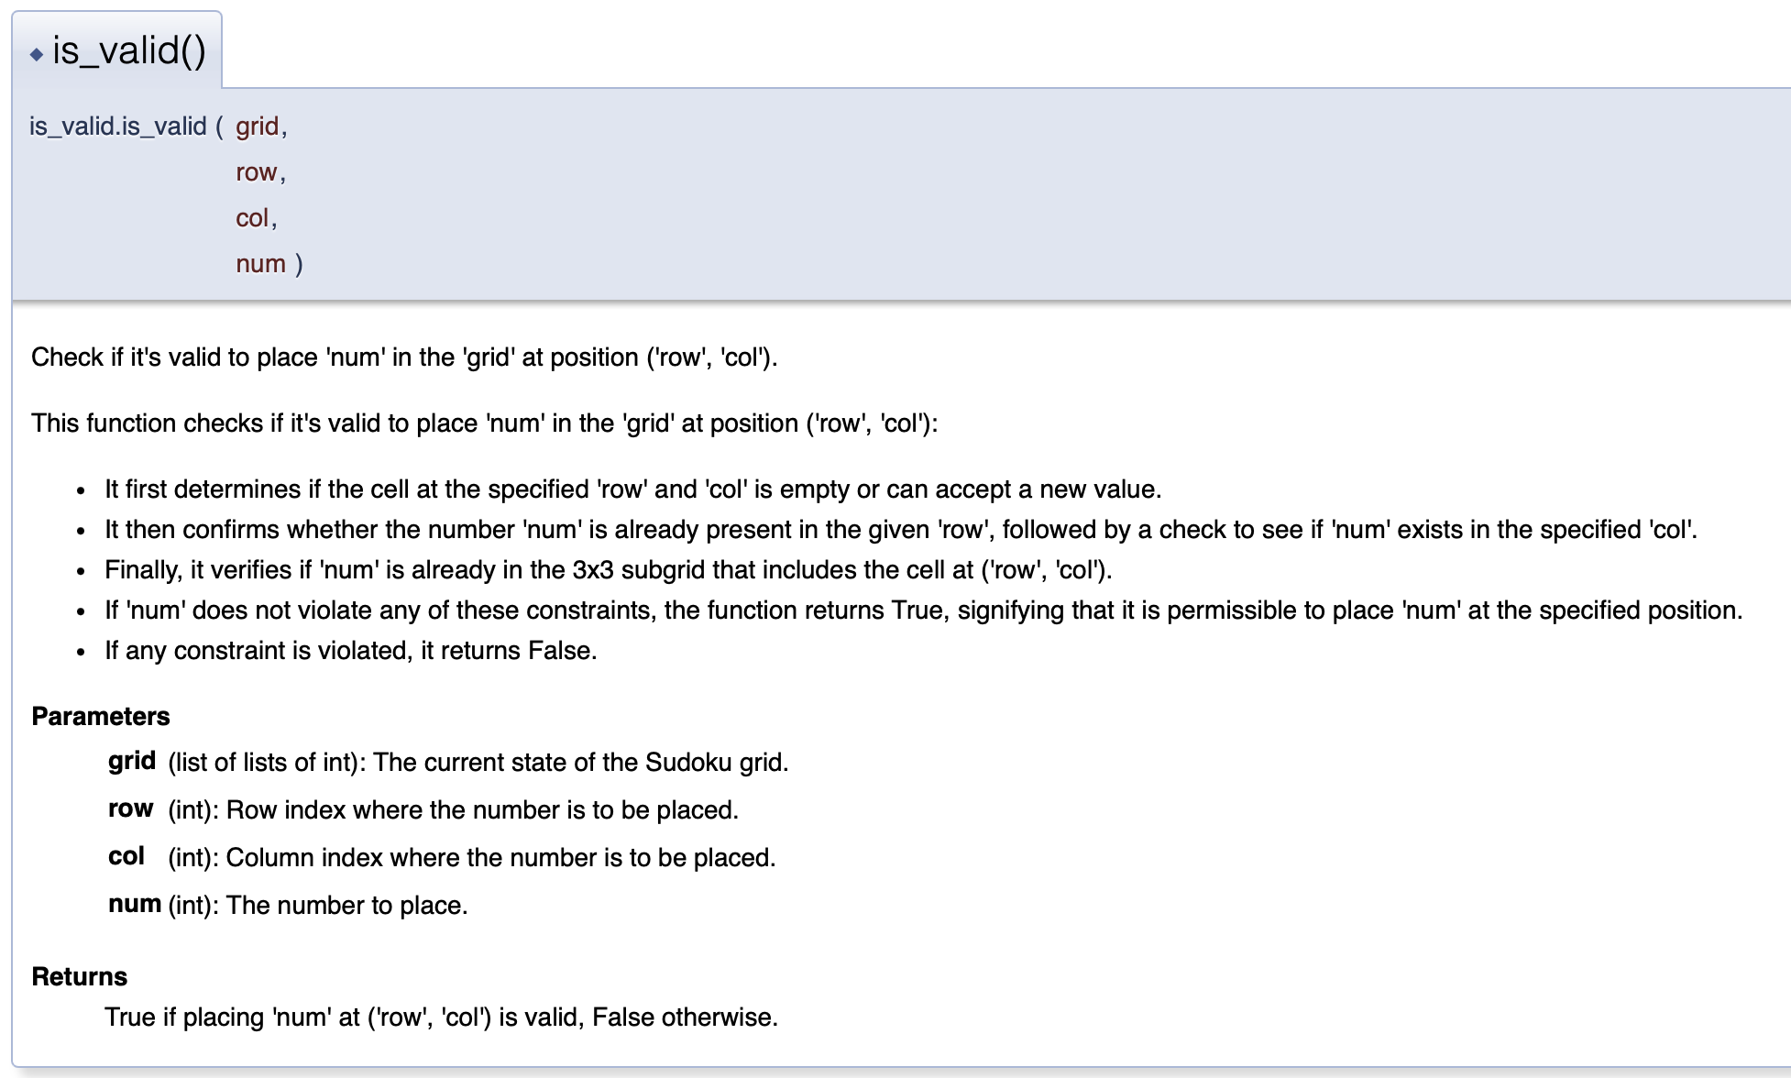
Use None and Docstrings to Specific Dynamic Default Argument
Dynamic default values for parameters
By documenting these dynamic defaults
transparent to other users or collaborators.

Slide 6
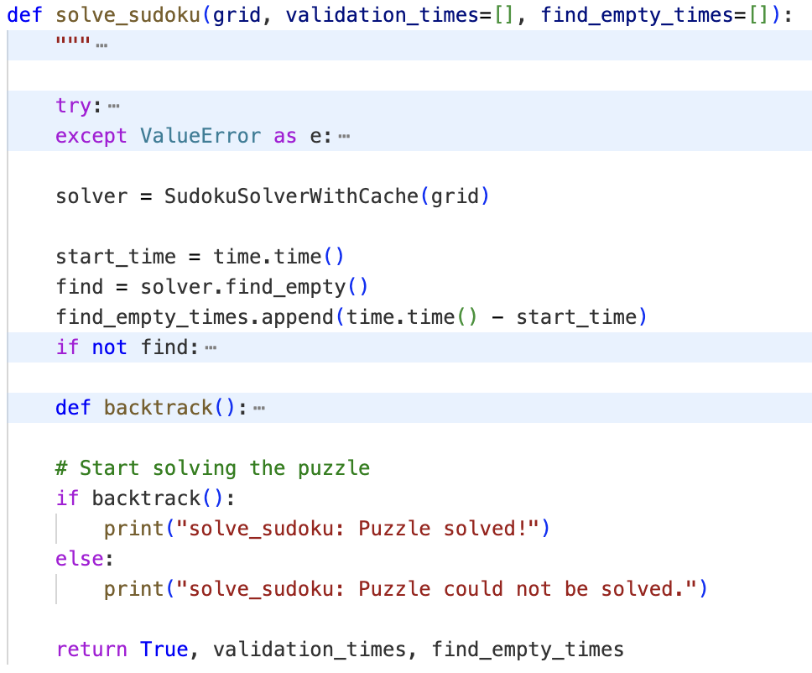
Never Unpack More than three variables when functions return multiple values
This practice keeps the code
manageable and understandable
Keeping the return values to a manageable number avoids confusion and reduces errors

Slide 7
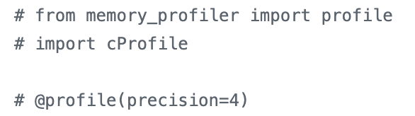
Profile Before Optimizing
../Profiles : time profile and memory profile
Helps identify the real bottlenecks
Ensuring the focus is on the parts of algorithm that genuinely need improvement.

Slide 8
Use Virtual Environments for Isolated and Reproducible Dependencies
../environment.yml
../Dockerfile
Ensures that the machine learning environment is consistent across different setups
Build Image: docker build -t sudoku-solver .
Run the Dockerfile: docker run -it sudoku-solver

Slide 9
Thank you !

