Slide 1
Py4AS Course Summary
November 2018

Slide 2
Outline
Python
Data Analysis
Atmospheric Sciences

Slide 3
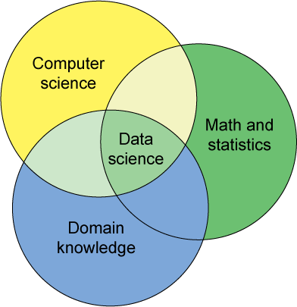
What is Data Science?
It is not totally new
Statistics
Computer Science
Domain Knowledge
It is not a new name for old stuff
Data science is a “data-driven” approach for decision making
電腦科學/資訊工程
數學、統計
領域知識/商業靈敏度
Notes:
所以，看完了這整個資料科學流程，到底什麼是資料科學？

Slide 4
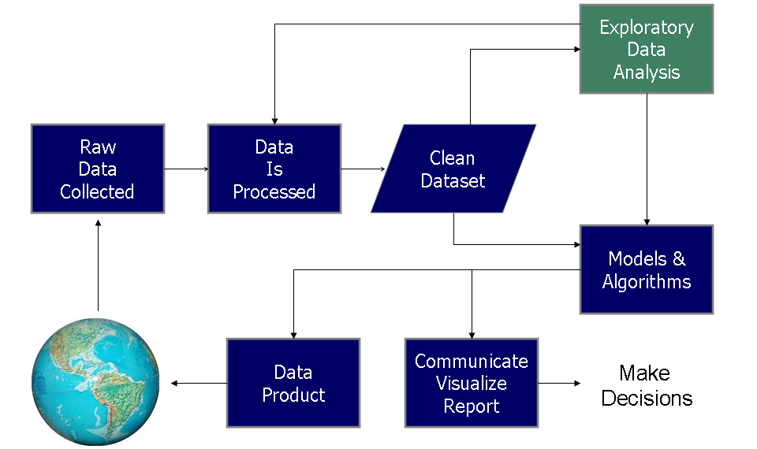
Data Science Process (資料科學流程)
https://en.wikipedia.org/wiki/Data_analysis#/media/File:Data_visualization_process_v1.png

Slide 5
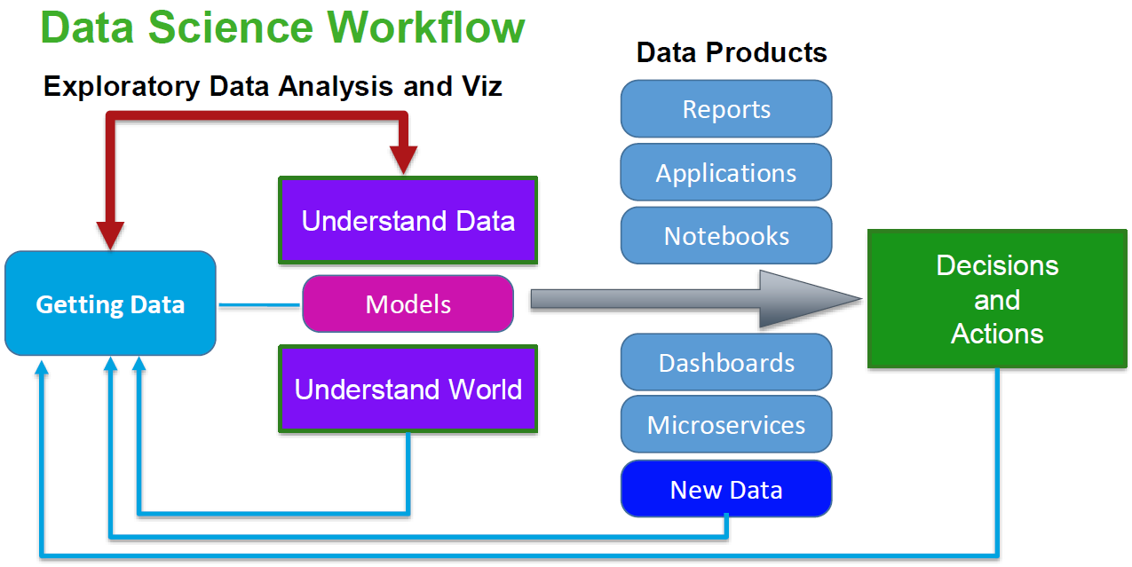
Data Science Process (資料科學流程)

Slide 6
What We Have Talked in This Course
Python Basics
Exploratory Data Analysis
Data Manipulation
Data Visualization

Slide 7
What Skills You (Should) Obtained
Basic Python programming
package management with pip and conda
Variables and controls
Functions
Built-in data structures
Some useful libraries
Data Processing
Subset, cleaning, merging, reshaping,…
Data Analysis
Basic statistics
Basic graphics
Advanced statistics
All with libraries
Data Visualizations
Show the meaning of data
Graphics with maps

Slide 8
Takeaways (Beyond the Skills)
Python is currently the best programming language for data analysis, and this will stay true for 5 ~ 10 years.
The world keeps changing, rapidly, so don’t rely on one single skill.
The generalizable concepts behind the skills will last much longer:
The logic of programming, data structures, and algorithms.
Mathematics and statistics.

Slide 9
Takeaways (Beyond the Skills)
How deep shall I dive into the technology behind?
The deeper your understanding is, the more you can do with it.
Go as deep as you can, but don’t forget the tasks at hands
No one can be fully prepared for coming challenges
Search for answers or examples
Read manuals
Learn how to learn
Ask for help

Slide 10
Questions?

