Slide 1
Ridez
Take Somebody With You

Slide 2
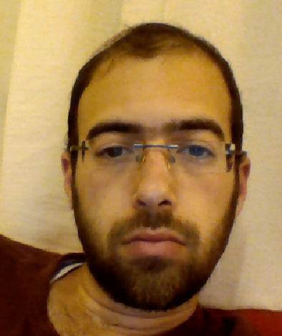
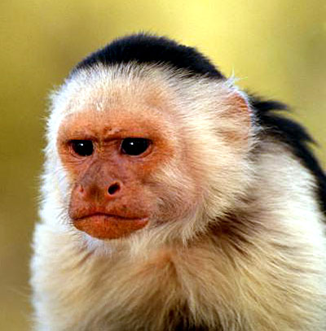
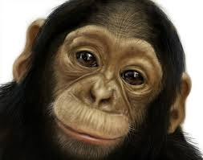
Ridez Team
Simcha Adin
Tzvi Corn
Tzachi Taub
https://github.com/TRILILILI

Slide 3
Concept
Someones have a car.
Someones doesn’t have, but they want to go to the same place as the with-car guys.
Lets connect them.

Slide 4
Market Research
There are no apps like this already.
הלוואי

Slide 5
Uniqueness
Hmmm...

Slide 6
Schematic

Slide 7
Learning

Slide 8
Tasks

Slide 9
Lets ride

