Slide 1
Discover UEFI with U-Boot
2020-02-01, Heinrich Schuchardt
CC-BY-SA-4.0

Slide 2
About Me
Software-Consultant ERP, Supply Chain
Contributor to U-Boot since 2017
Maintainer of the UEFI sub-system
since 02/2019

Slide 3
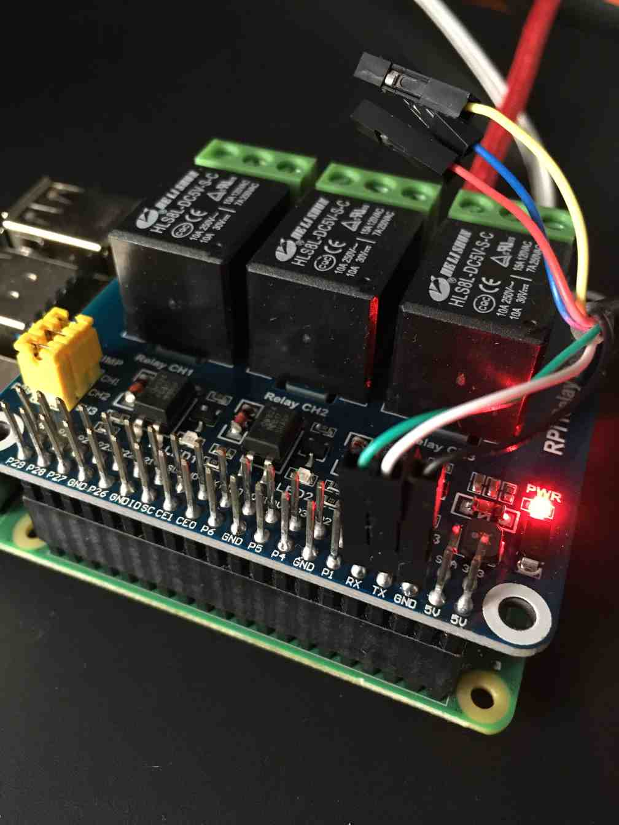
I Want a Network Drive
Many single board computers have neither SATA nor PCIe.
For many boards Ethernet is the fastest connector.
An SSD drive costs more than most SBCs.

Slide 4
Network Booting in U-Boot
BOOTP
BOOTP server provides tFTP server address and name of boot script
Boot script loads kernel via tFTP or NFSv3 (UDP)
No authentication at all
tFTP
NFSv3

Slide 5
iSCSI
SCSI protocol transported via TCP
Offers entire data stores (LUNs) to iSCSI client
Mutual authentication of client and server
with CHAP: MD5(ID + secret + challenge)
Further security via VLAN separation and IPsec

Slide 6

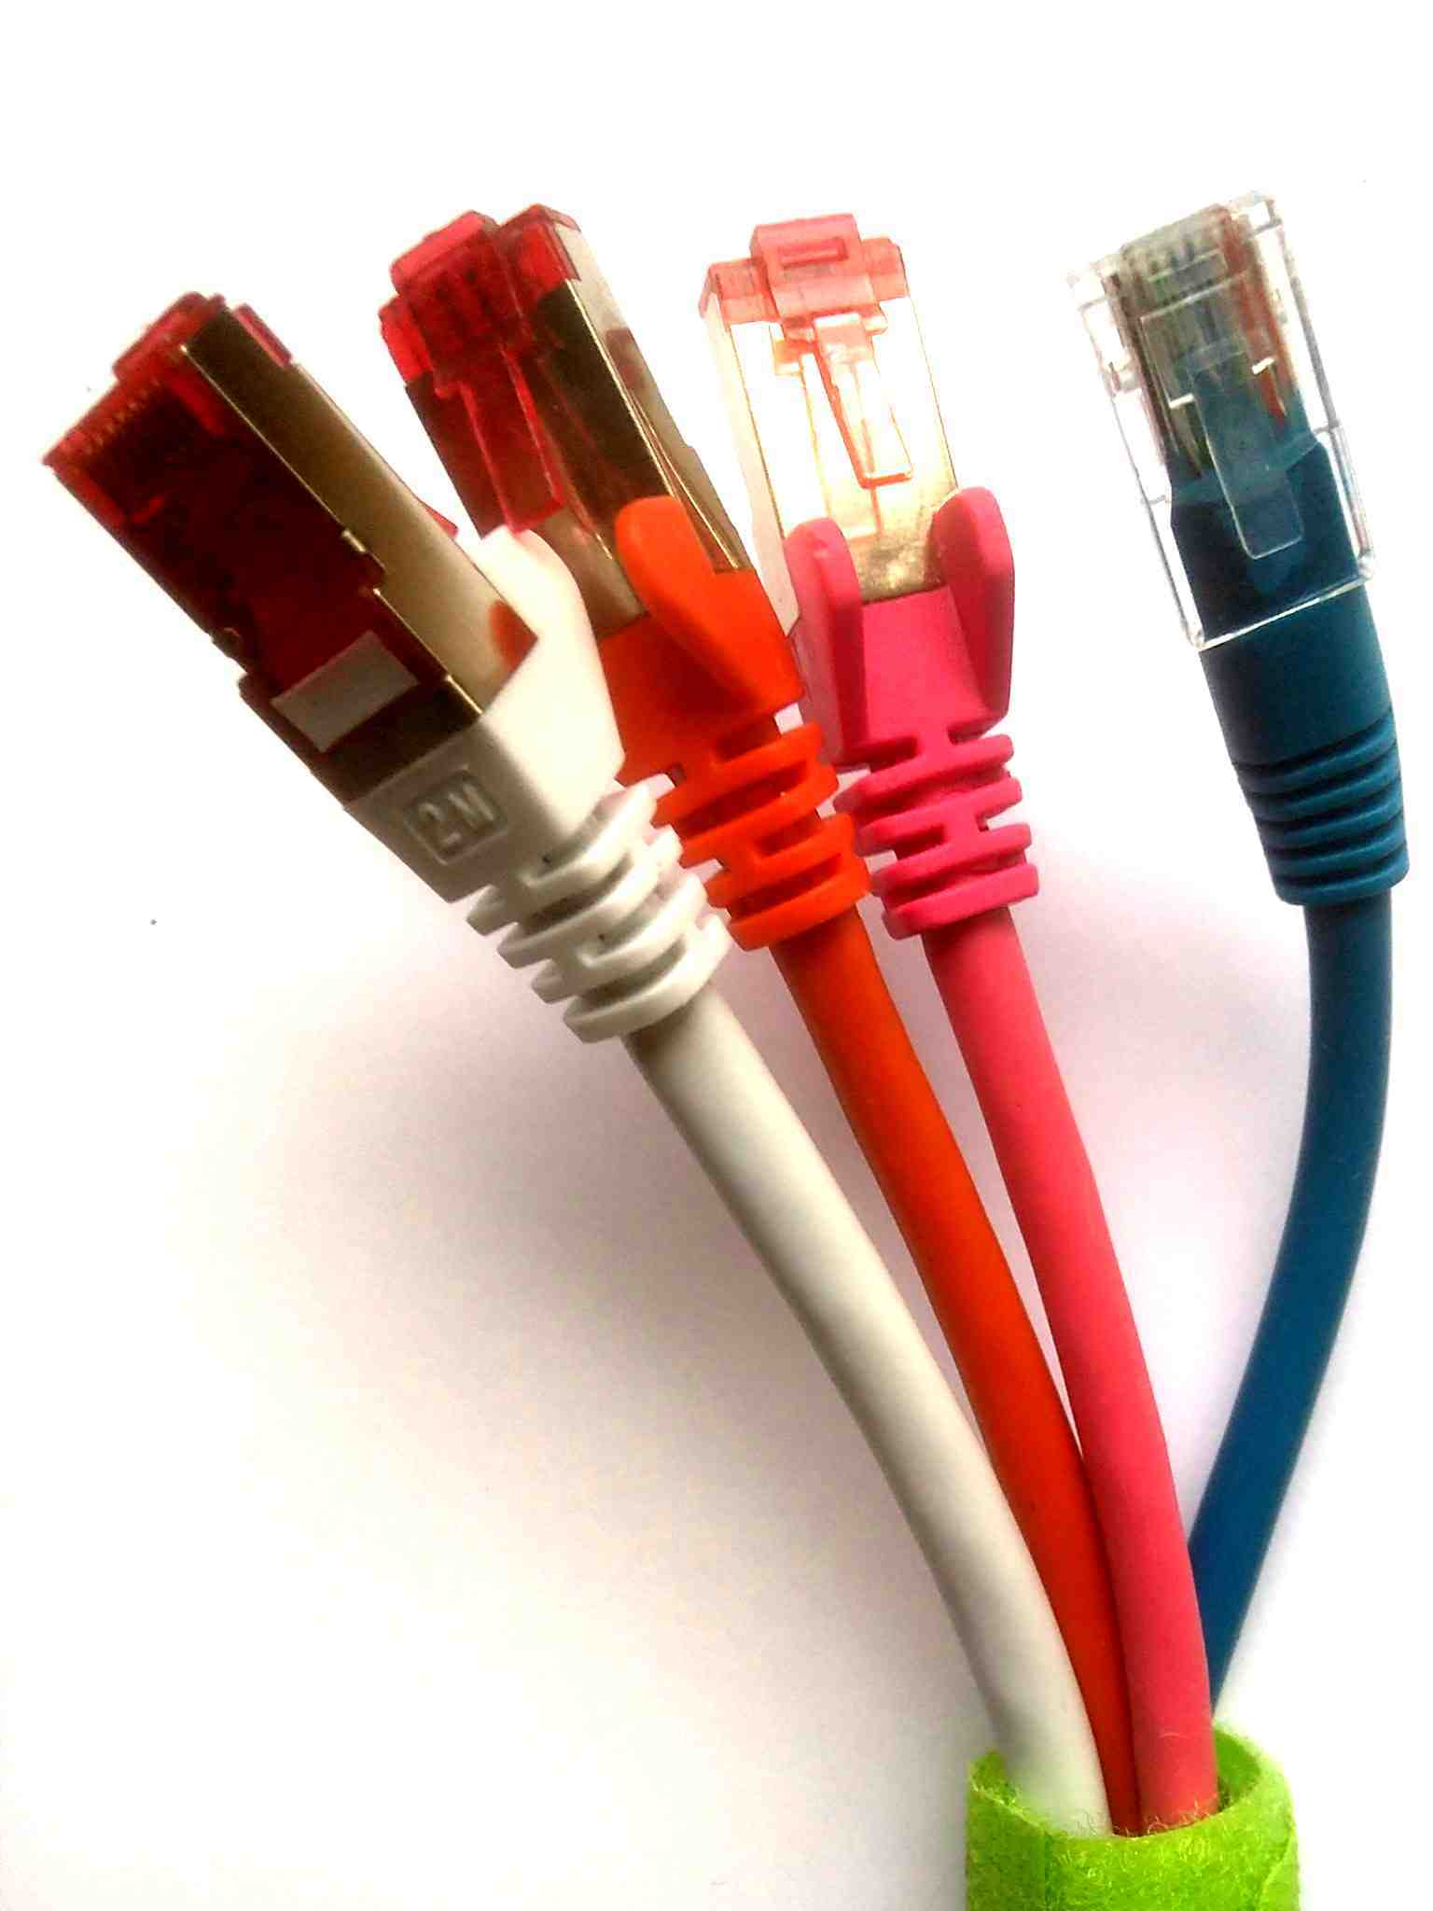
iPXE
Swiss army knife of network booting:
Boot from HTTP(s) server
Boot via iSCSI
Boot via FCoE (Fibre Channel over Ethernet)
Boot via AoE (ATA over Ethernet)
Scriptable
Can be built as UEFI payload
See https://ipxe.org,
Developer Michael Brown <mcb30@ipxe.org>

Slide 7
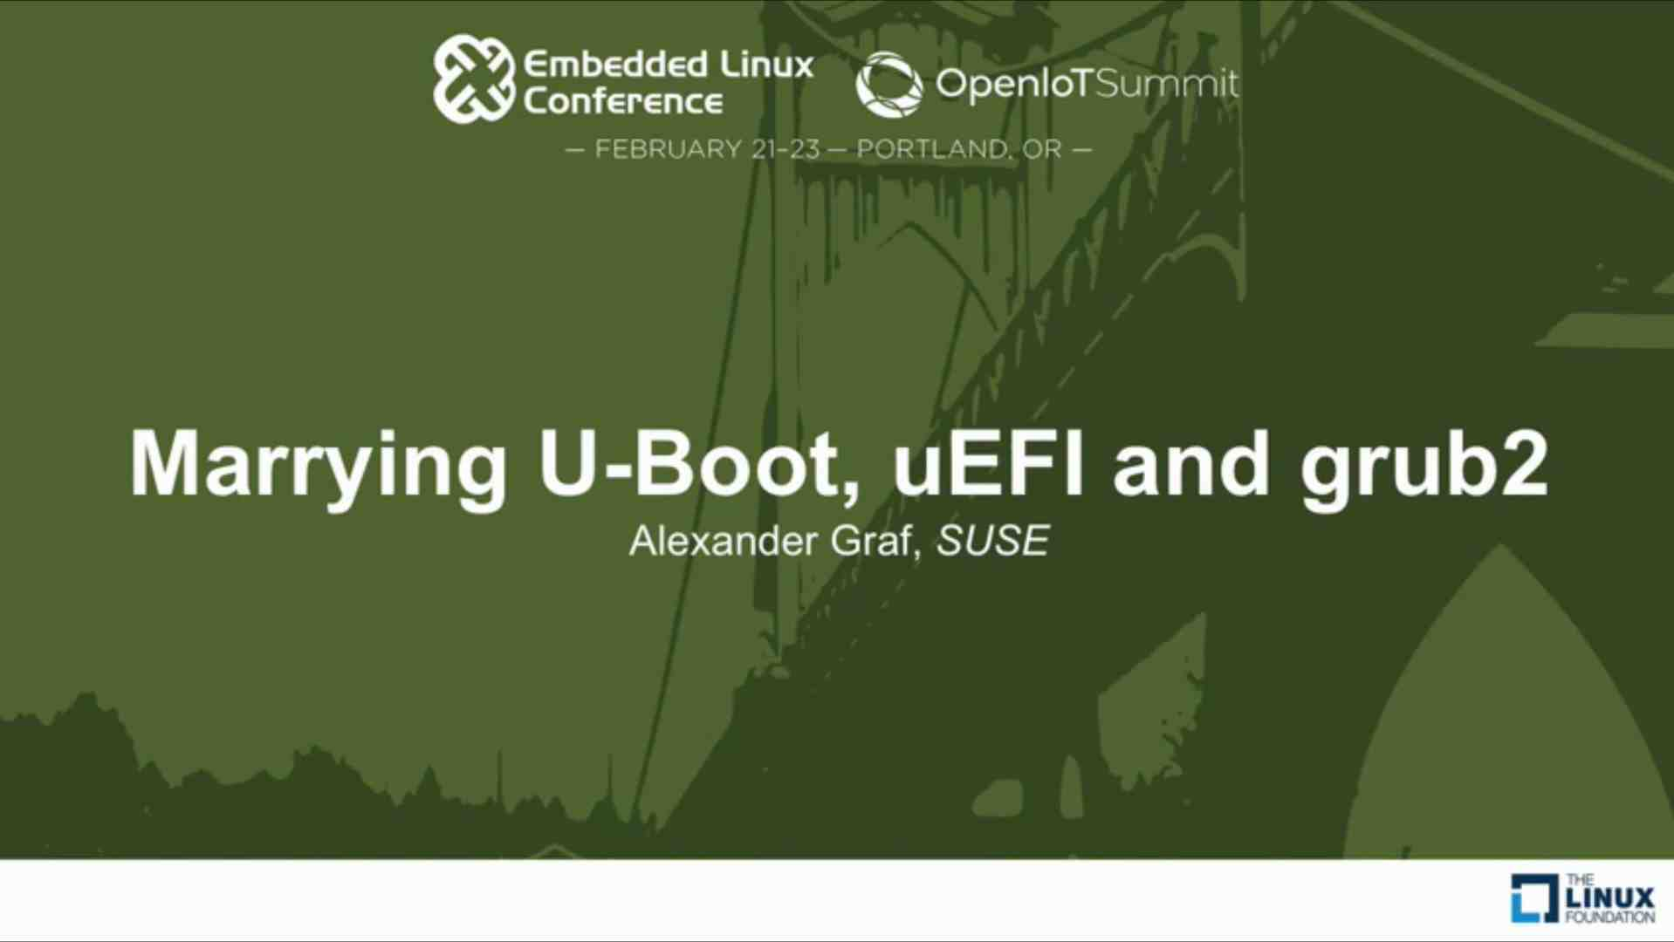
UEFI in U-Boot Started 2016

Slide 8
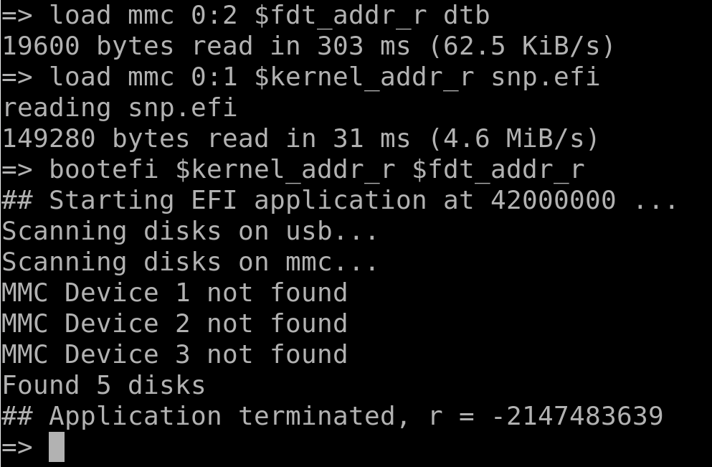
First Try
-2147483639 = 0x80000009 = EFI_OUT_OF_RESOURCES

Slide 9
My U-Boot Journey Begins
Bare Minimum
to start GRUB
iSCSI boot
with iPXE
Run EFI Shell
and EDK II SCT
2016/17
2018
2019
together with 40 UEFI sub-system contributors

Slide 10
Where Sits UEFI?
Booting with ATF on ARMv8
Operating System
BSD, Linux, Windows
UEFI
Trusted Apps
Boot Loader
GRUB, iPXE
BL31
EL3 Runtime
BL32
Secure EL1 Firmware
PSCI
OP-TEE OS
BL33
U-Boot, EDK2, ...
BL2
Trusted Boot Firmware
BL1
Boot ROM
ATF – ARM Trusted Firmware
OP-TEE – Open Portable Trusted Execution Environment
PSCI – Power State Coordination Interface
UEFI – Unified Extensible Firmware Interface

Slide 11
UEFI
System Table
Boot Services
Run Time Services
Protocols
Events, timers, task priority
Variable services
Device path
Memory allocation
Time services
Driver model
Protocol handling
Virtual memory services
Console support
Image services
Miscellaneous
Media access
Miscellaneous
Network protocols
Configuration Tables
ACPI
SMBIOS
Device Tree

Slide 12

“Atoms” of UEFI
Handles
  void* pointer
  Protocols are installed on handles
Events
  Triggered by timer or service call
  Callback function

Slide 13
Lifetime of a Handle
Creation by
installing first protocol
Deletion by
removing last protocol
InstallProtocolInterface
InstallMultipleProtocolInterfaces
UninstallProtocolInterface
UninstallMultipleProtocolInterfaces

Slide 14
Driver
Handle with EFI_DRIVER_BINDING_PROTOCOL
  GUID
  {0x18A031AB, 0xB443, 0x4D1A, {0xA5, 0xC0, 0x0C, 0x09, 0x26, 0x1E, 0x9F, 0x71}}
  Protocol Interface Structure
    Supported()
    Start()
    Stop()
    Version
    ImageHandle
    DriverBindingHandle

Slide 15
Device (aka Controller)
Handle with the EFI_DEVICE_PATH_PROTOCOL
  Sequence of device path nodes
  Arranges devices in a tree
PciRoot(0x0)
PciRoot(0x0)/Pci(0x1,0x1)
PciRoot(0x0)/Pci(0x1,0x1)/Pci(0x0,0x0)/NVMe(0x1,AD-A9-B1-73-55-38-24-00)
PciRoot(0x0)/Pci(0x1,0x1)/Pci(0x0,0x0)/NVMe(0x1,AD-A9-B1-73-55-38-24-00)
/HD(1,GPT,F24494A4-585B-4E34-A367-4DC70CFFC93D,0x800,0x1DC800)
PciRoot(0x0)/Pci(0x8,0x2)
PciRoot(0x0)/Pci(0x8,0x2)/Pci(0x0,0x0)/Sata(0x0,0x0,0x0)
/HD(1,GPT,11C3D446-F6E4-4C67-937E-992AFC6F454F,0x800,0x108800)

Slide 16
Attaching Drivers
ConnectController() boot service
  calls Supported() methods of all drivers
  to find matches for controller
  calls Start() method of the matching drivers
Driver
  installs protocols on controller
  may create child controllers

Slide 17
U-Boot Exposes Ethernet
U-Boot’s UEFI
sub-system
U-Boot
Drivers
EFI Block Device Driver
Simple Network
Protocol
Network Driver

Slide 18
U-Boot Provides Network
U-Boot exposes handle with
  EFI_SIMPLE_NETWORK_PROTOCOL
  transmits layer 2 Ethernet frames
  EFI_DEVICE_PATH_PROTOCOL
  /VenHw(U_BOOT_GUID)/MAC(e52c7d926d5c,1)

Slide 19
U-Boot EFI Block Device Driver
U-Boot provides a driver that binds to handles exposing the the EFI_BLOCK_IO_PROTOCOL
EFI_BLOCK_IO_PROTOCOL
  Read from and write to block device, e.g.
  SATA, NVMe, SD-card, eMMC, USB

Slide 20
iPXE Exposes Block IO Protocol
iPXE
U-Boot’s UEFI
sub-system
U-Boot
Drivers
Block IO
Protocol
EFI Block Device Driver
iSCSI Driver
TCP/IP Driver
Simple Network
Protocol
Network Driver

Slide 21
iPXE Network Handle
iPXE creates new handle with
  EFI_SIMPLE_NETWORK_PROTOCOL
  EFI_NETWORK_INTERFACE_IDENTIFIER_PROTOCOL
  EFI_NETWORK_INTERFACE_IDENTIFIER_PROTOCOL_31
  EFI_COMPONENT_NAME2_PROTOCOL
  EFI_LOAD_FILE_PROTOCOL
  EFI_DEVICE_PATH_PROTOCOL
  /VenHw(U_BOOT_GUID)/MAC(e52c7d926d5c,1)/MAC(e52c7d926d5c,1)

Slide 22
IPXE Block Device Handle
iPXE creates new handle with
  EFI_BLOCK_IO_PROTOCOL
  EFI_DEVICE_PATH_PROTOCOL
  /VenHw(U_BOOT_GUID)/MAC(e52c7d926d5c,1)/MAC(e52c7d926d5c,1)
  /VenHw(IPXE_BLOCK_DEVICE_PATH_GUID,
  "iscsi:192.168.1.9:::1:iqn.2000-01.de.xypron:pine-a64-lts")

Slide 23
iPXE Connects Controller
iPXE
U-Boot’s UEFI
sub-system
U-Boot
Drivers
Block IO
Protocol
EFI Block Device Driver
iSCSI Driver
TCP/IP Driver
Simple Network
Protocol
Network Driver

Slide 24
ConnectController
iPXE calls ConnectController() for handle with EFI_BLOCK_IO_PROTOCOL
U-Boot identfies the driver via the supported() method of the EFI_DRIVER_BINDING_PROTOCOL
U-Boot starts the driver

Slide 25
U-Boot Discovers Partitions
iPXE
U-Boot’s UEFI
sub-system
U-Boot
Drivers
Simple
File Protocol
FAT Driver
Block IO
Protocol
EFI Block Device Driver
iSCSI Driver
TCP/IP Driver
Simple Network
Protocol
Network Driver

Slide 26
U-Boot Block IO Driver
Creates U-Boot block IO device
Analyses partition table
Creates new handles for each partition and installs
  EFI_SIMPLE_FILE_SYSTEM_PROTOCOL
  EFI_BLOCK_IO_PROTOCOL
  EFI_DEVICE_PATH_PROTOCOL
  /VenHw(U_BOOT_GUID)/MAC(e52c7d926d5c,1)/MAC(e52c7d926d5c,1)
  /VenHw(IPXE_BLOCK_DEVICE_PATH_GUID,
  "iscsi:192.168.1.9:::1:iqn.2000-01.de.xypron:pine-a64-lts")
  /HD(1,MBR,0x4a8807bd,0x800,0x2f000)

Slide 27
iPXE and U-Boot Loading File
iPXE
U-Boot’s UEFI
sub-system
U-Boot
Drivers
Load File
Protocol
Simple
File Protocol
FAT Driver
Block IO
Protocol
EFI Block Device Driver
iSCSI Driver
TCP/IP Driver
Simple Network
Protocol
Network Driver

Slide 28
GRUB Loading Kernel
GRUB
iPXE
U-Boot’s UEFI
sub-system
U-Boot
Drivers
GRUB Binary
Simple
File Protocol
FAT Driver
Block IO
Protocol
EFI Block Device Driver
iSCSI Driver
TCP/IP Driver
Simple Network
Protocol
Network Driver

Slide 29

Take Away
Providing UEFI in U-Boot as a standardized API allows for easy integration with other software

Slide 30
Implementation Events
U-Boot is single threaded
No interrupts supporting networking, timers
Call event handling routines in
  console routines
  network routines
  CheckEvent(), WaitForEvent(),
  RestoreTPL(), Stall()

Slide 31
Integration of UEFI sub-system
U-Boot is in the middle of moving from legacy drivers to a device tree based driver model
UEFI sub-system sits on top of U-Boot rather than being integrated into U-Boot driver model

Slide 32
Development Targets
Support subset of UEFI specification
  Embedded Base Boot Requirements (EBBR)
    Boot services
    Run time services
    Required elements according to
    UEFI 2.8, chapter 2.6
Stay small
  31000 lines, ca. 70 kiB in U-Boot binary

Slide 33
Achievements in 2019
Missing boot services added
Major improvements in UEFI standard compliance
https://github.com/U-Boot-EFI/u-boot-sct-results
U-Boot runs EFI shell on ARM, x86, x86_64
U-Boot runs EDK II SCT on ARM, x86

Slide 34
Usage in Distributions
Fedora, Suse use GRUB EFI by default to boot from U-Boot to Linux
OpenBSD and FreeBSD rely on U-Boot UEFI for booting.
The Debian installer sets up GRUB EFI if started via UEFI. Manual setup is needed to get DTB updates.

Slide 35
Fedora Wiki (2018-07-03)
We've supported uEFI on aarch64 as the only way of booting Fedora supporting both Tianocore, proprietary uEFI implementations and since Fedora 27 we've supported uEFI via u-boot too.
The uEFI provided by u-boot is now stable enough that we can now move ARMv7 to this method too allowing us to move ARMv7 to grub2-efi and have a single standard booth path/stack for both ARMv7 and aarch64.
https://fedoraproject.org/wiki/Changes/uEFIforARMv7

Slide 36
TODOs
Fix remaining SCT compliance issues
Support for variables at runtime
Secure UEFI boot
Integration with U-Boot’s driver model -
depends on completion of U-Boot’s conversion to driver model

Slide 37
Work in Progress
Verified UEFI Boot via FIT images
Cristian Ciocâltea
UEFI Secure Boot
Takahiro Akashi (Linaro)
EFI_RNG_PROTOCOL based on hardware RNG
Sugosh Gani (Linaro)

