Slide 1

Cross-Application Web API Authorization using a Centralized Server
Design Phase (Review-1)
Presented by:
U Chanakya Srinivas
Bhanuprasad L
Rohit V Raichur
Shreyas G Trivikram
Guide: Rajesh N, Assistant Professor
Co-Guide: Shwetha S , Assistant Professor

Slide 2

Abstract
Network Service Security is an important aspect that developers of a service always need to be careful at. Preventing DDOS attacks, stealing of access tokens, management of access tokens, hashing the passwords and verifying the service requests are part of it.
Since, Authorization and Authentication of network services is a common process, Having a centralized system and a standard communication protocol can be helpful to save time, resources and maintenance burden for the organizations.

Slide 3

Introduction
A Web service usually consists of a server and database, which a web client can use by authenticating with it. Currently, Most of the communications between the client and server use REST architectural style through HTTP or simply RESTful API. The client requests resources through URL-encoded params to access the specific resource provided by the server. The request and responses are usually formatted as JSON.
Not all the requests are authorized to access the services. Like only owner can access only his private information but not others, which requires the owner proving that they are the owner of that resources, which we call “Authentication”. While the process of granting authenticated party a permission to do something is called “Authorization”. JSON Web Tokens is a standard that can be used for communicating the information of Authentication and Authorization between client and servers, where server issues one such JWT if the user is a valid owner and JWT can store stateless information about the access rights etc.
Which mostly leans towards decentralization of access control….

Slide 4
Objectives
To centralize the Authorization Process across multiple services
To centralize the third-party access management
To develop a library of functions for the preceding objectives

Slide 5
Literature survey
Links:
https://en.wikipedia.org/wiki/Representational_state_transfer
https://en.wikipedia.org/wiki/Kerberos_(protocol)
https://oauth.net/2/
https://auth0.com/docs/get-started/auth0-overview
https://www.rfc-editor.org/rfc/rfc7519
https://auth0.com/blog/what-is-an-authentication-server/
IEEE Papers:
Y. Wang, Q. Wen and H. Zhang, "A Single Sign-On Scheme for Cross Domain Web Applications Using Identity-Based Cryptography", 2010, pp. 483-485, doi: 10.1109/NSWCTC.2010.120
B. Leiba, "OAuth Web Authorization Protocol," in IEEE Internet Computing, vol. 16, no. 1, pp. 74-77, Jan.-Feb. 2012, doi: 10.1109/MIC.2012.11.
V. Krylov, N. Volkova and Y. Kozina, "Information technology of user authentication in cross-platform systems", 2017, pp. 952-954, doi: 10.1109/IDAACS.2017.8095227.

Slide 6
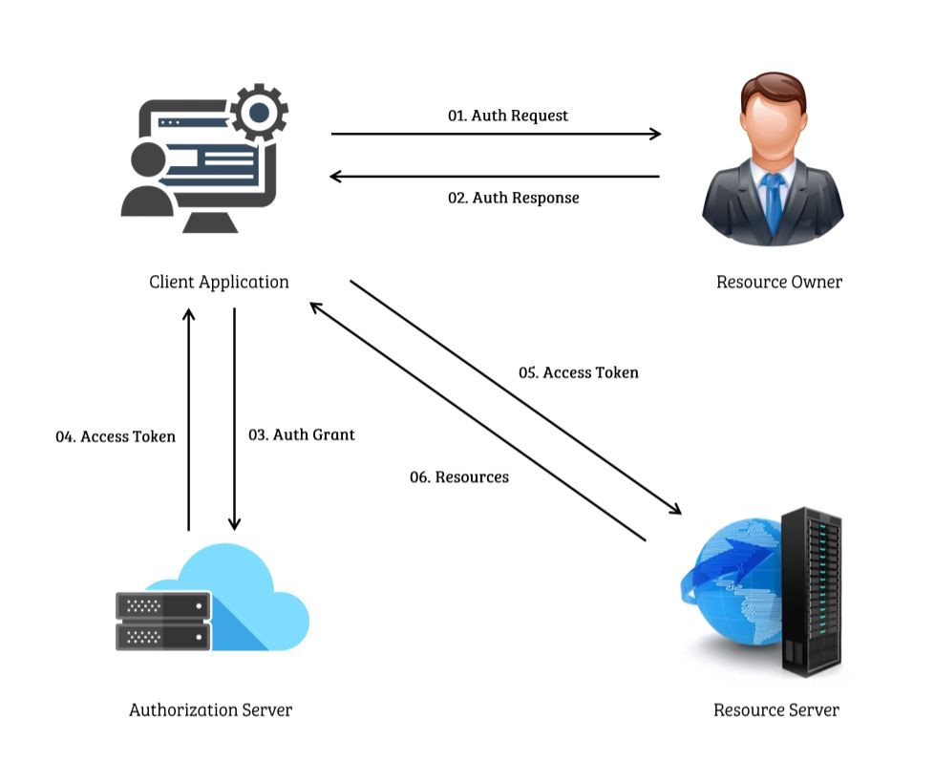
Existing System
For developers building their service/client that needs to fetch resources from other services, They need to build their own solution and while also, providing their own custom solution for authorize and authenticate users of their service too
This can cause inconsistencies across multiple services despite being built by same organization while also taking additional cost, time and risk each time
This custom solution makes it harder and more manpower for migration and maintenance in the future
Ex: OAuth 2.0 Working

Slide 7
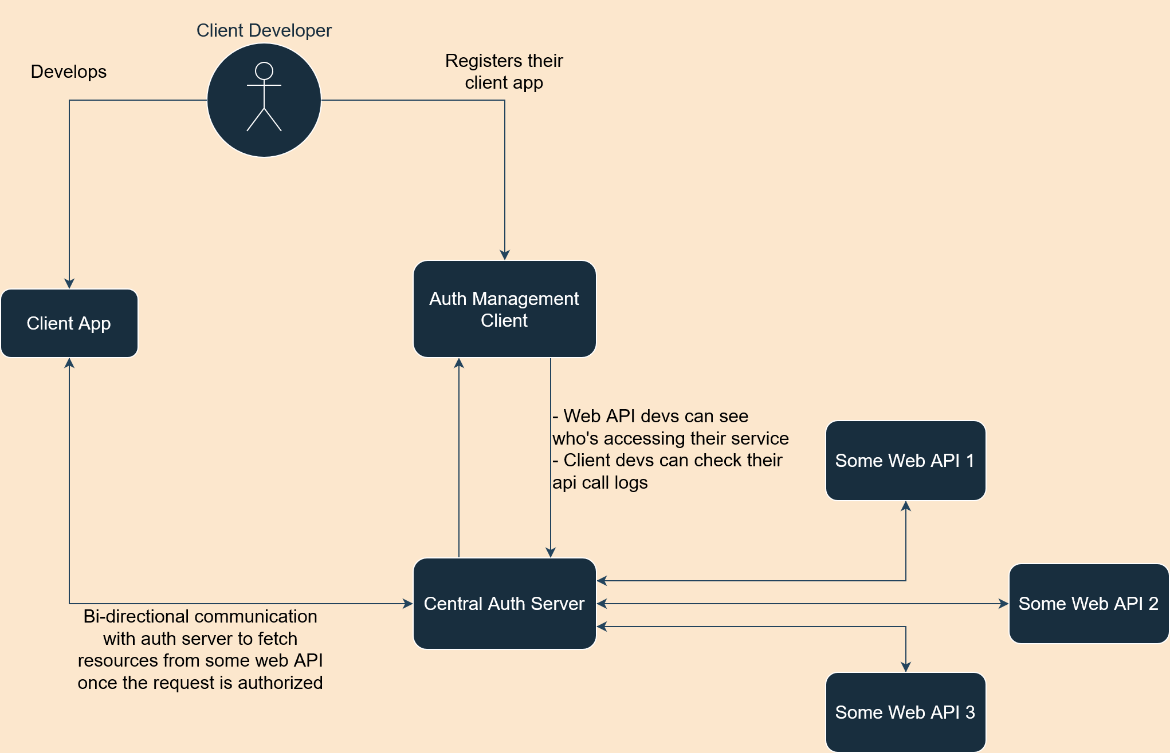
Proposed system
If there exists a set of services, we centralize the access control process and management for easier management of services and development.
The client developer can request access to any of these services specifically. Once the service provider grants the permission, The client developer links his client application with a service. Unlike existing systems, The client developer gets to use the standard library developed as part of this project, which can easily call the service.
While the service provider can also use this standard library to rapidly initialize the authorization server and integrate his service with this server or already existing server, its up to the service provider to decide whether all the client requests should pass through this centralized server to access the service

Slide 8
Hardware Requirements
Memory : 8GB RAM or above
Processor : intel 8th gen, AMD Zen 2 or above
Disk : Minimum 5GB free space
Software Requirements
Operating System : Linux kernel v3.2 / Windows build 1809 or higher
Processor : intel 8th gen, AMD Zen 2 or above
Tools and Runtimes : NodeJS v14+, Git

Slide 9

Thank you

