Slide 1

Cross-Application Web API Authorization using a Centralized Server
Design Phase
Presented by:
U Chanakya Srinivas
Bhanuprasad L
Rohit V Raichur
Shreyas G Trivikram
Under the Guidance of :
- Rajesh N, Assistant Professor
- Shwetha S , Assistant Professor
Department of Information Science and Engineering,
NIE Mysore

Slide 2



Abstract
Network Service Security is an important aspect that developers of a service always need to be careful at. Preventing DDOS attacks, stealing of access tokens, management of access tokens, hashing the passwords and verifying the service requests are part of it.
Since, Authorization and Authentication of network services is a common process, Having a centralized system and a standard communication protocol can be helpful to save time, resources and maintenance burden for the organizations.

Slide 3
Introduction
Currently, Most of the communications between the client and server use REST architectural style through HTTP or simply RESTful API. The client requests resources through URL-encoded params to access the specific resource provided by the server. The request and responses are usually formatted as JSON.
Not all the requests are authorized to access the services. Owner can access only his private information but not others, which requires the owner proving that they are the owner of that resources, which we call “Authentication”. While the process of granting authenticated party a permission to do something is called “Authorization”.
JSON Web Tokens is a new standard that can be used for communicating the information of Authentication and Authorization between client and servers, where server issues one such JWT if the user is a valid owner and JWT can store stateless information about the access rights etc.
All this mostly leans towards decentralization of access control….

Slide 4
Objectives
To centralize the Authorization Process across multiple services
01
To centralize the third-party access management
02
To develop a library of functions for the preceding objectives
03

Slide 5
Literature Survey
Information Technology of User Authentication in Cross-Platform Systems
Author : Victor Krylov, Natalya Volkova, Yuliya Kozina
Description : Authors proposed the information technology of user authentication for cross-platform systems has been developed, which is characterized by high reliability and efficiency. Additional researches on the appearance of collisions while generating unique keys for user authentication have been carried out. In conditions of information technology growth, systems which are being developed to be used on multiple platforms, gain in importance and popularity. As a rule, such systems have client-server architecture and have strong security requirements for user authentication.

Slide 6
A Single Sign-On Scheme For Cross Domain Web Applications Using Identity-Based Cryptography
Authors : Yanjiong Wang1 , Qiaoyan Wen, Hua Zhang
Description : Authors proposed a novel scheme to satisfy the requirement of cross domain application single sign-on. Identity based encryption and signature have been applied in this protocol, which supports the progress of single sign on between heterogeneous target systems. A ticket can roam from a single sign on domain to the other. The communication between application servers, in this scheme, we use identity-based encryption to protect the data safety; the data transfer between user’s browser and servers we choose session key to prevent attacking.
OAuth Web Authorization Protocol
Authors : Barry Leiba
Description : Barry Leiba’s paper discuss about Internet identity management is an umbrella that covers several related problems, all which stem from our use of multiple Internet services that come from different providers and reside in different trust domains. For each domain, we have a separate identity and use separate authentication. Where NSTIC seeks to consolidate these identities through central management, and software such as password managers tries to make it easier to manage authentication credentials for our various identities .

Slide 7
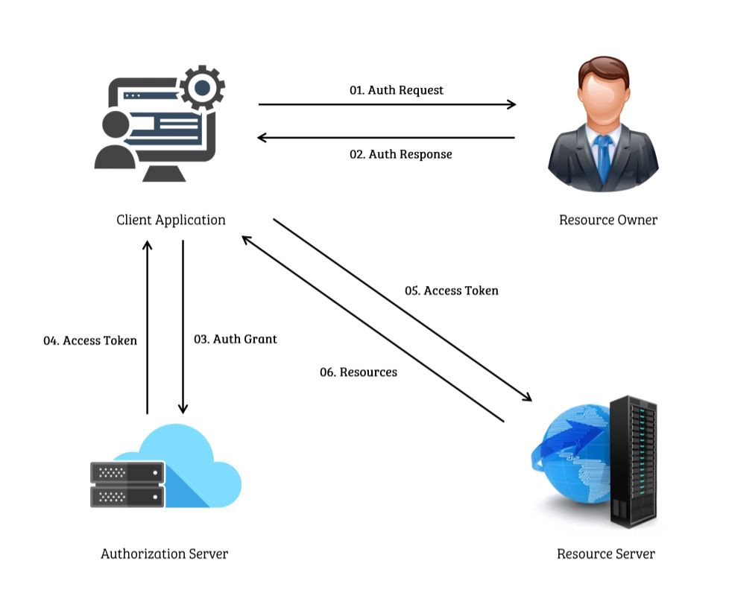
Existing System
For developers building their service/client that needs to fetch resources from other services, They need to build their own solution and while also, providing their own custom solution for authorize and authenticate users of their service too
This can cause inconsistencies across multiple services despite being built by same organization while also taking additional cost, time and risk each time
This custom solution makes it harder and more manpower for migration and maintenance in the future
Ex: OAuth 2.0 Working

Slide 8
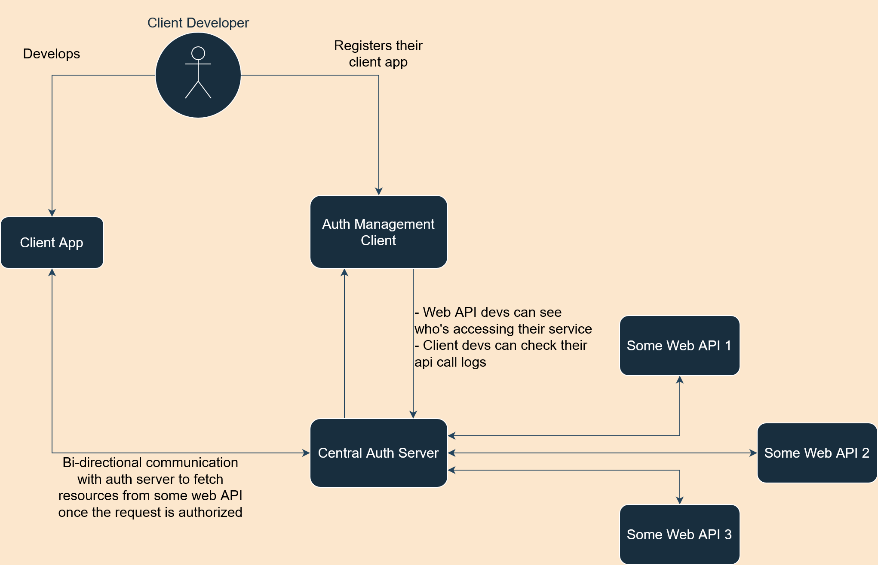
Proposed system
If there exists a set of services, we centralize the access control process and management for easier management of services and development.
The client developer can request access to any of these services specifically. Once the service provider grants the permission, The client developer links his client application with a service.
Unlike existing systems, The client developer gets to use the standard library developed as part of this project, which can easily call the service.
While the service provider can also use this standard library to rapidly initialize the authorization server and integrate his service with this server or already existing server, its up to the service provider to decide whether all the client requests should pass through this centralized server to access the service

Slide 9
This system provides a Software Development Kit that helps the developers of Client and Service Providers with various libraries that simplifies the Authorization process.
SDK
Client Developer Libraries
Auth Server Development Libraries
Resource Fetching
Authenticated Client Management
Session Management
Role-based Auth
Deployment

Slide 10
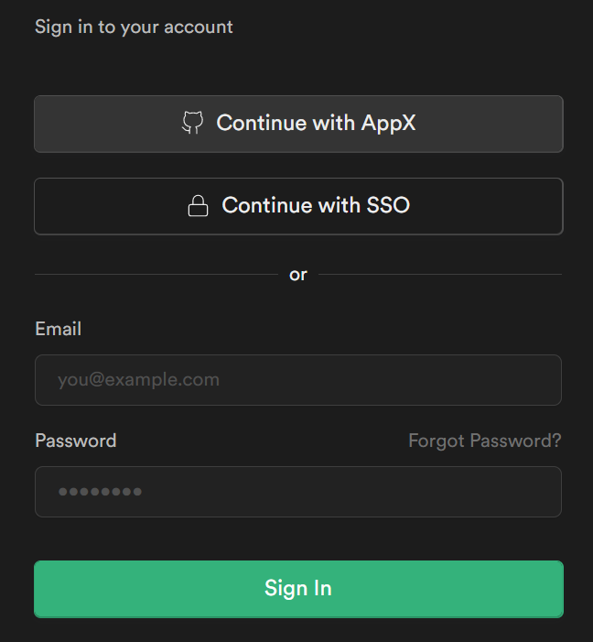
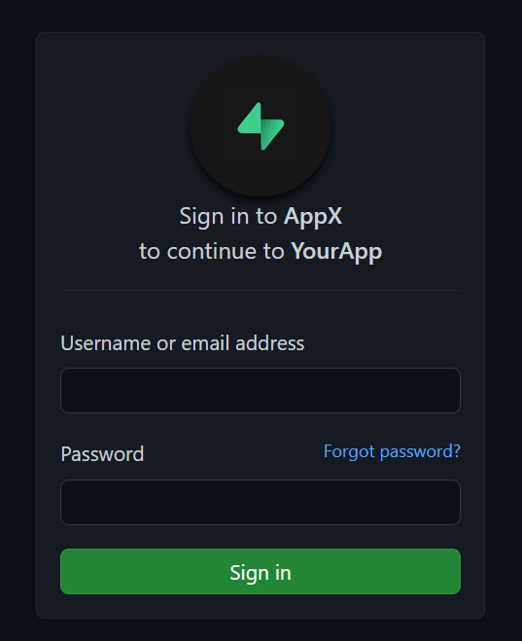
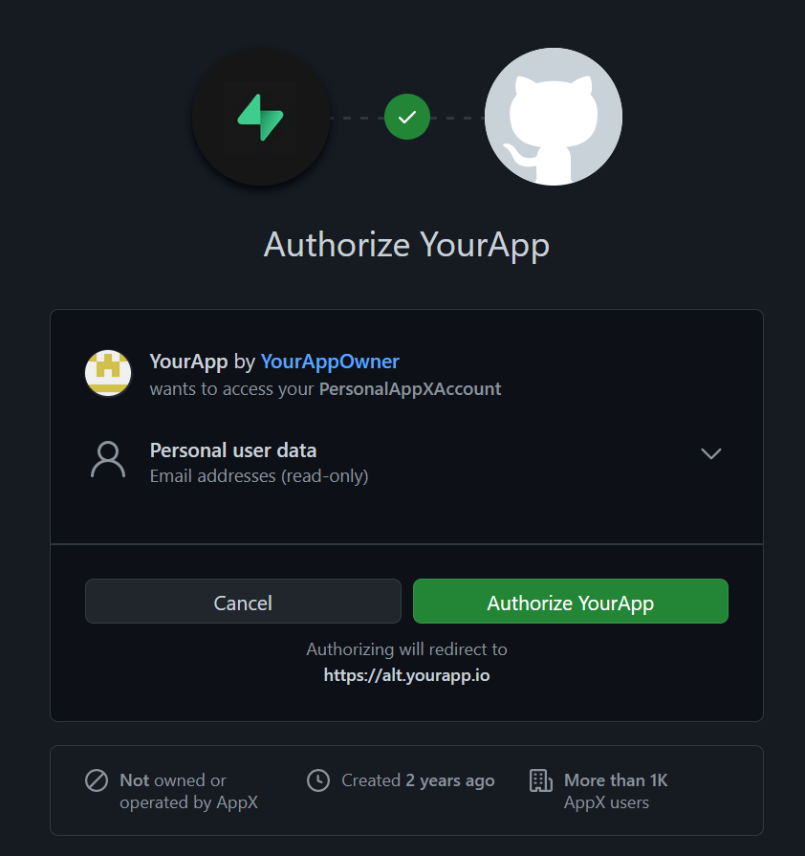
Example Application (User POV)
UI Provided by Auth Providers “AppX”, part of library API
👆
[a]
👆
👆
1. Client “YourApp” login UI
2. Auth Provider “AppX” login UI
3. “AppX” Permission for “YourApp” to access data
[a] -> The developer of client “YourApp” needs to register with “AppX” Auth Service so that they can declare the data access permissions

Slide 11
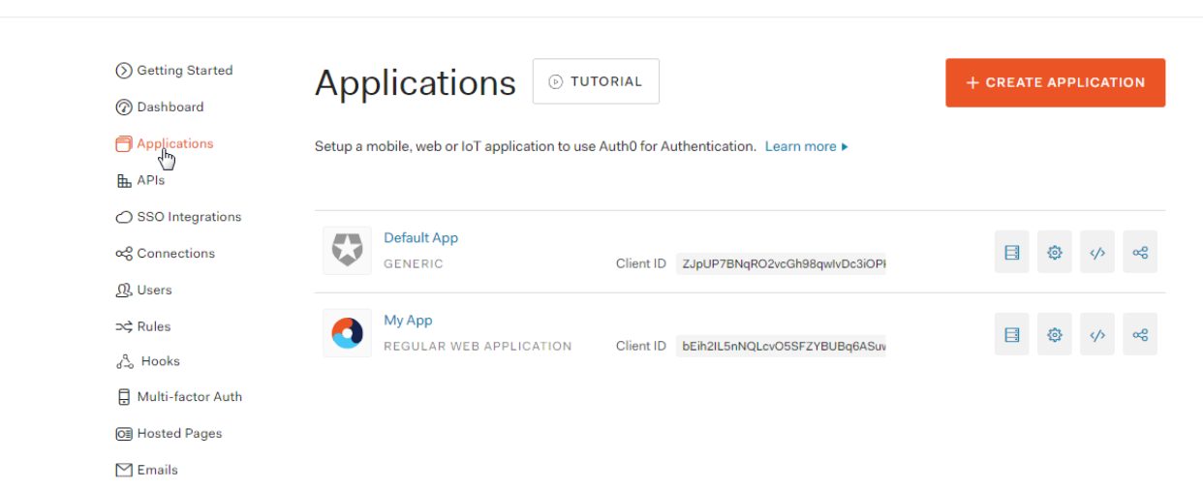
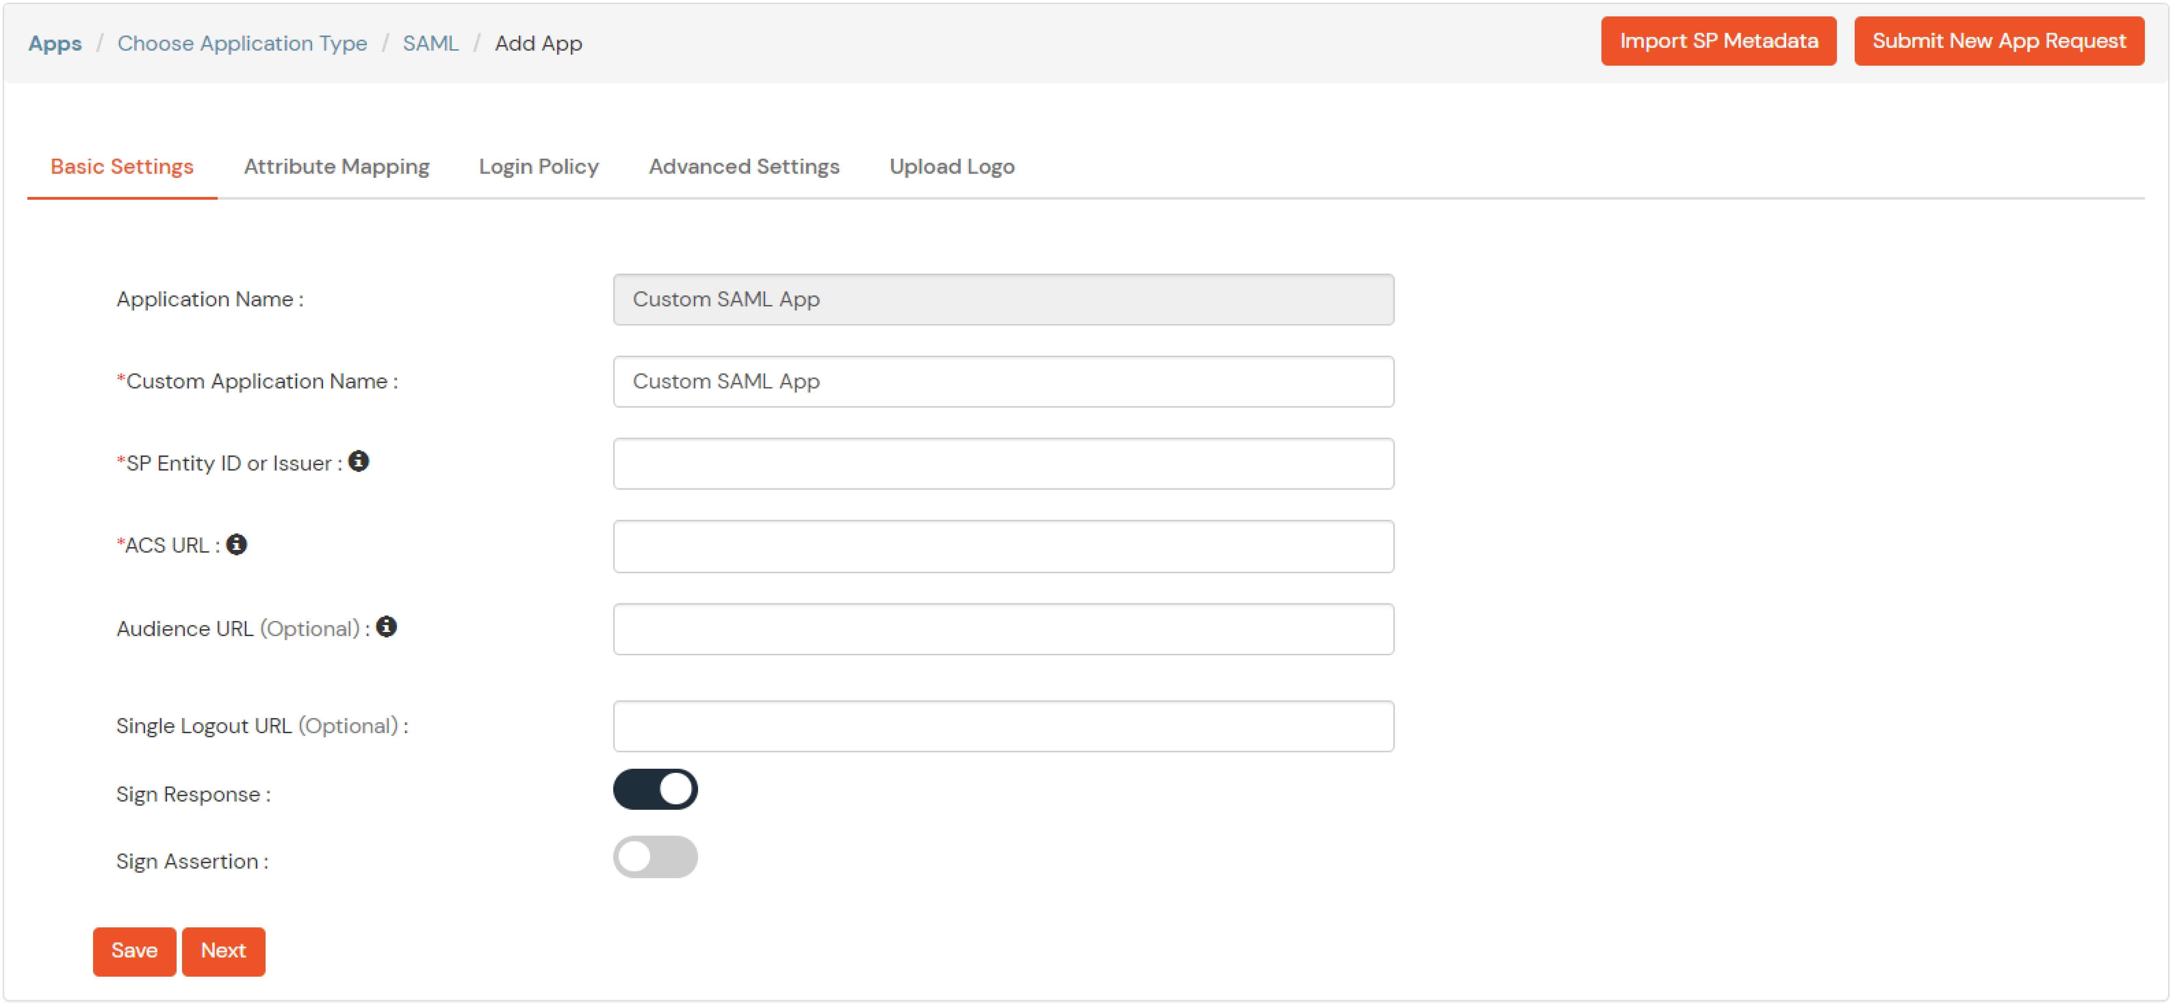
Example Application (API Service Registration)

Slide 12
Flow Diagram
Resource owner
Resource owner requests a service from client
Client redirects user agent (UA) to authorization server
Authorization server authenticates resource owner and gets approval
Authorization server redirects UA back to client, and includes authorization code
Client uses authorization code to request authorization token from authorization server
Authorization server authenticates client, validates authorization code, and returns authorization token
1
3
Resource owner’s user agent
3
2
4
Authorization server
1 2 4
5
Client
6

Slide 13

Advantages
Useful for large Organizations with many user-facing applications that needs one unified auth system
Simplifies the client developer’s job
One Token can be used for accessing all the different services
One platform to register with all the services his client app needs to access
Easy usage access control like Rate-limiting, Banning client, Monetization etc
Avoids reimplementation, hence a consistent Auth protocol across the services

Slide 14
Challenges to overcome
Load balancing of servers, Since this is a central server operated by an organization, all the requests and responses are generated and passes through this single server.
Securely Storing all the private Keys, in a central database
Maintaining Logs
Multiple Programming Languages SDK
Supporting already pre-existing protocols or auth providers
Going beyond Web
Monetization of API Requests
Rate-limiting
Email & Other forms of User Verification, including Security Devices

Slide 15
Hardware Requirements
Memory : 8GB RAM or above
Processor : intel 8th gen, AMD Zen 2 or above
Disk : Minimum 5GB free space
Software Requirements
Operating System : Linux kernel v3.2 / Windows build 1809 or higher
Processor : intel 8th gen, AMD Zen 2 or above
Tools and Runtimes : NodeJS v14+, Git

Slide 16
References
Y. Wang, Q. Wen and H. Zhang, "A Single Sign-On Scheme for Cross Domain Web Applications Using Identity-Based Cryptography", 2010, pp. 483-485, doi: 10.1109/NSWCTC.2010.120
B. Leiba, "OAuth Web Authorization Protocol," in IEEE Internet Computing, vol. 16, no. 1, pp. 74-77, Jan.-Feb. 2012, doi: 10.1109/MIC.2012.11.
V. Krylov, N. Volkova and Y. Kozina, "Information technology of user authentication in cross-platform systems", 2017, pp. 952-954, doi: 10.1109/IDAACS.2017.8095227.
Other Links:
https://en.wikipedia.org/wiki/Representational_state_transfer
https://en.wikipedia.org/wiki/Kerberos_(protocol)
https://oauth.net/2/
https://auth0.com/docs/get-started/auth0-overview
https://www.rfc-editor.org/rfc/rfc7519
https://auth0.com/blog/what-is-an-authentication-server/

Slide 17


Progress so far (implementation review 1)

Slide 18
Major Project Phase-2 Planning
Review-1 : Implement Auth Server, inc. services and clients manage APIs
In btw : Add Login Page , Management Page and implement prototype library
Review-2 : Full implementation of the entire Library and a sample application using that library.
Post Review-2 : Final suggestions and polish to the project.

Slide 19
Current Implementation Architecture
Auth Server Managment
Authorization Server
Hello World API
Client
Whether forecast proxy API

Slide 20


Alternative Implementation
Each service keeps internally keeps a track of requests from authenticated requests, to avoid too much dependence on AuthServer
Auth Server Managment
Authorization Server
Echo API
Client
Whether forecast proxy API

Slide 21
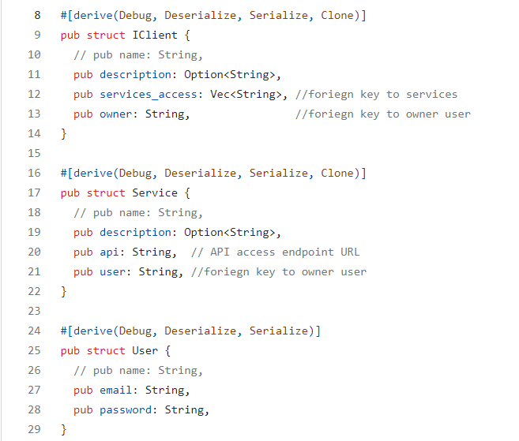
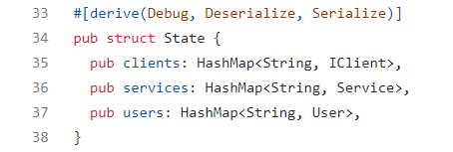
Database structure
Auth Server’s Database Structure consists of:
Client : this table contains the information related the client and all the services that particular client has assess to and also the information of the owner of that service.
Service : This table contains the details of all the services available with the API access URLs to access that service and also has the information of the owner of that service.
User : This table contains the list of users with there email addresses and passwords so as to authenticate the user to let them manage the clients and services
State : This is the structure that is stored in memory that contains all the above structures in the form of HashMap. This structure can only be accessed by a single thread at a particular time using the read writer lock depending on the value of the Atomic Reference Counter (Arc).

Slide 22
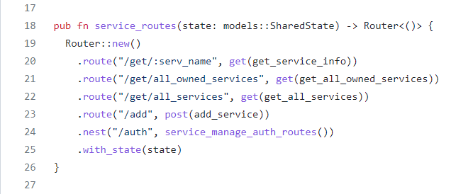
Auth Server Manage API Routes
These are all the routing services were
serv_name : we can retrieve server name and server information
all_owned_services : All the services owned by the authenticated user
all_services : All available services within the auth server
add : where a authenticated user can add a new service
auth : This routing is used for authenticating user who manages adding new services and clients into the auth server

