Slide 1
Cross-Application Web API Authorization using a Centralized Server (Implementation phase: Review-2)
Presented by:
- U Chanakya Srinivas
- Bhanuprasad L
- Rohit V Raichur
- Shreyas G Trivikram

Slide 2
The current prototype implementation can be done in 3 ways, each being its own authentication pattern that currently the industry follows
As a User Management Platform
As a Single Sign-on
More Indirect and as a Proxy to hide the server implementations
For this project, we tackle on the Single Sign-on pattern, while the rest being put under the Future enhancements for their more complexity

Slide 3
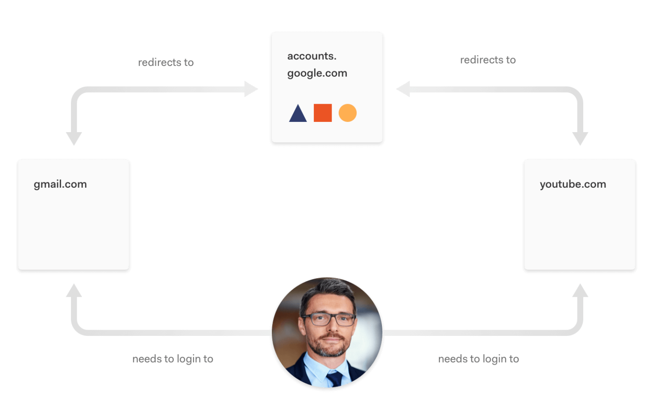
Single Sign-on Scheme (SSO) Real World Example
Here the `accounts.google.com` is the identity provider for both gmail and youtube, hence most of the user data is shared between both of this applications. Also allowing user to easy and quick login without passwords
User

Slide 4
3rd party Service
Identity
Provider
Server
App
Server
App server uses those UserId params to verify and fetch user data from Identity provider
If verified, sends data to generate a new user id mapped to the client id
Send those params to Server
User
Login Page
Redirect with client id info
Identity Provider
verify page
User App
Redirect/Home Page
Redirect to User App with UserId parameters
In the final implementation, we plan to showcase full working communication between multiple applications

Slide 5






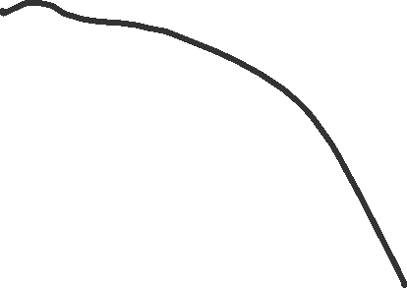
















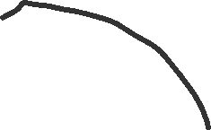








In the final implementation, we plan to showcase full working communication between multiple applications

Slide 6

3rd party Service
Identity
Provider
Server
App
Server
App server uses those UserId params to verify and fetch user data from Identity provider
If verified, sends data to generate a new user id mapped to the client id
Send those params to Server
User
Login Page
Redirect with client id info
Identity Provider
verify page
User App
Redirect/Home Page
Redirect to User App with UserId parameters
Current Progress: (Project integration is in-progress)

Slide 7
The Project currently has multiple components to make this possible
Proxy Server (which can redirect requests to identify providers)
2 Client Applications (Samples)
Info App (The identity Provider which shares the data user enters here with other apps)
Movie App (This is an existing OSS project with regular login through username and password, being replaced with “Login with InfoApp”)
Auth Management Application and it’s Server, which combined controls the behavior of the Proxy Server
And Finally, Take out the common approaches and code used, And Modularize them into multiple libraries for reusage. The Proxy Server is the most reusable component, due to its small scope and extensibility.

Slide 8
Challenges Faced
Integration in between
The samples applications we developed, being all localhost on the same system, can be bit hard to develop and time taking
Proxy Server’s DB integration
Proxy server written in Rust for faster and low-latency, took weeks to integrate with Database because of lack of experience
Architectural Understanding
We studied existing systems implementation to take best practices which involved building a prototype with existing technologies and looking at it’s architecture on higher level to get a better understanding. This also pointed out few limitations with our current approach

