Slide 1
Cross-Application Web API Authorization using a Centralized Server
Presented by:
- U Chanakya Srinivas(4NI18IS106)
- Bhanuprasad L(4NI19IS021)
- Rohit V Raichur(4NI19IS077)
- Shreyas G Trivikram(4NI19IS094)
Under the guidance of:
Mr. Rajesh N
Assistant professor

Slide 2
Introduction

Slide 3
ABSTRACT
Network Service Security is an important aspect that developers of a service always need to be careful at. Preventing DDOS attacks, stealing of access tokens, management of access tokens, hashing the passwords and verifying the service requests are part of it.
Since, Authorization and Authentication of network services is a common process, Having a centralized system and a standard communication protocol can be helpful to save time, resources and maintenance burden for the organizations.

Slide 4
Currently, Most of the communications between the client and server use REST architectural style through HTTP or simply RESTful API. The client requests resources through URL-encoded params to access the specific resource provided by the server. The request and responses are usually formatted as JSON.
Not all the requests are authorized to access the services. Owner can access only his private information but not others, which requires the owner proving that they are the owner of that resources, which we call “Authentication”. While the process of granting authenticated party a permission to do something is called “Authorization”.
JSON Web Tokens is a new standard that can be used for communicating the information of Authentication and Authorization between client and servers, where server issues one such JWT if the user is a valid owner and JWT can store stateless information about the access rights etc.
All this mostly leans towards decentralization of access control….

Slide 5
OBJECTIVES
To create a authentication pattern that integrates with 3rd party provider
To develop a centralized way of managing the access management of applications and services
To have custom protocol implemented on existing standards for the validation of requests

Slide 6
Literature Survey
1.Information Technology of User Authentication in Cross-Platform Systems
Author : Victor Krylov, Natalya Volkova, Yuliya Kozina
Description : Authors proposed the information technology of user authentication for cross-platform systems has been developed, which is characterized by high reliability and efficiency. Additional researches on the appearance of collisions while generating unique keys for user authentication have been carried out. In conditions of information technology growth, systems which are being developed to be used on multiple platforms, gain in importance and popularity. As a rule, such systems have client-server architecture and have strong security requirements for user authentication.

Slide 7
2.A Single Sign-On Scheme For Cross Domain Web Applications Using Identity-Based Cryptography
Authors : Yanjiong Wang1 , Qiaoyan Wen, Hua Zhang
Description : Authors proposed a novel scheme to satisfy the requirement of cross domain application single sign-on. Identity based encryption and signature have been applied in this protocol, which supports the progress of single sign on between heterogeneous target systems. A ticket can roam from a single sign on domain to the other. The communication between application servers, in this scheme, we use identity-based encryption to protect the data safety; the data transfer between user’s browser and servers we choose session key to prevent attacking.
3.OAuth Web Authorization Protocol
Authors : Barry Leiba
Description : Barry Leiba’s paper discuss about Internet identity management is an umbrella that covers several related problems, all which stem from our use of multiple Internet services that come from different providers and reside in different trust domains. For each domain, we have a separate identity and use separate authentication. Where NSTIC seeks to consolidate these identities through central management, and software such as password managers tries to make it easier to manage authentication credentials for our various identities .

Slide 8
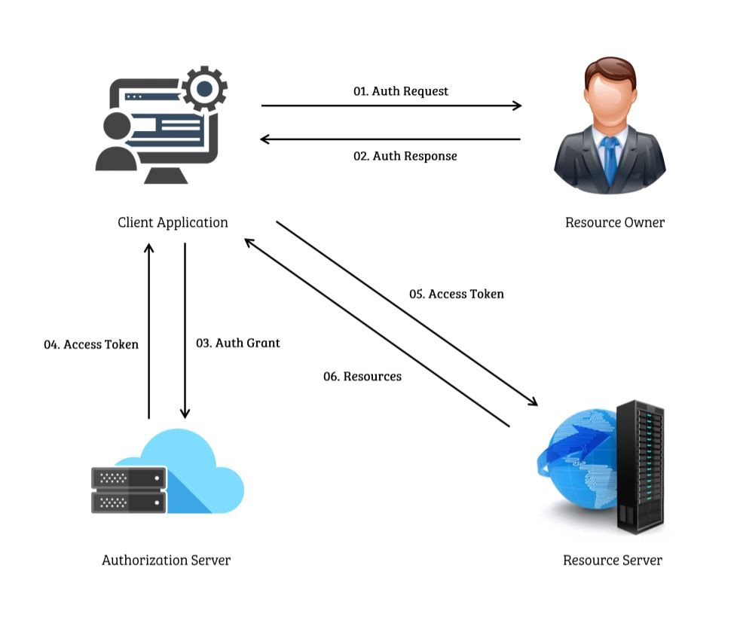
Existing System
For developers building their service/client that needs to fetch resources from other services, They need to build their own solution and while also, providing their own custom solution for authorize and authenticate users of their service too
This can cause inconsistencies across multiple services despite being built by same organization while also taking additional cost, time and risk each time
This custom solution makes it harder and more manpower for migration and maintenance in the future
Ex: OAuth 2.0 Working

Slide 9
DESIGN

Slide 10
Private Service
App1
Weather API
App2
Reddit API
Private Service
Reddit API
Vs.
Weather API
Proxy
App1
Reddit API
App2
Reddit API

Slide 11
The current prototype implementation can be done in 3 ways, each being its own authentication pattern that currently the industry follows
As a User Management Platform
As a Single Sign-on (SSO) and other patterns
More Indirect and as a Proxy to hide the server implementations
For this prototype project, we tackle on partial implementations of each pattern, while the rest being put under the Future enhancements for their more complexity

Slide 12
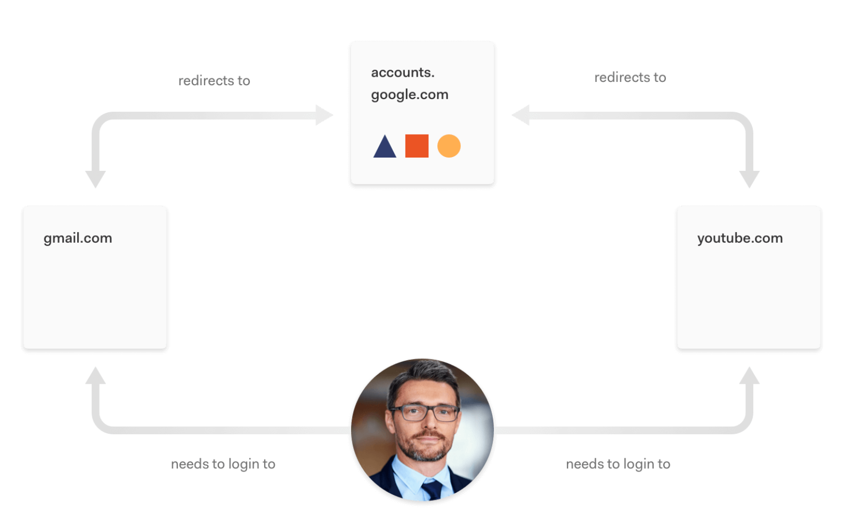
Single Sign-on Scheme (SSO) Real World Example
Here the `accounts.google.com` is the identity provider for both gmail and youtube, hence most of the user data is shared between both of this applications. Also allowing user to easy and quick login without passwords
User

Slide 13
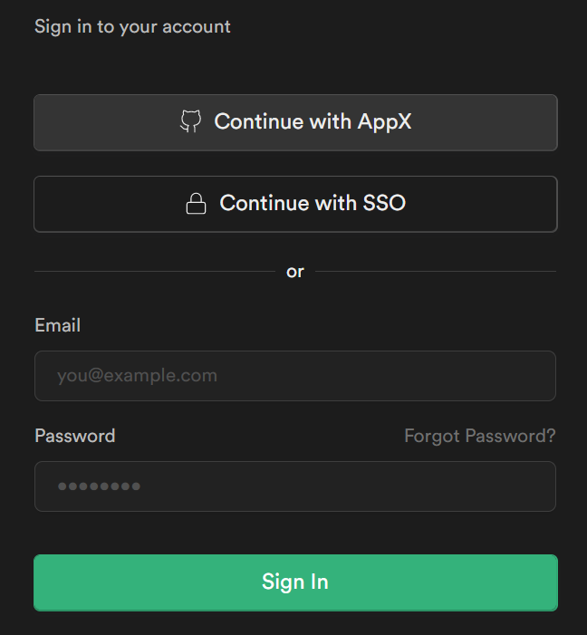
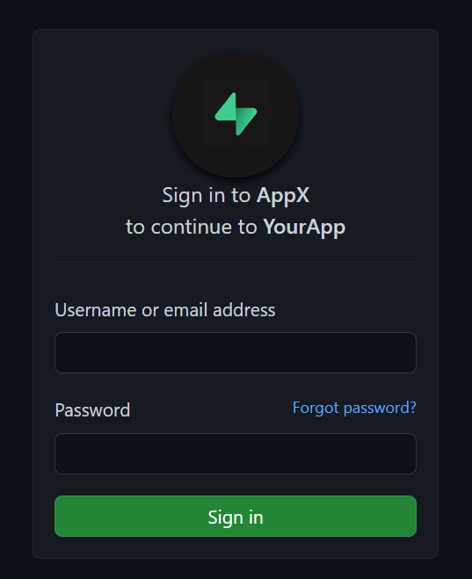
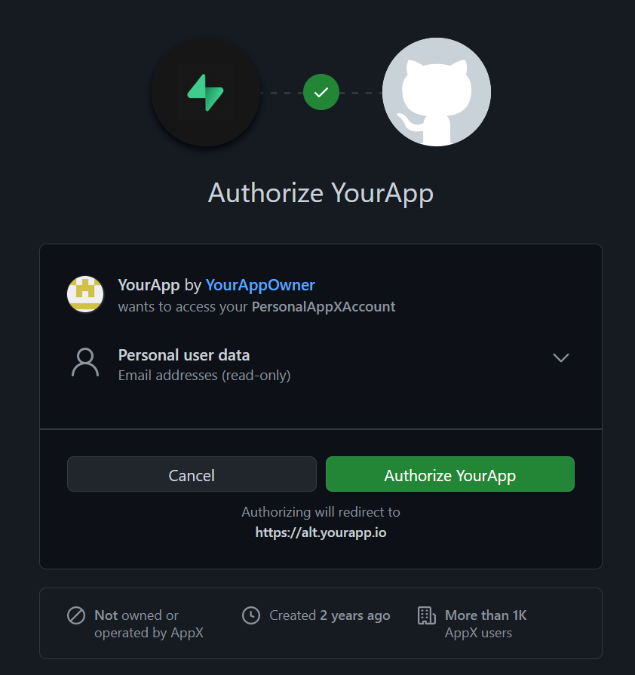
Example Application (User POV)
UI Provided by Auth Providers “AppX”, part of library API
👆
[a]
👆
👆
1. Client “YourApp” login UI
2. Auth Provider “AppX” login UI
3. “AppX” Permission for “YourApp” to access data
[a] -> The developer of client “YourApp” needs to register with “AppX” Auth Service so that they can declare the data access permissions

Slide 14
IMPLEMENTATION

Slide 15
Hardware Requirements
Memory : 8GB RAM or above
Processor : intel 7th gen, AMD Zen 2 or above
Disk : Minimum 20GB free space
Software Requirements
Operating System : Linux kernel v3.2 / Windows build 1809 or higher
Tools and Runtimes : NodeJS v16+, Git, Rust 2021 Edition

Slide 16
The Project currently has multiple components to make this possible
Proxy Server
Management Server and its Frontend
2 Samples
Info App/API Demo
Movie Watchlist Site
Finally, Take out the common approaches and code used, And Modularize them into multiple libraries for reusage. The Proxy Server is the most reusable component, due to its small scope and extensibility.

Slide 17
DB
manage-api
proxy
Service
Application

Slide 18
3rd party Service
Identity
Provider
Server
App
Server
App server uses those UserId params to verify and fetch user data from Identity provider
If verified, sends data to generate a new user id mapped to the client id
Send those params to Server
User
Login Page
Redirect with client id info
Identity Provider
verify page
User App
Redirect/Home Page
Redirect to User App with UserId parameters
In the final implementation, we plan to showcase full working communication between multiple applications

Slide 19
Challenges Faced
Integration in between
The samples applications we developed, being all localhost on the same system, can be bit hard to develop and time taking
Proxy Server’s DB integration
Proxy server written in Rust for faster and low-latency, took weeks to integrate with Database because of lack of experience
Architectural Understanding
We studied existing systems implementation to take best practices which involved building a prototype with existing technologies and looking at it’s architecture on higher level to get a better understanding. This also pointed out few limitations with our current approach

Slide 20
Advantages
Useful for large Organizations with many user-facing applications that needs one unified auth system
Simplifies the client developer’s job
One Token can be used for accessing all the different services
One platform to register with all the services his client app needs to access
Avoids reimplementation of certain patterns, hence a consistent Auth protocol across the services

Slide 21
Future Potential Enhancements
Load balancing of servers, Since this is a central server operated by an organization, all the requests and responses are generated and passes through this single server.
Securely Storing all the private Keys, in a central database
Maintaining and Creation of Logs
Multiple Programming Languages SDK
Supporting already pre-existing protocols or auth providers
Going beyond Web
Monetization of API Requests
Rate-limiting
Email & Other forms of User Verification, including Security Devices

Slide 22
This system provides a Software Development Kit that helps the developers of Client and Service Providers with various libraries that simplifies the Authorization process.
SDK
Client Developer Libraries
Auth Server Development Libraries
Resource Fetching
Authenticated Client Management
Session Management
Role-based Auth
Deployment

Slide 23
References
Y. Wang, Q. Wen and H. Zhang, "A Single Sign-On Scheme for Cross Domain Web Applications Using Identity-Based Cryptography", 2010, pp. 483-485, doi: 10.1109/NSWCTC.2010.120
B. Leiba, "OAuth Web Authorization Protocol," in IEEE Internet Computing, vol. 16, no. 1, pp. 74-77, Jan.-Feb. 2012, doi: 10.1109/MIC.2012.11.
V. Krylov, N. Volkova and Y. Kozina, "Information technology of user authentication in cross-platform systems", 2017, pp. 952-954, doi: 10.1109/IDAACS.2017.8095227.
Other Links:
https://en.wikipedia.org/wiki/Representational_state_transfer
https://en.wikipedia.org/wiki/Kerberos_(protocol)
https://oauth.net/2/
https://auth0.com/docs/get-started/auth0-overview
https://www.rfc-editor.org/rfc/rfc7519
https://auth0.com/blog/what-is-an-authentication-server/

