Slide 1

Ambumetrix
Optimal hospital selection for EMS transport of COVID-19 patients
Team 176
Prateek Gowda, Ruchita Kothari, Alex Lu,
Nicole Pagane, Kate Schole, Utkarsh Sharma
Notes:
Hospital shortage is a problem, and inefficient transport adds to this problem. We hope to address both.
Ambumetrix

Slide 2


EMS routing decisions impair COVID-19 care delivery
Hospital 1
Notes:
Complicated Call Transfer
Time consuming
Increased call volume for hospitals
Risk of Failure
https://www.usfa.fema.gov/downloads/pdf/publications/handbook_for_ems_medical_directors.pdf

Slide 3

EMS routing decisions impair COVID-19 care delivery
Care capacity exceeded
Hospital 1
Notes:
Complicated Call Transfer
Time consuming
Increased call volume for hospitals
Risk of Failure
https://www.usfa.fema.gov/downloads/pdf/publications/handbook_for_ems_medical_directors.pdf

Slide 4

EMS routing decisions impair COVID-19 care delivery
Care capacity exceeded
Hospital 1
Transfer
Hospital 2
Notes:
3 EMTs, 3 critical care physicians - EMTs cited frustrations with ER wait times
Complicated Call Transfer
Time consuming
Increased call volume for hospitals
Risk of Failure
https://www.usfa.fema.gov/downloads/pdf/publications/handbook_for_ems_medical_directors.pdf

Slide 5
Current efforts to track hospital status do not support COVID-19 specific burden
County/Hospital Alert Tracking System (CHAT) in Maryland
Only accepting Priority I patient (emergently unstable)
No ECG monitored beds
Not accepting any patients

Slide 6
In urban environments with multiple hospitals, there is a need for EMS first responders to quickly select the most appropriate hospital for each suspected COVID-19 patient, based on the hospital’s COVID-19 care capacity.

Slide 7
Design Requirements
Develop method for optimal hospital selection
Reduce time for patient to receive appropriate care
Preserve ED workflow

Slide 8
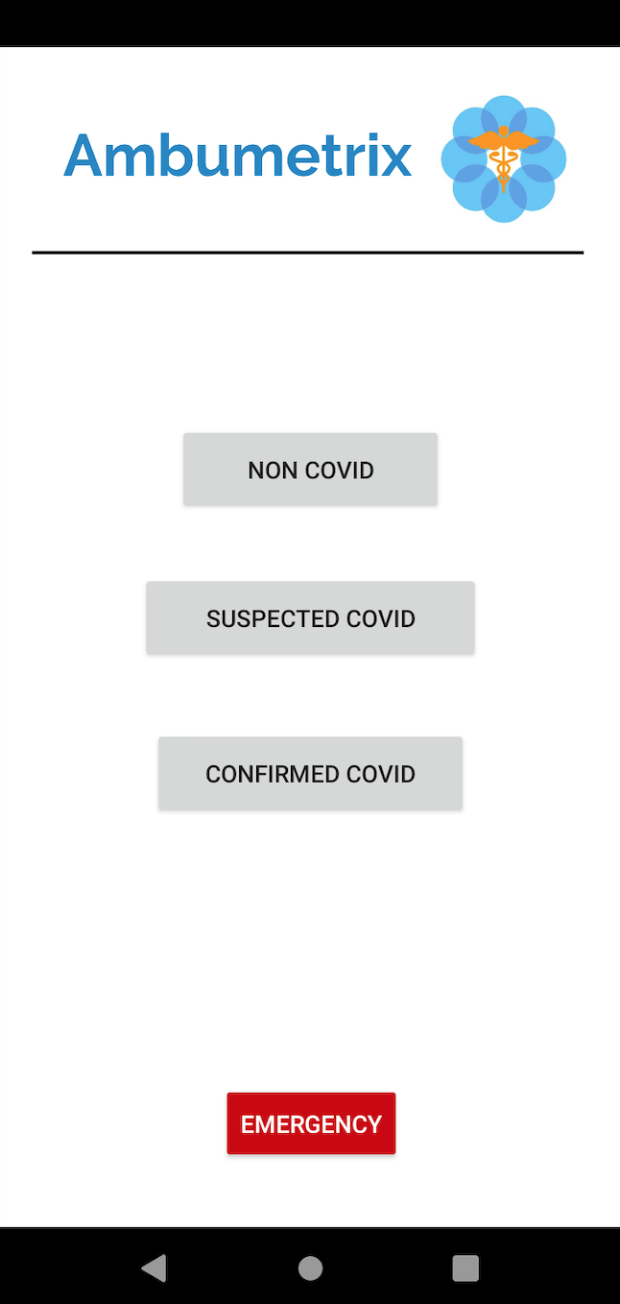
Our Solution: Ambumetrix
Mobile application for EMS users
Provides ranked hospital list according to highest capacity of care for a particular patient
Allows for direct phone call to hospital of choice through app

Slide 9
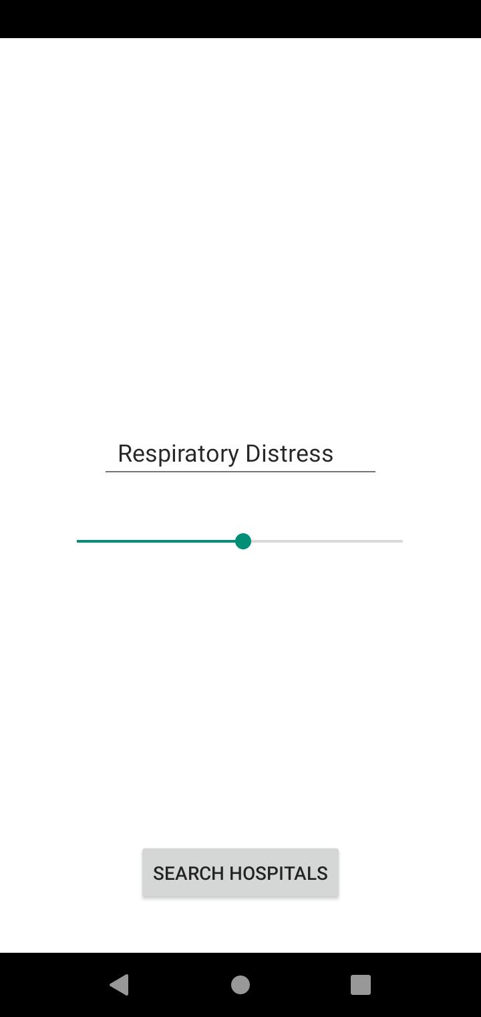
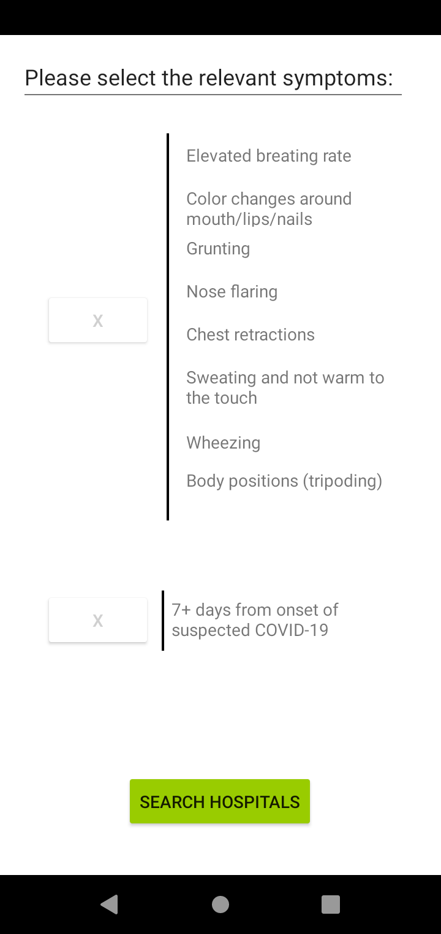
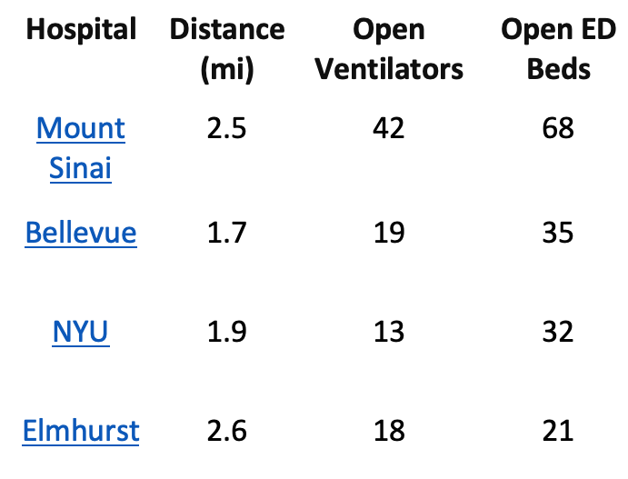

Ambumetrix Workflow

Slide 10
EMS is guided to optimal hospital
Hospital 2
“Overburdened”
Hospital 1
“Optimal”

Slide 11
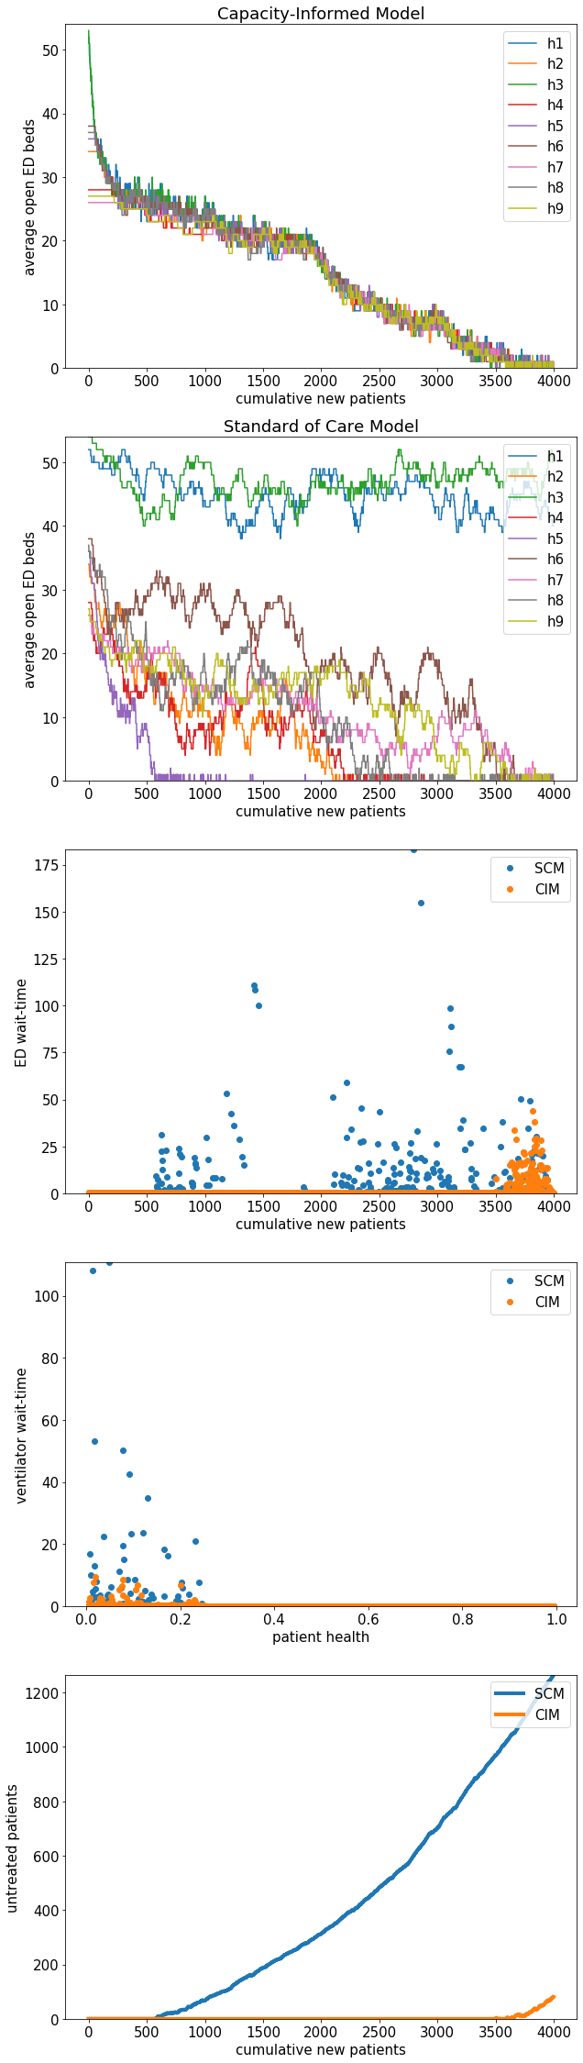
App decreases ED and ventilator wait time
Assumptions:
ED beds: 20-60 per hospital
ICU beds/ventilators: ⅓ of ED beds per hospital
Probabilistic discharges
SCM = Standard of Care Model
CIM = Capacity Informed Model

Slide 12
App decreases ED and ventilator wait time
 | Current Standard of Care | With Ambumetrix
Number of patients treated (out of 4000) | 2964 | 3914
Percent treated | 74.1% | 97.85%
Assumptions:
ED beds: 20-60 per hospital
ICU beds/ventilators: ⅓ of ED beds per hospital
Probabilistic discharges
SCM = Standard of Care Model
CIM = Capacity Informed Model

Slide 13
Large scale implementation in NY health systems
Develop beta
Partner with NY Dept. of Health
Pilot Study
Develop implementation with EPIC database
Coordinate connections across different hospital and EMS systems
Multi-center study for 1 week
All major NYC hospital systems are currently incentivized to improve ambulance coordination through the recently implemented ET3 model.

Slide 14
Summary
In urban environments with multiple hospitals, there is a need for EMT first responders to quickly select the most appropriate hospital for each suspected COVID-19 patient, based on the hospital’s COVID-19 care capacity.

Slide 15
Capacity-Informed Model distributes patient load
ED beds: 20-60 per hospital
ICU beds/ventilators: ⅓ of ED beds per hospital
Probabilistic discharges
f(symptoms) = ɑ*openEDbeds +
β*symptoms*openICUventilators + ...

Slide 16
CIM allows for higher patient care capacity

