Slide 1

Spatial Network Analysis for Cycling
Dr Crispin Cooper

Slide 2
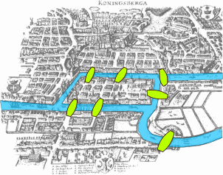
Spatial Network Analysis
Euler, 1736
"Konigsberg bridges" by Bogdan Giuşcă - Public domain (PD), based on the image. Licensed under CC BY-SA 3.0

Slide 3
Spatial Network Analysis
Burgess (Concentric city model)
Christaller (Central Place Theory)
Euler
Freeman 1977
(Betweenness)
Shimbel 1953
(Closeness)
Social network analysis (trendy!)
Space Syntax
sDNA
MIT UNA, etc

Slide 4
Spatial Network Analysis
Burgess (Concentric city model)
Christaller (Central Place Theory)
Euler
Freeman 1977
(Betweenness)
Shimbel 1953
(Closeness)
Social network analysis (trendy!)
Space Syntax
sDNA
MIT UNA, etc
All of these offer a spectrum of approaches from data-rich (origins, destinations, intermediate routes) to data-sparse (network only).

Slide 5
Spatial Network Analysis
Burgess (Concentric city model)
Christaller (Central Place Theory)
Euler
Freeman 1977
(Betweenness)
Shimbel 1953
(Closeness)
Social network analysis (trendy!)
Space Syntax
sDNA
MIT UNA, etc
SoftwareX paper on sDNA 2020

Slide 6
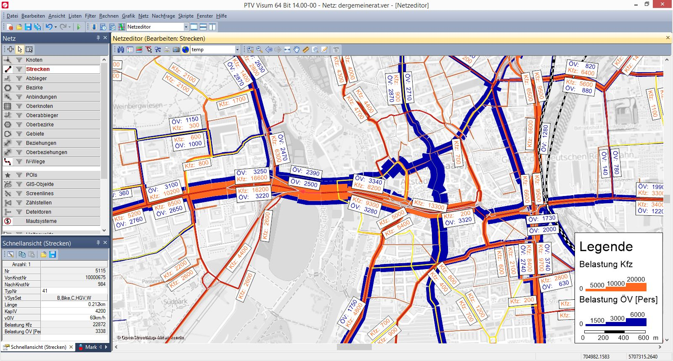
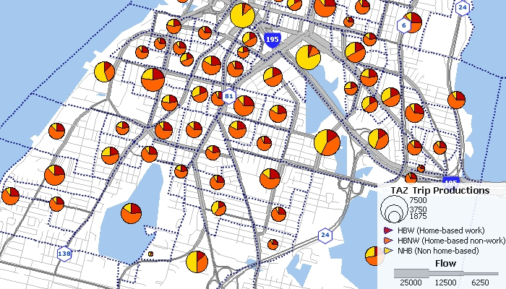
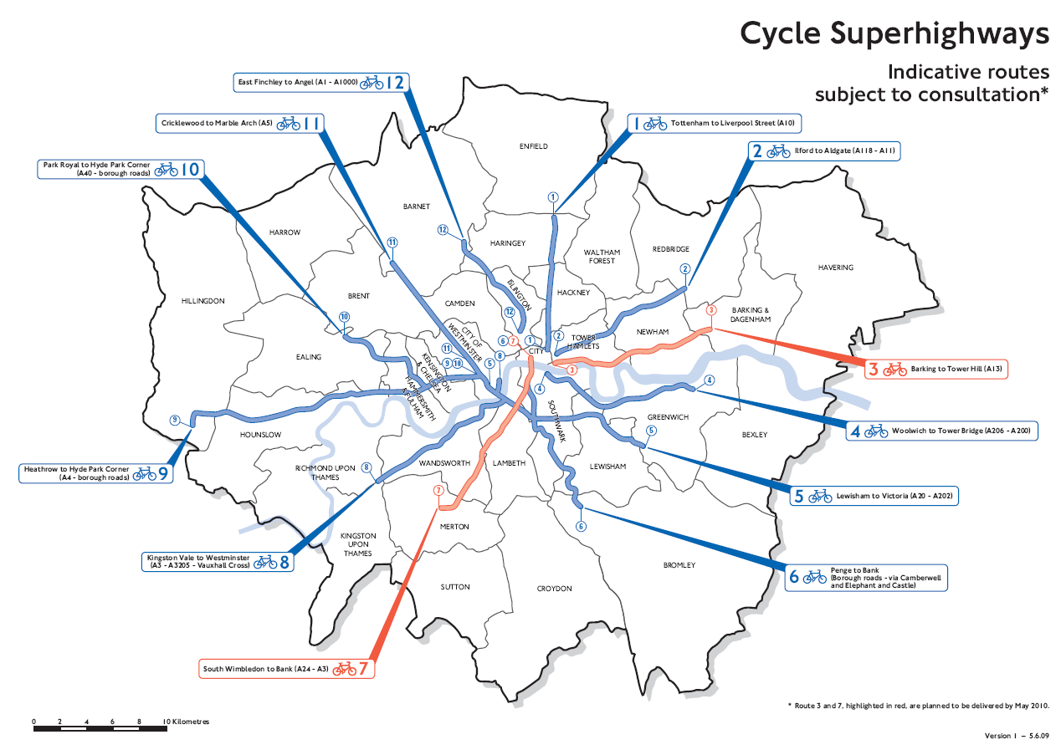

Why not use the models we already have for vehicles?
Residential Self-Selection
Moving to London … hmm, where to live?

Slide 7
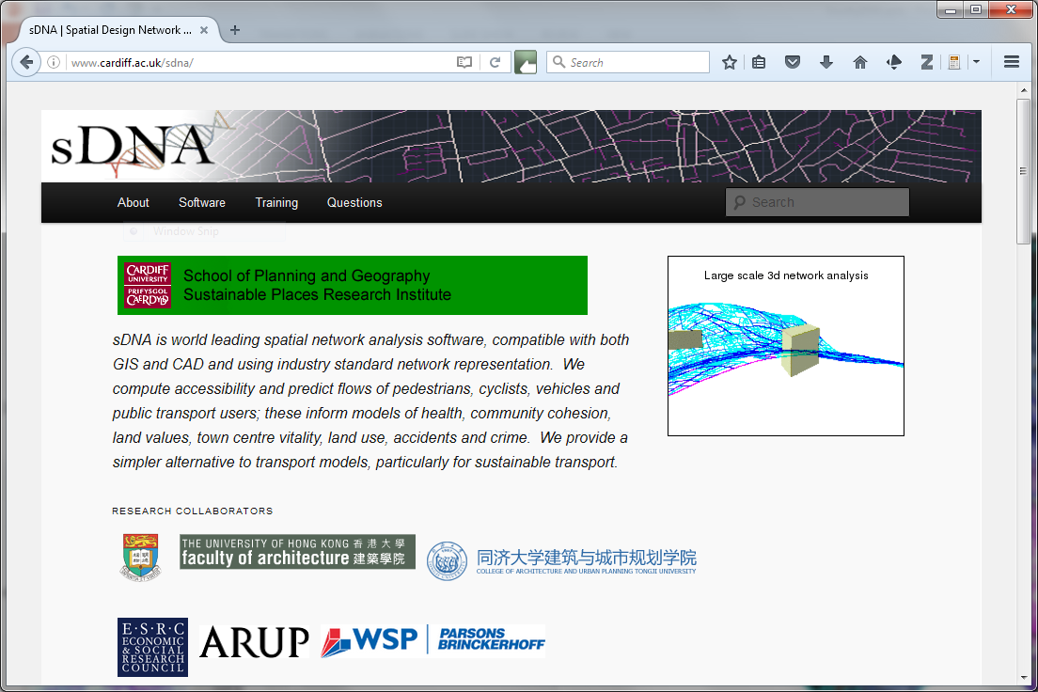

Slide 8
Tool | (Cycle) Route Selection Tool / Walking Route Audit Tool RST/WRAT | Propensity to Cycle Tool PCT | Cycling Infrastructure Prioritization Tool CyIPT | Spatial Design Network Analysis sDNA+
Mode of transport | Walk + Cycle | Cycle | Cycle | Walk + Cycle
Purpose | Audit current/potential route quality | Determine where potential exists | Prioritization for infrastructure investment | Potential, Prioritization, Detailed proposal evaluation
Assumptions | Compares routes by rule of thumb Doesn’t specify where to put them | Commute focused Zone based | Commute focused Zone based Fastest route used (currently) | Accounts for individual variance in choosing mode of transport and route
Technology | Spreadsheet | Cloud (website) |  | GIS
Detail | Route specific | Broad brush - LSOA | Routes by segment, Desire lines by LSOA | Custom; Link based
Work | DIY | Already done for you |  | Likely needs commissioning Can leverage data from other tools
Costs | Free
Use own designs | On spreadsheet | No | Not yet implemented (or edit OSM) | Yes
Outputs | Route quality score No evaluation of potential/projected uptake | Potential | Projected uptake & CBR for all* schemes Variety of GIS layers | Predicted accessibility, uptake, flows Prioritization

Slide 9
Lisbon workflow
QGIS2 OSM Downloader
QGIS3 STRM-Downloader
Project to Portuguese National Grid
Drape (interpolate shape)
roadclass = {'motorway':7,'motorway_link':7,'trunk':5,'trunk_link':5,'primary':4,'primary_link':4,'secondary':3,'secondary_link':3,'tertiary':2,'tertiary_link':2,'living_street':1,'residential':1,'unclassified':1,'cycleway’:0} Follows Chan & Cooper paper (pushed to repo) but no distinction for residential/non-residential dual carriageways
dropped highway=“ “
aadt = [9798,8698,4385,2253,1108,267,13,0][7-roadclass] (again following Chan & Cooper – but usually we would calibrate)

Slide 10
Lisbon workflow
sdnaprepare.py --im net=join_drape_proj_hwclasses --om net=join_drape_proj_hwclasses_p action=repair;xytol=0.5;nearmisses;isolated;data_text=highway;data_absolute=aadt,roadclass
Note network quality issue
sdnaintegral.py --im net=join_drape_proj_hwclasses_p --om net=integral.shp metric=cycle_roundtrip;radii=10000
Compute cyclediff=(HMf+HMb)/Llen
Display cyclediff, MHD20000, BtH20000
All the above for zero traffic spine (comparison)
N.b. Usually we would calibrate to either flow or journey to work mode share data (see Cooper 2018 paper in repo)
Difference to PCT? Hard work to prepare the network, but we can test interventions.
Hackathon challenge: can anyone make a better Lisbon network..?

