Slide 1
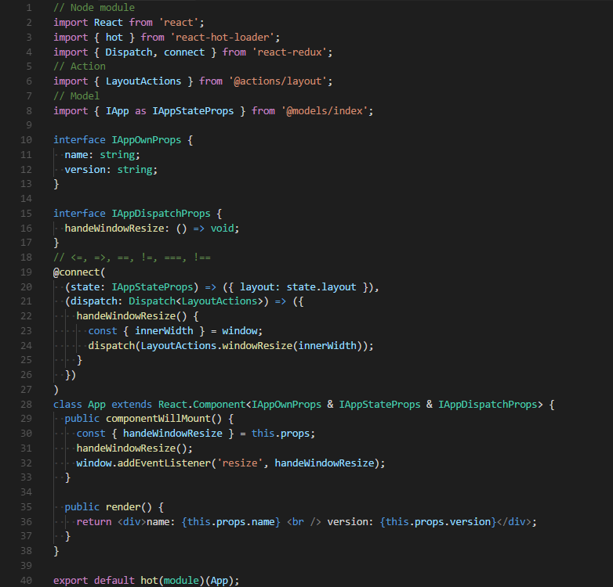

Default Dark+
&
Consolas

Slide 2
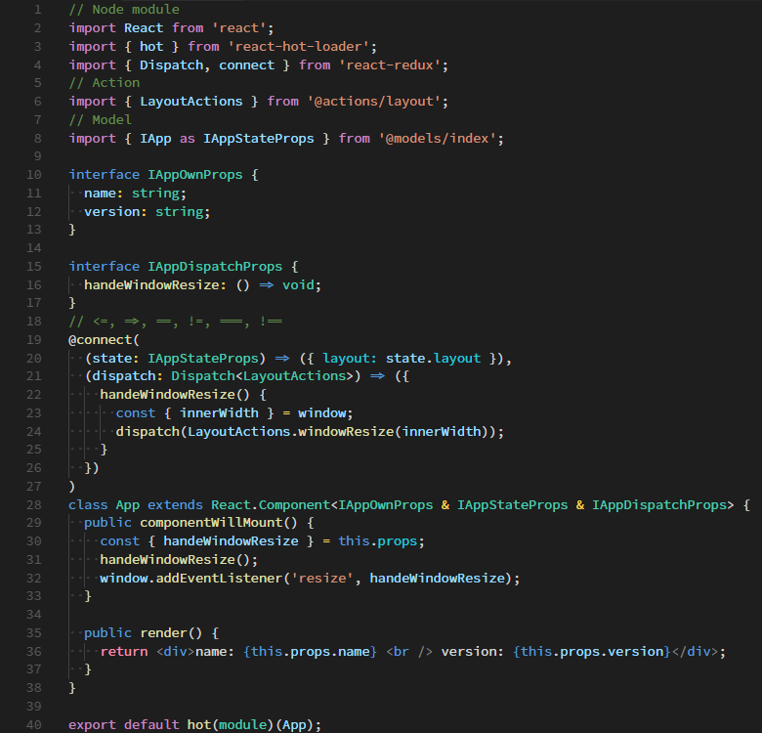

Dark++ Regular
&
Hasklig

Slide 3
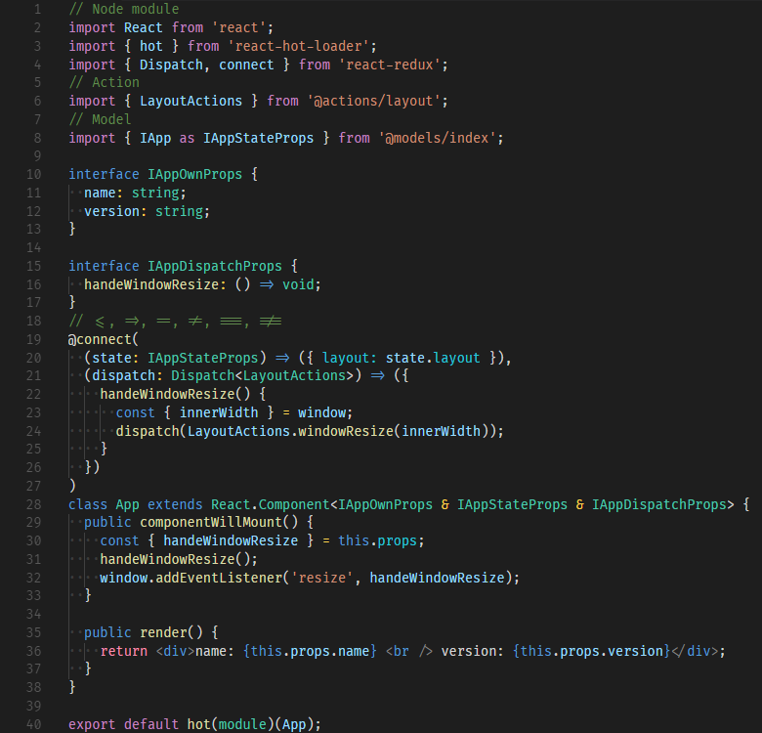
Dark++ Regular
&
Fira Code

