Slide 1
General course
2022-2023
Programmeren 2
Files I/O, Regular expression & validation
Serhat Erdogan

Slide 2
Last week
Repetition of what we saw last week

Slide 3
Goals of this lesson
Student can open & read files in Python.
Student can write to a file in python.
Student can create complex regexes to find a specific pattern.

Slide 4
Content table
Files I/O
Open & Read file
Writing to a file
Regular expression
Matching
Capturing
Substituting
Validation

Slide 5
Content table
Files I/O
Open & Read file
Writing to a file
Regular expression
Matching
Capturing
Substituting
Validation

Slide 6
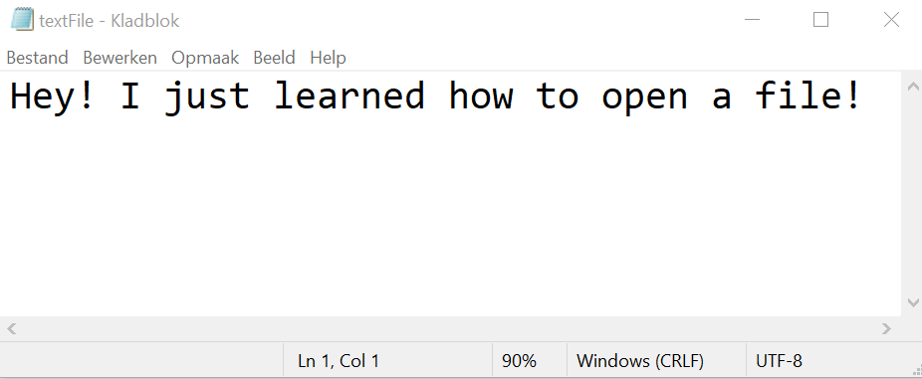
Python Open File
To open the file, use the built-in open() function (default encoding is UTF-8).
The open() function returns a file object, which has a read() method for reading the content of the file:
#creates a text file object for reading
fileObject = open("textFile.txt", "r")
print(fileObject.read())
#to close the file, use .close() method
fileObject.close()
Output: Hey! I just learned how to open a file!

Slide 7
Python Open File modus
There are a number of different modes you can use to open a file.
Mode | Description
“r” | Creates a tekst file object for reading and raises an error if the file can’t be openend
“w” | Creates a tekst file object for writing and overwrites all exisiting data in the file
“a” | Creates a tekst file object for appending data to the end of a file
“rb” | Creates a binary file object for reading and raises an error if the file can’t be openend
“wb” | Creates a binary file object for writing and overwrites all existing data in the file
“ab” | Creates a binary file object for appending data to the end of the file

Slide 8
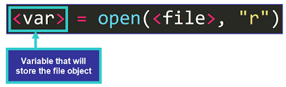
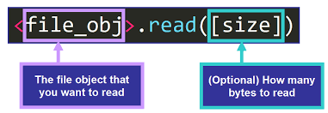
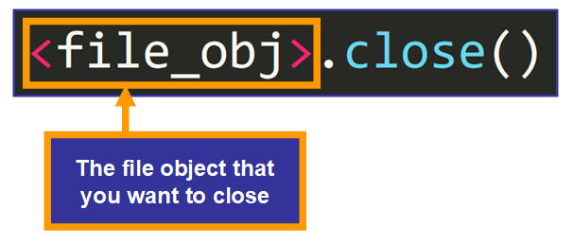
Python File Objects
Everything in python is considered an object!
Files are represented in Python with file objects which are instances of classes designed to work with different types of files.
Python uses these files objects to interact with external files on your computer.

Slide 9
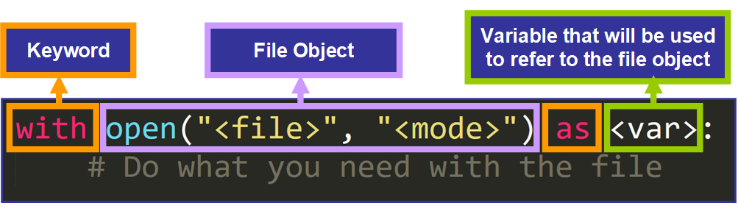
Python File open “with”
When you use with statement with open function, you do not need to close the file at the end, because with would automatically close it for you:
#creates a text file object for reading
with open("textFile.txt", "r") as fileObject:
print(fileObject.read())
Output: Hey! I just learned how to open a file!

Slide 10
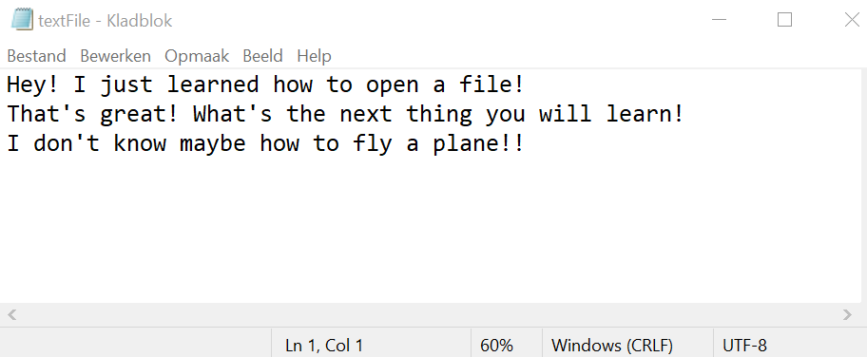
Python read lines
Instead of reading the entire file at once, you can process each line of the file one at a time:
#creates a text file object for reading lines
with open("textFile.txt", "r") as fileObject:
[print(line) for line in fileObject.readlines()]
Output:
Hey! I just learned how to open a file!
That's great! What's the next thing you will learn!
I don't know maybe how to fly a plane!!

Slide 11
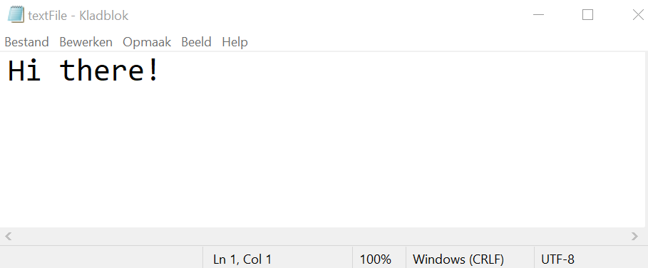
Python write to a file
To write data to a plain text file, you pass a string to a file object’s .write() methods.
The file object must be opened in the write mode!
When the text “Hi there!” is written to the textFile.txt file, any existing contents are overwritten.
#creates a text file object to write
with open("textFile.txt", "w") as fileObject:
fileObject.write("Hi there!")

Slide 12
Exercise I/O
Write a script copy.py that copies a file.
Write a script that adds the symbol “+” to the end of each sentence in the given text file.
Read the file names.txt and print the names that start with the letter “D”.
Notes:
Small exercise so that the students understand it better and we can go further with the theory

Slide 13
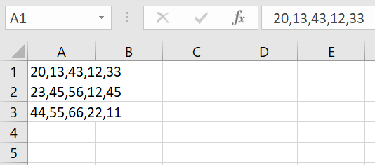
Python reading CSV Files
To read a CSV file, you can use the csv.reader class.
https://docs.python.org/3/library/csv.html
import csv
with open("textFile.csv") as fileObject:
reader = csv.reader(fileObject, delimiter=",")
for row in reader:
int_row = [int(value) for value in row]
print(int_row)
Output:
[20, 13, 43, 12, 33]
[23, 45, 56, 12, 45]
[44, 55, 66, 22, 11]

Slide 14
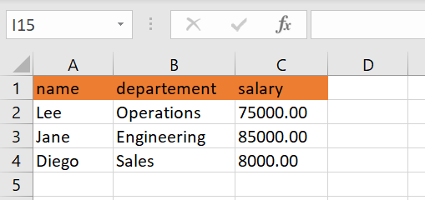
Python reading CSV Files with headers
The first line of the file contains field names. Each following line contains a record with a value for each field.
Return each row as a dictionary whose keys are the field names and whose values are the field values in the row => csv.DictReader

Slide 15
Python reading CSV Files with headers example
import csv
with open("textFile.csv") as fileObject:
reader = csv.DictReader(fileObject)
for row in reader:
row["salary"] = float(row["salary"]) print(row)
Output:
{'name': 'Lee', 'departement': 'Operations', 'salary': 75000.0}
{'name': 'Jane', 'departement': 'Engineering', 'salary': 85000.0}
{'name': 'Diego', 'departement': 'Sales', 'salary': 8000.0}

Slide 16
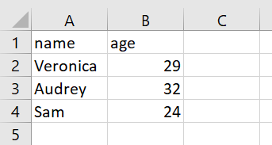
Python writing to CSV Files
import csv
people = [
{ "name": "Veronica", "age": 29},
{ "name": "Audrey", "age": 32},
{ "name": "Sam", "age": 24} ]
with open("textFile.csv","w", newline='') as fileObject:
writer = csv.DictWriter(fileObject, fieldnames=["name","age"])
writer.writeheader()
writer.writerows(people)
Notes:
The csv.writer module directly controls line endings and writes \r\n into the file directly. In Python 3 the file must be opened in untranslated text mode with the parameters 'w', newline='' (empty string) or it will write \r\r\n on Windows, where the default text mode will translate each \n into \r\n.

Slide 17
Exercise csv files
Write a program that that reads the people.csv file and adds all the ages together.
name,age
Veronica,29
Audrey,32
Sam,24
Output should be “85”
Notes:
Let them create their own csv file names people.csv and copy past the data

Slide 18
Content table
Files I/O
Open & Read file
Writing to a file
Regular expression
Matching
Capturing
Substituting
Validation

Slide 19
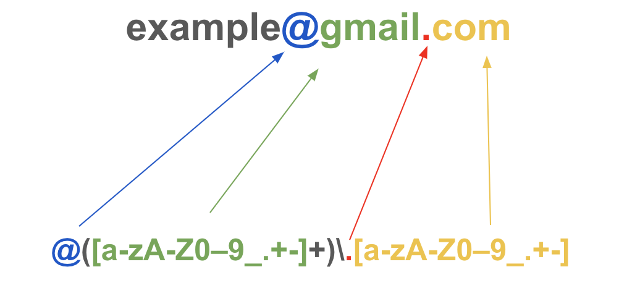
What are Regulaire Expressions?
A Regular Expression is a sequence of characters that forms a pattern that we can use to find or match other characters or groups of characters.
Matched charachters
Regex

Slide 20
Examples Regulaire Expressions
Regex | Matches any string that
gray|grey | contains {gray, grey}
gr(a|e)y | contains {gray, grey}
gr[ae]y | contains {gray, grey}
b[aeiou]bble | contains {babble, bebble, bibble, bobble, bubble}
colou?r | contains {color, colour}
rege(x(es)?|xps?) | contains {regex, regexes, regexp, regexps}
go*gle | contains {ggle, gogle, google, gooogle, goooogle, ...}

Slide 21
Regex cheat sheet
Character | Discription | Example
[] | A set of characters | "[a-m]"
\ | Signals a special sequence (can also be used to escape special characters) | "\d"
. | Any character (except newline character) | "he..o"
^ | Starts with | "^hello"
$ | Ends with | "planet$"
* | Zero or more occurrences | "he.*o"
+ | One or more occurrences | "he.+o"
https://www.dataquest.io/wp-content/uploads/2019/03/python-regular-expressions-cheat-sheet.pdf

Slide 22
Exercise regex
On https://regexr.com/ try to write Regexes that matches the following strings:
Regex 1 (abc or xyz)
{abc, xyz}
Regex 2 (one or more times “abc”)
{abc, abcabc, abcabcabc, …}
Regex 3 (only vowels)
{a, e, I, o, u , aeiou, eioaauie}
Regex 4 (only digits)
{0, 1, 2, 3, 4, 5, 6, 7, 8, 9, 10, 1235020284}
Regex 5 (words longer atleast 8 long)
{ABCDEFGH, AZERTYAZ, QWERTYAZ, AZERTYUIOPQSDGH} ​
Notes:
Small exercise so that the students understand it better and we can go further with the theory

Slide 23
Re module python
In Python, regular expression functionality is provided through the re module. This module consists of many functions, each one corresponding to a specific use of regular expressions.
Re module provides functions:
re.match(pattern, string , flags=0)
re.fullmatch(pattern, string, flags=0)
re.search(pattern, string, flags=0)
re.findall(pattern, string, flags=0)
re.sub(pattern, repl, string, count=0, flags=0)

Slide 24
Re module matching
re.match() function of re in Python will search the regular expression pattern and return the first occurrence. The Python RegEx Match method checks for a match only at the beginning of the string. So, if a match is found in the first line, it returns the match object.
import re
list = ["guru99 get", "guru99 give", "guru Selenium" ]
[print(i) for i in list if re.match("(g\w+)\W(g\w+)", i)]
Output:
guru99 get
guru99 give

Slide 25
Re module searching
re.search() function will search the regular expression pattern and return the first occurrence. The Python re.search() function returns a match object when the pattern is found and “NoneType” if the pattern is not found
import re
patterns = ["[a-z]{4,}", "[0-9]" ]
text = "I love this course so much! The teachers are the best!"
[print(re.search(i, text).group() + "-> found match for regex " + i) for i in patterns if re.search(i, text)]
Output:
love-> found match for regex [a-z]{4,}

Slide 26
Re module findall
findall() function is used to search for “all” occurrences that match a given pattern. In contrast, search() module will only return the first occurrence that matches the specified pattern. findall() will iterate over all the lines of the file and will return all non-overlapping matches of pattern in a single step.
import re
#searching the pattern “regex” in the string
text = "She is bloned, bored and she has a beard"
object = re.findall("b[a-z]+d", text)
[print(i) for i in object]
Output:
bloned
bored
beard

Slide 27
Re module sub
The sub() function searches for the pattern in the string and replaces the matched strings with the replacement. If the sub() function couldn’t find a match, it returns the original string. Otherwise, the sub() function returns the string after replacing the matches.
import re
#substituting with the words with pattern “b[a-z]+k” the word leg
text = "My back really hurts!“
object = re.sub("b[a-z]+k", "leg" , text)
print(string)
Output:
My leg really hurts!

Slide 28
Repetition of this lesson
How can we open a file in Python?
How can we write to a file in Python?
What is a regex?
What are the functions that can be usefull for regex in Python?

