Slide 1
CONSTRUCTORS IN SOLIDITY

Slide 2
WHAT IS A CONSTRUCTOR?
Definition: A constructor is a special function that is automatically called during contract deployment.
Purpose: Used to initialize the state variables and perform any required setup for the contract.

Slide 3
WHEN AND WHY TO USE CONSTRUCTORS
When to use: Constructors are used when you need to set initial values or perform setup tasks when deploying a contract.
Why to use:
- Initialize contract variables with specific values.
- Perform one-time setup operations.
- Validate and enforce certain conditions before contract deployment.

Slide 4
BASIC SYNTAX OF CONSTRUCTORS
Constructors have the same name as the contract and do not have a return type.
They are made using the constructor keyword
Example:
constructor(uint256 initialValue) {
// Initialization logic
}

Slide 5
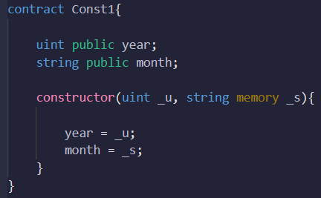
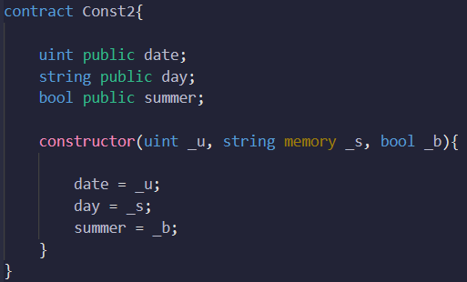
BASIC SYNTAX OF CONSTRUCTORS
-

Slide 6
THINGS TO KEEP IN MIND
Constructors are optional. If not defined, a default constructor is added automatically.
Only one constructor is allowed per contract.
Constructors cannot be called after the contract is deployed.
Constructors cannot be inherited or overridden.

Slide 7
PARENT AND CHILD CONTRACTS
Parent Contracts:
Parent contracts serve as base contracts that can be inherited by other contracts.
They define common functionality and state variables that child contracts can access and extend.
Parent contracts can have their own constructor, modifiers, and functions.

Slide 8
PARENT AND CHILD CONTRACTS
Child Contracts:
Child contracts inherit from parent contracts using the `is` keyword.
They can extend the functionality of parent contracts by adding additional state variables, functions, or modifiers.
Child contracts can override inherited functions or modifiers to modify their behavior.

Slide 9
PARENT AND CHILD CONSTRUCTORS
Parent Constructors: Constructors of the base contracts (parent contracts) are called before the child contract's constructor.
Child Constructors: Child contracts can define their own constructors, which can have additional parameters or logic.

Slide 10
CONSTRUCTOR ORDER
When a child contract is created, the constructors of the parent contracts are executed first, in the order they are inherited.
After parent constructors are executed, the child contract's constructor is executed.

Slide 11
CREATING CHILD CONTRACT
Write ‘contract’ followed by the contract name followed by ‘is’. Then write the name of parent contracts separated by commas in the order that you want to inherit them
In the child contract, through the child constructor, you can pass values to the parent constructors as well if required to using constructor arguments

Slide 12
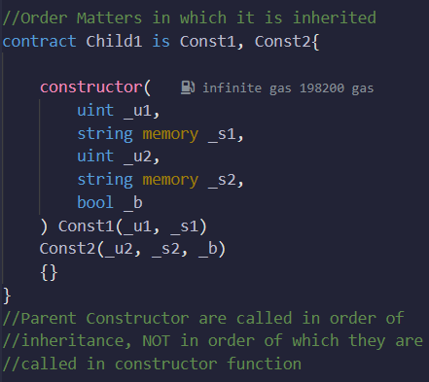
CREATING CHILD CONTRACT
-

Slide 13
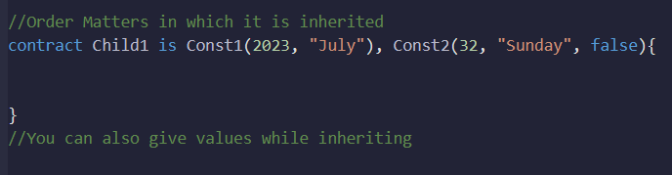
CREATING CHILD CONTRACT
You can also pass parent constructor arguments on inheritance as well

Slide 14
BEST PRACTICES
Keep constructors concise and focused on initialization tasks.
Avoid complex or lengthy logic within constructors for better readability.
Use descriptive names for constructors and ensure they are properly documented.
Understand the order of parent constructor execution when using multiple inheritance.

Slide 15
SUMMARY
Constructors are special functions executed during contract deployment to initialize variables and perform setup tasks.
They are used to set initial values, enforce conditions, and validate inputs.
Parent and child contracts enable code reuse, inheritance, and modular design in Solidity.
Child contracts can extend and customize the functionality of parent contracts.
Multiple inheritance is possible, allowing a child contract to inherit from multiple parent contracts.

