Slide 1
ENUM IN SOLIDITY

Slide 2
WHAT IS AN ENUM?
Definition: An enum, short for enumeration, is a user-defined data type in Solidity that represents a set of named values.
Enums allow you to define a fixed set of possible values for a variable.
Each value in an enum is assigned a unique identifier.

Slide 3
WHEN AND WHY TO USE ENUMS
Use cases: Enums are commonly used when there is a need to represent a predefined set of options, states, or categories in a contract.
Benefits:
Enhances code readability by using meaningful names instead of magic numbers or strings.
Provides compile-time checks to ensure only valid enum values are used.
Simplifies logic by restricting the available choices to a predefined set.

Slide 4
ENUM SYNTAX
Syntax:
enum EnumName { Value1, Value2, ..., ValueN }
Example:
enum DayOfWeek { Monday, Tuesday, Wednesday, Thursday, Friday, Saturday, Sunday }

Slide 5
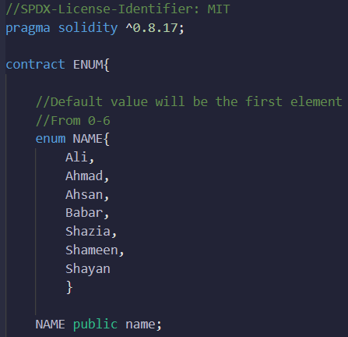
ENUM EXAMPLE
Defining the Enum:

Slide 6


ENUM EXAMPLE
The get function returns NAME in the form of a number, e.g. ‘0’ will represent ‘Ali’ which is the default value

Slide 7
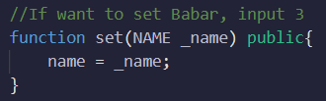


ENUM EXAMPLE
We input a number in the set function, where the number represents which element of the enum you require. E.g., for Ahsan you will input 2

Slide 8
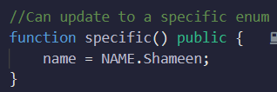
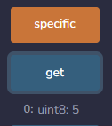
ENUM EXAMPLE
To declare a specific enum:

Slide 9
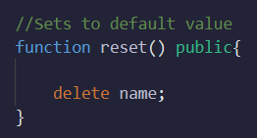


ENUM EXAMPLE
To reset value back to default value:

Slide 10
WRITING ENUMS IN A SEPARATE FILE AND IMPORTING
Best practice: Writing enums in a separate file allows for better organization and reusability.
Create a separate `.sol` file to define the enum.
Use the `import` statement to import the enum into other Solidity contracts.

Slide 11
ENUM VS ARRAY
Enums are used to represent a predefined set of options or states, while arrays are used to store and access collections of elements.
Enums restrict the available choices to a predefined set, whereas arrays can store multiple values of the same type.
Enums have a fixed number of values defined during compilation, while arrays can have a dynamic size.

Slide 12
BENEFITS OF USING ENUMS
Improved Readability: Enums use meaningful names that enhance code comprehension.
Compile-Time Checks: Enums provide compile-time verification of valid values, preventing runtime errors.
Simplified Logic: Enums restrict options to a predefined set, simplifying conditional statements.

Slide 13
BENEFITS OF USING ENUMS
Better Documentation: Enums serve as documentation by explicitly listing available values.
Enforced Constraints: Enums ensure that only valid values can be assigned to variables.
Enhanced Collaboration: Enums establish a shared language for discussing and implementing specific behaviors or states.

Slide 14
ADDITIONAL ENUM CONSIDERATIONS
Enums can be used in function parameters, return types, and struct members.
Enums can also be used as keys in mappings or as elements in arrays.
Enums are assigned integer values starting from 0, which can be accessed using type casting.

