Slide 1

IF-ELSE CONDITIONAL IN SOLIDITY

Slide 2

WHAT IS AN IF-ELSE CONDITIONAL
A fundamental programming construct that allows for decision-making based on conditions

Slide 3
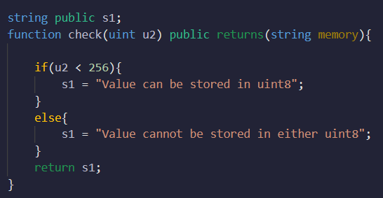
IF-ELSE CONDITIONAL

Slide 4
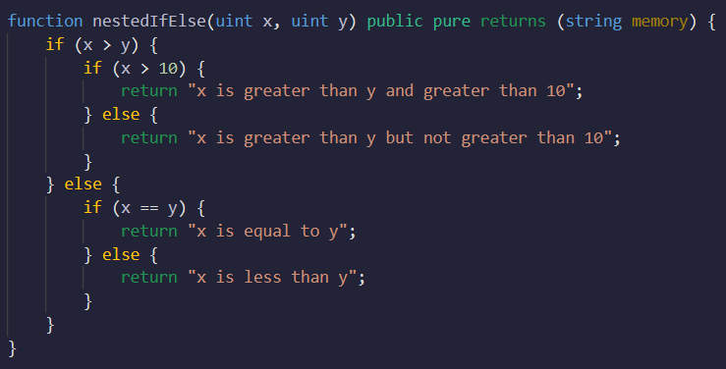
NESTED IF-ELSE CONDITIONAL
IF-ELSE statements within other IF or ELSE blocks
Allows for more complex decision-making

Slide 5
IF-ELSE-IF CONDITIONAL
An extension of the IF-ELSE construct that allows for multiple conditional branches
Provides a way to handle multiple scenarios and execute different code blocks based on various conditions

Slide 6
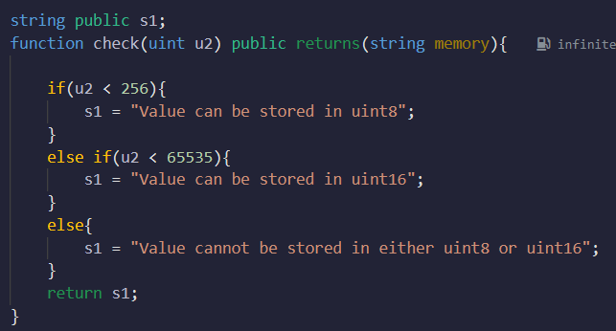
IF-ELSE-IF CONDITIONAL

Slide 7
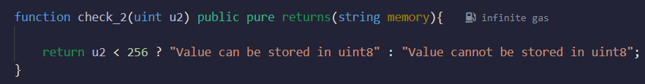
TERNARY/CONDITIONAL OPERATOR
A concise shorthand for simple IF-ELSE statements
the "?" operator is called the ternary operator
Syntax:
condition ? value_if_true : value_if_false

Slide 8
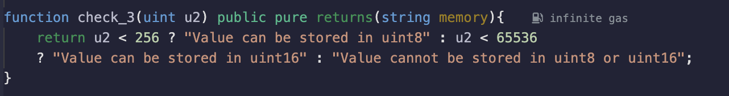
Convert this to if-else

Slide 9
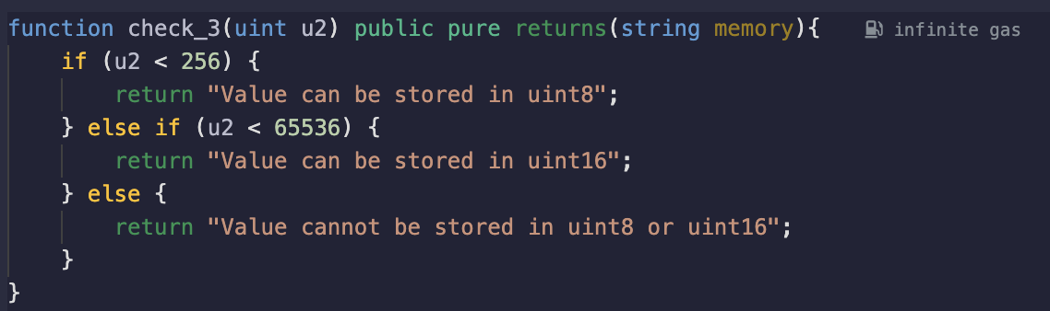
Convert this to if-else

Slide 10
Quiz
What will the code given below output for u2 = 7000

Slide 11
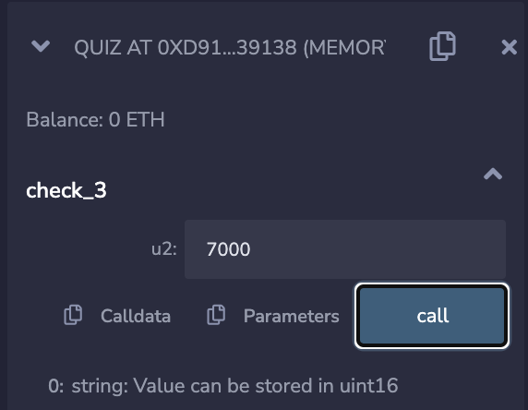
Quiz
What will the code given below output for u2 = 7000

