Slide 1
PAYABLE IN SOLIDITY

Slide 2
What is Payable?
Definition: Payable is a special state variable, constructor, or function in Solidity that allows contracts to receive Ether (cryptocurrency) as part of a transaction.
It enables the contract to accept incoming Ether transfers.

Slide 3
Why do we use Payable?
To receive Ether payments for goods or services.
To handle fundraising or crowdfunding.
To implement payment systems or financial contracts.
To interact with other contracts that transfer Ether.

Slide 4
When to use Payable?
E-commerce and online payment systems.
ICOs (Initial Coin Offerings) and token sales.
Donations or fundraising campaigns.
Gaming platforms with in-game purchases.

Slide 5

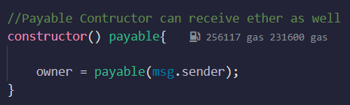
How to use Payable - Basic Syntax
State Variable: address payable public recipient;
Constructor: constructor() payable {}

Slide 6
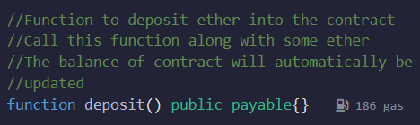
How to use Payable - Basic Syntax
Function: function deposit() public payable {}

Slide 7

Not using payable
Not using the payable keyword for functions involving ether transactions will give you an error

Slide 8
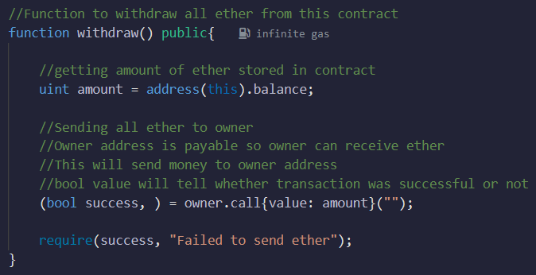
Withdrawing ether from contract
-

Slide 9
Withdrawing ether from contract
The withdraw function allows the contract owner to withdraw all the ether stored in the contract.
The amount of ether available in the contract is obtained using address(this).balance.
The owner address is payable, which means it can receive ether.

Slide 10
Withdrawing ether from contract
The owner.call{value: amount}("") statement sends the entire balance of the contract to the owner's address.
The returned boolean value success indicates whether the transaction was successful or not.
The require(success, "Failed to send ether") statement ensures that the ether transfer was successful; otherwise, it throws an exception with the specified error message.

Slide 11
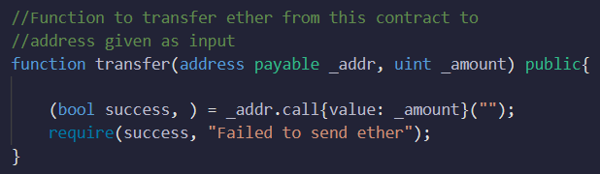
Transfer ether from contract
The previous example can be modified to take address and amount of ether to be transferred as input

Slide 12
Benefits of using Payable
Seamless integration with cryptocurrency payments.
Flexibility in designing payment mechanisms.
Interoperability with other contracts that transfer Ether.
Enables the contract to act as a financial intermediary.

Slide 13
Restrictions in using Payable
Payable functions must be external or public.
The fallback function is automatically payable.
Proper validation and security measures are crucial to handle incoming Ether safely.

Slide 14
Additional Considerations
Gas costs and transaction fees for payable functions.
Handling multiple currencies or tokens.
Error handling and fallback mechanisms.

