Slide 1
SOLIDITY CODE BASIC SYNTAX

Slide 2
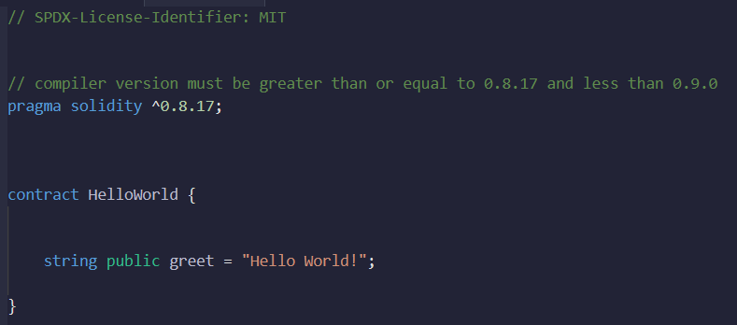
HELLO WORLD

Slide 3
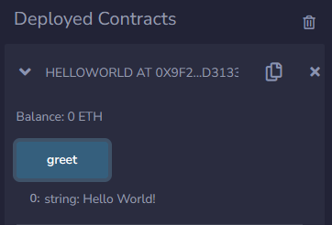
OUTPUT

Slide 4
LICENSE IDENTIFIER & COMPILER VERSION
SPDX-License-Identifier is a standard way to specify the license under which the code is released
The MIT license is a permissive open-source license that allows the code to be used, modified, and distributed.
The "pragma solidity" statement is used to specify the compiler version
In this code, the compiler version must be greater than or equal to 0.8.17 and less than 0.9

Slide 5
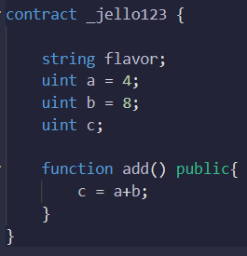
CONTRACT
Solidity contracts are defined using the "contract" keyword
Contracts act as containers for functions and data
Contracts consist of variables, functions, and other declarations

Slide 6
DEMO
Notes:
Show how changing compiler version causes error.
1.1) Just change the pragma solidity version
Show how you can place 2 contracts in the same file
but you’ve to deploy them separately, one by one.
Or combine them using inheritance
// SPDX-License-Identifier: MIT
pragma solidity ^0.8.3;
contract Child1 {
function doSomething() public pure returns (string memory) {
return "Child1 function called";
}
}
contract Child2 {
function doSomething() public pure returns (string memory) {
return "Child2 function called";
}
}
contract Deployer {
Child1 public child1;
Child2 public child2;
constructor() {
child1 = new Child1();
child2 = new Child2();
}
}

Slide 7
Solidity by example

