Slide 1
SOLIDITY VARIABLES
[STATE + LOCAL + GLOBAL]

Slide 2
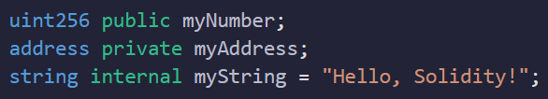
VARIABLES IN SOLIDITY PROGRAMMING
Variables in Solidity are used to store and manipulate data.
They are declared with a specific data type and can hold values of that type.

Slide 3
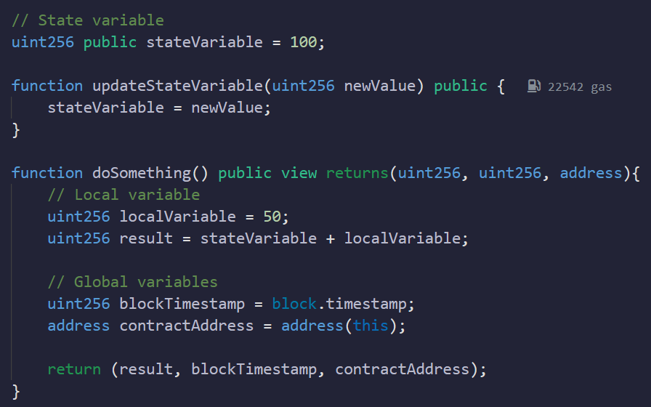
TYPES OF VARIABLES IN SOLIDITY
State Variables
Local Variables
Global Variables

Slide 4
STATE VARIABLES
State variables in Solidity are declared within a contract and stored on the blockchain.
They hold values that persist across function calls and maintain their state between transactions.

Slide 5
USAGE OF STATE VARIABLES
Storing contract-specific data: State variables can hold values that need to be stored and accessed throughout the contract's lifetime.
Managing contract state: State variables can track the current state of the contract, such as balance, ownership, or status.
Interacting with other contracts: State variables can store addresses of other contracts for interaction and function calls.

Slide 6
STATE VARIABLES
State variables can have different visibility levels, such as public, private, or internal, determining their accessibility.
Changes to state variables usually require a transaction and incur gas costs.

Slide 7
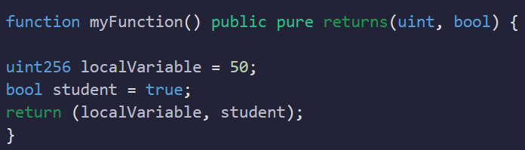
LOCAL VARIABLES
Local variables in Solidity are declared within a function or a block of code.
They are temporary and exist only within the scope of the function or block where they are defined.

Slide 8
LOCAL VARIABLES
Local variables are not stored on the blockchain and do not persist beyond the execution of the function or block.
Local variables can have different data types, such as uint, bool, address, or custom-defined types.

Slide 9
GLOBAL VARIABLES
Global variables in Solidity are variables that are accessible from any part of the contract.
They provide access to important information and functionality.
Global variables simplify the handling of blockchain-related data and facilitate interaction with other contracts and users.
Notes:
Improve security. Example:

Slide 10
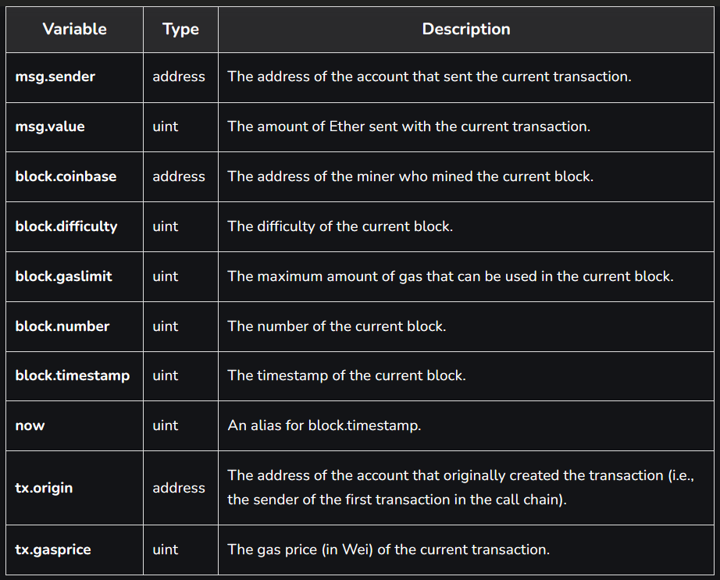
SOME COMMON GLOBAL VARIABLES
Notes:
Solidity Global Variables - GeeksforGeeks

Slide 11
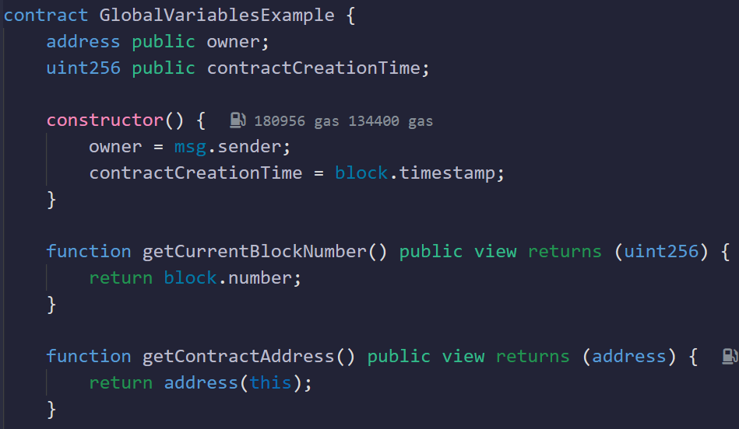
GLOBAL VARIABLES

Slide 12
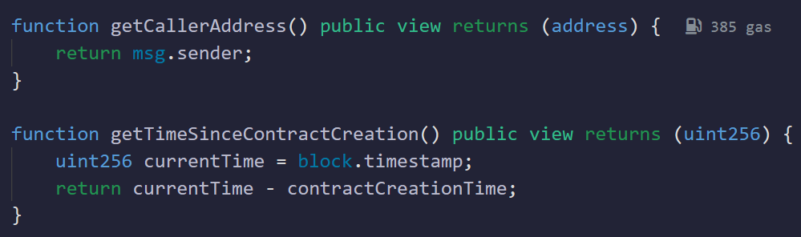
GLOBAL VARIABLES

Slide 13
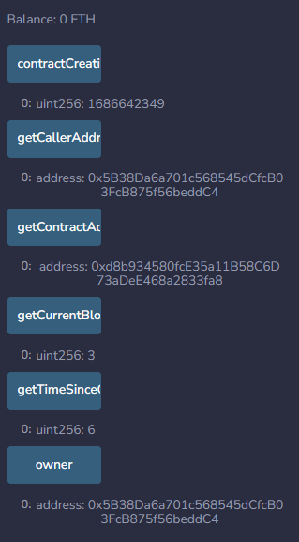
GLOBAL VARIABLES

Slide 14
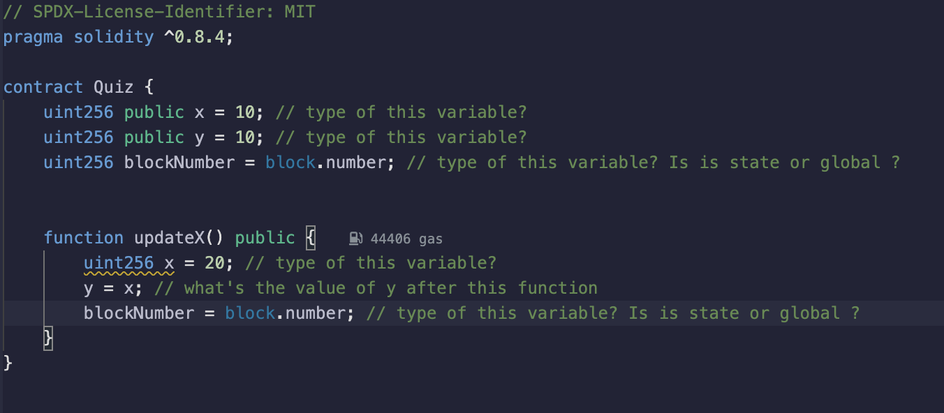
Quiz

Slide 15
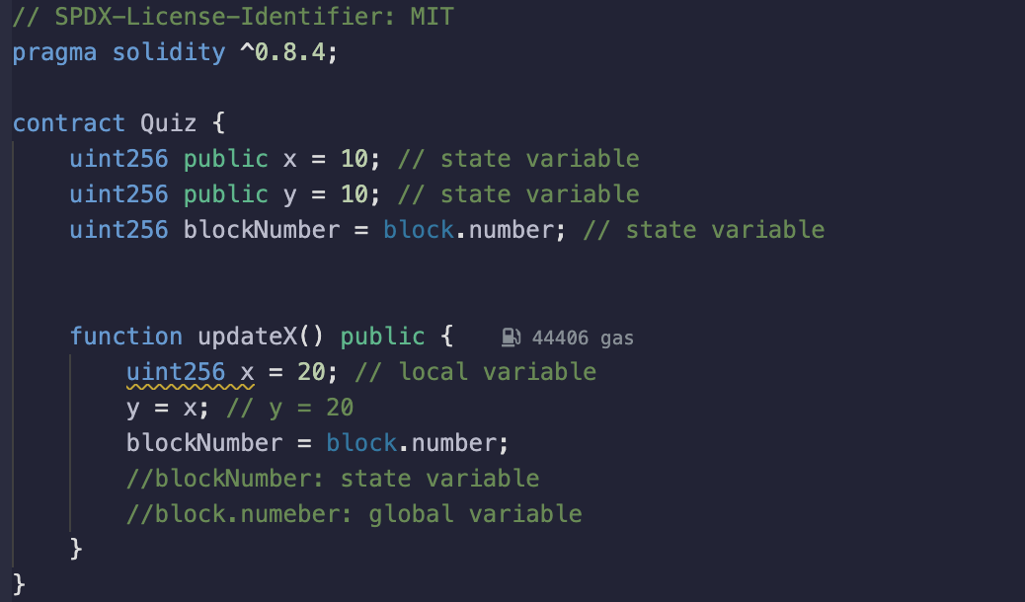
Quiz

Slide 16
SUMMARY
Variables in Solidity store and manipulate data within smart contracts.
State variables are stored on the blockchain, accessible throughout the contract, and maintain their value between function calls.
Local variables exist only within their scope and are temporary.
Global variables provide access to blockchain-related information and contract metadata.
Solidity supports various data types for variables.
Consider scoping, visibility, and gas efficiency when working with variables in Solidity contracts.

