Slide 1
CALLING PARENT CONTRACTS

Slide 2
WHAT IS SUPER KEYWORD?
Definition: The `super` keyword is used to call functions from the parent contract in Solidity.
Purpose: Allows child contracts to invoke and extend the functionality of parent contract functions.

Slide 3
WHEN AND WHY TO USE THE SUPER KEYWORD
When to use: The `super` keyword is used when you want to call a function from the parent contract within a child contract.
Why to use:
- Customization: Allows child contracts to extend or modify the behavior of inherited functions.
- Function Order: Helps specify the order in which parent functions are called in multi-layer inheritance.

Slide 4

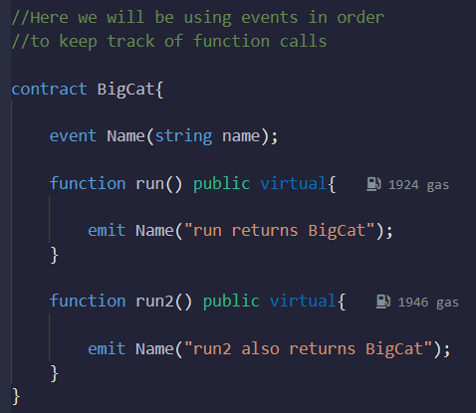



BASIC SYNTAX OF USING THE SUPER KEYWORD
Syntax: `super.functionName()`

Slide 5
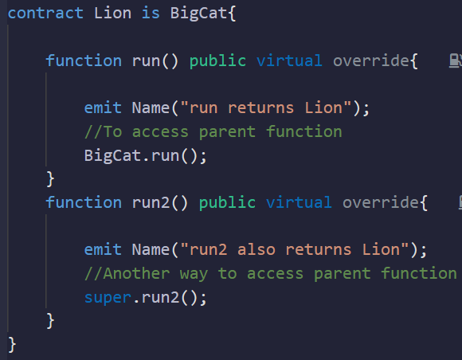
BASIC SYNTAX OF USING THE SUPER KEYWORD
-

Slide 6






BASIC SYNTAX OF USING THE SUPER KEYWORD
-

Slide 7
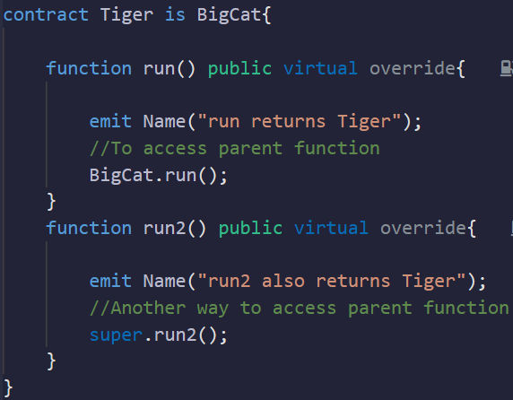
BASIC SYNTAX OF USING THE SUPER KEYWORD
-

Slide 8


BASIC SYNTAX OF USING THE SUPER KEYWORD
-

Slide 9
CALLING PARENT FUNCTION IN MULTI-LAYER INHERITANCE
Inheritance Tree Example:
A
/ \
B C
\ /
D

Slide 10
CALLING PARENT FUNCTION IN MULTI-LAYER INHERITANCE
As we can see from the inheritance tree, contract B and C both inherit from contract A
And contract D inherits from both contract B and C, as a result it indirectly inherits from contract A as well
A parent function can be called using ParentName.FunctionName() as well

Slide 11
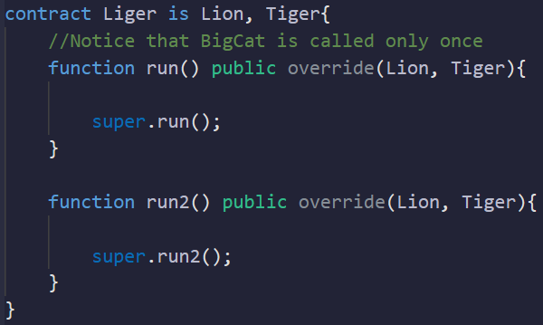
CALLING PARENT FUNCTION IN MULTI-LAYER INHERITANCE
-

Slide 12







CALLING PARENT FUNCTION IN MULTI-LAYER INHERITANCE
-

Slide 13
CALLING PARENT FUNCTION IN MULTI-LAYER INHERITANCE
In contract Liger, contract Tiger is inherited first as it is on the right-most
When ‘run()’ function is run in contract Liger, it causes Tiger.run() function to run which in turn causes BigCat.run() function to run
Note that in this case, only one super function is executed, which is in the ‘Liger’ contract

Slide 14
CALLING PARENT FUNCTION IN MULTI-LAYER INHERITANCE
The run2() function of both Lion and Tiger contracts consists of a super function
So when Liger contract calls run2() function, it first calls Tiger.run2() as it was inherited first and then Lion.run2() due to usage of super keyword. Finally the grandparent BigCat.run2() is called

Slide 15
CALLING PARENT FUNCTION BY NAME VS. USING THE SUPER KEYWORD
Calling by Name: Invoking parent function directly by its name.
Using the Super Keyword: Calling parent function using the `super` keyword.

Slide 16
SUMMARY
The `super` keyword is used to call functions from the parent contract.
It allows child contracts to extend, modify, or invoke parent functions.
`super` is particularly useful in multi-layer inheritance scenarios to specify the order of function execution.

