Slide 1
VIEW AND PURE IN SOLIDITY

Slide 2
Introduction
Solidity provides two function modifiers: `view` and `pure`, used to indicate the behavior of functions.
These modifiers enhance code clarity by explicitly specifying whether a function modifies state or performs computations without modifying state.
`view` and `pure` functions are read-only and do not consume any gas when called externally.

Slide 3
View Modifier
The `view` modifier is used to indicate that a function does not modify the state of the contract.
It can read data from the state and other contracts but cannot modify or write any state variables.
View functions are used for querying and accessing contract data.

Slide 4
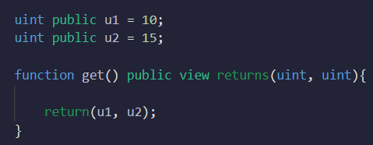
View Modifier
The `view` modifier only allows you to see or access state variables, it doesn’t allow you to change them

Slide 5
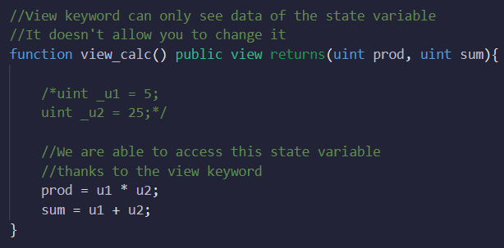
View Modifier
What will happen if u1 and u2 are replaced by _u1 and _u2 respectively

Slide 6
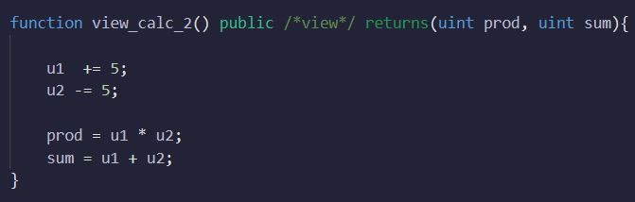
View Modifier
Why do we get error if view is used?

Slide 7
Pure Modifier
The `pure` modifier is used to indicate that a function does not read or modify the state.
It performs computations solely based on the provided inputs and returns a value.
Pure functions are useful for performing calculations or transformations without interacting with the contract's state.

Slide 8
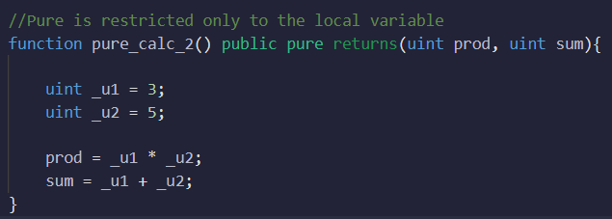
Pure Modifier
Using pure means that we are not accessing any state variables and only working with local variables

Slide 9
pure Modifier
Why is pure not used here?
Can pure function have parameters?

Slide 10
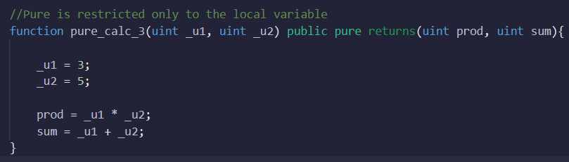
pure Modifier
Can pure function have parameters?

Slide 11
Difference Between View and Pure
State Modification:
- View functions can read state variables but cannot modify them.
- Pure functions neither read nor modify state variables.
External Calls:
- View functions can make external calls to other contracts.
- Pure functions cannot make any external calls.

Slide 12
Difference Between View and Pure
Gas Consumption:
- Both view and pure functions are gas-free when called externally.
- They do not consume any gas as they don't modify state.

Slide 13
When to Use View and Pure
View Functions:
- Use view functions when you need to access contract state or retrieve data without modifying it.
- Suitable for querying and retrieving information from the blockchain.

Slide 14
When to Use View and Pure
Pure Functions:
- Use pure functions when you need to perform computations or transformations without interacting with the contract's state.
- Suitable for mathematical calculations or string manipulations.

Slide 15
Summary
Use `view` for functions that read state variables.
Use `pure` for functions that don't read or modify state.
View and pure functions are gas-free when called externally.

