Slide 1
ERROR HANDLING IN SOLIDITY

Slide 2
Introduction to Error Handling
Solidity provides various error handling mechanisms to handle exceptional scenarios and enforce contract requirements.
Error handling helps in preventing unexpected behavior and ensuring the integrity of smart contracts.
Three commonly used error handling mechanisms in Solidity are `assert`, `revert`, and `require`.

Slide 3
Assert Statement
The `assert` statement is used to check for internal errors and validate conditions that should never occur.
It is typically used to assert conditions that must always be true for the contract to function correctly.
If an assertion fails, it indicates a bug in the contract, and the transaction is reverted.

Slide 4
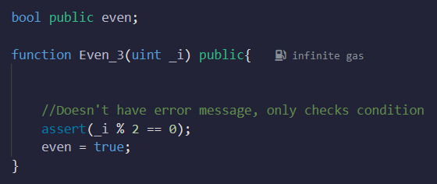


Assert Statement
-

Slide 5
Assert Statement
Why is the function in the previous slide not reusable?

Slide 6
Revert Statement
The `revert` statement is used to explicitly revert the current transaction and provide an error message.
It is commonly used for user-induced errors or to handle exceptional conditions.
When a `revert` statement is encountered, all changes made during the transaction are reverted.

Slide 7
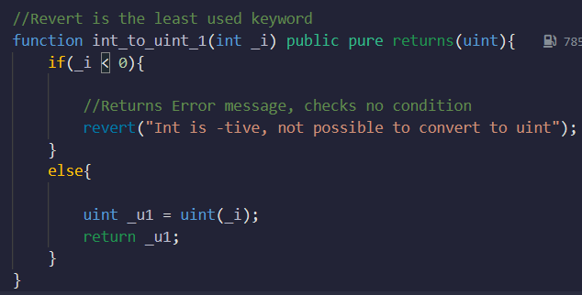

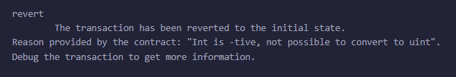
Revert Statement
It is the least used of the three
It has no condition, it will execute when it is encountered

Slide 8
Revert Statement
After going through the slides, tell why revert is the least used of the three?

Slide 9
Difference Between Revert and Require
Error Message:
- `revert` allows providing an error message to explain the reason for reverting.
- `require` also allows providing an error message to provide context for the revert, but it has a different purpose.

Slide 10
Difference Between Revert and Require
Use Case:
- Use `revert` to handle exceptional conditions or user-induced errors.
- Use `require` to validate inputs, enforce contract preconditions, or check for specific conditions.

Slide 11
Require Statement
The `require` statement is used to validate user inputs and enforce contract preconditions.
It is commonly used to validate function inputs, contract state, or to ensure specific conditions are met.
If the condition evaluates to false, the transaction is reverted, and any changes made during the transaction are rolled back.

Slide 12
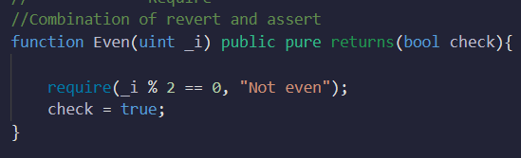
Require Statement
It can be considered combination of assert and revert
It consists of both condition and error message

Slide 13
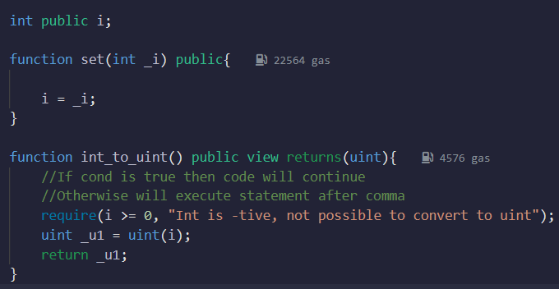


Require Statement
-

Slide 14
Require Statement
How can previous code be written as a combination of assert and revert?

Slide 15
Revert as Combination of Require and Assert
The `require` statement is a combination of `revert` and `assert`.
`require` performs input validation and reverts the transaction with an error message if the condition fails.
If the condition within `require` evaluates to false, it behaves like `revert`.
If the condition evaluates to true, it continues executing the function like `assert`.

Slide 16
Summary
Error handling in Solidity is crucial for enforcing contract requirements and preventing unexpected behavior.
Use `assert` for internal error checking.
Use `revert` to handle exceptional conditions and provide error messages.
Use `require` to validate inputs and enforce contract preconditions.

