Slide 1
INHERITANCE IN SOLIDITY

Slide 2
WHAT IS INHERITANCE?
Definition: Inheritance is a mechanism that allows a contract to inherit properties (state variables and functions) from another contract.
Purpose: Enables code reuse, modularity, and hierarchical structure in Solidity contracts.

Slide 3
WHEN AND WHY TO USE INHERITANCE
When to use: Inheritance is used when you want to reuse code from an existing contract or establish a hierarchical relationship between contracts.
Why to use:
- Code Reusability: Inherit properties from a base contract to avoid duplicating code.
- Modularity: Break down complex contracts into smaller, manageable pieces.
- Extensibility: Customize and extend the functionality of existing contracts.

Slide 4
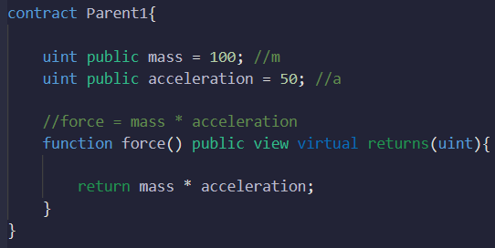
BASIC SYNTAX OF INHERITANCE
Use the `is` keyword to inherit from a parent contract.
Child contracts gain access to parent contract's state variables and functions.

Slide 5
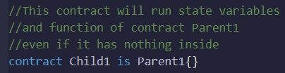
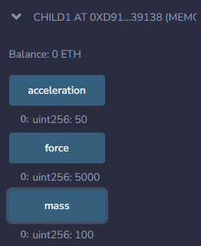
BASIC SYNTAX OF INHERITANCE

Slide 6
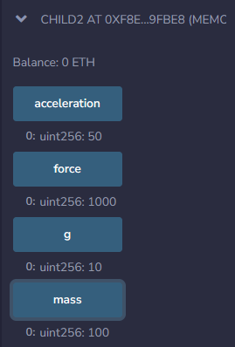
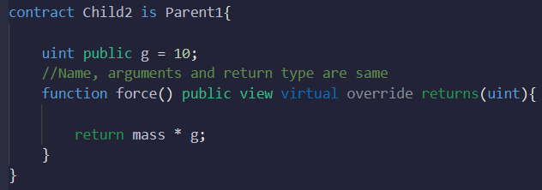
VIRTUAL AND OVERRIDE KEYWORDS
`virtual`: Used in parent contracts to indicate that a function can be overridden.
`override`: Used in child contracts to explicitly indicate function overriding.

Slide 7
SUPER FUNCTION
It allows the child contract to execute additional logic while retaining the functionality of the parent contract.
Useful when you want to execute the parent's logic before or after the child's logic.

Slide 8
SUPER FUNCTION
Syntax:
contract ChildContract is ParentContract {
function foo() public override {
// Child contract logic
super.foo(); // Call parent's foo function
// More child contract logic
}
}

Slide 9
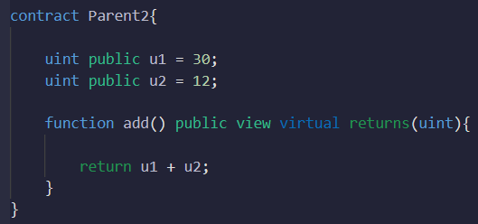
SUPER FUNCTION
Example:

Slide 10
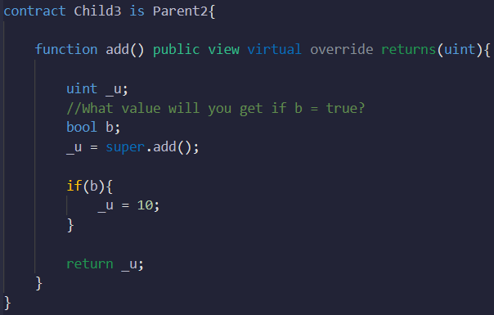

SUPER FUNCTION
What will happen if bool b = true?

Slide 11
MULTIPLE INHERITANCE
Solidity supports multiple inheritance, allowing a child contract to inherit from multiple parent contracts.
Separate parent contracts with commas.
Order is very important here, as contract name that is written right most is inherited first

Slide 12
MULTIPLE INHERITANCE
The order in which parent contracts are listed determines the order of constructor execution and function overriding.
Child contracts can override functions from parent contracts.

Slide 13
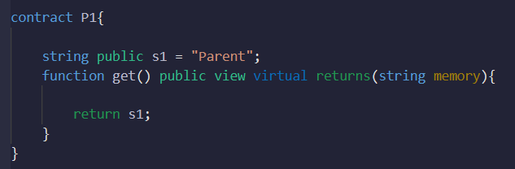
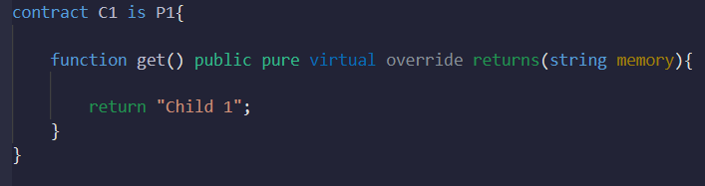
MULTIPLE INHERITANCE
Example:

Slide 14
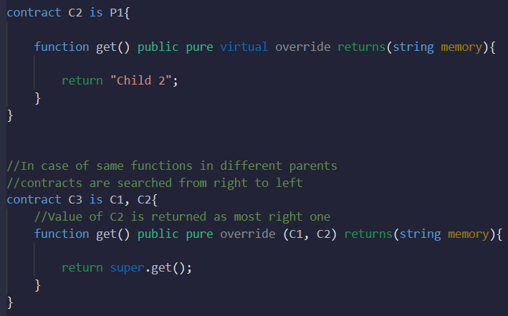

MULTIPLE INHERITANCE
-

Slide 15
MULTIPLE INHERITANCE
In case of example in the previous slide, contract C2 is inherited first
As both C1 and C2 contracts have get function hence after override keyword both are mentioned, order doesn’t matter here
As C2 is inherited first, so super function will execute get function of C2 contract

Slide 16
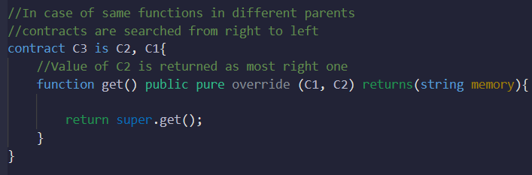
MULTIPLE INHERITANCE
What will be the output in this case?

Slide 17
MULTI-LAYER INHERITANCE
Contracts can be structured in multi-layer inheritance, creating a hierarchical relationship.
Child contracts inherit from a parent contract, which can also be a child of another parent contract.
In this case the direct parent is inherited from first and then the parent of that parent, otherwise you will get compilation error

Slide 18
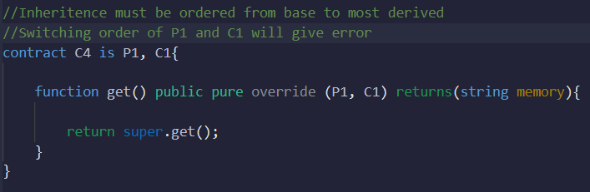
MULTI-LAYER INHERITANCE
Example:

Slide 19
SUMMARY
Inheritance allows for code reuse, modularity, and hierarchical organization of contracts.
The `is` keyword is used for inheritance, and multiple inheritance is supported.
The order of inheritance determines constructor execution and function overriding.
`virtual`, `override`, and `super` keywords enable customization and interaction between parent and child contracts.

