Slide 1

MetaMask Wallet

Slide 2
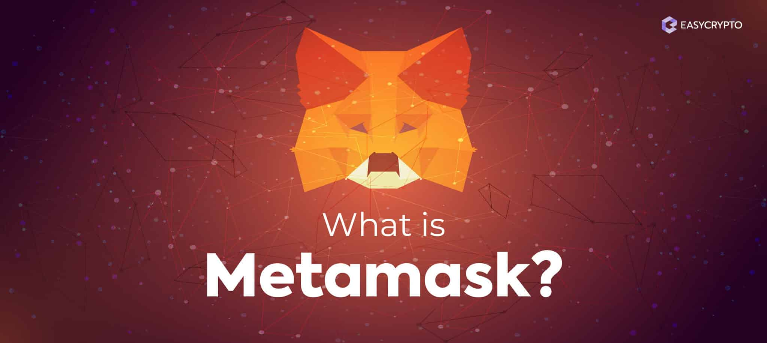
WHAT IS METAMASK WALLET?

Slide 3
WHAT IS METAMASK WALLET?
MetaMask is a cryptocurrency wallet and a browser extension that allows you to interact with the Ethereum blockchain.
It serves as a bridge between your web browser and the Ethereum network, enabling you to manage your digital assets and access decentralized applications (DApps).

Slide 4
GETTING STARTED WITH METAMASK WALLET
Install MetaMask: Add the MetaMask extension to your preferred web browser (Chrome, Firefox, etc.).
Create an Account: Set up a new wallet or import an existing one using a mnemonic phrase or JSON file.

Slide 5
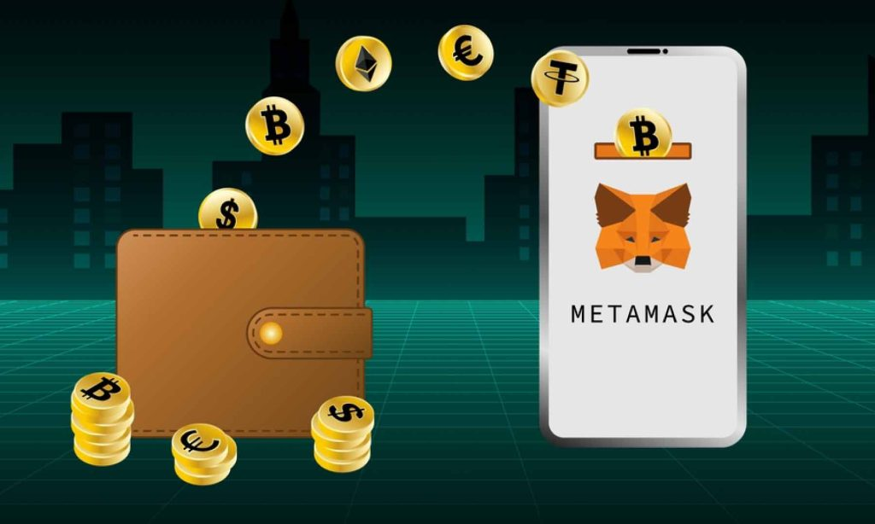
GETTING STARTED WITH METAMASK WALLET
Fund Your Wallet: Add ETH (Ethereum) or other ERC-20 tokens to your MetaMask wallet for transactions and interactions.

Slide 6
GETTING STARTED WITH METAMASK WALLET
Connect to DApps: Visit DApp websites and connect your MetaMask wallet to start using them.
Security Measures: Enable additional security features like a password, biometric authentication, or hardware wallet integration for enhanced protection.

Slide 7
Mnemonic VS Private Key
Mnemonic Phrase: A single mnemonic phrase can generate multiple private keys through a process defined in BIP32 (Hierarchical Deterministic Wallets). This allows users to manage multiple accounts with a single mnemonic phrase.
BIP32 seed is generated from mnemonic that is used to generate the private key which generates the public key.
Private Key: A single private key corresponds to a single public key (and therefore a single account). If you want multiple accounts, you would need multiple private keys.

Slide 8
DEMO

Slide 9
TIPS AND BEST PRACTICES
Keep Your Seed Phrase Safe: Store your mnemonic phrase offline in a secure location. Do not share it with anyone.
Beware of Phishing Attempts: Ensure you are interacting with the official MetaMask website and exercise caution when entering your wallet details.
Regularly Update the Extension: Install updates and security patches to benefit from the latest features and bug fixes.
Research DApps: Before using a DApp, verify its reputation, review user feedback, and understand the risks involved.

