Slide 1
SOLIDITY- CONSTANT & IMMUTABLE

Slide 2
CONSTANT
Constant variables in Solidity are variables whose value cannot be changed after initialization.
They must be assigned a value on declaration

Slide 3
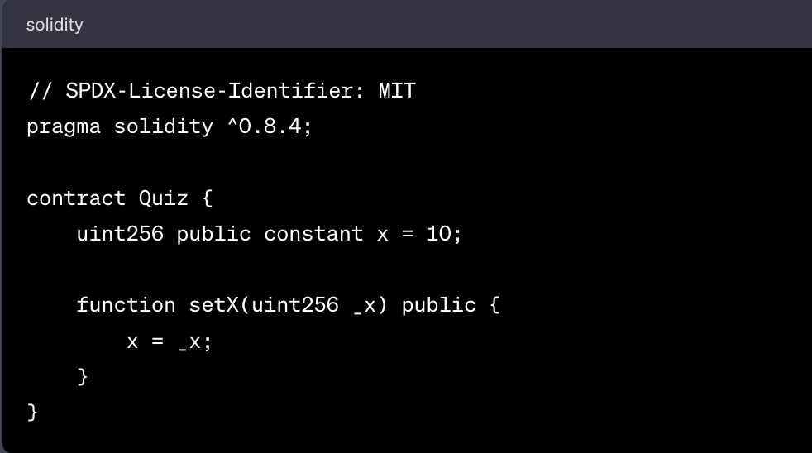
Will this compile?
Notes:
Answer: NO

Slide 4
BENEFITS OF CONSTANT
Immutable values: Once assigned, their value cannot be changed, ensuring data integrity.
Gas optimization: Constant values are computed at compile-time, reducing gas costs. Once assigned, is directly inserted into the bytecode at the points where it is used. This can mean fewer SLOAD operations, which are relatively expensive in terms of gas
Code readability: Clearly indicate values that should not be modified, improving code understanding.
Efficiency: Constant variables are stored directly in the bytecode, eliminating storage and state access costs.
Notes:
Draw a diagram for this like Opcode Push ……. number …..

Slide 5
IMMUTABLE
Immutable variables in Solidity are variables whose value cannot be changed after initialization.
They are declared using the immutable keyword.
Immutable can only be initialized inline or assigned directly in the constructor

Slide 6
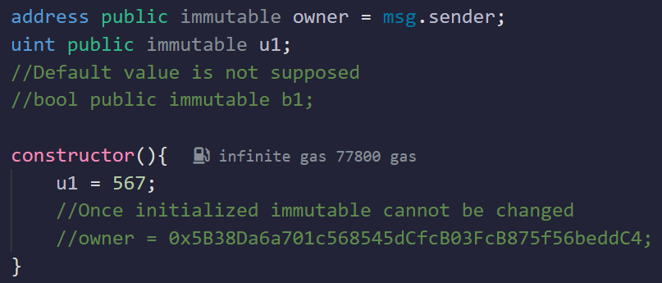
IMMUTABLE
Notes:
only initilized once hence we use constructor

Slide 7
IMMUTABLE
Compile-time assignment: Values are computed during contract deployment and cannot be changed afterward. The actual locations in the bytecode where the value will be stored are determined when the contract is compiled
Gas optimization: Immutable values are computed at compile-time, reducing gas costs. Once assigned, is directly inserted into the bytecode at the points where it is used. This can mean fewer SLOAD operations, which are relatively expensive in terms of gas
Code safety: Prevents accidental modification of important values, enhancing code stability.
Enhanced security: Immutable variables can provide protection against certain attacks, such as reentrancy vulnerabilities.

Slide 8
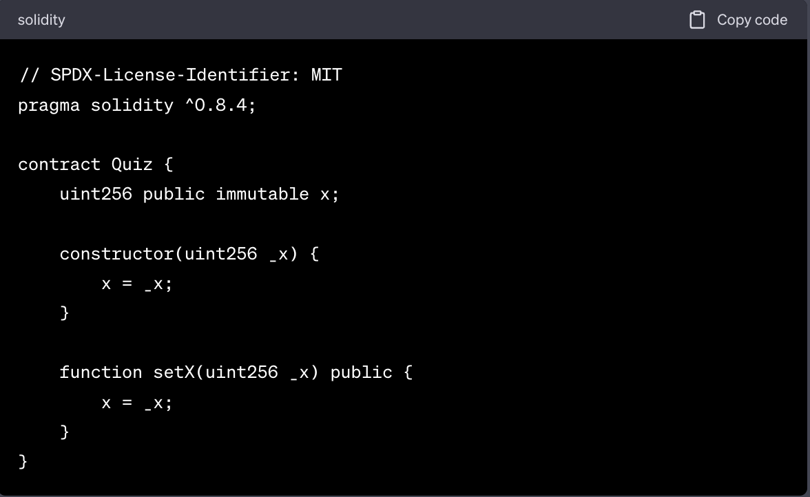
Will this compile?
Notes:
Answer: NO

Slide 9
CONSTANT VS IMMUTABLE
CONSTANT
IMMUTABLE
Declared using the `constant` keyword.
Assigned at compile-time.
Can be state variables or local variables.
Example:
uint256 constant public MAX_VALUE = 100;
Declared using the `immutable` keyword.
Assigned at deployment-time.
Can only be state variables.
Example:
uint256 immutable public MAX_VALUE = 100;

