Slide 1
SOLIDITY PRIMITIVE DATA TYPES

Slide 2
Data Type | Description
Boolean | Represents a binary value: true or false
Integer | Represents whole numbers without decimal points
Address | Represents a 20-byte Ethereum address
String | Represents a sequence of characters
Bytes | Represents a fixed-length array of bytes
Fixed-Point Numbers | Represents decimal numbers with a fixed number of decimal places
Enum | Represents a user-defined data type with a set of named values
Mapping | A key-value data structure to map values to unique keys

Slide 3
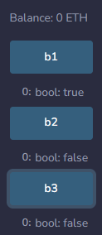
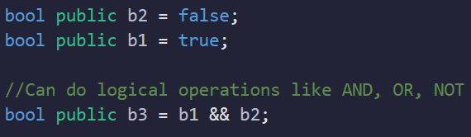
BOOLEAN TYPE
Represents binary values: true or false
Used for logical operations and conditions
Logical operators such as && (AND), || (OR), and ! (NOT) can be used with boolean values

Slide 4
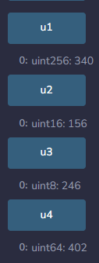
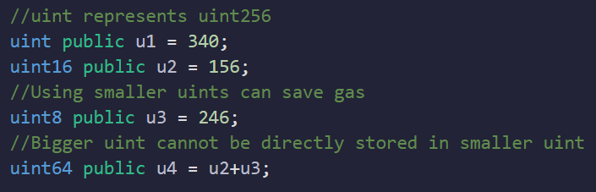
UNSIGNED INTEGER
Non-negative integers
Different sizes available: uint8, uint16, ..., uint256
uint’n’ can store values from 0 to (2^n)-1, where ‘n’ is a number from 8 - 256
Notes:
DEMO

Slide 5
Understanding Binary to Denary(Unsigned)
Here's an example of converting a binary number (base 2) to a decimal number (base 10)
Let's take the binary number 1000 1011. Uint8
2^7 | 2^6 | 2^5 | 2^4 | 2^3 | 2^2 | 2^1 | 2^0
1 | 0 | 0 | 0 | 1 | 0 | 1 | 1
2^7 + 2^3 + 2^1 + 2^0 = 128 + 8 + 2 + 1 = 139

Slide 6
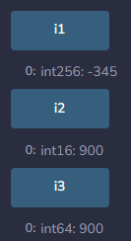
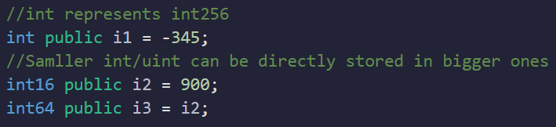
SIGNED INTEGER
Includes negative numbers
Different sizes available: int8, int16, ..., int256
int'n' can store values from -(2^n-1) to (2^n-1)-1, where n is a constant number ranging from 8 - 256
Notes:
DEMO

Slide 7
Understanding Binary to Denary(Signed)
Here's an example of converting a binary number (base 2) to a decimal number (base 10)
Let's take the binary number 1000 1011. Int8
2^7 | 2^6 | 2^5 | 2^4 | 2^3 | 2^2 | 2^1 | 2^0
1 | 0 | 0 | 0 | 1 | 0 | 1 | 1
-(2^7) + 2^3 + 2^1 + 2^0 = 128 + 8 + 2 + 1 = -117

Slide 8
Understanding Binary to Denary(Signed)
Here's an example of converting a binary number (base 2) to a decimal number (base 10)
Let's take the binary number 0000 1011 to Int8
2^7 | 2^6 | 2^5 | 2^4 | 2^3 | 2^2 | 2^1 | 2^0
0 | 0 | 0 | 0 | 1 | 0 | 1 | 1
2^3 + 2^1 + 2^0 = 8 + 2 + 1 = 11

Slide 9
Quiz Binary to Denary(Signed)
Here's an example of converting a binary number (base 2) to a decimal number (base 10)
Let's convert the binary number 1001 1101 to Int8

Slide 10
Quiz Binary to Denary(Signed)
Here's an example of converting a binary number (base 2) to a decimal number (base 10)
Let's take the binary number 1001 1101. Int8
2^7 | 2^6 | 2^5 | 2^4 | 2^3 | 2^2 | 2^1 | 2^0
1 | 0 | 0 | 1 | 1 | 1 | 0 | 1
-(2^7) + 2^4 + 2^3 + 2^2 + 2^0 = -128 + 16 + 8 + 4 +1 = -99

Slide 11

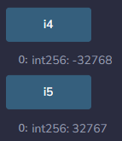
MAX & MIN
You can also find the maximum and minimum values that can stored in an int/uint data type through solidity as well

Slide 12
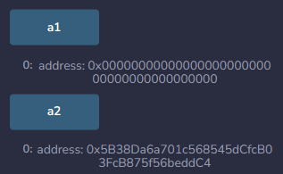
ADDRESS TYPE
Represents Ethereum addresses
Used for interacting with contracts or transferring funds
Addresses are 20-byte values (160 bits) typically represented in hexadecimal format
Notes:
DEMO

Slide 13
BENEFITS OF ADDRESS DATA TYPE
They can be used to store and manage contract addresses, allowing for interaction with other contracts through function calls.
Address data types allow for secure and precise handling of addresses, ensuring accurate transactions and account management.
They prevent accidental transfers to invalid or non-existent addresses by providing address validity checks.

Slide 14
QUIZ
No. of Bits in address type ?
No. of Bytes in Uint64 ?
No. of Bits in Int8?

Slide 15
QUIZ
No. of Bits in address type ?
No. of Bytes in Uint64 ?
No. of Bits in Int8?
20 bytes -> 20*8 = 160 bits
64 bits -> 64/8 = 8 bytes
8 bits

Slide 16
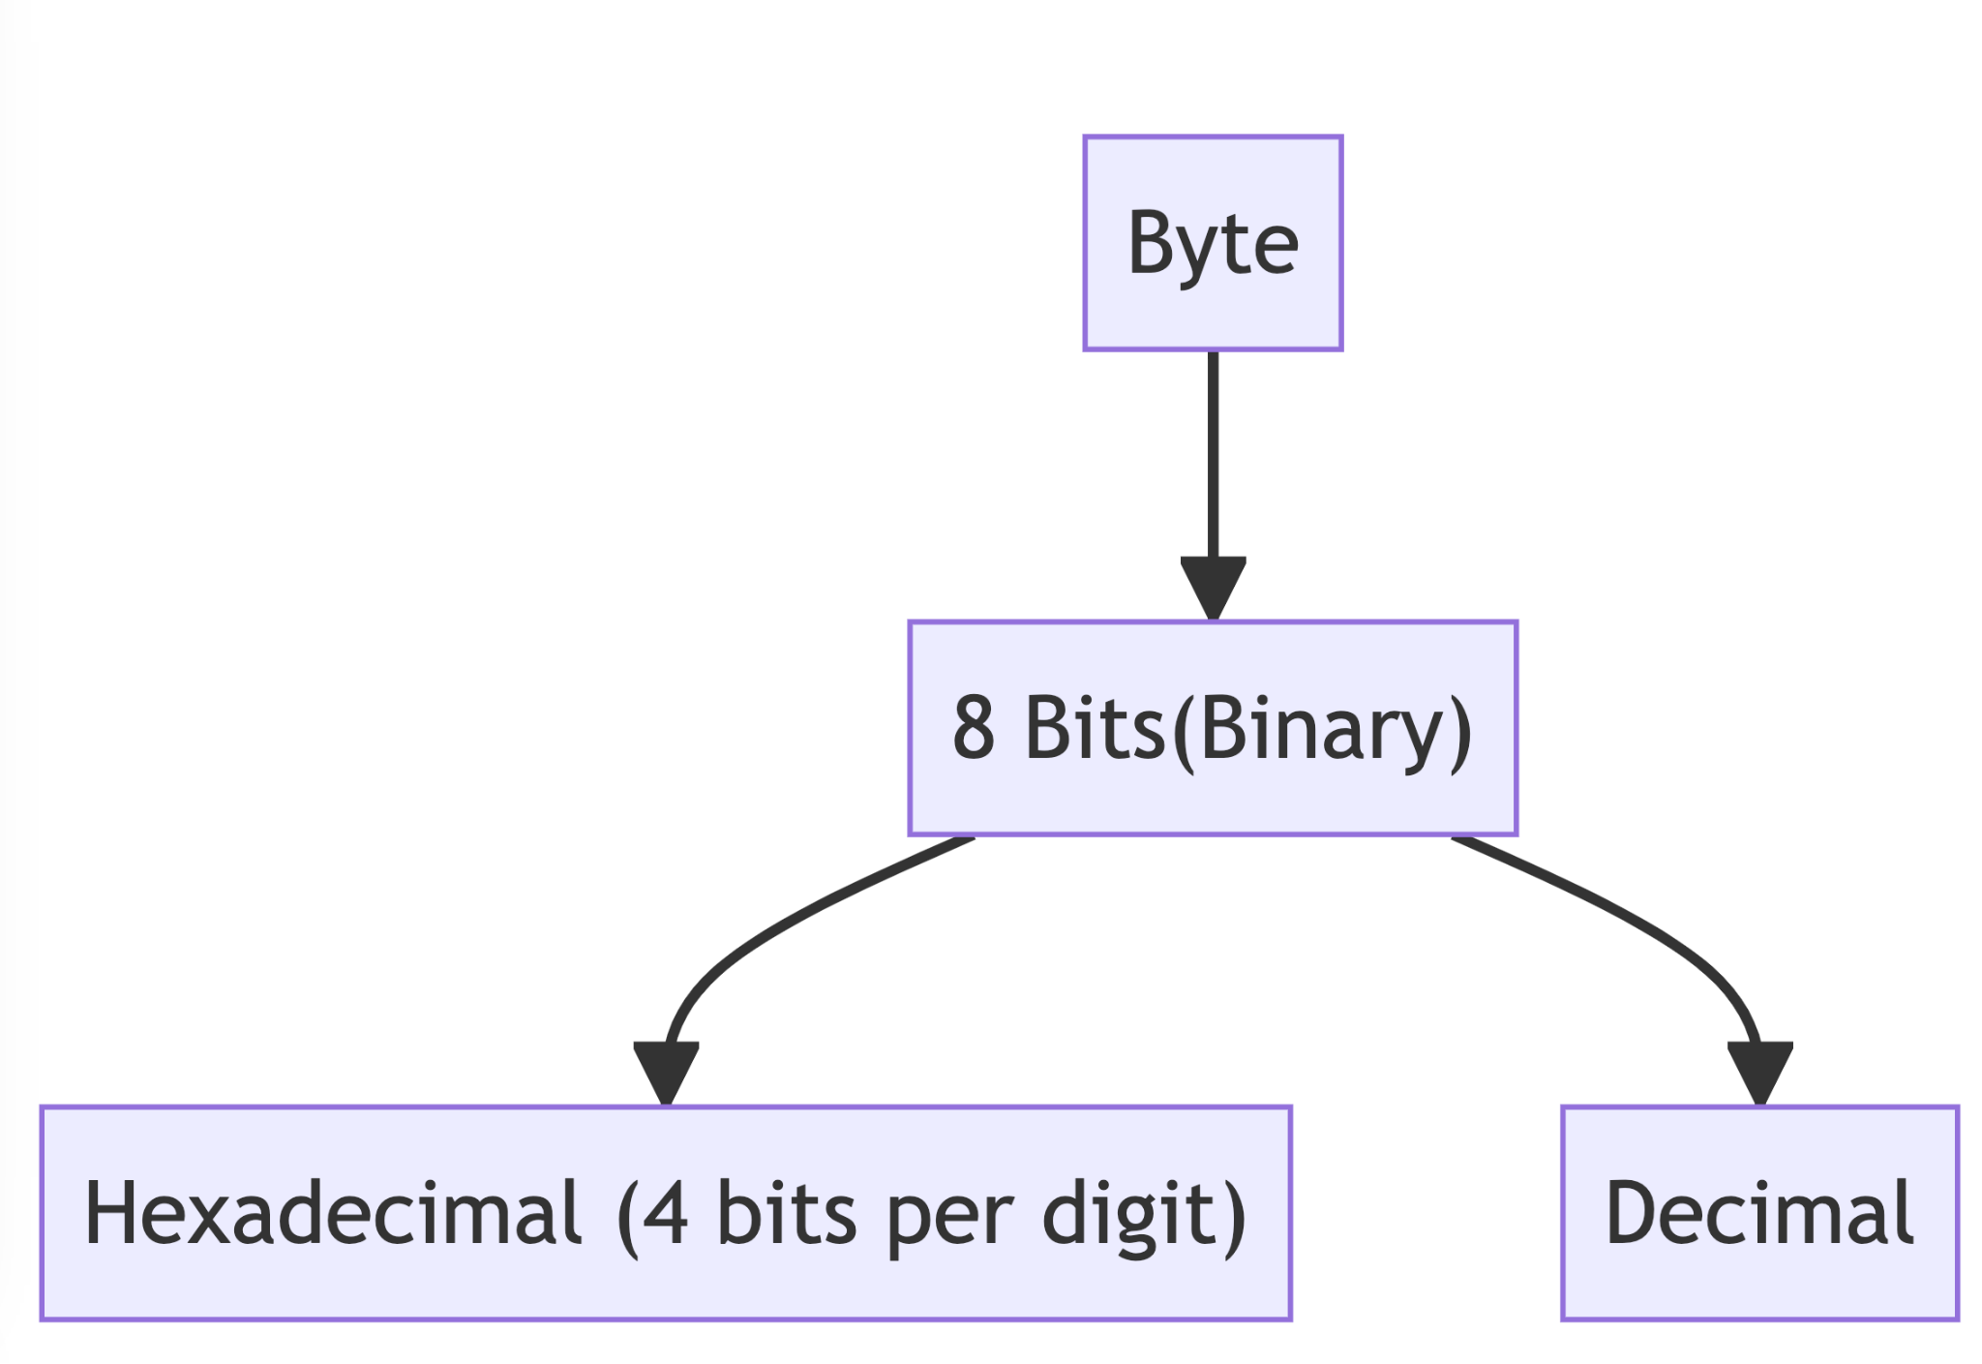
Relation between Binary, Decimal,HexaDecimal
All are types to represent data.
Data is usually stored in binary then converted back decimal or hexadecimal.
Have
Coverts
Coverts

Slide 17
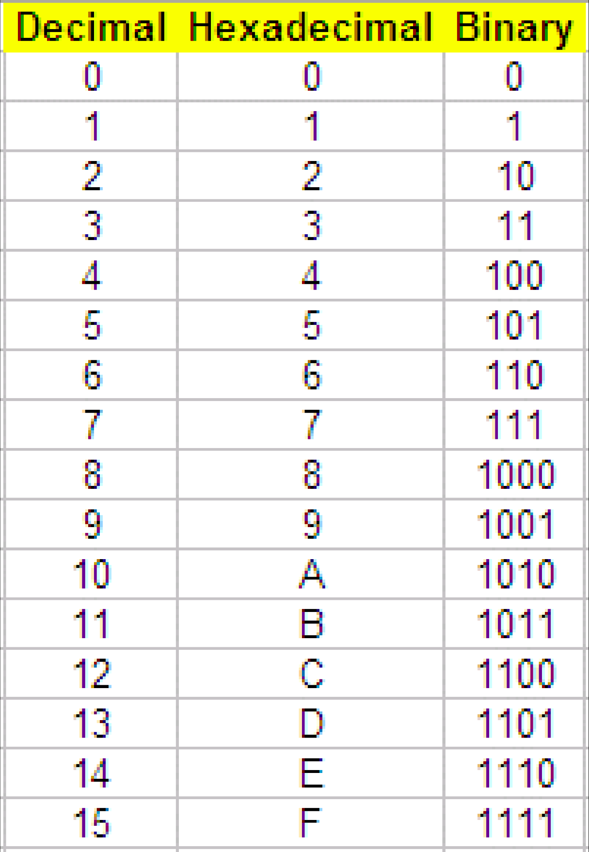
Relation between Binary, Decimal,HexaDecimal
Notes:
save storage and all

Slide 18
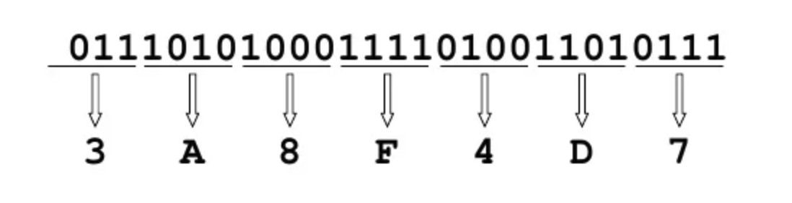
Binary to HexaDecimal Conversion
Every 4 bits is a hex digit
Start from right-hand side
Consult table for conversion

Slide 19
QUIZ
Convert a HexaDecimal for
1011010100111101

Slide 20
QUIZ
Convert a HexaDecimal for
1011010100111101
1011 in binary is B in hexadecimal
0101 in binary is 5 in hexadecimal
0011 in binary is 3 in hexadecimal
1101 in binary is D in hexadecimal
So, 10110101001101101 in binary is B5CD in hexadecimal.

Slide 21
Why Learn HexaDecimal
In Solidity and many other programming languages, the bytes type stores data as a sequence of bytes.
It's common to represent these bytes as hexadecimal values for readability and convenience.
It also save a lot of storage space as well.

Slide 22
BYTES TYPE
Represents a sequence of bytes
There are two types:
Fixed-Sized Byte Arrays
Dynamic-Sized Byte Arrays
bytes is shorthand for byte[]
Bytes automatically converts string to hex when storing
We need to forcefully convert non-string types into hex or byte format to store these values.

Slide 23
Example
Initialization Type | Example
Empty Bytes | bytes memory emptyBytes = ""
String literals | bytes memory stringBytes = "Hello, World!"
Hexadecimal Literal | bytes memory hexBytes = hex"48656c6c6f2c20576f726c6421"
From integer | bytes memory intBytes = abi.encodePacked(uint256(12345))
From address | bytes memory addressBytes = abi.encodePacked(address(0x1234)
From a bytes32 | bytes memory bytes32Bytes = abi.encodePacked(bytes32(0x1234))
In these examples, abi.encodePacked is used to convert non-string types to bytes.
Notes:
DEMO: ASCII Codes - Table of ascii characters and symbols
ascii.cl

Slide 24
FIXED-SIZE BYTES ARRAYS
Solidity also provides byte-sized types such as bytes1, bytes2, up to bytes32 for fixed-size byte arrays
Fixed-size byte arrays are useful when you know the exact number of bytes you want to work with.
Fixed-size byte arrays have a specific length, and you cannot add or remove elements from them.
Elements of fixed-size byte arrays can be accessed using indexing.

Slide 25
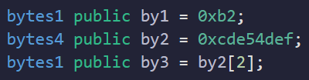
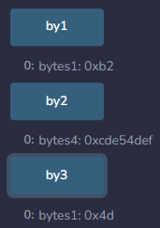
FIXED-SIZE BYTES ARRAYS

Slide 26
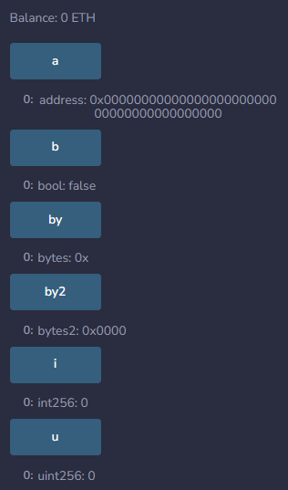
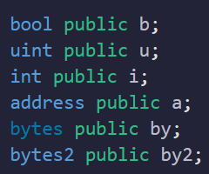
DEFAULT VALUES

Slide 27
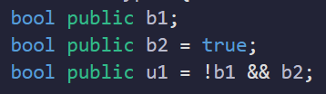

PROBLEMS

Slide 28
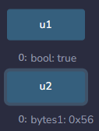
SOLUTION

