Slide 1
STRUCT IN SOLIDITY

Slide 2
What is a struct?
Definition: A struct is a user-defined data type in Solidity that allows you to group together multiple variables of different types into a single entity.
Structs enable you to create custom composite data types tailored to your specific needs.

Slide 3
When and Why to Use Structs
Use cases: Structs are commonly used when you want to create more complex data structures that hold related data points.
Benefits:
Organize and group related data elements together.
Enhance code readability and maintainability.
Enable the creation of more sophisticated contracts by defining custom data structures.

Slide 4
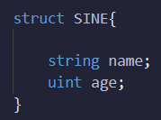
Struct Syntax
Syntax: struct StructName { variable1Type variable1; variable2Type variable2; ... }
Example:

Slide 5



Creating and Initializing Structs
Creating an instance of a struct:
There are 3 ways discussed here to initialize structs:
-
-

Slide 6
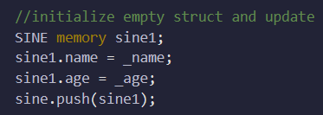
Creating and Initializing Structs
-
You can use any one of these methods to initialize a struct

Slide 7
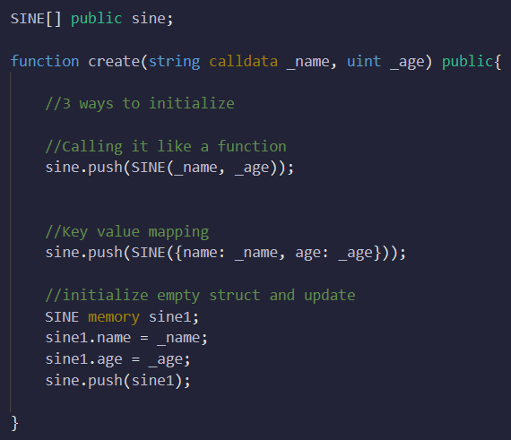
Creating and Initializing Structs

Slide 8
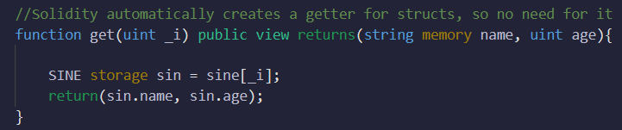
Get function for struct
In solidity, a get function runs in the background so there is no need to make our own. But for completeness’s sake, it is explained here:

Slide 9
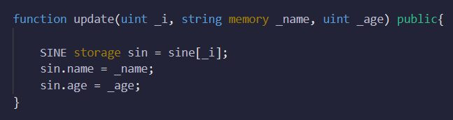
Updating struct
Struct is basically an array, so we can access a single struct by inputting its index. And from there we can modify each of its value:

Slide 10
Writing Structs in a Separate File and Importing
Best practice: Writing structs in a separate file allows for better organization and reusability.
Create a separate `.sol` file to define the struct, e.g., `MyStruct.sol`.
Use the `import` statement to import the struct into other Solidity contracts.

Slide 11
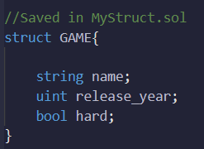
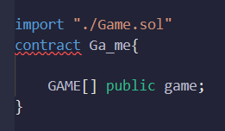
Writing Structs in a Separate File and Importing

