Slide 1
LOOPS IN SOLIDITY (While, Do-While, For)

Slide 2
WHILE LOOP
Definition: Executes a block of code repeatedly as long as a condition is true
Usage: When the number of iterations is unknown in advance

Slide 3
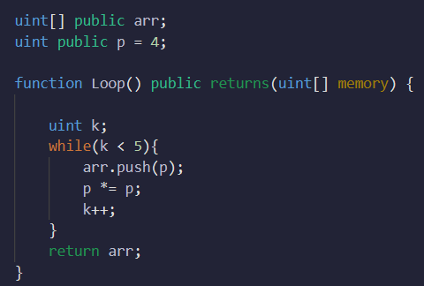

WHILE LOOP
Syntax:
while (condition) {
// Code to be executed
}

Slide 4
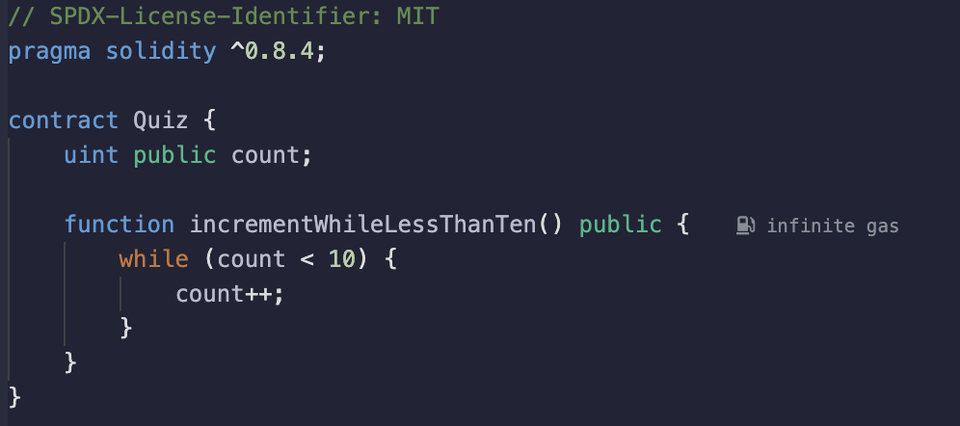
Quiz
What will be the value of count after executing function for the first time?
What will happen if we call function again after the first call? Why?

Slide 5
Quiz
What will be the value of count after executing function for the first time? count = 10.
What will happen if we call function again after the first call? Why? Transaction is successful but the count remains 10

Slide 6
DO-WHILE LOOP
Definition: Executes a block of code at least once, then repeats as long as a condition is true
Usage: When you want the code to run at least once, regardless of the condition
Syntax: do {
// Code to be executed
} while (condition);

Slide 7
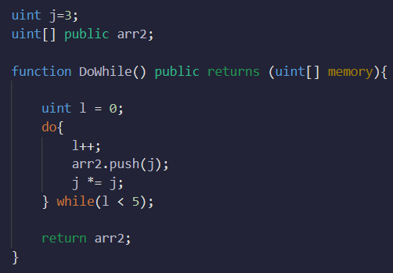

DO-WHILE LOOP

Slide 8
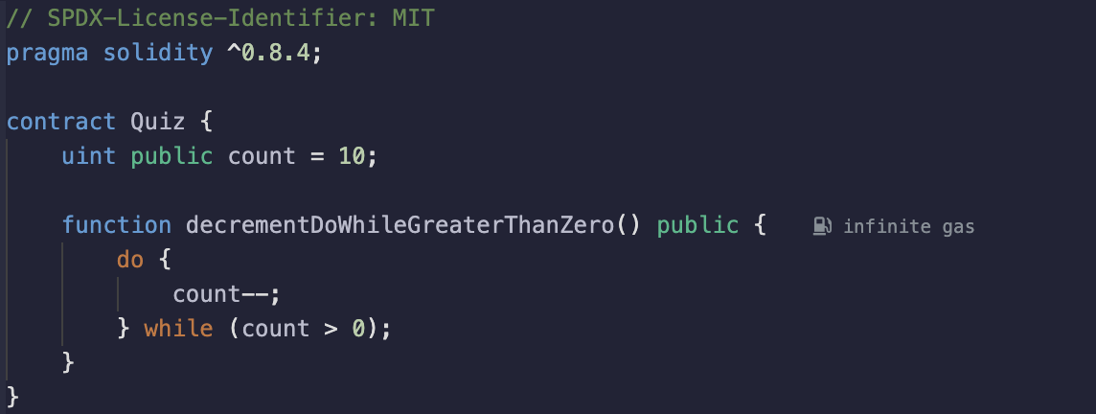
Quiz
What will be the value of count after executing function for the first time?
What will happen if we call function again after the first call? Why?
Without changing do-while and count = 10, what’s the easiest way to avoid error?

Slide 9
Quiz
What will be the value of count after executing function for the first time? count =0
What will happen if we call function again after the first call? Why? count = error
Without changing do-while and count = 10, what’s the easiest way to avoid error? Convert uint to int

Slide 10
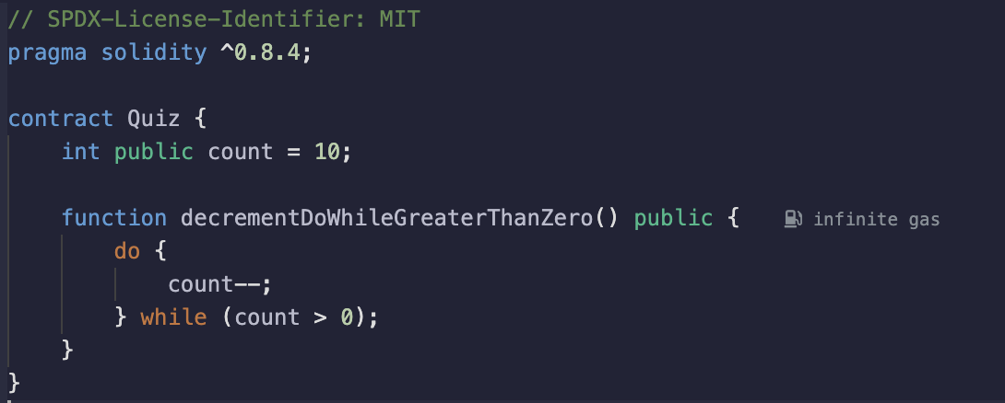
Quiz(updated uint to int)
What will be the value of count after executing function for the first time?
What will be the value of count after executing function for the second time?

Slide 11
Quiz(updated uint to int)
What will be the value of count after executing function for the first time? count = 0
What will be the value of count after executing function for the second time? count = -1

Slide 12
FOR LOOP
Definition: Executes a block of code for a specified number of times
Usage: When the number of iterations is known or when iterating over arrays or lists
Syntax:
for (initialization; condition; increment/decrement) {
// Code to be executed
}

Slide 13
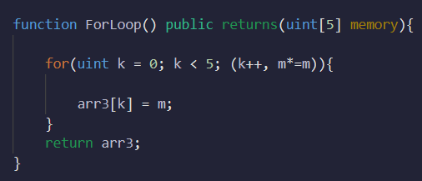

FOR LOOP
Notes:
Board demo

Slide 14
WHEN AND WHY DO WE USE LOOPS?
- Executing repetitive tasks or computations
- Iterating over data structures such as arrays or lists
- Implementing complex algorithms or conditions with iterations

Slide 15
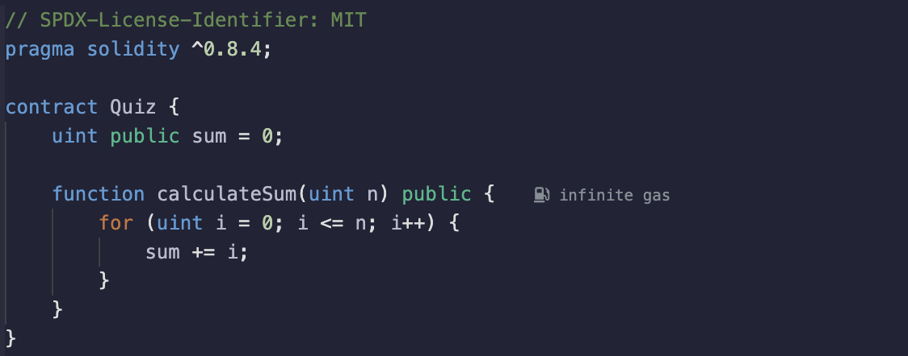
Quiz
What will be the value of sum after executing calculateSum(5) for the first time?
What will happen if we call calculateSum(5) function again after the first call? Why?

Slide 16
Quiz
What will be the value of sum after executing calculateSum(5) for the first time? sum = 15
What will happen if we call calculateSum(5) function again after the first call? Why? sum =30

Slide 17
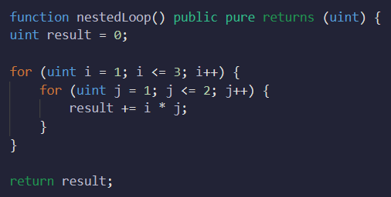
NESTED LOOPS
Definition: Including loops within other loops
Usage: Handling complex iterations and multidimensional data structures

Slide 18
PRACTICES AND TIPS
Ensure loop termination to prevent infinite loops
Use meaningful loop control variable names
Avoid unnecessary nested loops for performance reasons
Consider alternative control structures when appropriate (e.g., function recursion)

Slide 19
CONSIDERATIONS WHEN USING LOOPS IN SOLIDITY
Gas Consumption: Loops consume significant gas, affecting cost and performance.
Block Gas Limit: Complex loops can exceed the block gas limit, causing transaction failures.
Large Data Structures: Iterating over large arrays or mappings can lead to scalability issues and increased gas costs.
Security Vulnerabilities: Improper loop conditions can result in unexpected behaviors and vulnerabilities.

Slide 20
CONSIDERATIONS WHEN USING LOOPS IN SOLIDITY
Alternative Approaches: Use mapping and indexing techniques to reduce loop usage and optimize gas consumption.
Precomputation and Off-chain Processing: Move computation-intensive tasks off-chain to minimize on-chain loop usage.
Readability and Maintainability: Excessive or nested loops make code complex and harder to understand.
Conclusion: Balance the need for loops with gas efficiency and code optimization in Solidity development.

Slide 21
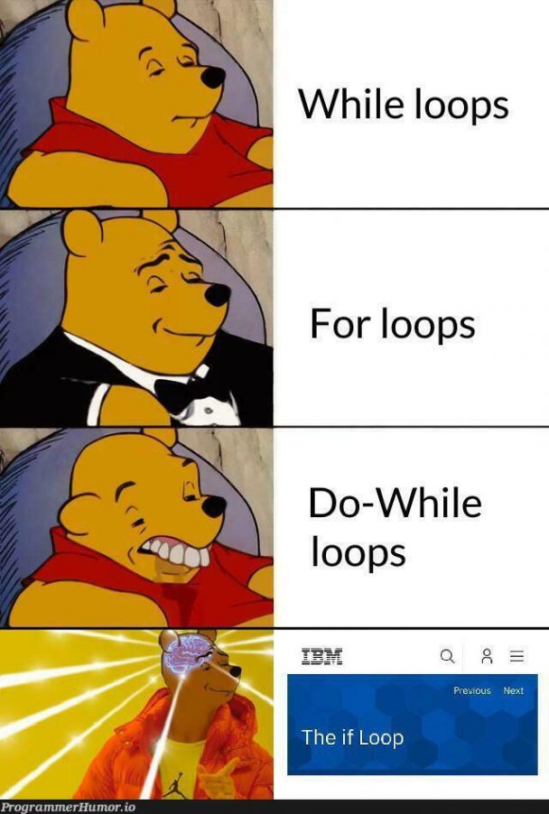
LOOPS IN SOLIDITY

