Slide 1
FALLBACK FUNCTION

Slide 2
Introduction:
In Solidity, the fallback function is a special function that is automatically invoked when a contract receives Ether or when it receives a message with no matching function signature.
The fallback function is useful for handling unexpected or unspecified interactions with a contract.

Slide 3
Purpose and Usage
Purpose: The fallback function allows contracts to handle incoming Ether or messages that don't match any other function.
Usage: The fallback function can be used to implement custom logic for processing Ether, performing additional operations, or providing fallback functionality for external calls.

Slide 4
Fallback Function Syntax
The fallback function must be declared as `external`.
It has no name and no arguments.
It can be used to receive and handle Ether sent to the contract.
The fallback function can be used in conjunction with the `receive` function to handle different scenarios.

Slide 5
Restrictions and Considerations
It cannot have any arguments or return values.
The gas stipend for `send` or `transfer` inside the fallback is limited to 2300 gas.
It should be kept simple and efficient to avoid out-of-gas errors.
Care should be taken to handle reentrancy attacks and ensure contract security.

Slide 6
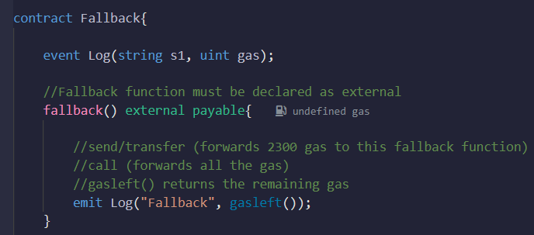
Code Example
-

Slide 7
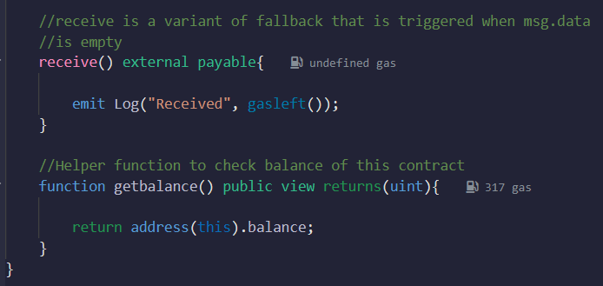
Code Example
-

Slide 8
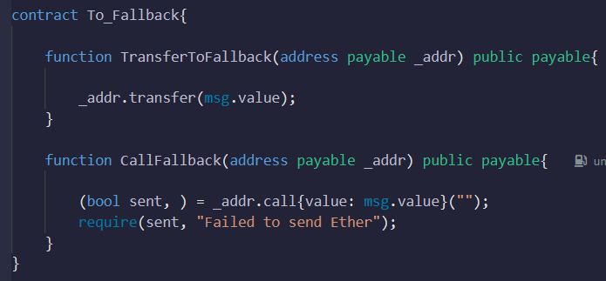
Code Example
-

Slide 9
Explanation of the Code Example
The `Fallback` contract defines the fallback function and the `receive` function.
The `Fallback` contract emits an event indicating the gas remaining in each function.
The `To_Fallback` contract demonstrates how to interact with the fallback function using `transfer` and `call`.

Slide 10
Benefits of Using Fallback Functions
Flexibility: Fallback functions provide flexibility in handling unexpected scenarios and undefined function calls.
Ether Handling: Fallback functions enable contracts to receive and process Ether transfers seamlessly.
Extensibility: Fallback functions can be combined with other functions to create versatile contract behavior.

Slide 11
Summary
The fallback function in Solidity is a special function triggered when a contract receives Ether or when it receives a message with no matching function signature.
It allows contracts to handle unexpected interactions and process incoming Ether transfers.
Fallback functions should be used carefully, keeping in mind the gas limitations and security considerations.

